Slide 1
CSCI 5343 Algorithms Spring 2025
Dept. of Computational, Engineering, and Mathematical Sciences
Chapters 1 & 2 Algorithms in Computing and Getting Started

Slide 2
Goals
Describe and analyze algorithms.
Examine two algorithms for sorting: insertion sort and merge sort.
Describe algorithms in pseudocode.
Use asymptotic notations to express running-time analysis.
Learn the technique of divide and conquer in the context of merge sort.

Slide 3
What is an algorithm?
Idea behind computer programs to solve problems.
Method that stays the same regardless of programming language and the computing hardware.
Precise and unambiguous specification of a sequence of steps that can be carried out to solve a given problem or to achieve a given condition.
Accepts some value or set of values as input and produces a value or set of values as output.

Slide 4
Why Study Algorithms?
Necessary in any computer programming problem
Improve algorithm efficiency: run faster, process more data, do something that would otherwise be impossible
Solve problems of significantly large size
Compare algorithms
Algorithms as a field of study
Learn about a standard set of algorithms
New discoveries arise
Numerous application areas
Learn techniques of algorithm design and analysis

Slide 5
Roadmap
Different problems
Sorting
Searching
String processing
Graph problems
Geometric problems
Numerical problems
Different design paradigms
Divide-and-conquer
Incremental
Dynamic programming
Greedy algorithms
Randomized/probabilistic

Slide 6
Typical Running Time Functions
1 (constant running time):
Instructions are executed once or a few times
logN (logarithmic)
A big problem is solved by cutting the original problem in smaller sizes, by a constant fraction at each step
N (linear)
A small amount of processing is done on each input element
N logN (linearithmic)
A problem is solved by dividing it into smaller problems, solving them independently and combining the solution
N² (quadratic)
Typical for algorithms that process all pairs of data items (double nested loops)
N³ (cubic)
Processing of triples of data (triple nested loops)
N^{K} (polynomial)
A function f(n) is polynomially bounded if f(n) = O(n^{k}) for some constant k
2^{N} (exponential)
A few exponential algorithms are appropriate for practical use (recursive approach of TSP)
N! (factorial)
Grows factorially, n! = 1 * 2* 3 * … * n (brute-force of TSP)

Slide 7
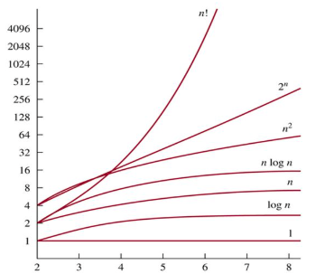
Comparing Running Time Functions
< O(n! )
Constant time
Logarithmic time
Linear time
Log-linear time
Quadratic time
Cubic time
Exponential time
O(n! )
Factorial Time
Image source: google image

Slide 8
Types of Analysis on Running Times
Worst case
Provides an upper bound on running time
An absolute guarantee that the algorithm would not run longer, no matter what the inputs are
Best case
Input is the one for which the algorithm runs the fastest
Average case
Provides a prediction about the running time
Assumes that the input is random

Slide 9
Example – Sorting Problem
Input: A sequence of N numbers a₁…a_{n}
Output: the permutation (reordering) of the input sequence such that a₁ ≤ a₂ … ≤ a_{n}.
Possible algorithms you’ve learned so far
Insertion, selection, bubble, quick, merge, heap, …

Slide 10
Example – Sorting Problem
The sorting problem
The sequences are typically stored in arrays
Several ways to solve the sorting problem
Each way will be expressed as an algorithm
Algorithm
a well-defined computational procedure
takes some value, or set of values, as input
produces some value, or set of values, as output
Seek algorithms that are both correct and efficient

Slide 11
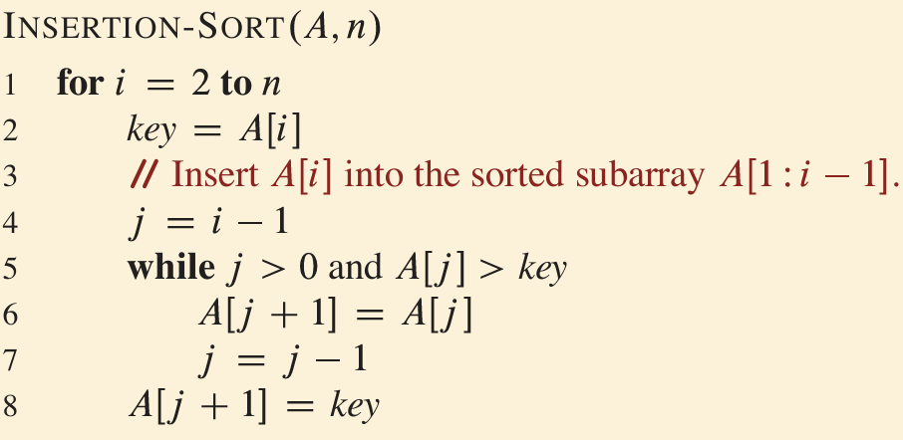
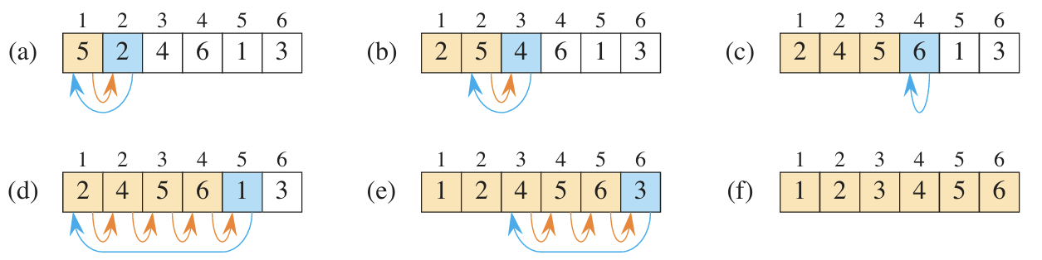
Insertion Sort Algorithm – Pseudocode & Operation

Slide 12
Input Size
Depends on the problem being studied
Usually, the number of items in the input
Size n of the array being sorted
But could be something else
If multiplying two integers, could be the total number of digits(bits) in the two integers.
Could be described by more than one number.
For example, graph algorithm running times are usually expressed in terms of the number of vertices and the number of edges in the input graph.

Slide 13
Running Time
On a particular input, it is the number of primitive operations (steps) executed.
Want to define steps to be machine-independent.
Figure that each line of pseudocode requires a constant amount of time.
One line may take a different amount of time than another, but each execution of line i takes the same amount of time ci .
Assuming that the line consists only of primitive operations.
If the line is a subroutine call, then the actual call takes constant time, but the execution of the subroutine being called might not.
If the line specifies operations other than primitive ones, then it might take more than constant time.

Slide 14
Analysis of Insertion Sort
Add statement costs and number of times executed
Assume that the i th line takes time ci , which is a constant. (If a line is a comment, it takes no time.)
For j = 2, 3, . . . , n, let tj be the number of times that the while loop test is executed for that value of j .
Note that when a for or while loop exits in the usual way - due to the test in the loop header - the test is executed one time more than the loop body.

Slide 15
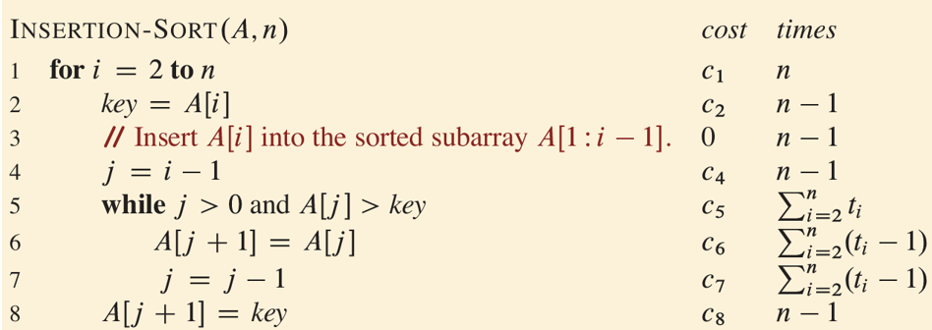
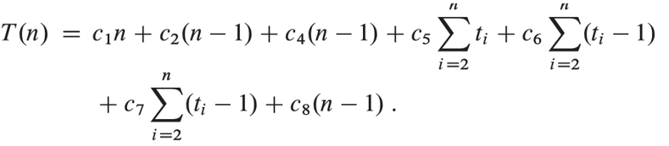
Analysis of Insertion Sort

Slide 16
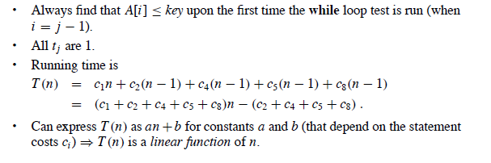
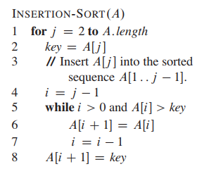
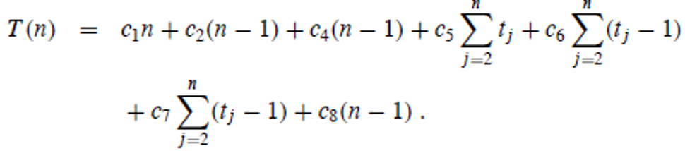
Best Case of Insertion Sort
When the array is already sorted

Slide 17
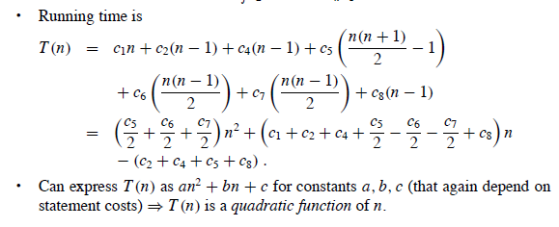
Worst Case of Insertion Sort
When the array is in reverse sorted order.
Always find that A[i ] > key in while loop test.
Have to compare key with all elements to the left of the j th position ⇒ compare with j − 1 elements.

Slide 18
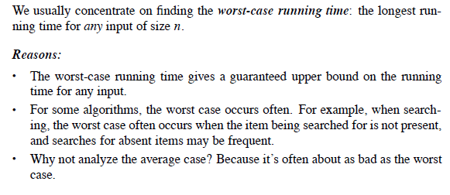
Worst Case and Average Case Analysis

Slide 19
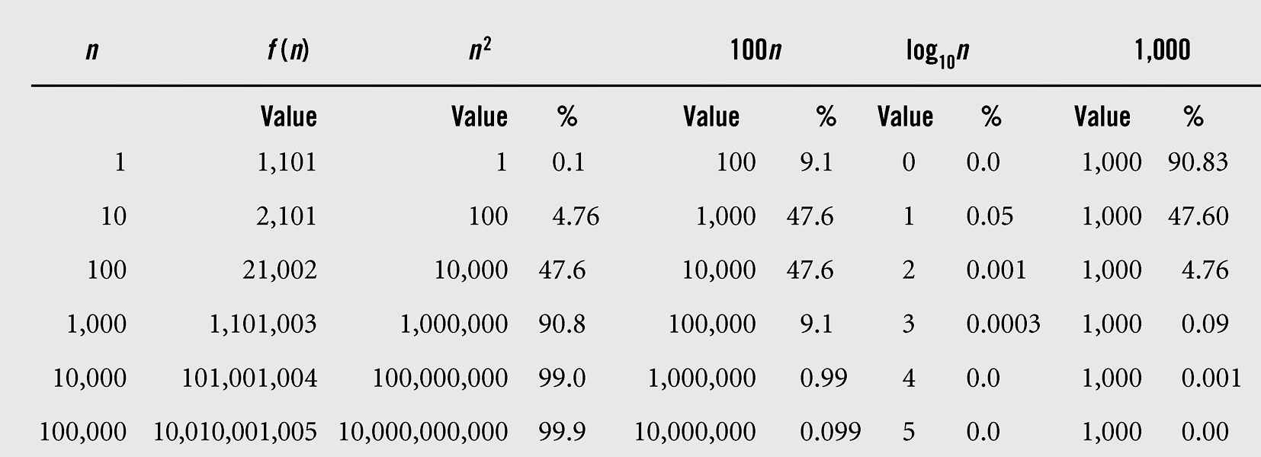
Order of Growth
The growth rate of all terms of function
f (n) = n² + 100n + log₁₀n + 1,000
For large values of n, the value of function f depends mainly on the value of the first term n² .

Slide 20
Order of Growth
Another abstraction to ease analysis and focus on the important features.
Look only at the leading term of the formula for running time.
Drop lower-order terms.
Ignore the constant coefficient in the leading term

Slide 21
Order of Growth: Insertion Sort
Abstracted the actual statement costs: the worst-case running time is an² + bn + c.
Drop lower-order terms⇒ an² + bn + c ⇒ an².
Ignore constant coefficient ⇒ an² ⇒ n².
But we cannot say that the worst-case running time T(n) equals n².
It grows like n². But it doesn’t equal n².
We say that the running time is Θ(n²) to capture the notion that the order of growth is n².
We usually consider one algorithm to be more efficient than another if its worst case running time has a smaller order of growth.

Slide 22
Designing Algorithms
Insertion sort uses incremental approach.
Divide and Conquer: anther common approach
Divide the problem into a number of subproblems.
Conquer the subproblems by solving them recursively.
Combine the subproblem solutions to give a solution to the original problem.

Slide 23
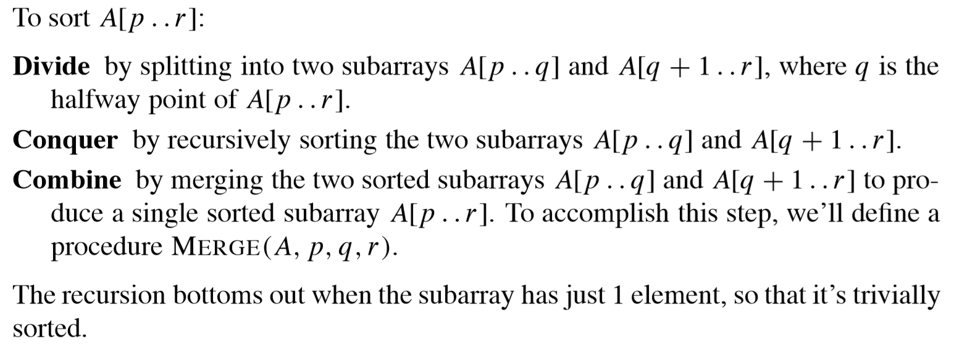
Merge Sort
A sorting algorithm based on divide and conquer.
Its worst-case running time has a lower order of growth than insertion sort.

Slide 24
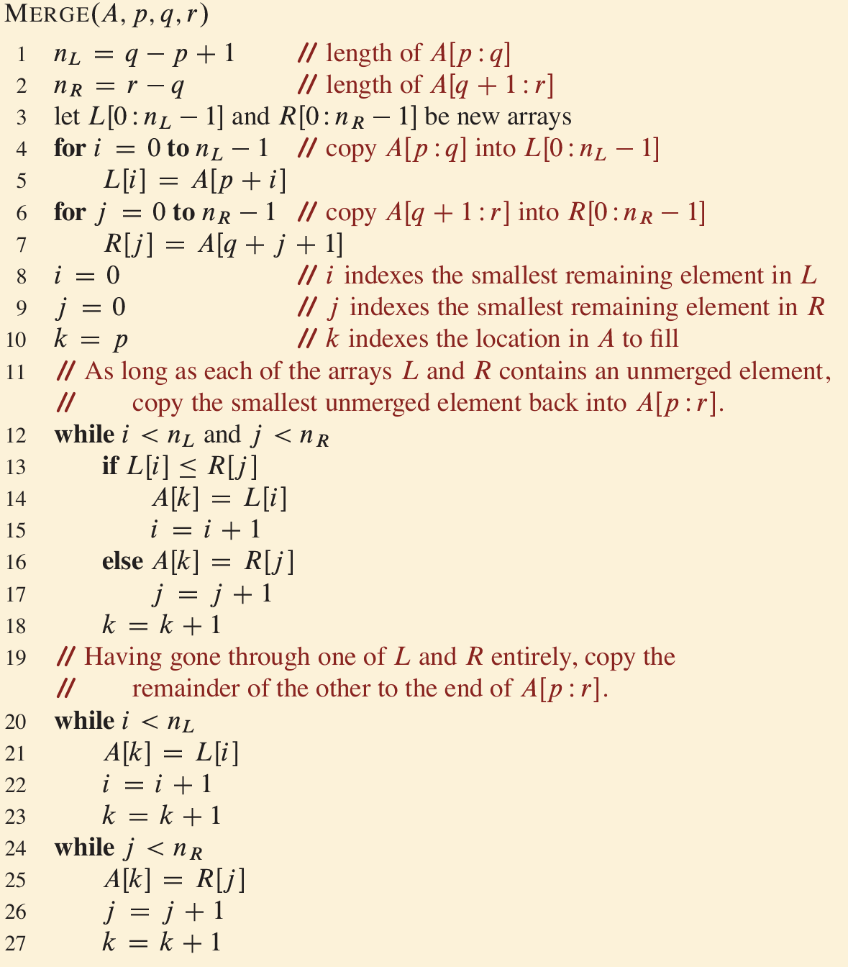
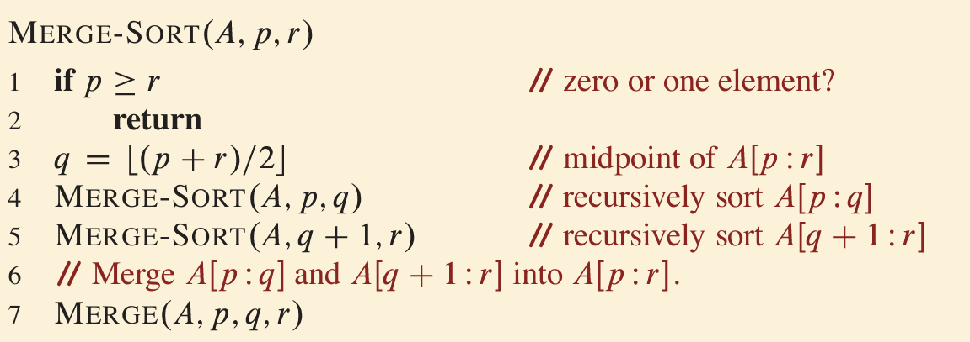
Merge Sort Algorithm
Two things to consider
Merge-Sort recursive calls
Merge (combine)

Slide 25
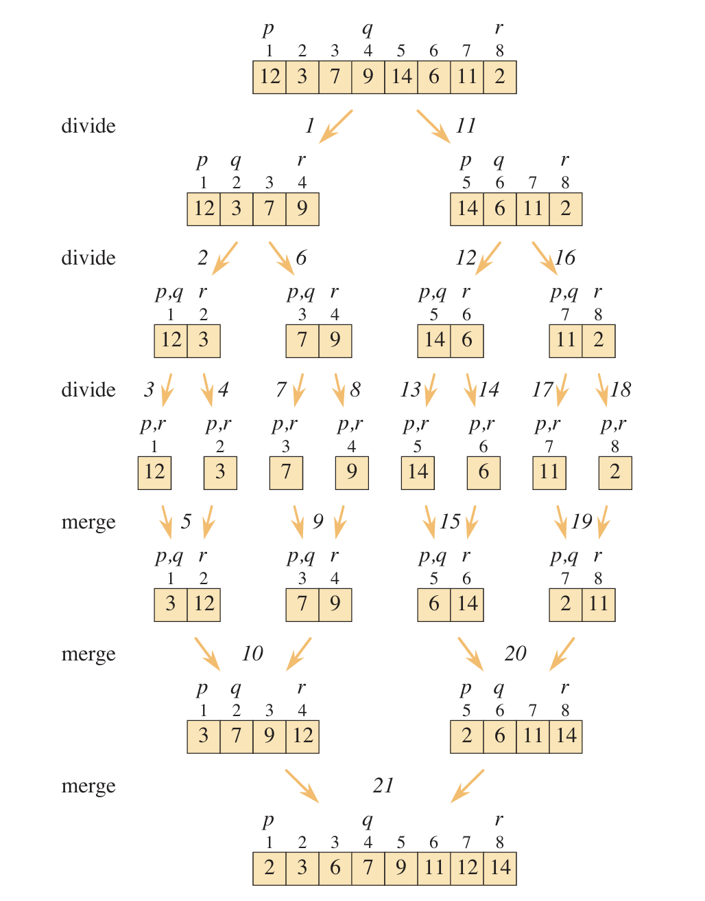
Operation of Merge Sort on Array

Slide 26
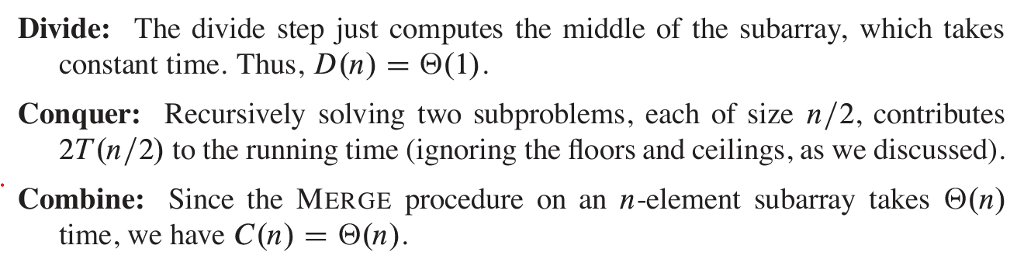

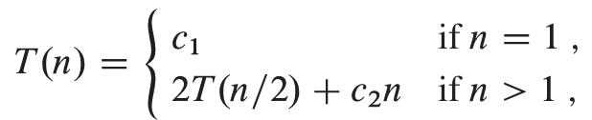
Analysis of Merge Sort

Slide 27
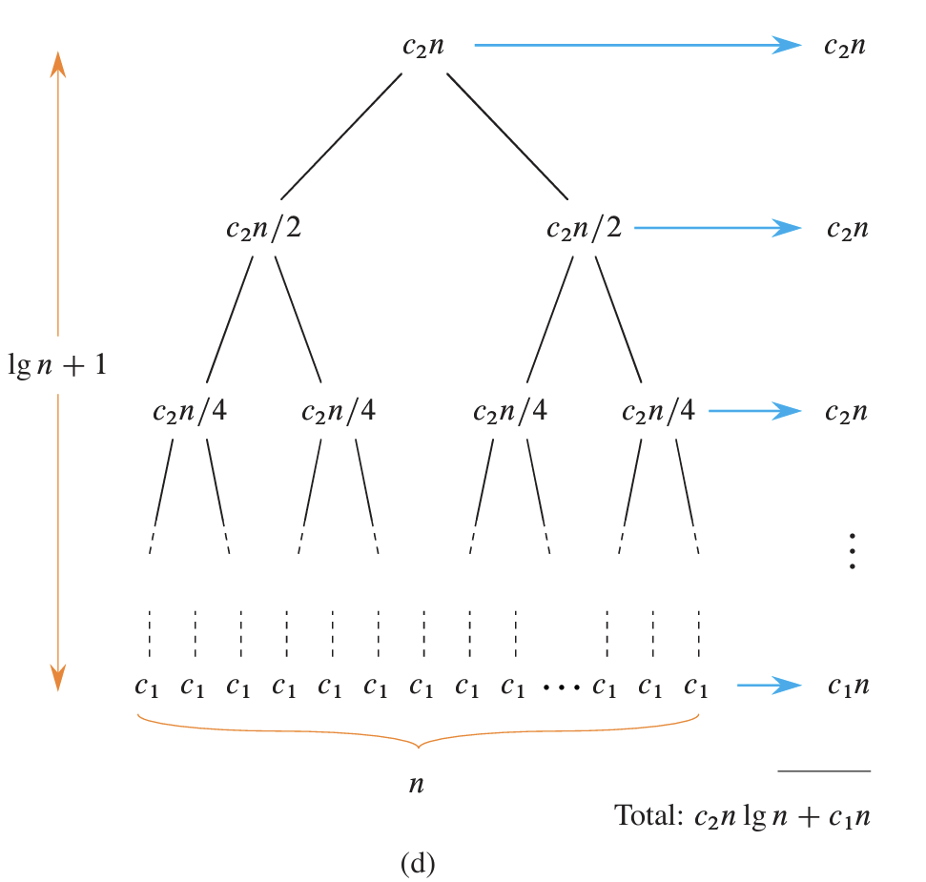
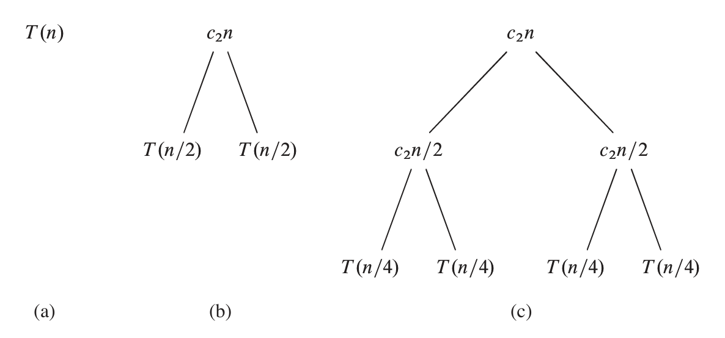
Construct a Recursion Tree for Recurrence

Slide 28
Running Time on Merging
Running time on Merge
The first two for loops take Θ(n1+n2) = Θ(n) time.
The last for loop makes n iterations, each taking constant time, for Θ(n) time.
Total time: Θ(n).

Slide 29
Running Time on Recursions
Running time on recursions
Recursive calls: continue expanding until the problem sizes get down to 1
Want to know ‘k’ which is the number of expanding (steps) of dividing until 2^{k} = 1
Therefore k = log₂n

Slide 30
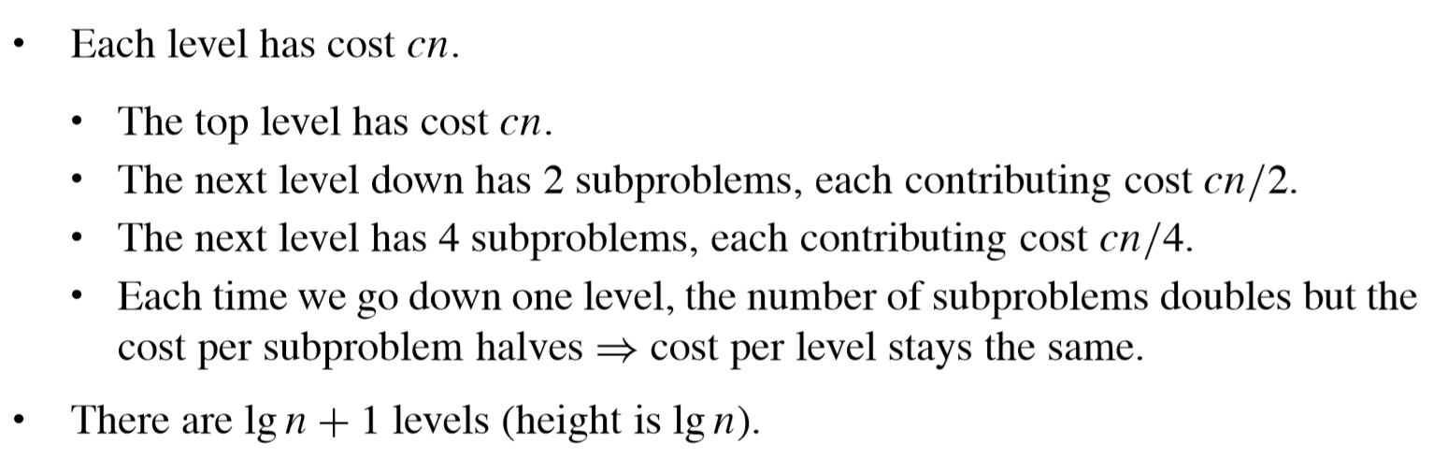
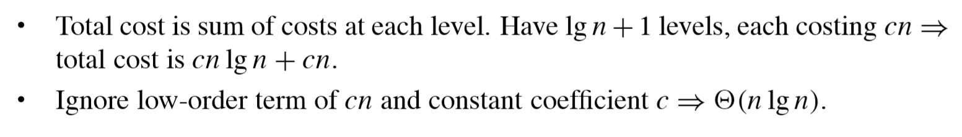
Analysis of Merge Sort
Discussion: what about best case, worst case, and average case?

