Slide 1
CSCI 5343 Algorithms Spring 2025
Dept. of Computational, Engineering, and Mathematical Sciences
Chapter 20 Elementary Graph Algorithms

Slide 2
Objectives
Discuss the following topics:
Graph Definition
Graph Representation
Graph Traversal (Search)
Breadth First Traversal (Search)
Depth First Traversal (Search)

Slide 3
Trees
Has the flexibility and many different tree applications
Limitation
Only can representations of a hierarchical type such as relations between parent and child
Other relations are indirectly represented such as siblings
Graph
Data structure in which this limitation is lifted
Computational problems can be defined in graph

Slide 4
Graphs
A graph is a collection of vertices (or nodes) and the connections between them
A simple graph G = (V, E) consists of a nonempty set V of vertices and a possibly empty set E of edges, each edge being a set of two vertices from V
A graph G = (V, E)
V = set of vertices
E = set of edges = subset of V × V
1
Vertices: {1, 2, 3, 4}
Edges: {(1, 2), (2, 3), (1, 3), (4, 3)}
2
4
3

Slide 5
Graphs
A directed graph, or a digraph, G = (V, E) consists of a nonempty set V of vertices and a set E of edges (also called arcs), where each edge is a pair of vertices from V
Edges have a direction
1
1
2
4
2
4
3
3
In-degree = 3
Out-degree = 0
Degree = 3
Directed
Undirected

Slide 6
Graphs (continued)
A path from v1 to vn is a sequence of edges edge(v1, v2), edge (v2, v3), … , edge (vn-1, vn) and is denoted as path v1, v2, v3, … , vn-1, vn. If v1 = vn and no edge is repeated, then the path is called a circuit
If all vertices in a circuit are different, then it is called a cycle. (a path that begins and ends on the same vertex)

Slide 7
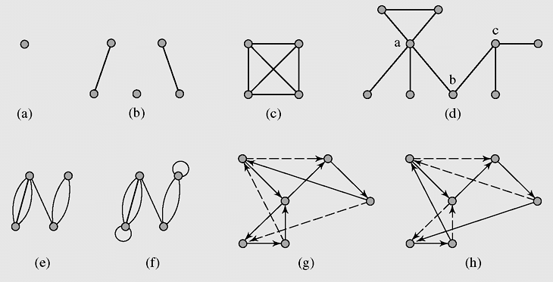

Graphs (continued)
Examples of graphs: (a-d) simple graphs, (c) complete graph, (g) a circuit in a digraph, (h) a cycle in the digraph

Slide 8
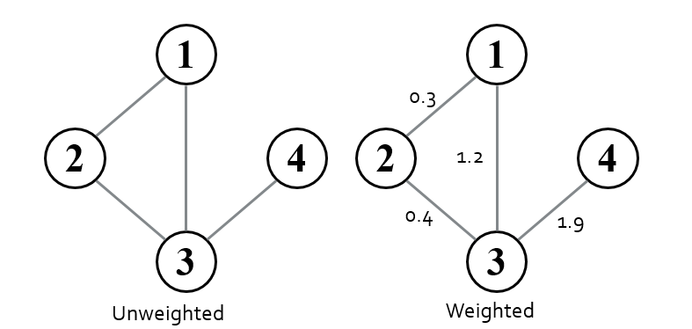
Graphs (continued)
A graph is called a weighted graph if each edge has an assigned number

Slide 9
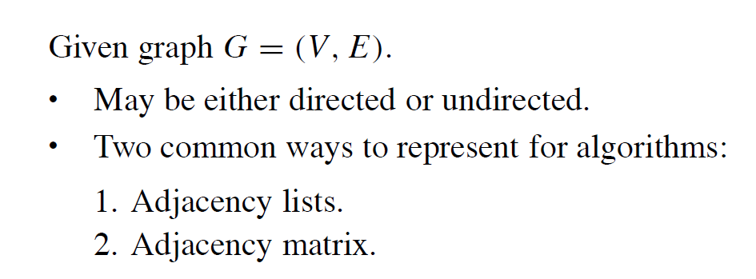
Graph Representation

Slide 10
Graph Representation: Adjacency Matrix
An adjacency matrix represents the graph as a n x n matrix A:
A[i, j] = 1 if edge (i, j) ∈ E = 0 if edge (i, j) ∉ E
For weighted graph
A[i, j] = w_{ij} if edge (i, j) ∈ E
= 0 if edge (i, j) ∉ E
For undirected graph
Matrix is symmetric: A[i, j] = A[j, i]

Slide 11
Graph Representation: Adjacency List
Adjacency list: for each vertex v ∈ V, store a list of vertices adjacent to v
Example:
Adj[1] = {2,3}
Adj[2] = {3}
Adj[3] = {}
Adj[4] = {3}
Variation: can also keep a list of edges coming into vertex
1
2
4
3

Slide 12
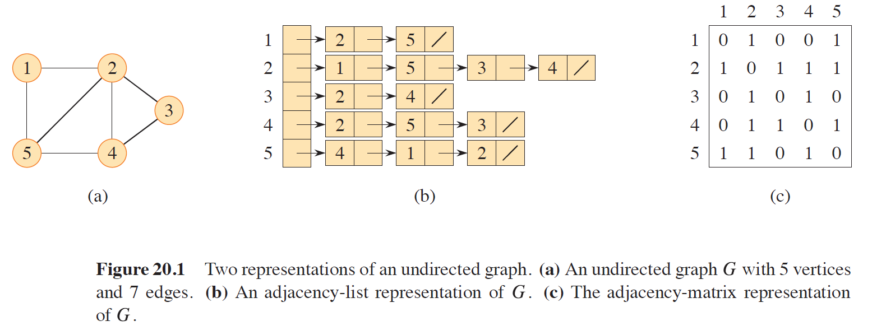
Graph Representation: Undirected Graph

Slide 13
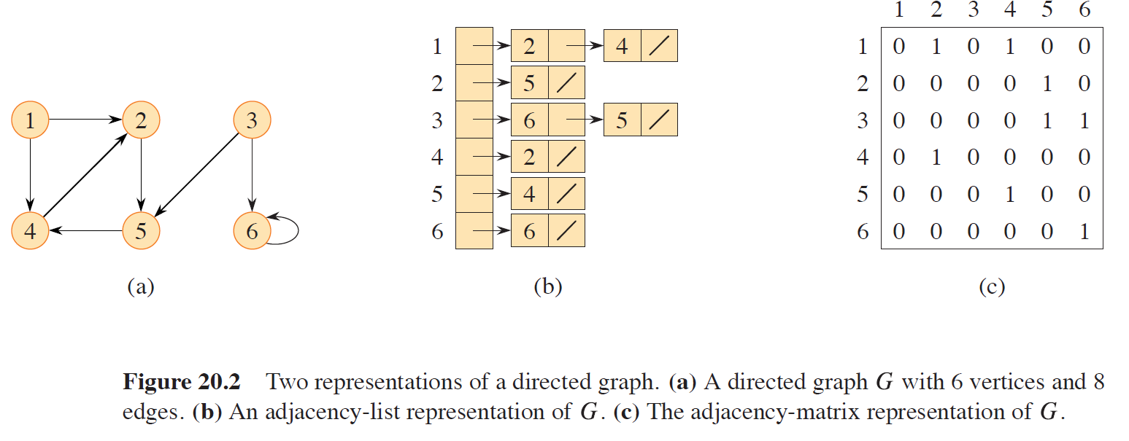
Graph Representation: Directed Graph

Slide 14
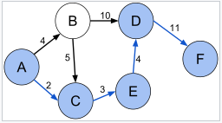
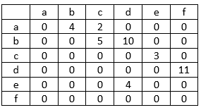
Weighted Graph
A weighted graph if each edge has an assigned number.
A weighted graph and its adjacency matrix.

Slide 15
Graph Traversal: Breadth-First Search
One of the simplest algorithm for searching a graph
Prim’s minimum-spanning tree algorithm and Dijkstra’s single-source shortest-paths algorithm use ideas similar to those in breadth-first search.

Slide 16
Graph Traversal: Breadth-First Search
Given a graph G = (V , E) and a distinguished source vertex s, breadth-first search systematically explores the edges of G to “discover” every vertex that is reachable from s.
It computes the distance (smallest number of edges) from s to each reachable vertex.
It also produces a “breadth-first tree” with root s that contains all reachable vertices.
For any vertex reachable from s, the simple path in the breadth-first tree from s to corresponds to a “shortest path” from s to in G, that is, a path containing the smallest number of edges.
The algorithm works on both directed and undirected graphs.

Slide 17
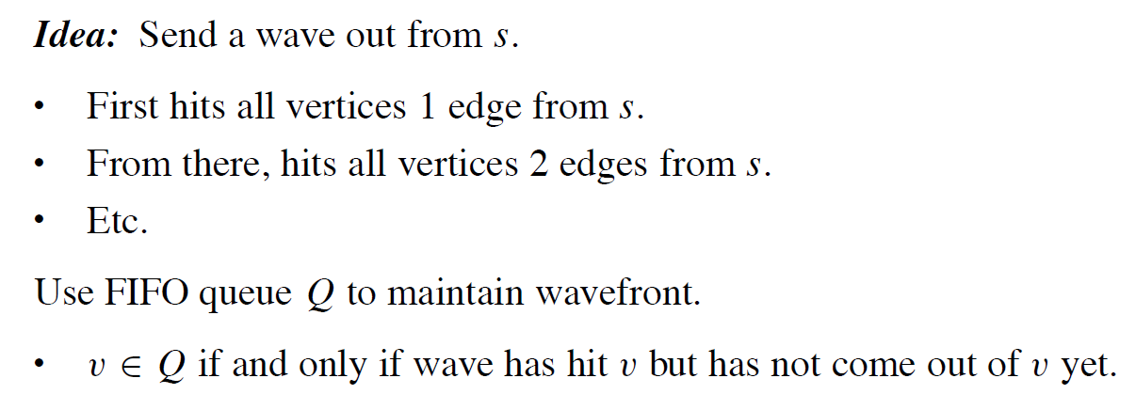
Graph Traversal: Breadth-First Search

Slide 18
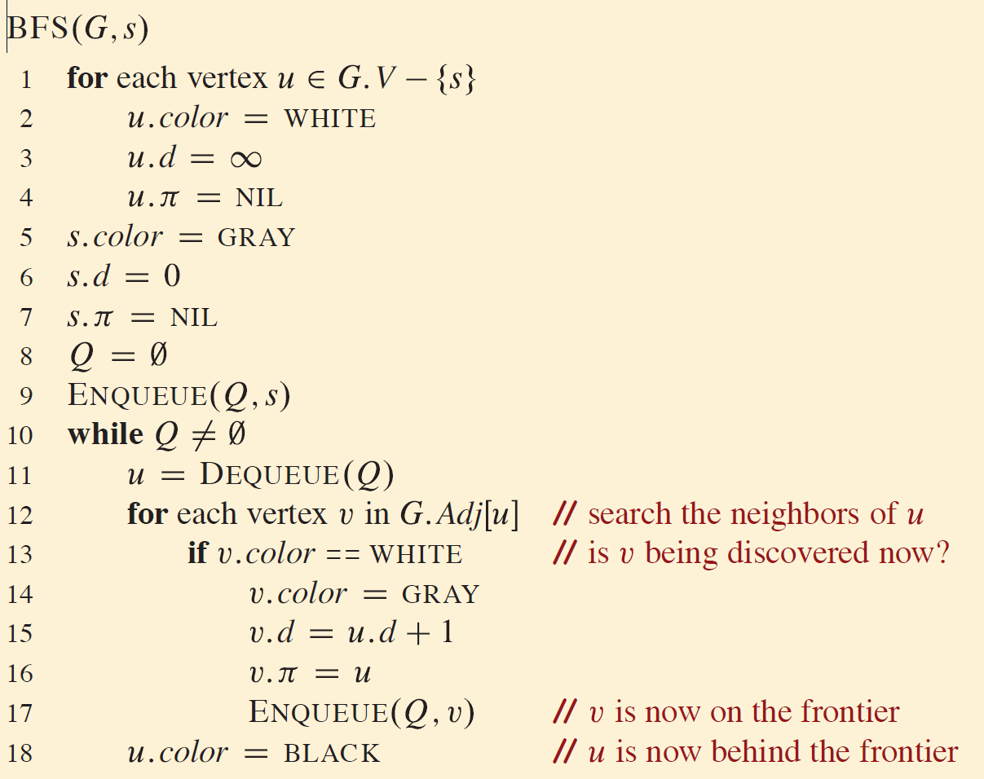
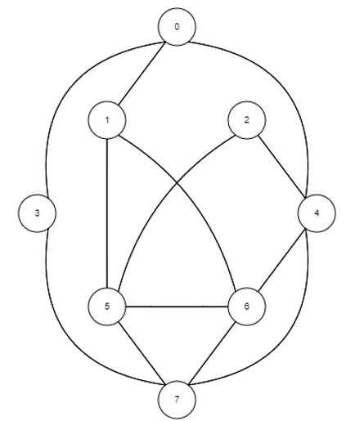

Slide 19
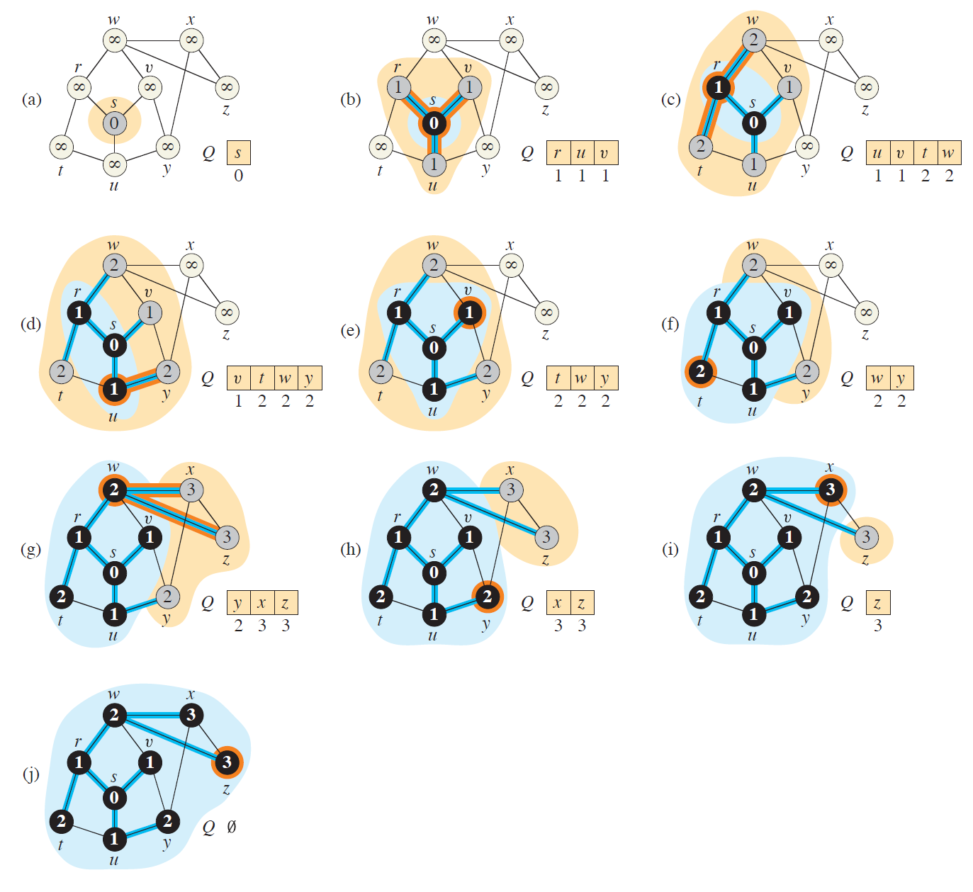

Slide 20
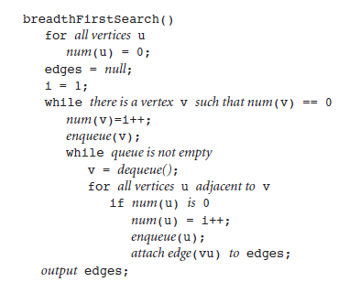

Breadth-First Search Algorithm

Slide 21
Running Time of Graph Algorithm
On a given graph G = (V,E)
Describe the size of the input with two parameters, not just one.
The number of vertices |V| and the number of edges |E| of the graph.
Inside asymptotic notation, the symbol V denotes |V | and the symbol E denotes |E|.
For example, “the algorithm runs in time O (VE)” meaning that the algorithm runs in time O (|V| |E|)
This convention makes the running-time formulas easier to read, without the risk of ambiguity.

Slide 22
Analysis of Breadth-First Search
The overhead for initialization is O(V)
Total time devoted to queue operations is O(V)
It scans each adjacency list at most once
Total time spent in scanning adjacency lists is O(E)
Total running time of the BFS procedure is O(V + E)

Slide 23
Graph Traversal: Depth-First Search
To search “deeper” in the graph whenever possible.
Explores edges out of the most recently discovered vertex that still has unexplored edges leaving it.
Once all of the edges have been explored, the search “backtracks” to explore edges leaving the vertex from which was discovered.
This process continues until we have discovered all the vertices that are reachable from the original source vertex.
If any undiscovered vertices remain, then depth-first search selects one of them as a new source, and it repeats the search from that source.
The algorithm repeats this entire process until it has discovered every vertex

Slide 24
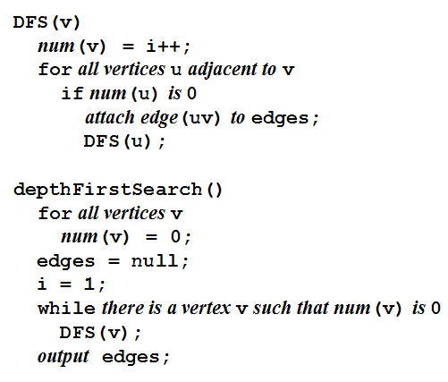
Depth-First Search Algorithm

Slide 25
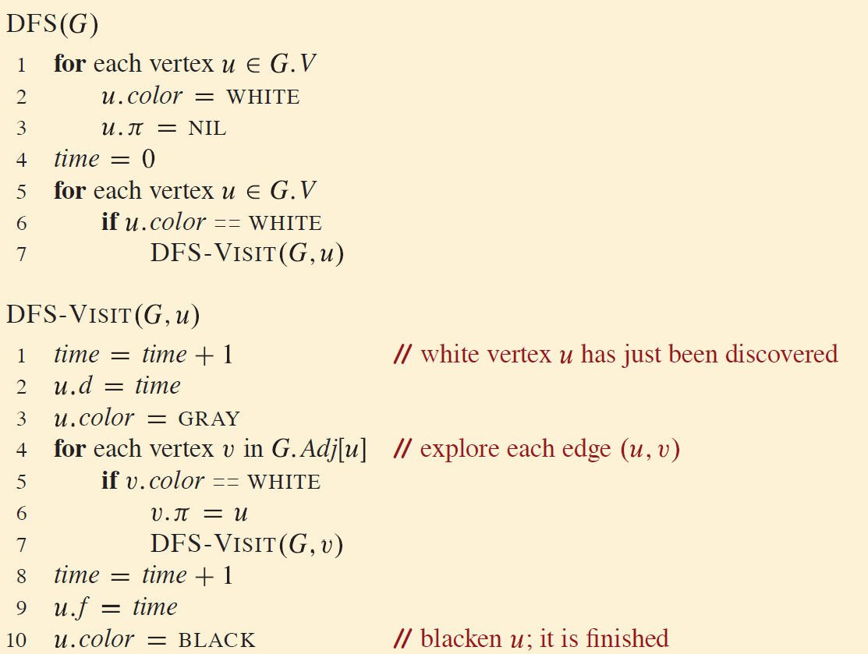

Slide 26
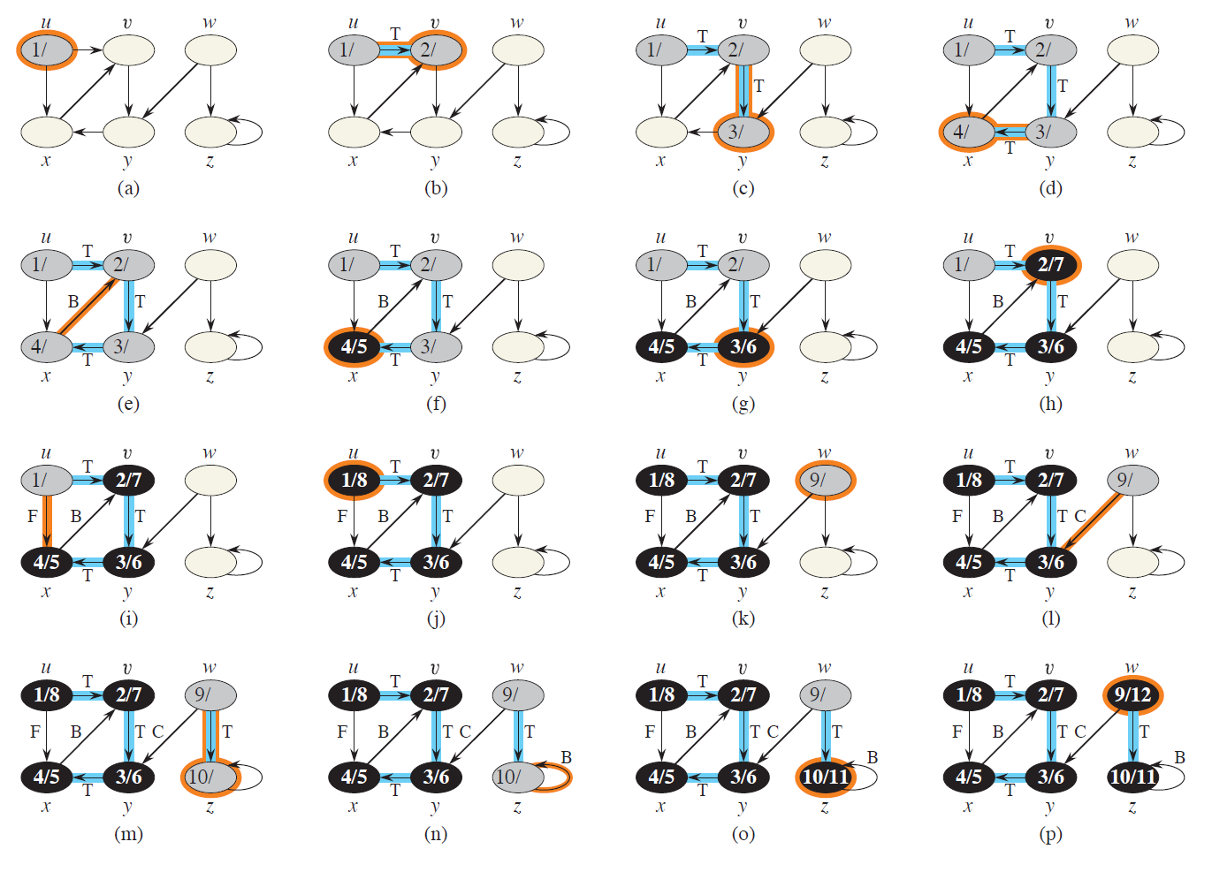

Slide 27
Analysis of Depth-First Search
The loops ‚ O(V)
DFS is called exactly once for each vertex v , since the vertex u on which DFS is invoked must be white and the first thing DFS-VISIT does is paint vertex u gray
During an execution of DFS, the loop executes Adj[v], with the sum of all Adj vertices, the total cost of is O(E)
Total running time of the DFS procedure is O(V + E)

