Slide 1
CSCI 5343 Algorithms Spring 2025
Dept. of Computational, Engineering, & Mathematical Sciences
Chapter 21 Minimum Spanning Trees

Slide 2
Objectives
Discuss the following topics:
Minimum Spanning Tree
Two Algorithms
Kruskal’s Algorithm
Prim’s Algorithm

Slide 3

Modeling a Wiring Problem
Electronic circuit designs often need to make the pins of several components electrically equivalent by wiring them together.
To interconnect a set of n pins, we can use an arrangement of n - 1 wires, each connecting two pins.
Of all such arrangements, the one that uses the least amount of wire is usually the most desirable.

Slide 4
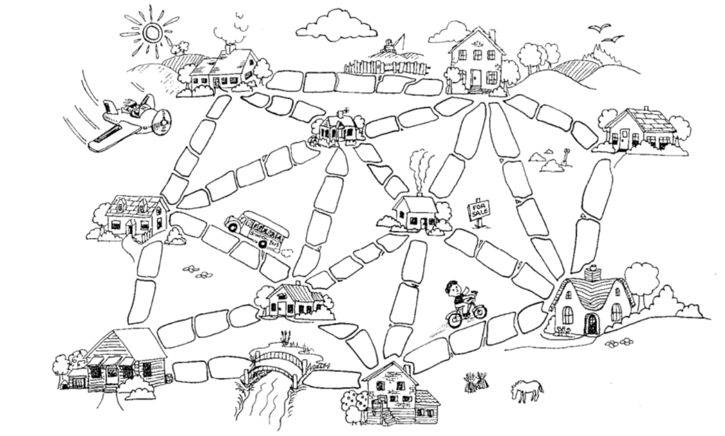
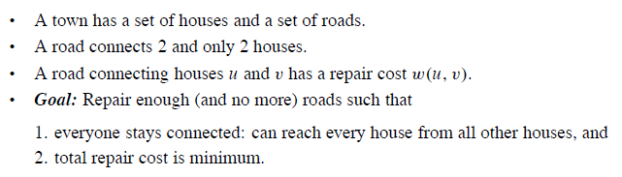
Another Problem

Slide 5

Modeling a Wiring Problem
Model this problem with a connected, undirected graph G = (V, E), where V is the set of pins, E is the set of possible interconnections between pairs of pins, and for each edge (u, v) ∈ E, we have a weight w(u,v) specifying the cost (amount of wire needed) to connect u and v.
Find an acyclic subset T ⊆ E that connects all of the vertices and whose total weight is minimum.
This must form a tree, called a spanning tree.
Problem of determining the tree T is the minimum-spanning-tree problem.

Slide 6
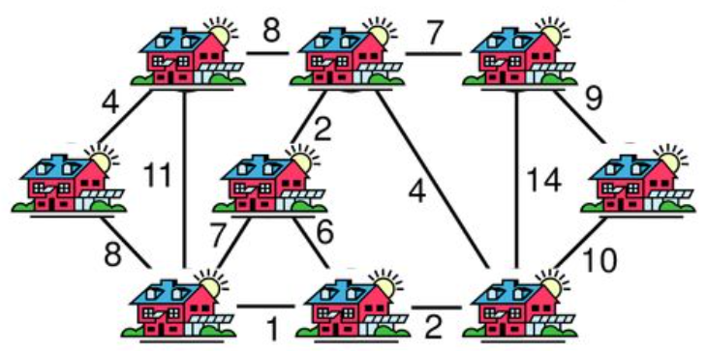
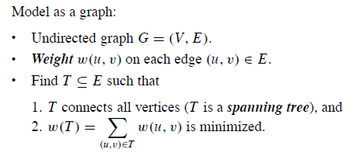
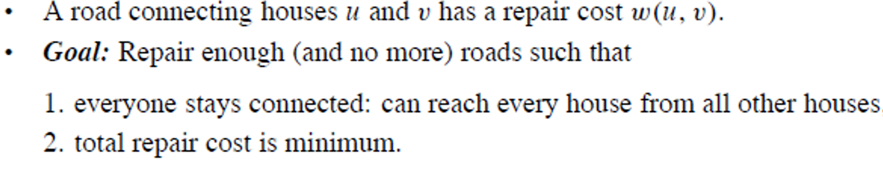
Another Problem

Slide 7
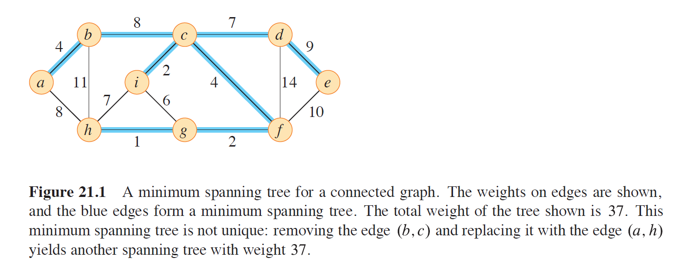
Minimum Spanning Tree Example

Slide 8
Two Algorithms
For solving the minimum spanning-tree problem
Kruskal’s algorithm
Prim’s algorithm
These are greedy algorithms
The greedy strategy advocates making the choice that is the best at the moment
Such a strategy does not generally guarantee that it will always find globally optimal solutions
Certain greedy strategies do yield a spanning tree with minimum weight

Slide 9
Kruskal’s Algorithm
The set A is a forest whose vertices are all those of the given graph.
The safe edge added to A is always a least-weight edge in the graph that connects two distinct components.

Slide 10
Kruskal’s Algorithm
Find a safe edge to add to the growing forest by finding, of all the edges that connect any two trees in the forest, an edge (u, v) of least weight.
Qualifies as a greedy algorithm because at each step it adds to the forest an edge of least possible weight.

Slide 11
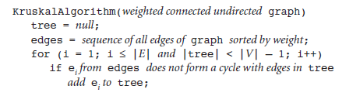
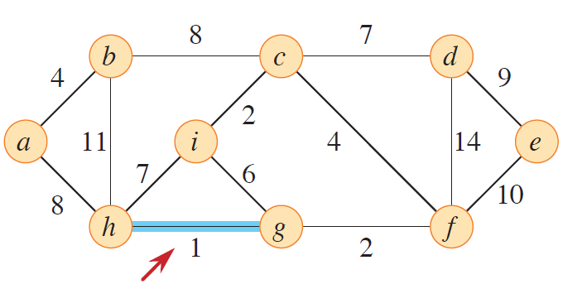
Kruskal’s Algorithm

Slide 12
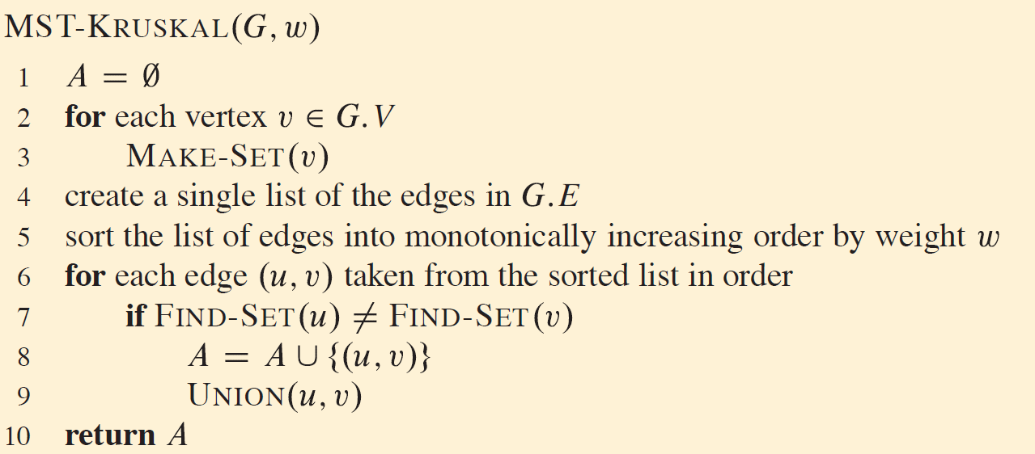
Kruskal’s Algorithm
Determine whether two vertices u and v belong to the same tree by testing whether FIND-SET(u) equals FIND-SET(v).
To combine trees, Kruskal’s algorithm calls the UNION procedure.

Slide 13
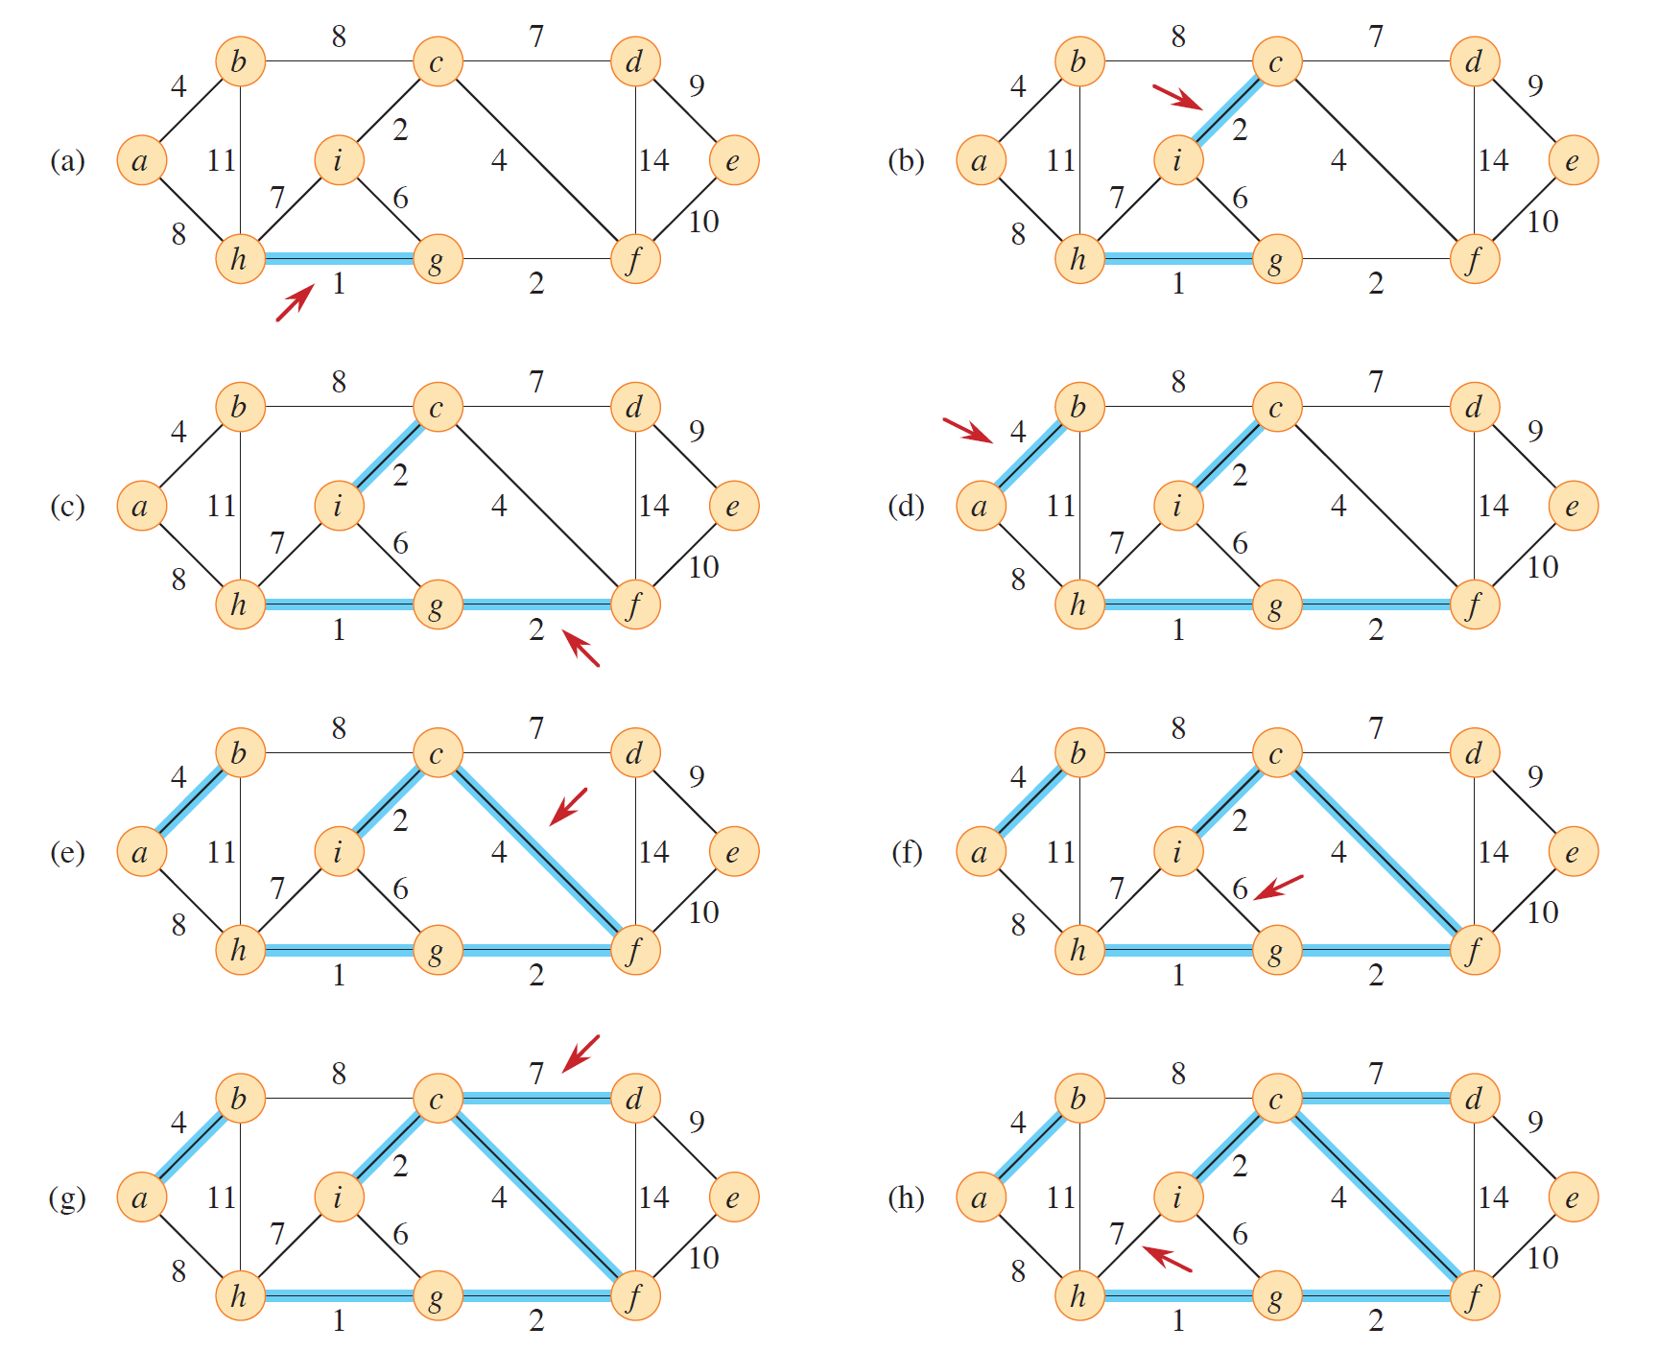

Slide 14
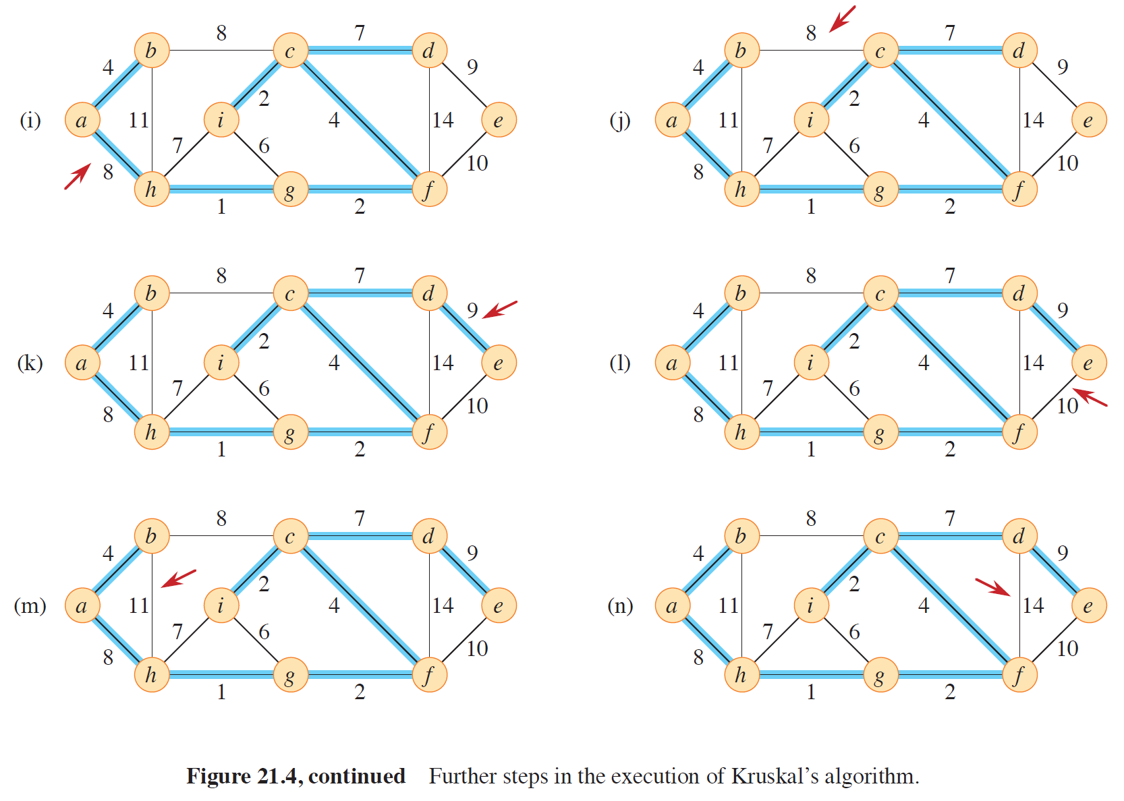

Slide 15
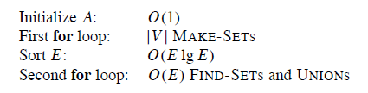
Kruskal’s Algorithm Analysis

Slide 16
Kruskal’s Algorithm Analysis
Lines 2–3 initialize the set A to the empty set and create |V| trees, one containing each vertex. O(V)
The time to sort the edges in line 5 is O(E lg E)
The for loop in lines 6–8 examines edges in order of weight, from lowest to highest. O(E )
The loop checks, for each edge (u, v), whether the endpoints u and v belong to the same tree.
If they do, then the edge (u, v) cannot be added to the forest without creating a cycle, and the edge is discarded.
Otherwise, the two vertices belong to different trees. In this case, line 8 adds the edge (u, v) to A, and line 9 merges the vertices in the two trees.
The running time of the Kruskal’s algorithm
O(V) + O(E lg E) + O(E ) = O(E lg E)
With a complete graph, |E| < | V²|
|E| < |V²|, log|E| < log|V²|, O(logE) < O(2logV), O(logE) ≈ O(logV)
O(E lg V)

Slide 17
Prim’s Algorithm
The set A forms a single tree.
The safe edge added to A is always a least-weight edge connecting the tree to a vertex not in the tree.

Slide 18
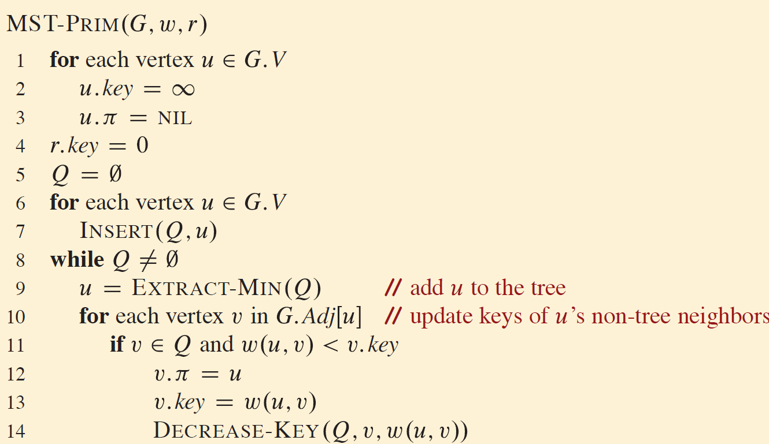
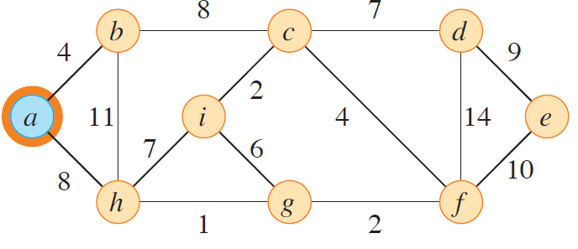
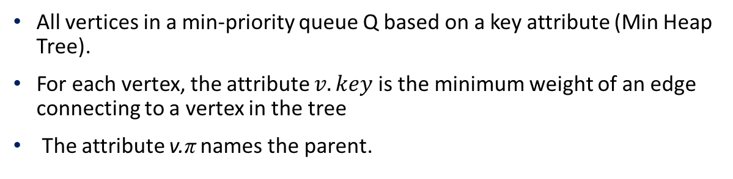
Prim’s Algorithm
All vertices in a min-priority queue Q based on a key attribute (Min Heap Tree).
For each vertex, the attribute $v.key$is the minimum weight of an edge connecting to a vertex in the tree
The attribute v.π names the parent.

Slide 19
Prim’s Algorithm
Operates much like Dijkstra’s algorithm for finding the shortest paths in a graph.
The tree starts from a root vertex r and grows until the tree spans all the vertices in V.
Each step adds to the tree A a light edge that connects A to an isolated vertex
This rule adds only edges that are safe for A; therefore, when the algorithm terminates, the edges in A form a minimum spanning tree.
This strategy qualifies as greedy since at each step it adds to the tree an edge that contributes the minimum amount possible to the tree’s weight.

Slide 20
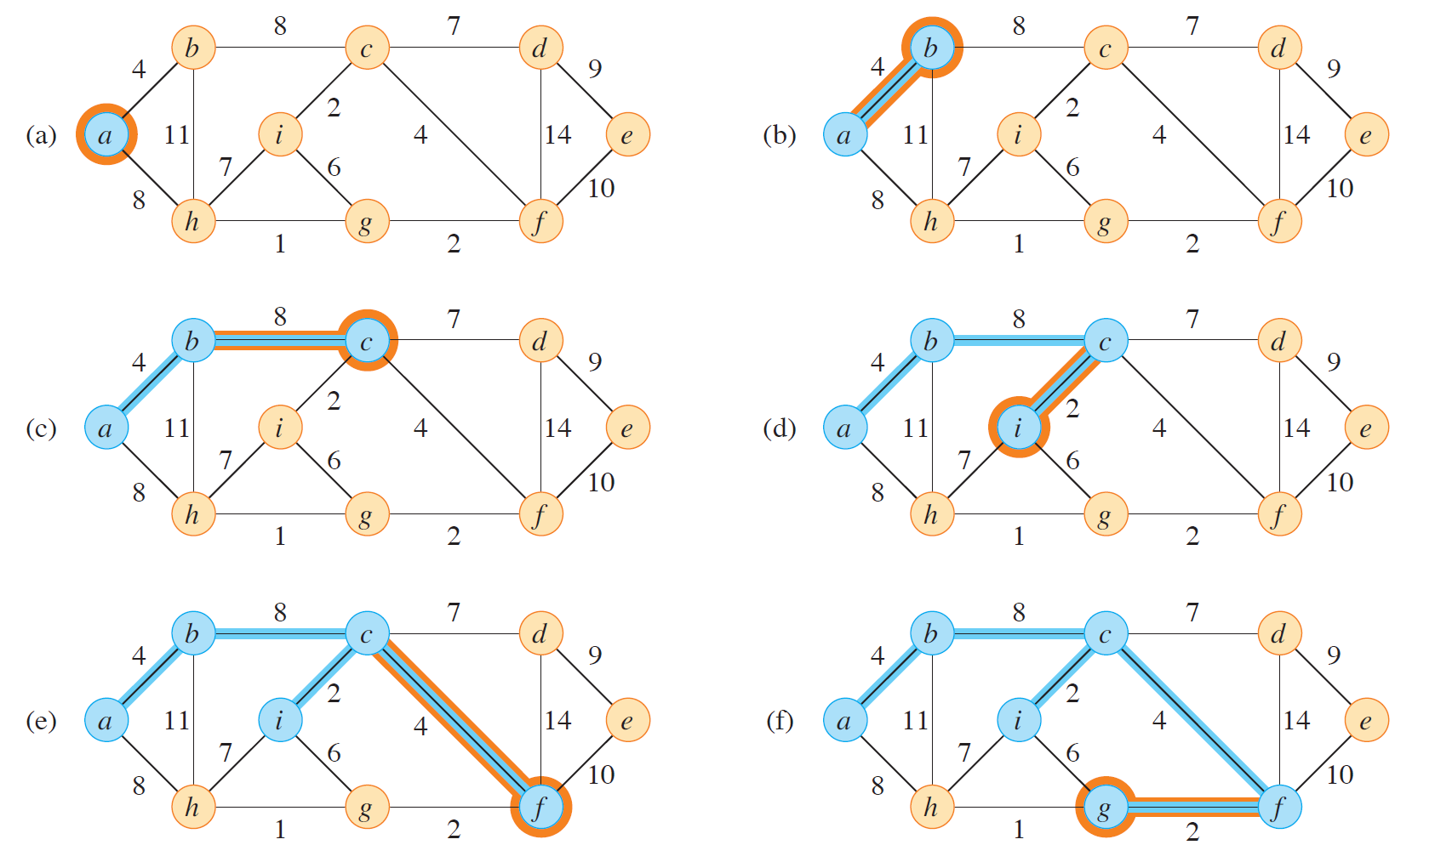
Prim’s Algorithm

Slide 21
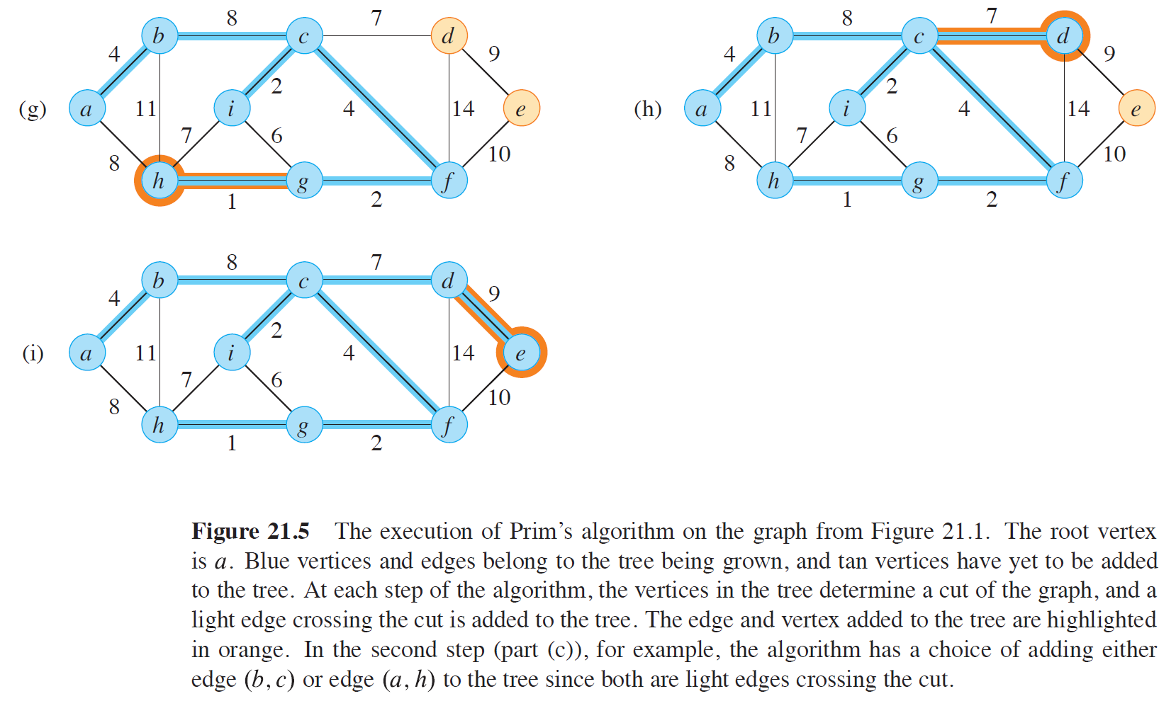
Prim’s Algorithm

Slide 22
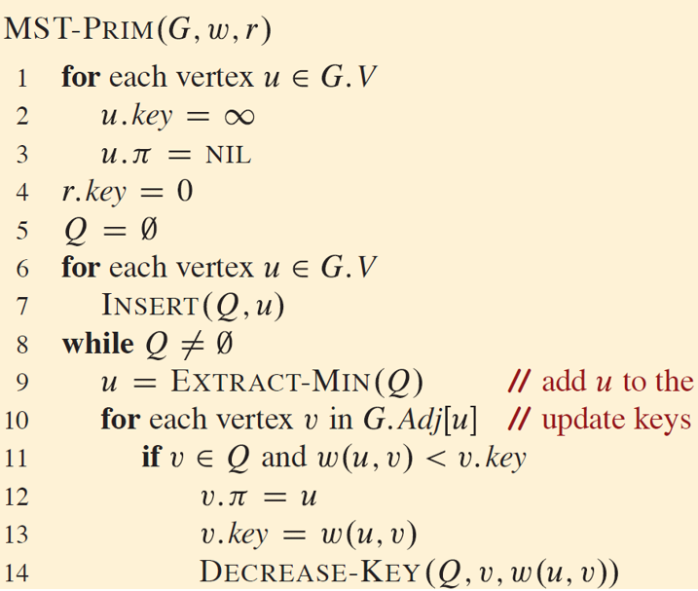
Prim’s Algorithm Analysis
The running time of Prim’s algorithm depends on how we implement the min-priority queue Q
If we implement Q as a binary min-heap, the total time to create the Q in line 9 and for all calls to EXTRACT-MIN is O(V lg V)
The for loop in lines 10–14 executes O(E)
The assignment in line 14 involves an implicit DECREASE-KEY operation on the min-heap, which a binary min-heap supports in O(lg V) time.
The total time for Prim’s algorithm is O(V lg V + E lg V) = O(E lg V).

