Slide 1
CSCI 5343 Algorithms Spring 2025
Dept. of Computational, Engineering, and Computational Sciences
Chapter 3 Growth of Functions

Slide 2
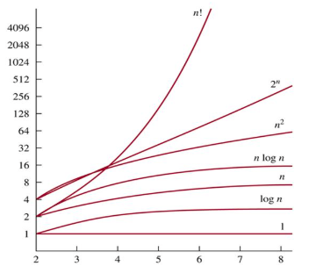
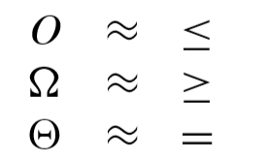
Goals of Growth Functions
Understand behavior of functions in studying asymptotic efficiency
Focus on what’s important by abstracting away low-order terms and constant factors
Indicate and understand running times of algorithms
Compare sizes of functions and times

Slide 3
Algorithm Analysis
The amount of resources used by the algorithm
Space
Computational time
Computational running time:
The number of primitive operations (steps) executed before termination
Order of growth
The leading term of a formula
Expresses the behavior of a function

Slide 4
Asymptotic Notation
A way to describe behavior of functions in the limit
How we indicate running times of algorithms
Describe the running time of an algorithm as n grows to ∞
Three Asymptotic Notations
O notation: asymptotic “less than”: f(n) “≤” cg(n)
𝝮 notation: asymptotic “greater than”: f(n) “≥” cg(n)
Θ notation: asymptotic “equality”: f(n) “=” cg(n)

Slide 5
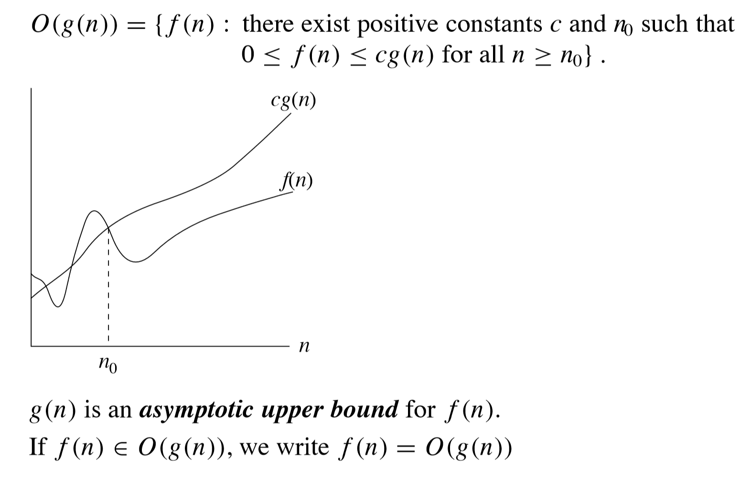
Asymptotic Notation: O – notation

Slide 6
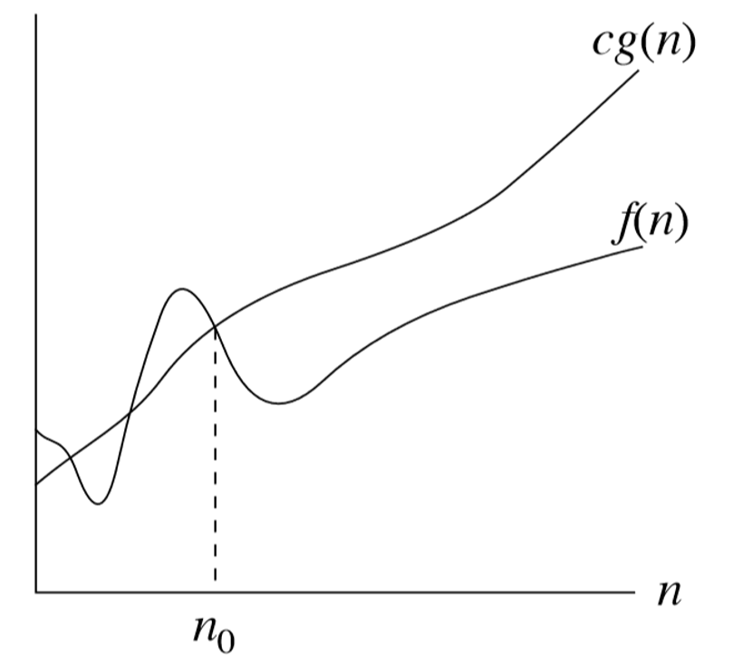

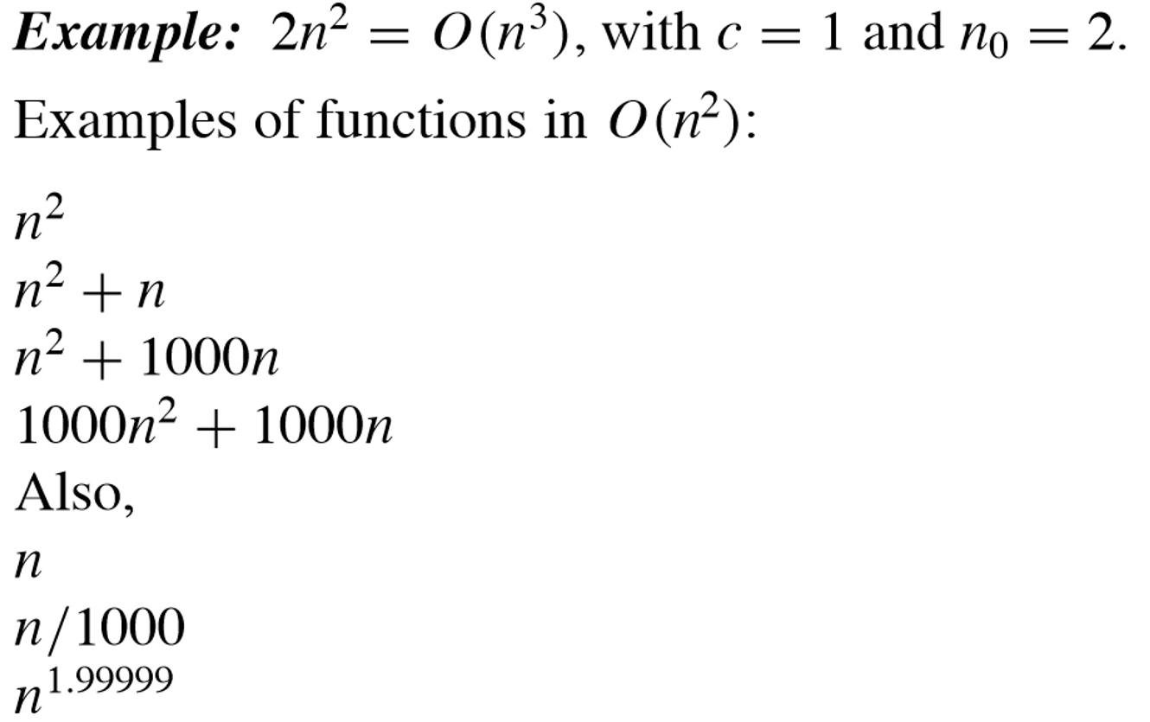
O-notation: Examples

Slide 7
O-notation: More Examples
2n² = O(n³):
n² = O(n²):
1000n²+1000n = O(n²):
n = O(n²):
2n² ≤ cn³ ⇒ 2 ≤ cn ⇒ c = 1 and n₀= 2
n² ≤ cn² ⇒ 1 ≤ c ⇒ c = 1 and n₀= 1
1000n²+1000n ≤ 1000n²+ 1000n² = 2000n²
⇒ c=2000 and n₀ = 1
n ≤ cn² ⇒ 1 ≤ cn ⇒ c = 1 and n₀= 1

Slide 8
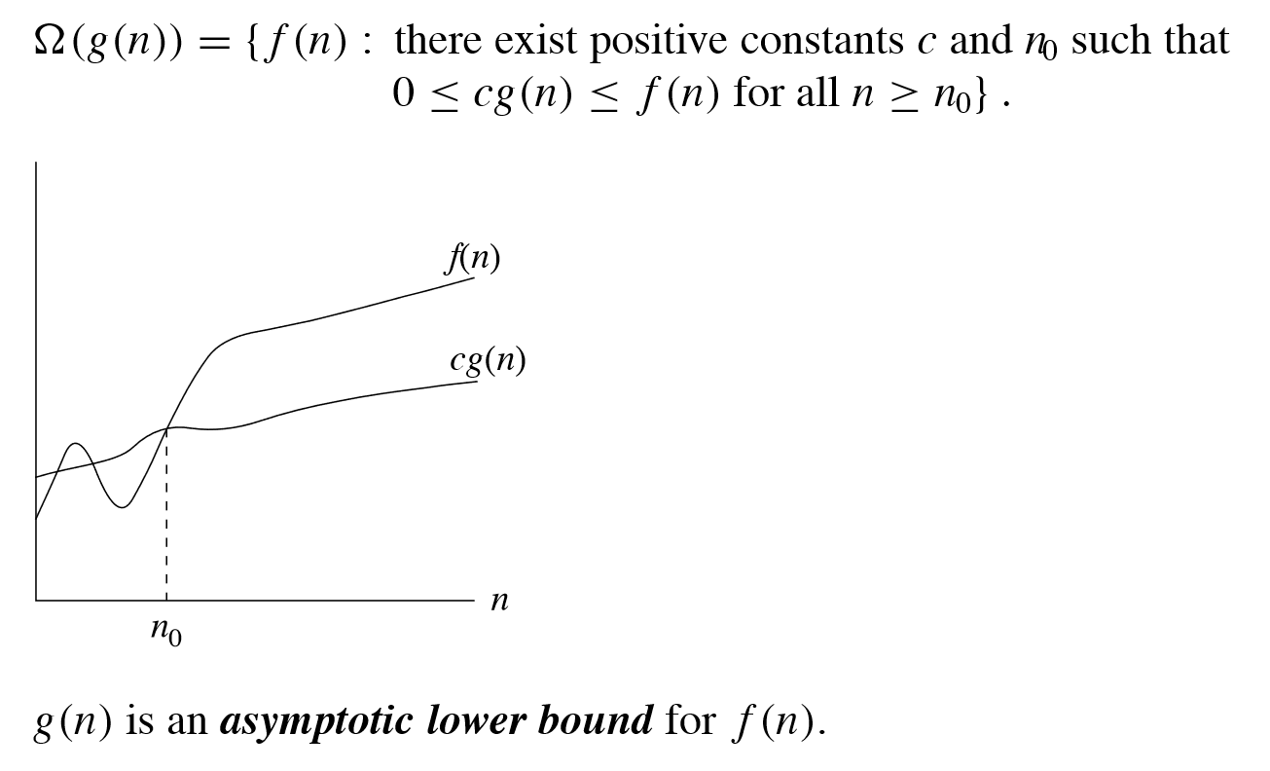

Asymptotic Notation: Ω-notation

Slide 9
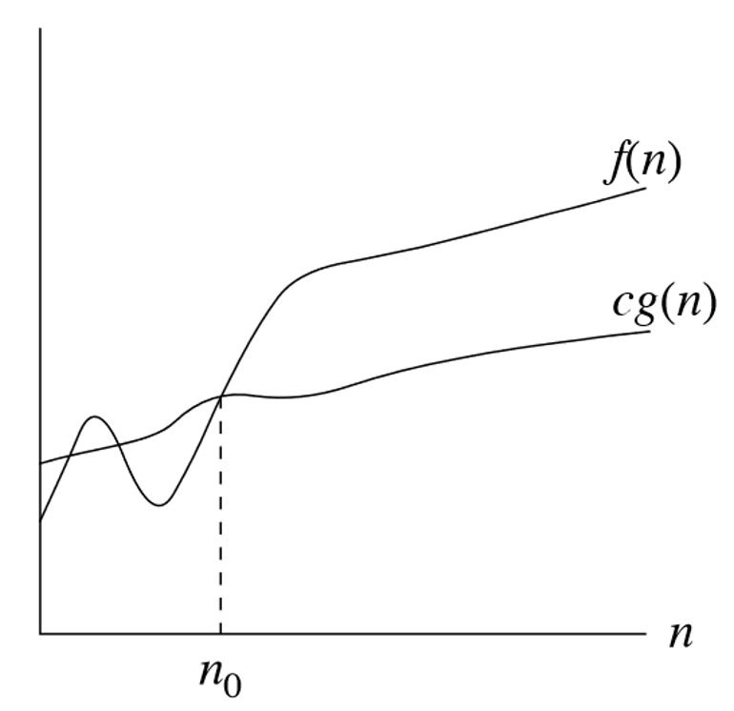

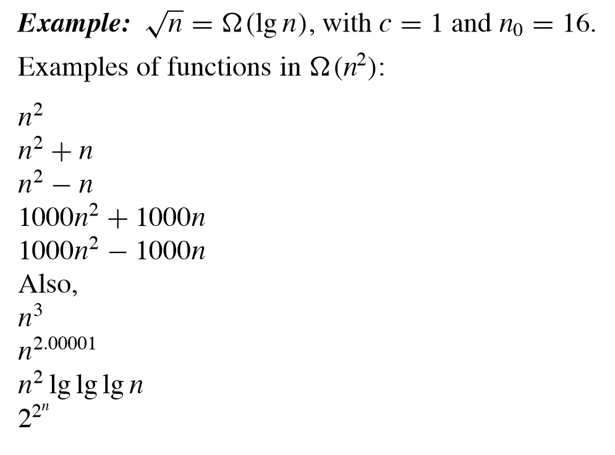
Ω-notation: Example

Slide 10
Ω-notation: More Examples
5n² = 𝝮(n)
100n + 5 ≠ 𝝮(n²)
n = 𝝮(n), n³ = 𝝮(n²), n = 𝝮(logn)
∃ c, n₀ such that: 0 ≤ cn ≤ 5n²
⇒ cn ≤ 5n²
⇒ c = 1 and n₀ = 1
∃ c, n₀ such that: 0 ≤ cn² ≤ 100n + 5
100n + 5 ≤ 100n + 5n (∀ n ≥ 1) = 105n
cn² ≤ 105n
Since n is positive ⇒
n ≤ 105/c

Slide 11
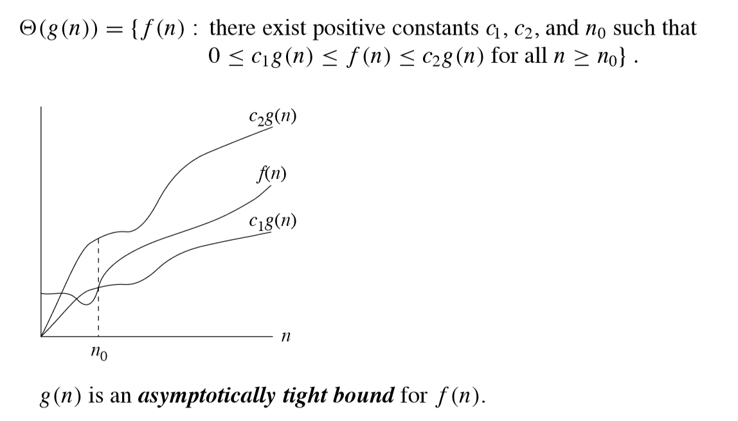

Asymptotic Notation: θ-notation

Slide 12

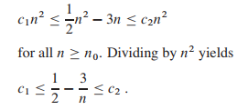
θ-notation: Example
To show ½ n² – 3n = θ(n²)
Must determine positive c₁, c₂, and n₀
Make the left-hand inequality hold for any value of n >= 7 by choosing any constant c₁ <= 1/14.
Make the right-hand inequality hold for any value of n >=7 by choosing any constant c₂ >= 1/2.
By choosing c₁ = 1/14, c₂ = 1/2, and n₀ = 7, we can verify that ½ n² – 3n = θ(n²)

Slide 13
θ-notation: More Examples
n²/2 –n/2 = Θ(n²)
½ n² - ½ n ≤ ½ n² ∀n ≥ 0 ⇒ c₂= ½
½ n² - ½ n ≥ ½ n² - ½ n * ½ n ( ∀n ≥ 2 ) = ¼ n² ⇒ c₁= ¼
n ≠ Θ(n²): c₁ n² ≤ n ≤ c₂ n² ⇒ only holds for: n ≤ 1/c₁
6n³ ≠ Θ(n²): c₁ n² ≤ 6n³ ≤ c₂ n² ⇒ only holds for: n ≤ c₂ /6
n ≠ Θ(logn): c₁ logn ≤ n ≤ c₂ logn
⇒ c₂ ≥ n/logn, ∀ n≥ n₀ – impossible

Slide 14
Asymptotic Notations - Examples
For each of the following pairs of functions, either f(n) is O(g(n)), f(n) is Ω(g(n)), or f(n) is Θ(g(n)). Determine which relationship is correct.
f(n) = log n²; g(n) = log n + 5
f(n) = n; g(n) = log n²
f(n) = n; g(n) = log n
f(n) = n log n + n; g(n) = log n
f(n) = 2^{n}; g(n) = 10n²
f(n) = 2^{n}; g(n) = 3^{n}
f(n) = Θ (g(n))
f(n) = 𝝮(g(n))
f(n) = 𝝮(g(n))
f(n) = 𝝮(g(n))
f(n) = 𝝮(g(n))
f(n) = O(g(n))

Slide 15
Asymptotic Notations - Implications
O notation: asymptotic upper bound f(n) “≤” cg(n)
Used to bound the worst-case running time of an algorithm
Example: O(n²) upper bound on the worst-case running time of Insertion Sort
𝝮 notation: asymptotic lower bound f(n) “≥” cg(n)
Used to bound the best-case running time of an algorithm
Example: 𝝮(n) lower bound on the best-case running time of Insertion Sort
The running time of insertion sort therefore belongs to both 𝝮(n) and O(n²)
Θ notation: asymptotic tight bound c1g(n) “≤” f(n) “≤” c2g(n)
Used to upper and lower bound the average running time of an algorithm

