Slide 1
CSCI 5343 Algorithms Spring 2025
Dept. of Computational, Engineering, and Computational Sciences
Chapter 4 Divide-And-Conquer

Slide 2
Goals
Understand divide-and-conquer design paradigm
Analyze recursive algorithms
Solutions for the maximum-subarray problem
A brute-force solution
A solution to find max-subarray
A solution with divide-and-conquer
A solution with dynamic programming
Analyze the running times of algorithms

Slide 3
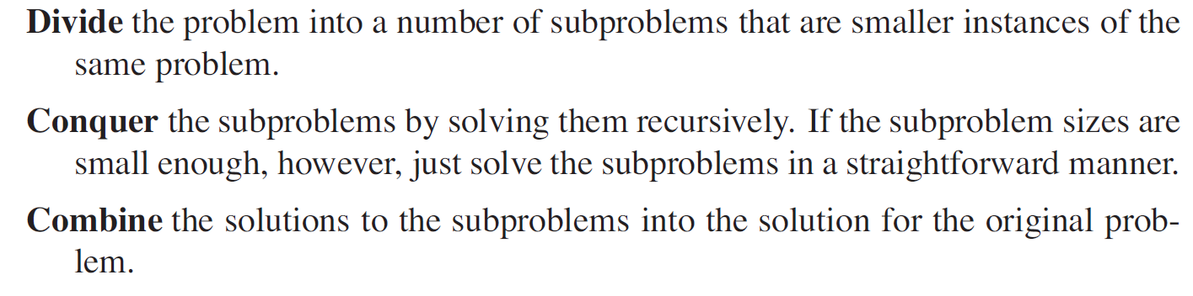
Divide-And-Conquer Approach
Solve a problem recursively, applying three steps at each level of the recursion

Slide 4
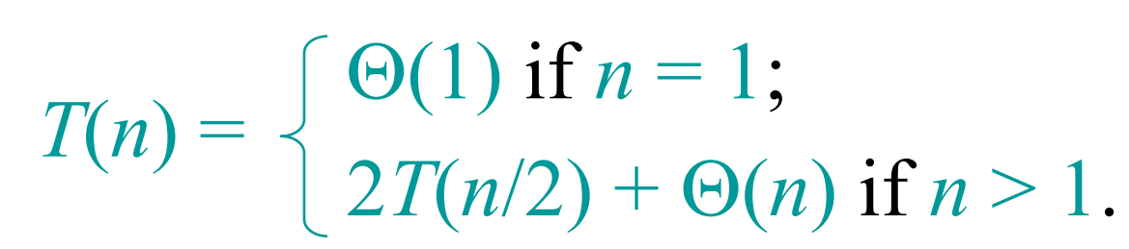
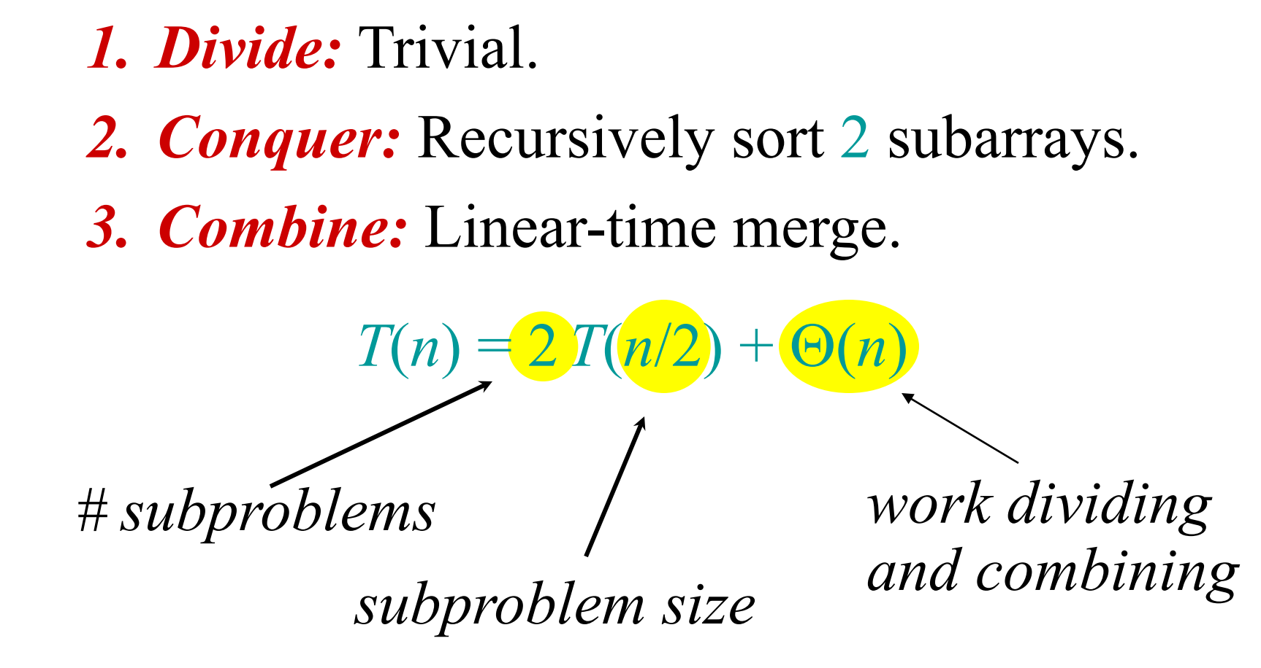
Recurrence for Merge Sort
Base case
Recursive case

Slide 5
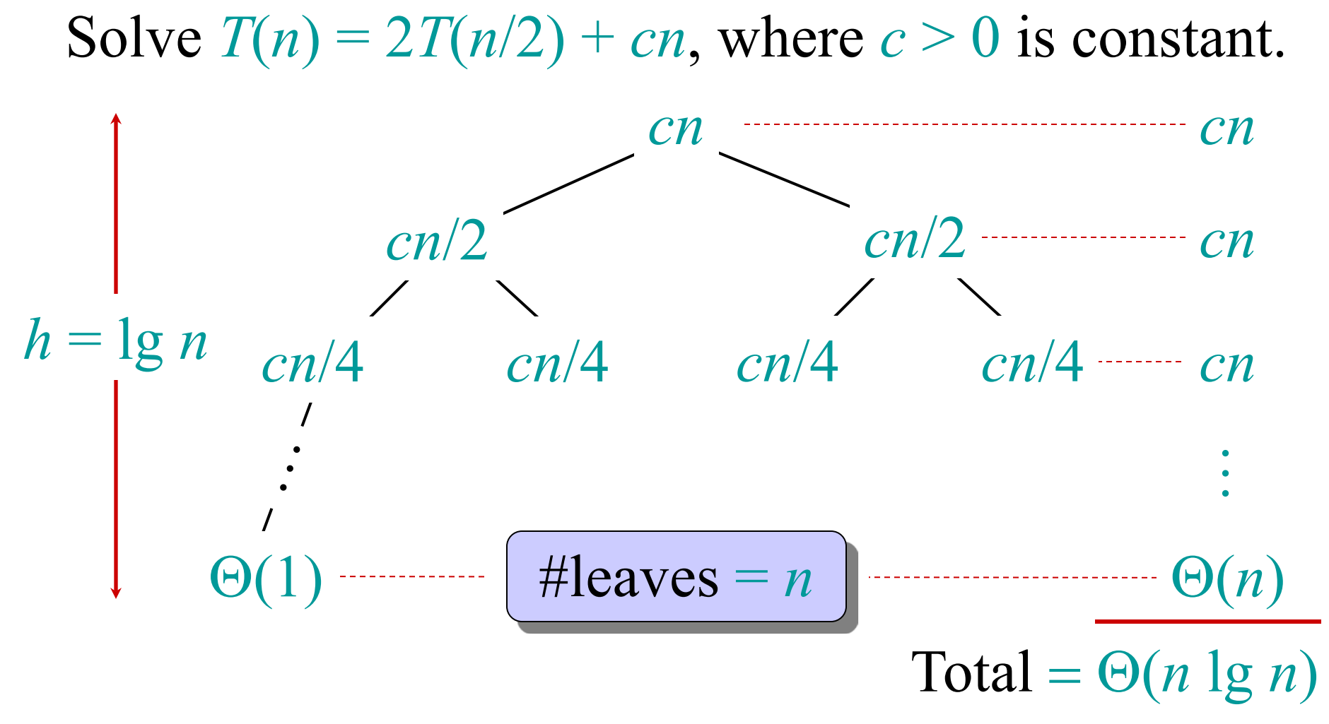
Recursion Tree

Slide 6
Maximum-Subarray Problem
Scenario
The stock price of the Volatile Chemical Corporation is rather volatile
Invest in the Volatile Chemical Corporation
Buy one unit of stock only one time and then sell it at a later date, buying and selling after the close of trading for the day
Goal is to maximize your profit

Slide 7
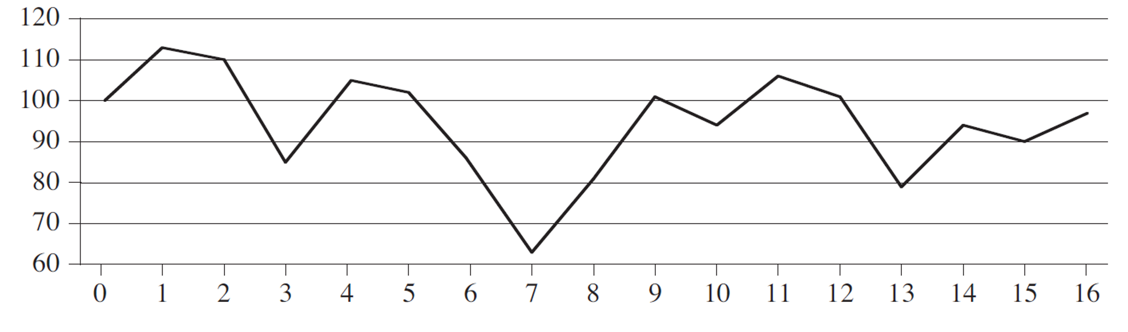
Maximum-Subarray Problem
Price of the stock over a 17-day period

Slide 8
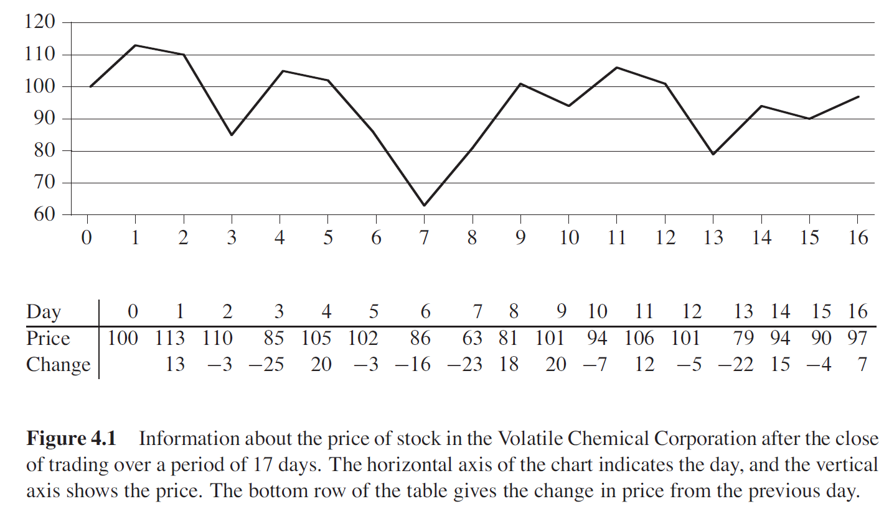
Maximum-Subarray Problem
Price of the stock over a 17-day period

Slide 9
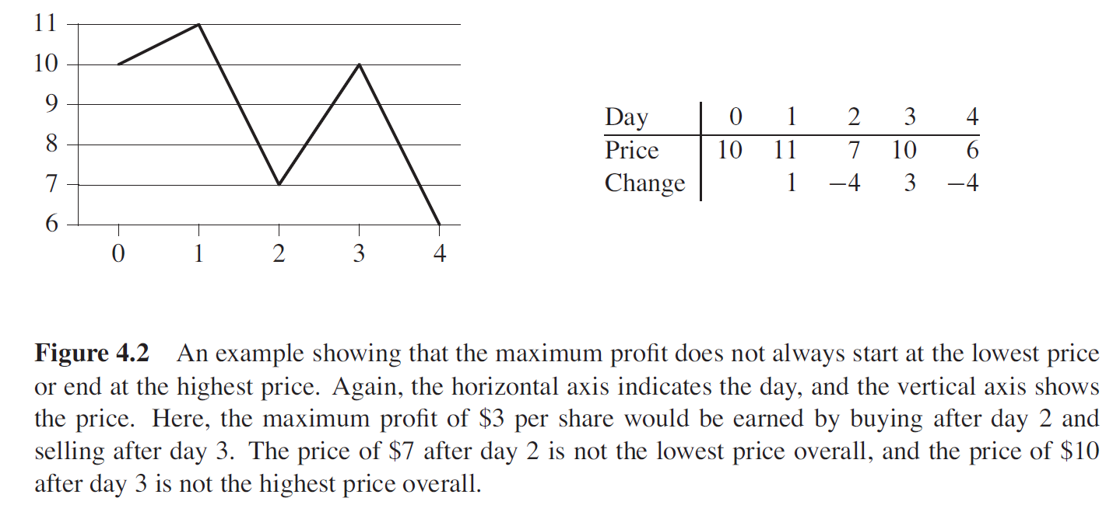
Maximum-Subarray Problem

Slide 10
1. A brute-force solution
Try every possible pair of buy and sell dates in which the buy date precedes the sell date
A period of n days has such pairs of dates
Evaluate each pair of dates in O(N²)

Slide 11
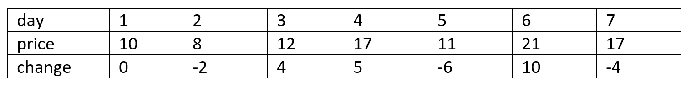
2. Maximum Contiguous Subarray
Consider the daily change in price
The change on day i is the difference between the prices after day i - 1 and after day i
Find the contiguous subarray of whose values have the largest sum
The maximum-subarray problem is interesting only when the array contains some negative numbers

Slide 12
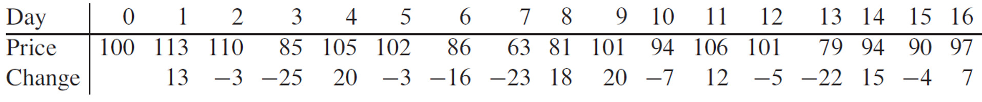
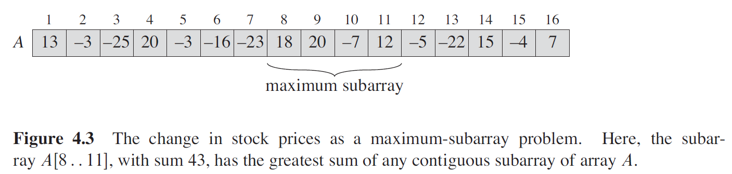
2. Maximum Contiguous Subarray
Maximum subarray of A[1..16] is A[8..11] with the sum 43
Want to buy the stock just before day 8 (that is, after day 70 at the close of the day) and sell it after day 11, earning a profit of $43 per share.

Slide 13
2. Maximum Contiguous Subarray
Still need to check O(N²) subarrays for a period of n days
Similar to the brute-force solution takes O(N²)

Slide 14
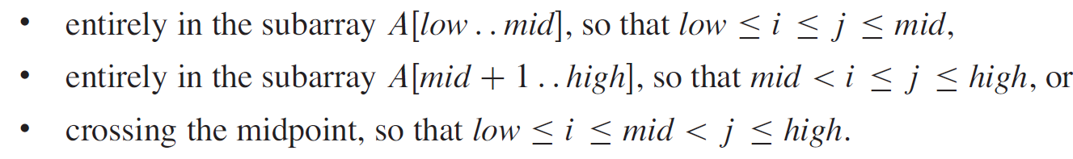
3. Solution with Divide-and-Conquer
More efficient solution
Divide the subarray into two subarrays of as equal size as possible
Find the midpoint, mid, of the subarray, and consider the subarrays A[low .. Mid] and A[mid+1..high]
Any contiguous subarray (Maximum) A[i..j] of A[low..high] must lie in one of the following places

Slide 15
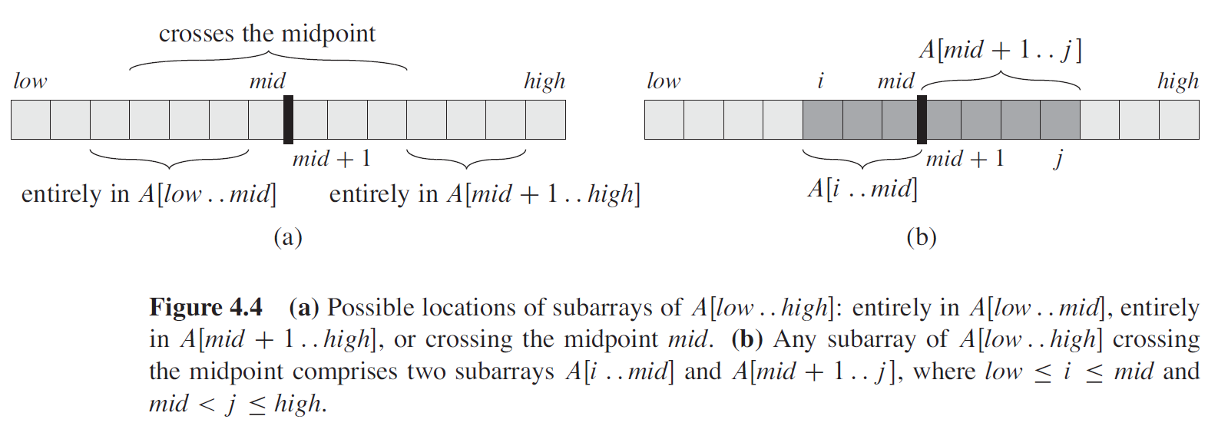
3. Solution with Divide-and-Conquer
Need to find maximum subarrays of the form A[i.. Mid] and A[Mid+1..j] and then combine them
Consider that the subarray it chooses must cross the midpoint

Slide 16
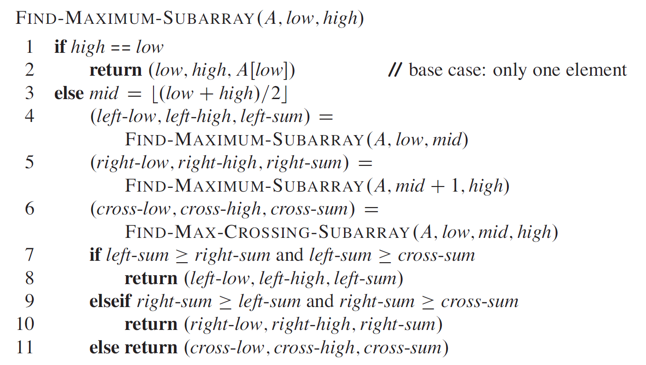
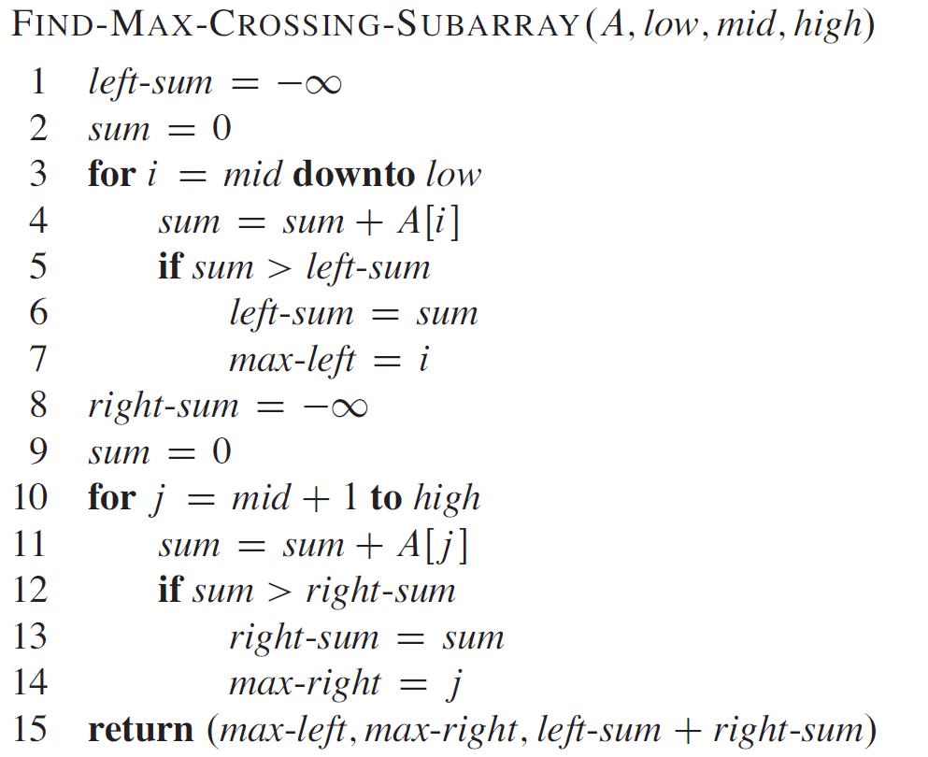
3. Solution with Divide-and-Conquer

Slide 17
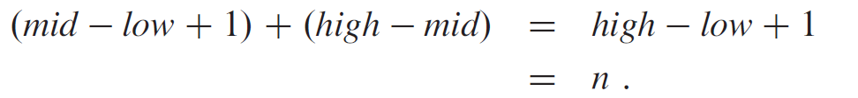
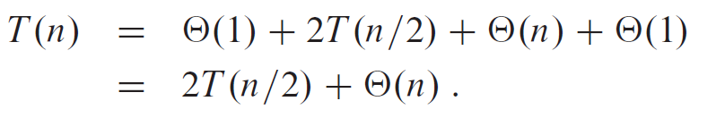
3. Analysis Using Divide-and-Conquer
FIND-MAX-CROSSING-SUBARRAY
The for loop of lines 3–7 makes (mid - low + 1) iterations, and the for loop of lines 10–14 makes (high – mid) iterations, and so the total number of iterations is
FIND-MAX-SUBARRAY
Base case when n = 1, T(1) = O(1) for lines 1-2
Recursive case when n > 1
O(1) for lines 1-3
T(n/2) for each subarray for line 4 and 5
O(n) for line 6
O(1) for lines 7-11
This recurrence happens logn times
So, the solution is O(nlogn)
Asymptotically faster than the brute-force method

Slide 18
4. Solution with Dynamic Programming
Kadane’s Algorithm
max_at_index at each array index
Max of subarray
int Maximum-SubArray-Kadane (int A[]) {
max_at_index = 0, Max = -∞;
for ( i = 1; i <= A.length, i++) {
max_at_index = max_at_index + A[i];
if (max_at_index > max)
Max = max_at_index;
if (max_at_index < 0)
max_at_index = 0;
}
return Max;
}

Slide 19
4. Analysis with Dynamic Programming
Kadane’s Algorithm
max_at_index at each array index
Max of subarray
int Maximum-SubArray-Kadane (int A[]) {
max_at_index = 0, Max = -∞;
for ( i = 1; i <= A.length, i++) {
max_at_index = max_at_index + A[i];
if (max_at_index > max)
Max = max_at_index;
if (max_at_index < 0)
max_at_index = 0;
}
return Max;
}
This algorithm now maintains the indices of low and high of the subarray and returns a Max of the array.
This algorithm only returns a max of the subarray.
The solution takes O(n).

Slide 20
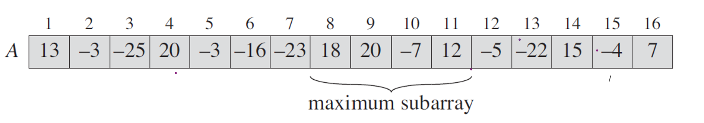
4. Analysis using Dynamic Programming
int low, high, t;
int Maximum-SubArray-Kadane (int A[]) {
max_at_index = 0, Max = -∞;
low = 0, high = 0, l = 0;
for ( i = 1; i <= A.length, i++) {
max_ at _index = max_ at _index + A[i];
if (max_ at _index > Max) {
Max = max_ at _index;
low = t;
high = i;
}
if (max_ at _index < 0) {
max_this_index = 0;
t = i + 1;
}
}
return Max;
}
To maintain indices of low and high of the subarray
The solution takes O(n).

Slide 21
Applications of Maximum–Subarray Problem
Stock market analysis
Analyze stock price over time and identify the period with the highest profit
Feature selection in machine learning
Identify the most relevant features contributing to the prediction of outcomes
Noise reduction in signal processing
Identify the strongest signals amidst noise
Optimizing operations
Identify the best times to allocate resources for max efficiency

