Slide 1
CSCI 5343 Algorithms Spring 2025
Dept. of Computational, Engineering, and Computational Sciences
Chapter 6 Heap Sort

Slide 2
Goals
Understand heap sort and its operations
Understand a heap sort algorithm
Build a heap
Maintain heap properties
Implement priority queues using heap

Slide 3
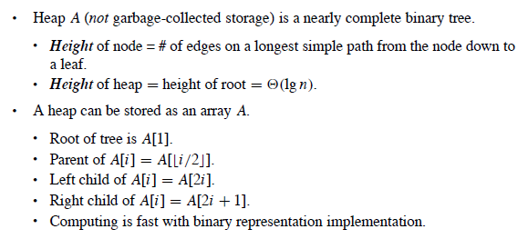
Heap Data Structure
The (binary) heap data structure is an array object that we can view as a nearly complete binary tree.
The heap tree is completely filled from the left up to a point.
https://www.cs.usfca.edu/~galles/visualization/HeapSort.html

Slide 4
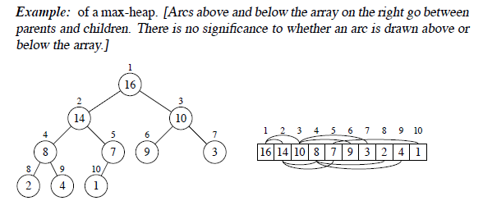
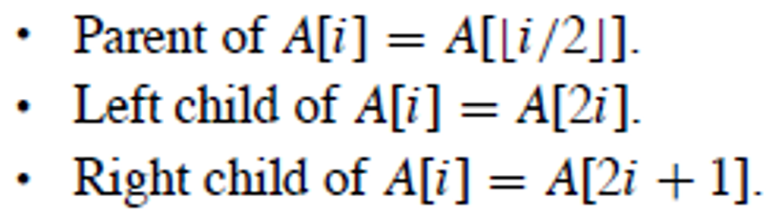
Heap Example

Slide 5
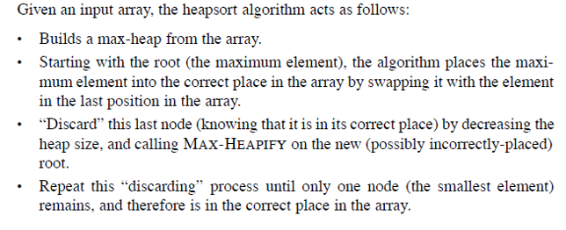
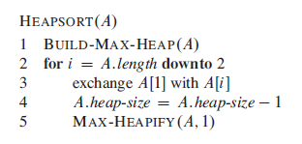
Heapsort Algorithm

Slide 6
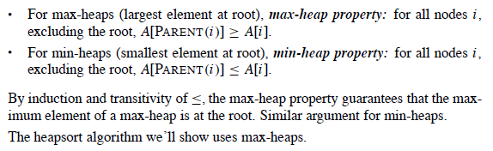
Heap Properties

Slide 7
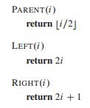
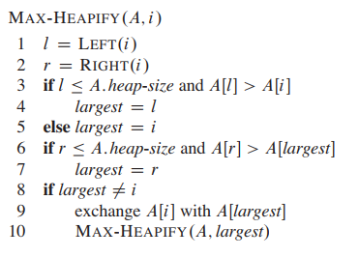

Heap Sort Algorithm
https://www.cs.usfca.edu/~galles/visualization/HeapSort.html

Slide 8
Create a heap tree and sort numbers with the tree along a corresponding array

Slide 9
Building A Heap
Use the procedure MAX-HEAPIFY in a bottom-up manner to convert an array A [1..n], where n = A.length, into a max-heap.
The procedure BUILD-MAX-HEAP goes through the remaining nodes of the tree and runs MAX-HEAPIFY on each one

Slide 10
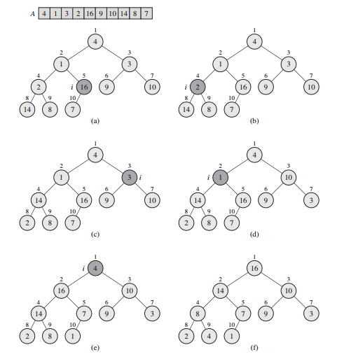

Slide 11

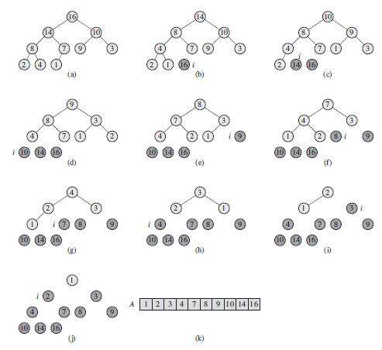

Slide 12
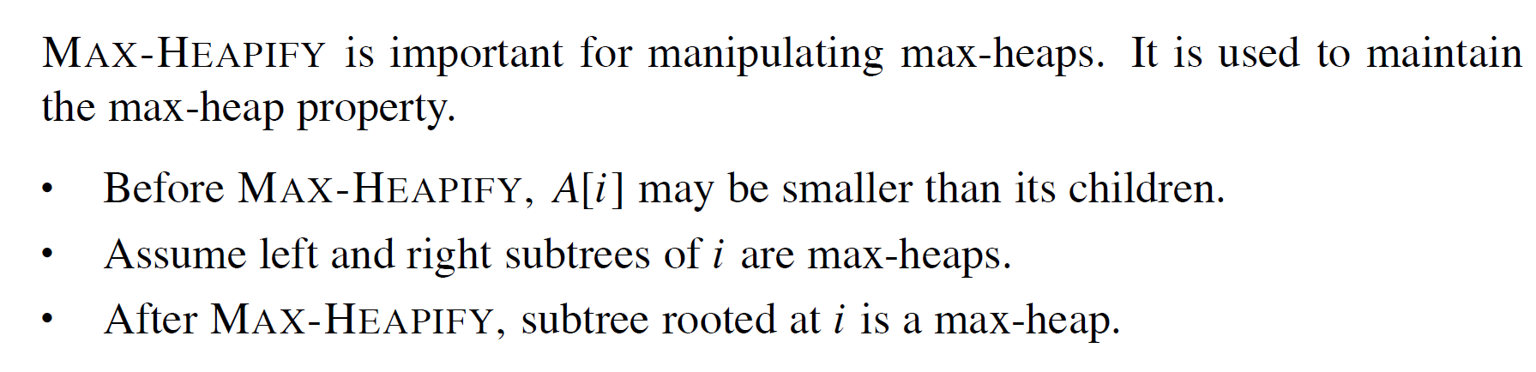
Maintaining Heap Property

Slide 13
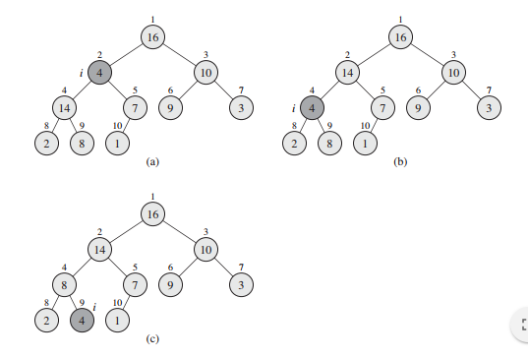
Maintaining Heap Property

Slide 14
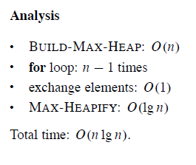
Analysis of Heap Sort

Slide 15
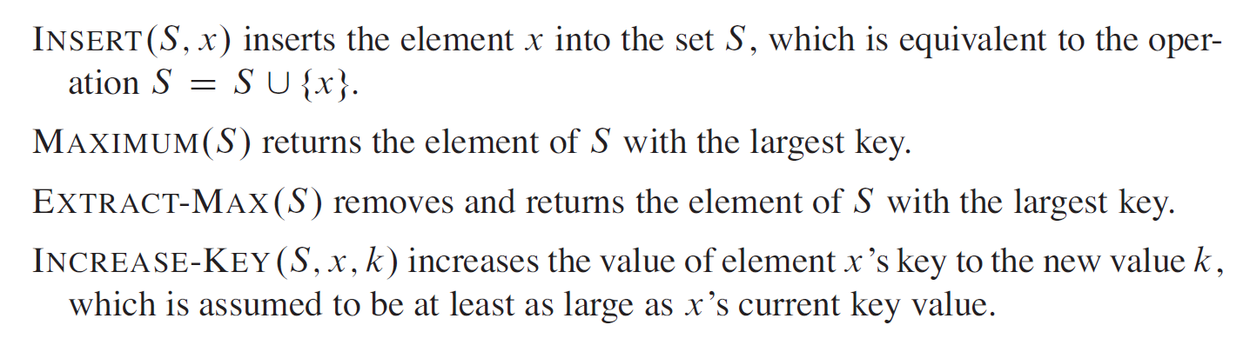
Heap Implementation of Priority Queue
Heaps efficiently implement priority queues.
A priority queue is a data structure for maintaining a set S of elements, each with an associated value called a key.
A max-priority queue supports the following operations:

Slide 16
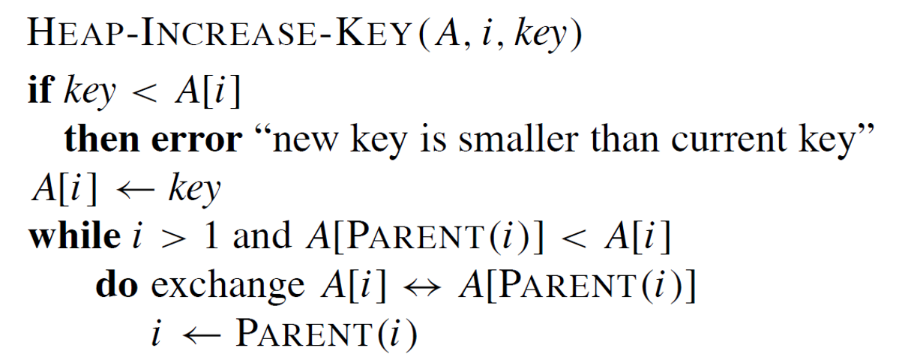
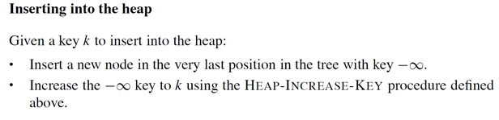
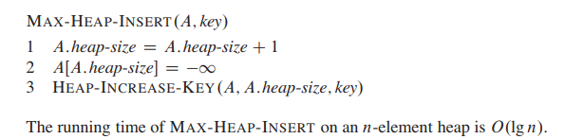
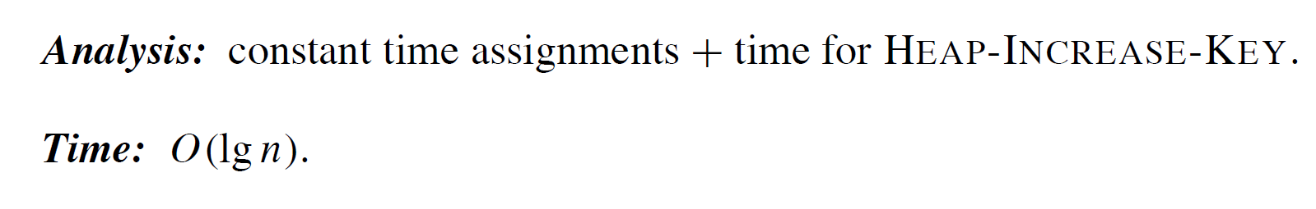
Priority Queue: Inserting a Key Value

Slide 17
Priority Queue: Inserting a Key Value
Inserting 3, 5, 1, 19, 11, and 22 to a heap, initially empty

Slide 18
Priority Queue: Inserting a Key Value
25, 13, 5, 26, 14, 7, 3, 8, 22, 18, 42

Slide 19
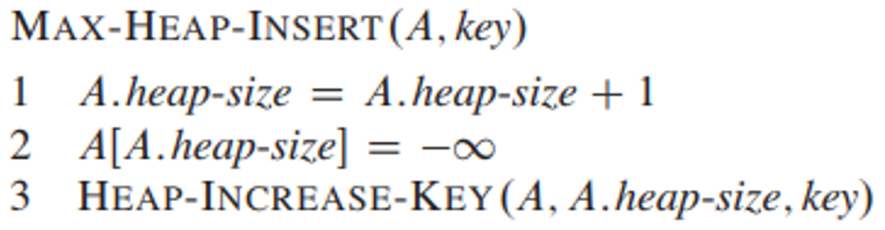
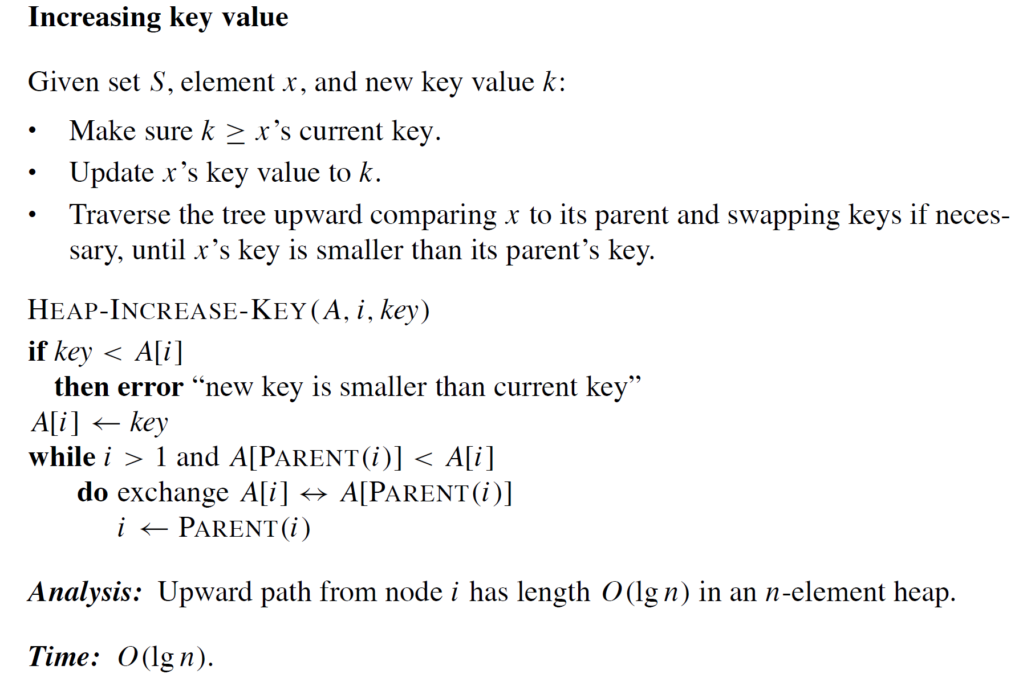
Priority Queue: Increasing a Key Value

Slide 20
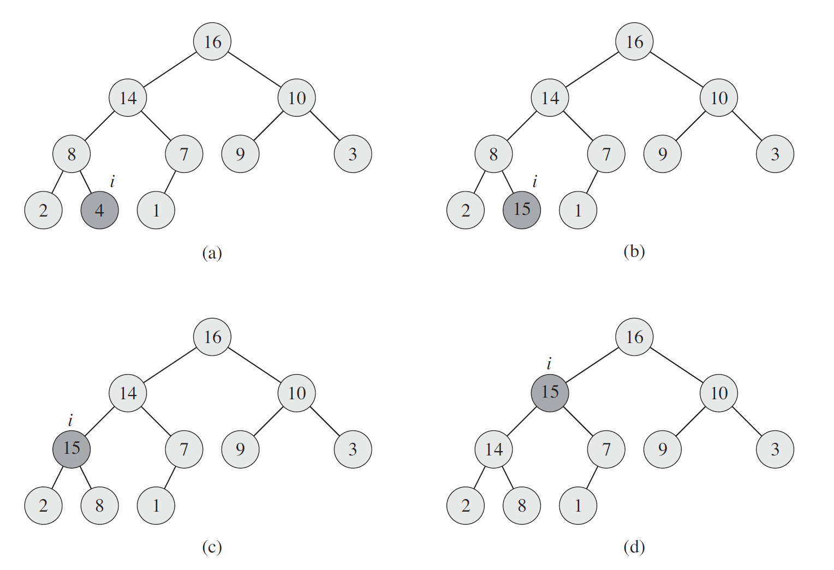
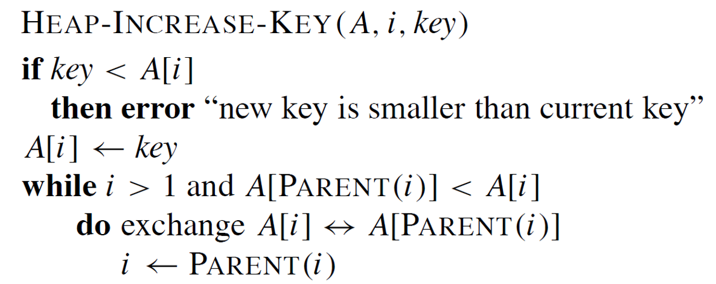
Operation of Increasing a Key Value

Slide 21
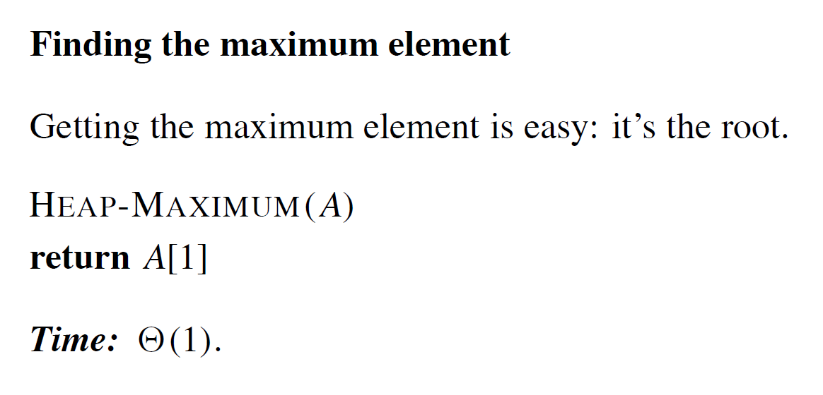
Priority Queue: Getting an Element with Largest Key

Slide 22
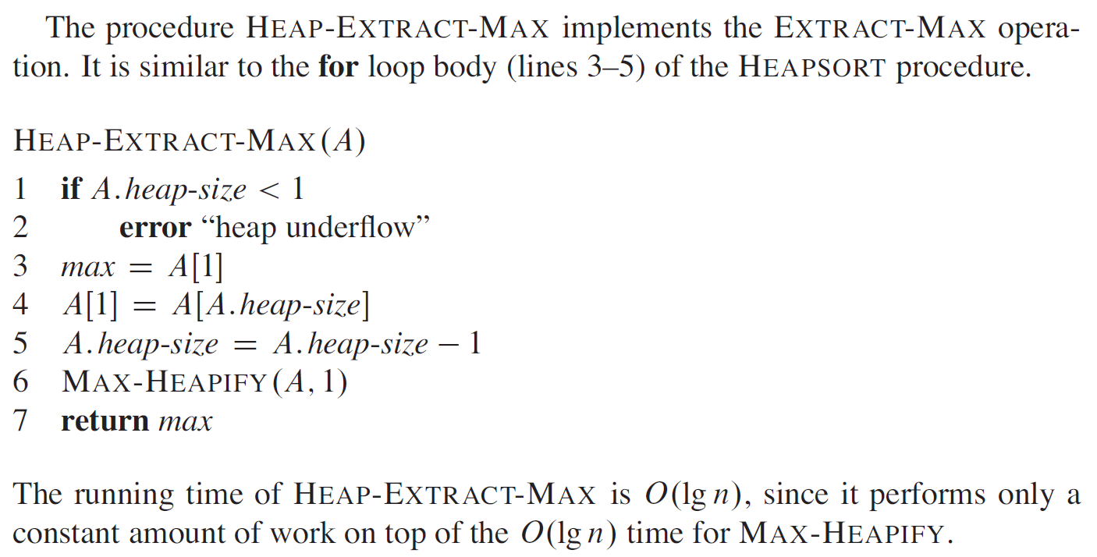
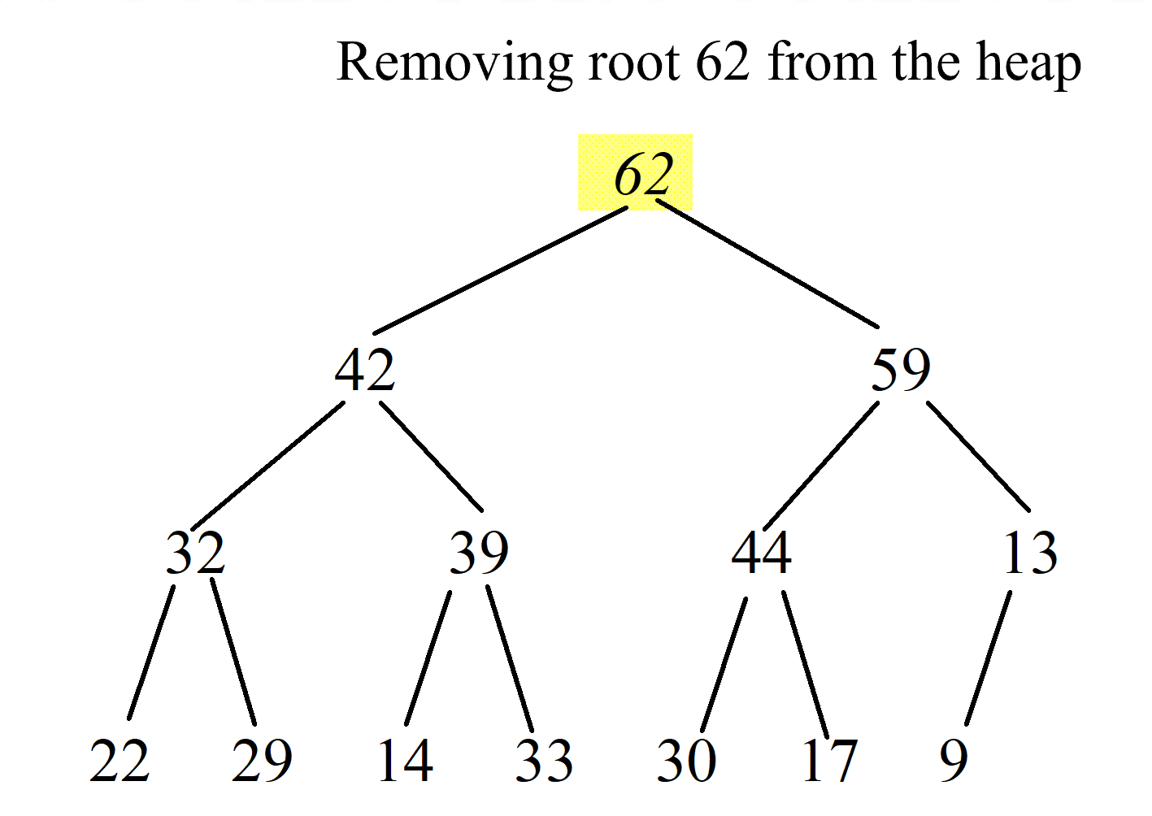
Priority Queue: Extracting Max

Slide 23
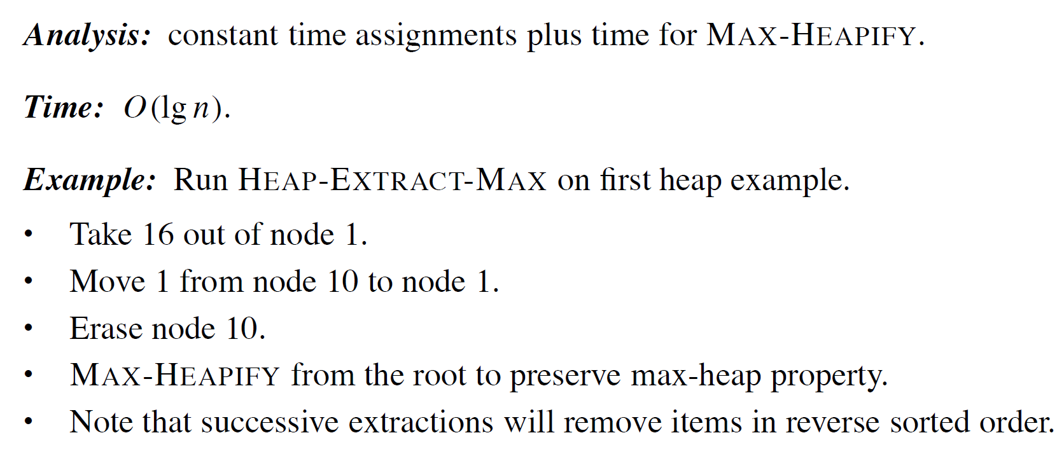
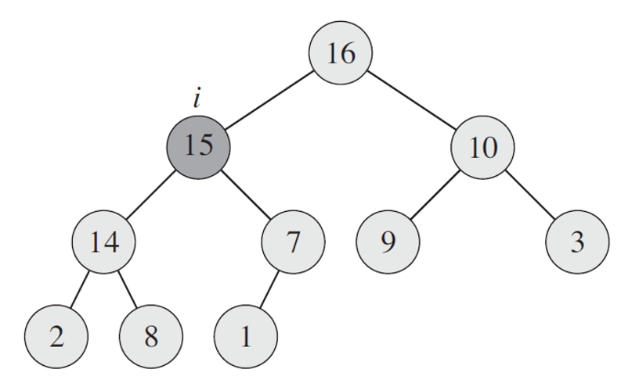
Priority Queue: Extracting Max

