Slide 1
Book 1
File created on: 2/19/2025 8:20:56 PM

Slide 2
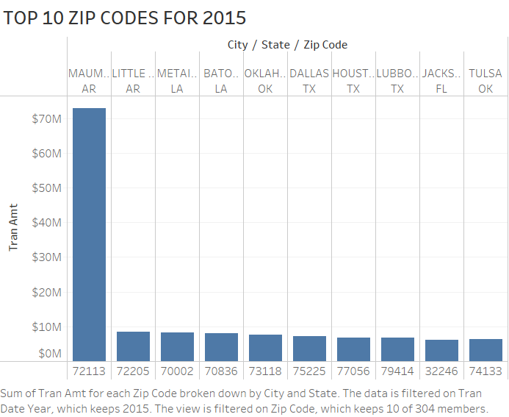

Slide 3
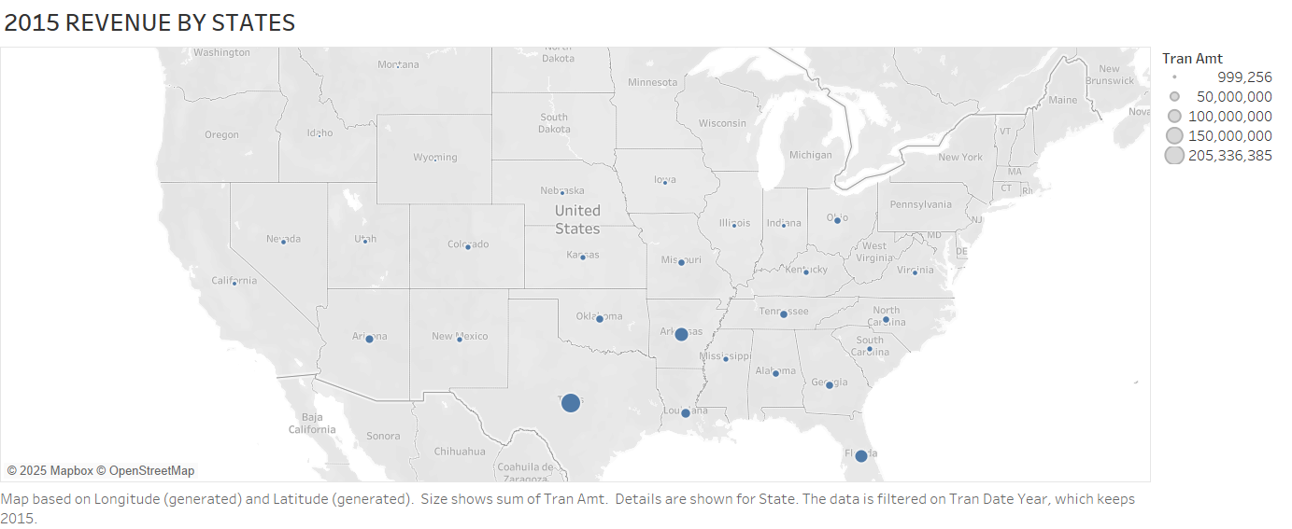

Slide 4
