Slide 1

Note: The data and information in this document is reflective of a hypothetical situation and client. This document is to be used for KPMG Virtual Internship purposes only.
Sprocket Central Pty Ltd
Data analytics approach
Vi Nguyen – Data Analyst

Slide 2
Note: The data and information in this document is reflective of a hypothetical situation and client. This document is to be used for KPMG Virtual Internship purposes only.
Agenda
Introduction
Data Exploration
Model Development
Interpretation

Slide 3
Note: The data and information in this document is reflective of a hypothetical situation and client. This document is to be used for KPMG Virtual Internship purposes only.
Introduction
Optimizing target audience
Objective
Narrow down target audience to increase revenue
Approach for Data Analysis
Prepare datasets for analysis
Clarify all filters which bring higher chance of increasing revenue on the 3 years transaction history
Make metrics to apply on new customer list to find out the target audience

Slide 4
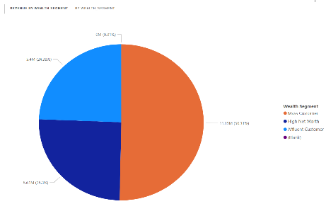
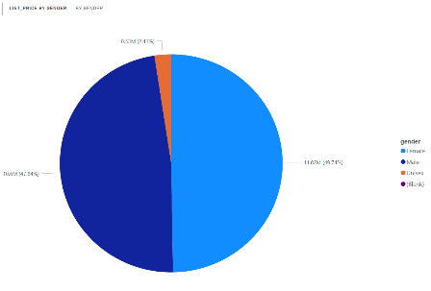
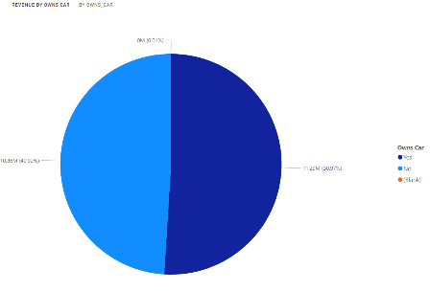
Note: The data and information in this document is reflective of a hypothetical situation and client. This document is to be used for KPMG Virtual Internship purposes only.
Data Exploration
Basic understanding of dataset
Mass wealth segment got over than 50% of total revenue
- More than 50% of customers purchased own cars (but not much differences)
- More than 50% of customers purchased are female (but not much differences)

Slide 5
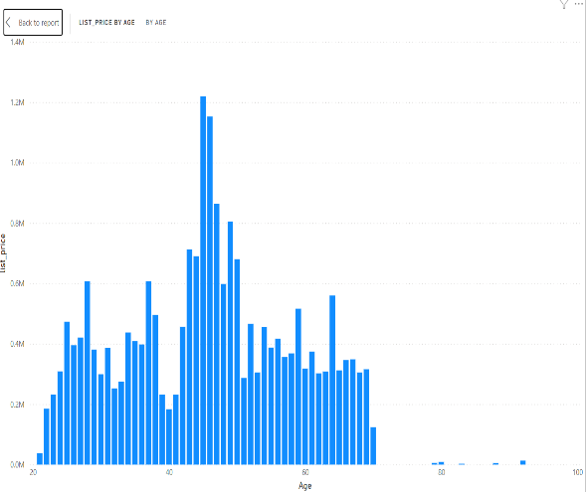
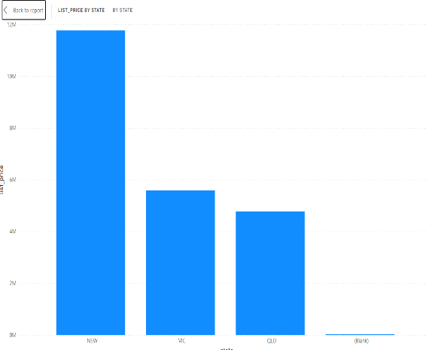
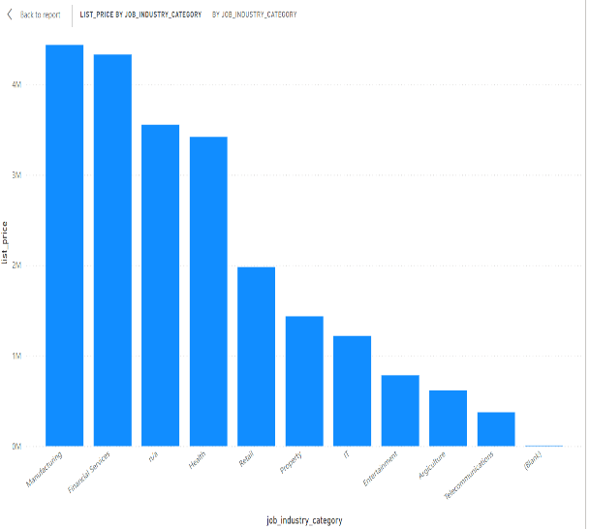
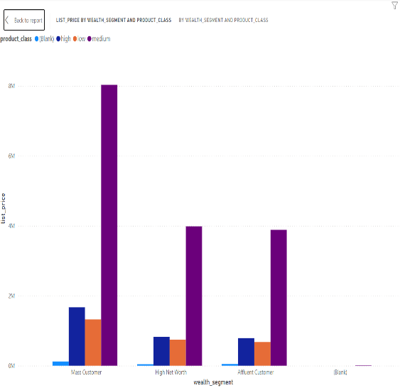
Note: The data and information in this document is reflective of a hypothetical situation and client. This document is to be used for KPMG Virtual Internship purposes only.
Data Exploration
Basic understanding of dataset
Most customers stay at 40-50 years old
More than 50% are at NSW
Top 2 job industries are Manufacturing and Financial Services
Medium product class takes the most percentage of revenue in all wealth segments, especially in Mass customer.

Slide 6
Note: The data and information in this document is reflective of a hypothetical situation and client. This document is to be used for KPMG Virtual Internship purposes only.
Model Development
Recommended Target Audience
1. Primary filters:
State: NSW
Gender: Female and Male
Age: 40-60 years old
Job Industry: Manufacturing and Financial Services
Wealth Segment: Mass Customer
2. Secondary filters:
State: VIC
Job Industry: Health
Age: 60-70

Slide 7
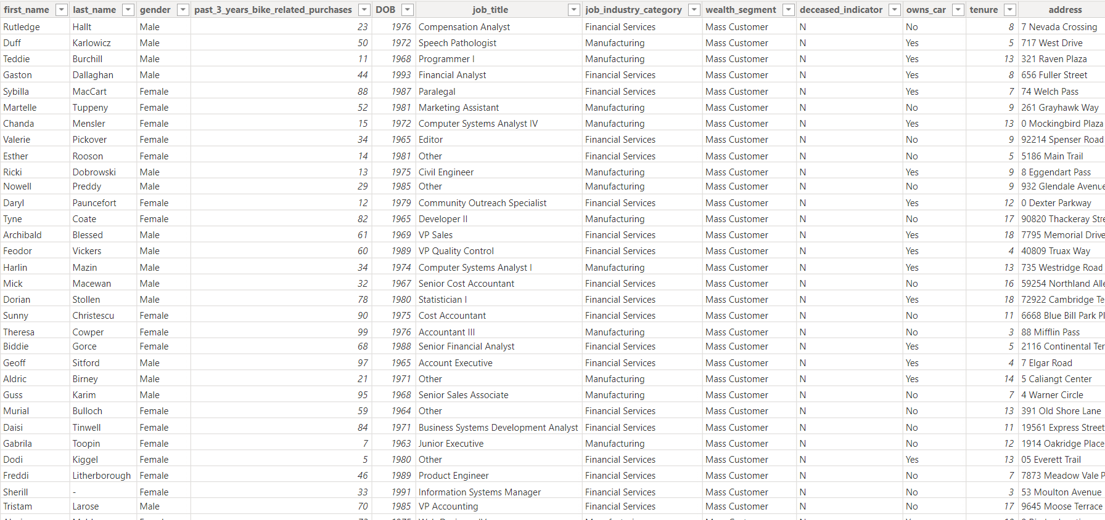
Note: The data and information in this document is reflective of a hypothetical situation and client. This document is to be used for KPMG Virtual Internship purposes only.
Interpretation
Summary table for the high value customers to target
After applying the filters in the last phases, we have a list of potential customer
Try to focus on this list and come back with results to double check this hypothesis

Slide 8
Note: The data and information in this document is reflective of a hypothetical situation and client. This document is to be used for KPMG Virtual Internship purposes only.
Appendix

