Slide 1
Real-Time Motion & Face Detection with HTML Logging
A Lightweight Cybersecurity Surveillance System using OpenCV
Team Members:
1. Vishakha Ghadage
2. Supriya Thamke
3. Manasi Jagtap

Slide 2
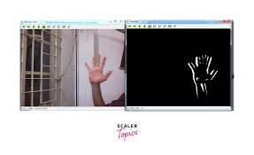

Slide 3
Introduction
Cybersecurity requires constant surveillance and monitoring.
• Traditional systems are resource-intensive and costly.
• Our system provides a real-time, lightweight, offline-compatible solution.

Slide 4
Problem Statement
Traditional systems are resource-heavy.
• Lack of immediate feedback or offline logging.
• Requirement for a cost-effective, local surveillance system.

Slide 5
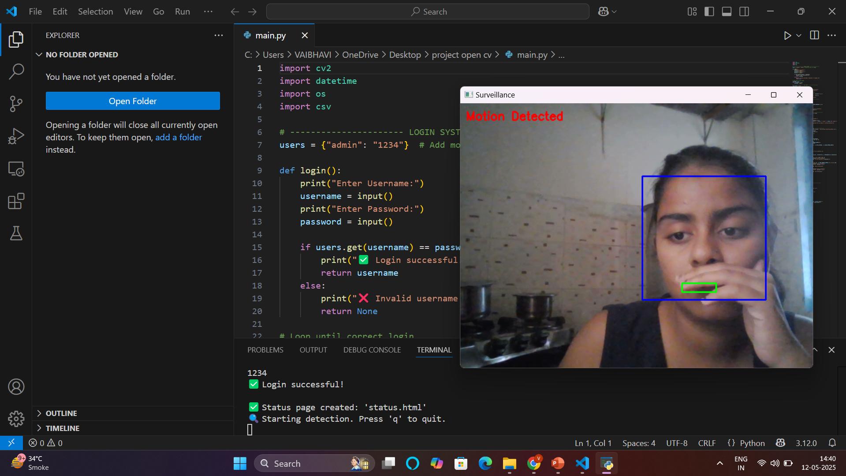

Slide 6
Proposed System
Login Authentication
• Motion Detection using Frame Differencing
• Face Detection using Haar Cascade Classifier
• Camera Health Check (e.g., black screen detection)
• Local Logging and HTML Status Page Generation

Slide 7
Tools & Technologies
Language: Python 3.10+
• Libraries: OpenCV (Only)
• Platform: Windows OS (Tested)
• No External Web Frameworks or Modules Required

Slide 8
System Architecture
User Login → Camera Feed → Motion Detection
• → Face Detection → Local Logging → HTML Page Output

Slide 9
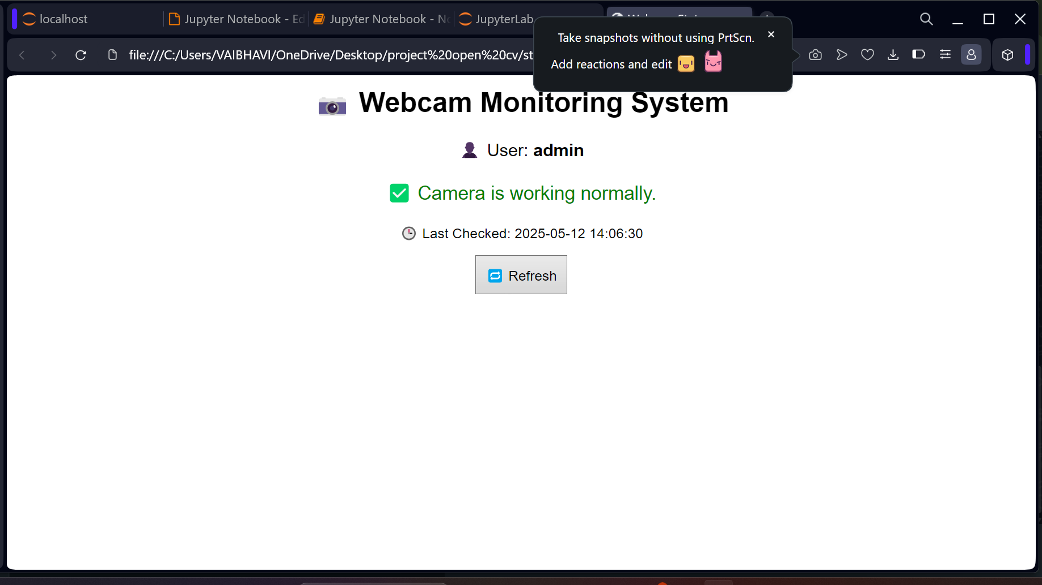

Slide 10
Key Features
Real-time Motion and Face Detection
• Face Bounding Box with Coordinates
• Automatic Log File Creation
• HTML Status Page for Camera Health
• No Internet or Web Framework Required

Slide 11
Demonstration
Login Terminal (Username/Password Prompt)
• Motion Detection (Green Rectangle Overlay)
• Face Detection (Face Bounding Box)
• HTML Status Page Output

Slide 12
Applications & Use Cases
Offline Surveillance in Rural Areas
• Basic Office or Home Security
• Cybersecurity Entry-Point Monitor
• Raspberry Pi Integration Possible

Slide 13
Conclusion & Future Scope
Efficient, Lightweight Monitoring System
• Operates Without Internet or Server
• Future Scope:
• • Email/SMS Alerts
• • Snapshot Saving

Slide 14
Thank You

