Slide 1
Internet of Things (IoT): Security Challenges,
Business Opportunities &Multilayered Method
For End to End Data Communications
BY VISHAL VIMAL KUMAR
ROLL NO-21

Slide 2
INTRODUCTION

Slide 3
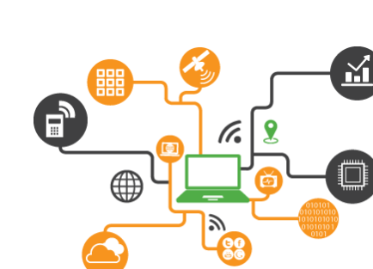
So What Is The Internet Of Things?
Internet of Things (IoT) is an ecosystem of connected physical objects that are accessible through the internet. The ‘thing’ in IoT could be a person with a heart monitor or an automobile with built-in-sensors, i.e. objects that have been assigned an IP address and have the ability to collect and transfer data over a network without manual assistance or intervention. The embedded technology in the objects helps them to interact with internal states or the external environment, which in turn affects the decisions taken.

Slide 4
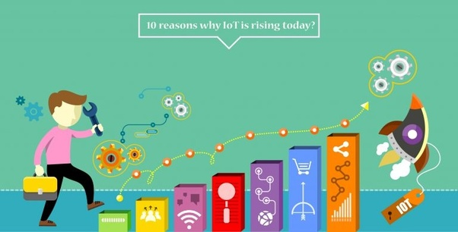
Why IoT?
An article by Ashton published in the RFID Journal in 1999 said, “If we had computers that knew everything there was to know about things - using data they gathered without any help from us - we would be able to track and count everything, and greatly reduce waste, loss and cost. We would know when things needed replacing, repairing or recalling, and whether they were fresh or past their best. We need to empower computers with their own means of gathering information, so they can see, hear and smell the world for themselves, in all its random glory.” This is precisely what IoT platforms does for us. It enables devices/objects to observe, identify and understand a situation or the surroundings without being dependent on human help.

Slide 5
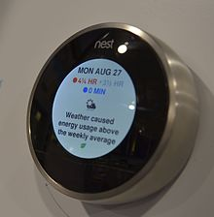
Applications of IOT
Consumer applications
A growing portion of IoT devices are created for consumer use, including connected vehicles, home automation, wearable technology (as part of Internet of Wearable Things (IoWT)]), connected health, and appliances with remote monitoring capabilities.
A Nest learning thermostat reporting on energy usage and local weather

Slide 6
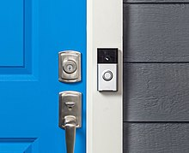
Smart home
IoT devices are a part of the larger concept of home automation, which can include lighting, heating and air conditioning, media and security systems. Long-term benefits could include energy savings by automatically ensuring lights and electronics are turned off.
A smart home or automated home could be based on a platform or hubs that control smart devices and appliances. For instance, using Apple's HomeKit, manufacturers can have their home products and accessories controlled by an application in iOS devices such as the iPhone and the Apple Watch. This could be a dedicated app or iOS native applications such as Siri. This can be demonstrated in the case of Lenovo's Smart Home Essentials, which is a line of smart home devices that are controlled through Apple's Home app or Siri without the need for a Wi-Fi bridge. There are also dedicated smart home hubs that are offered as standalone platforms to connect different smart home products and these include the Amazon Echo, Google Home, Apple's HomePod, and Samsung's SmartThings Hub. In addition to the commercial systems, there are many non-proprietary, open source ecosystems; including Home Assistant, OpenHAB and Domoticz.
A Ring doorbell connected to the Internet

Slide 7
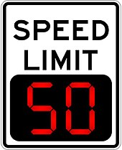
Transportation
The IoT can assist in the integration of communications, control, and information processing across various transportation systems. Application of the IoT extends to all aspects of transportation systems (i.e. the vehicle, the infrastructure, and the driver or user). Dynamic interaction between these components of a transport system enables inter- and intra-vehicular communication, smart, smart parking, electronic toll collection systems, logistics and fleet management, vehicle control, safety, and road assistance
Digital variable speed-limit sign.

Slide 8
Objective
To explains the concept of Internet of Things (IoT), its characteristics, explain security challenges, technology adoption trends and multi-layered method for securing data transport from a cellular connected Internet of Things device to a host through a cellular network.

Slide 9
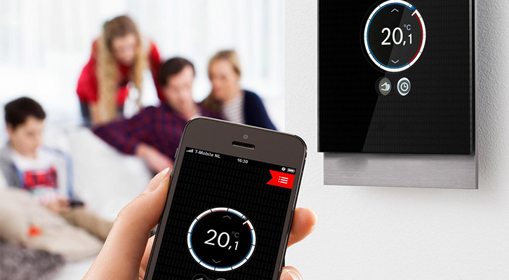
IoT Security Challenges
1. Insufficient testing and updating
Most of these devices and IoT products don’t get enough updates while, some don’t get updates at all.This means that a device that was once thought of as secure when the customers first bought it becomes insecure and eventually prone to hackers and other security issues.
IoT manufacturers, however, are more eager to produce and deliver their devices as fast as they can, without giving security too much of a thought.
Unfortunately, most manufacturers offer firmware updates only for a short period of time, only to stop the moment they start working on the next headline-grabbing gadget. Even worse, they use unsupported legacy Linux kernels.
This leaves their trusted customers exposed to potential attacks as a result of outdated hardware and software.
To protect their customers against such attacks, each device needs proper testing before being launched into the public and companies need to update them regularly.

Slide 10
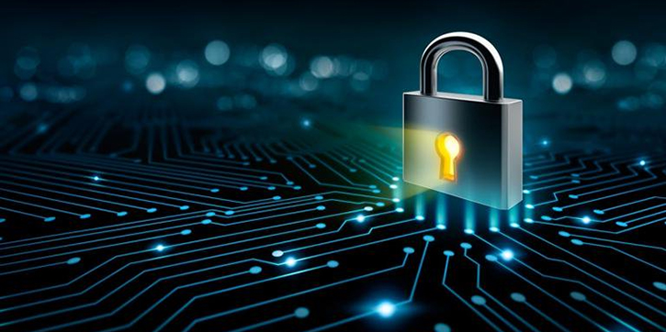
2. IoT malware and ransomware
As the number of IoT connected devices continues to rise in the following years, so will the number of malware and ransomware used to exploit them.
While the traditional ransomware relies on encryption to completely lock out users out of different devices and platforms, there’s an ongoing hybridization of both malware and ransomware strains that aims to merge the different types of attack.
The ransomware attacks could potentially focus on limiting and/or disabling device functionality and stealing user data at the same time.
The webcam can then be locked and footage funneled to an infected web address which could extract sensitive data using the malware access point and demand ransom to unlock the device and return the data.

Slide 11
3. Data security and privacy concerns (mobile, web, cloud)
Commonly, all this user-data is shared between or even sold to various companies, violating our rights for privacy and data security and further driving public distrust. We need to set dedicated compliance and privacy rules that redact and anonymize sensitive data before storing and disassociating IoT data payloads from information that can be used to personally identify us. Cached and no longer needed data should then be disposed of securely.
If the data is stored, then the largest challenge is in compliance with various legal and regulatory structures.
Secure development of mobile app and web-based IoT applications can be quite difficult for small companies with limited budgets and manpower.
Unless you want to risk a major breach of security and ruin your brand authority and trustworthiness, then you might want to consider going through a directory of mobile and web development companies and find the best one to help you iron out the kinks that come with multi-layered data management and its security.

Slide 12
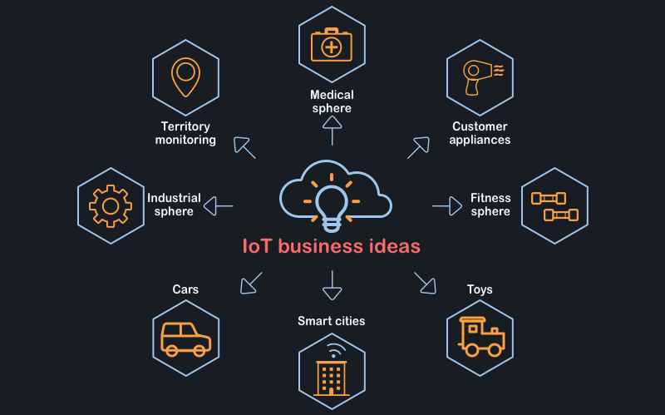
IOT business opportunities
There are so many IoT business ideas which you can use to build your business or a startup with that it would probably need a book to be written to describe all of them. That's why we choose 5 of the most promising and innovative Internet of things business opportunities. Here they are:

Slide 13
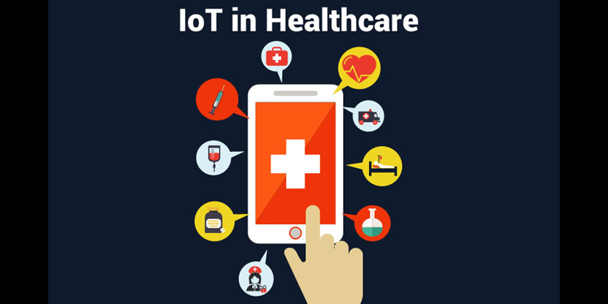
1. Medical and fitness spheres
Fitness wearables are not new to us and it seems that they are connected to the Internet as they communicate with our smartphones. But IoT goes further. A fit bracelet connected with the IoT system can do much more. The easiest and the most obvious ability of such devices is to pass data about your heartbeat to a medical establishment or to a doctor in an emergency occasion. If we add IoT technologies here along with modern devices we can reduce the average time a person spends on a visit dramatically, starting with making an appointment (the task can be easily performed by your smartphone even without your supervision) to leaving a hospital.

Slide 14
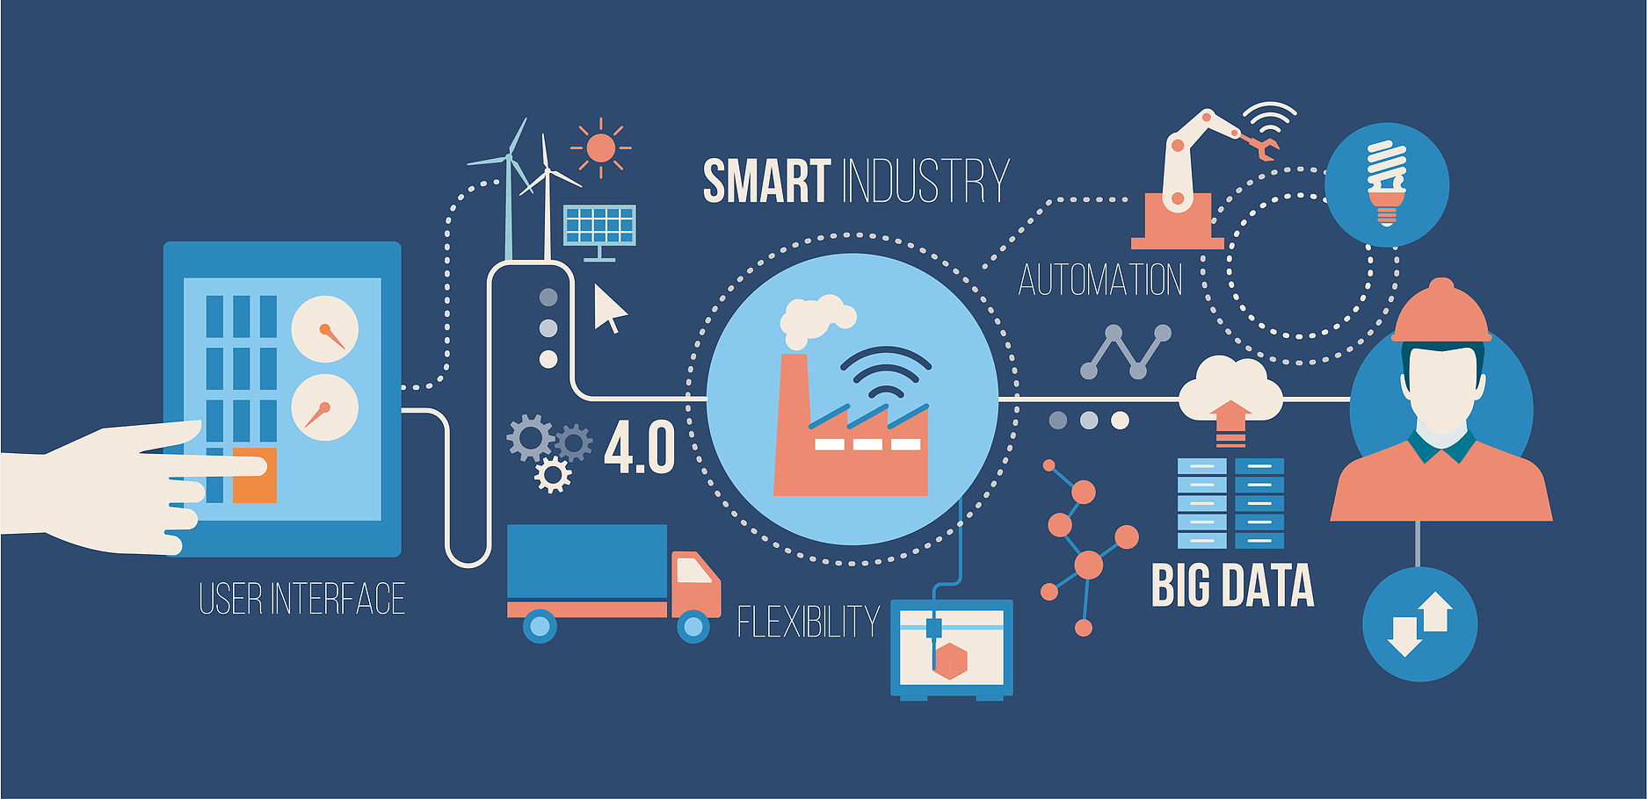
2. Industrial internet of things
If you don't have an idea for your business here's a tip for you - think about a common problem in a workplace and try to think of its solution with the help of IoT technologies. In such a case your business idea would be easily sold. For instance, a problem which we've already mentioned - breakage detection. As well as that, various sensors which help collect environmental metrics to optimize workflow.

Slide 15
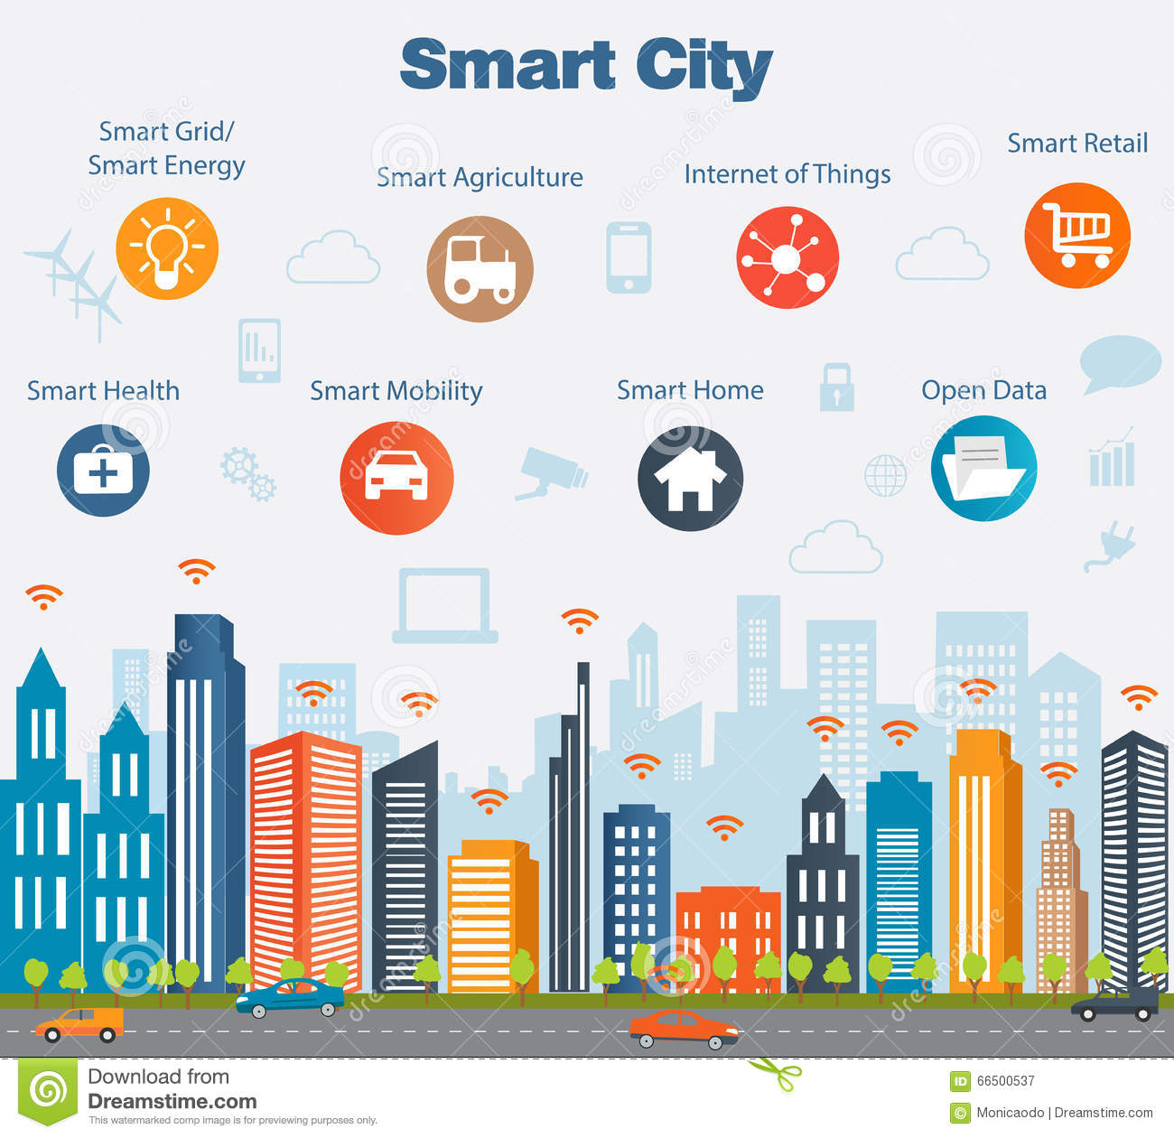
3. Smart cities
This is a vast sphere where you can easily implement everything that you like. The best part is that the niche is almost empty so you have every chance to become a pioneer. Solar roads: They are reusable and removable panels made of cheap materials. The panels use solar energy and have lots of advantages. For instance, they can warn drivers about obstacles and animals on the road. They have led lights that improve the visibility, can be used as a carriageway marking and help control traffic.

Slide 16
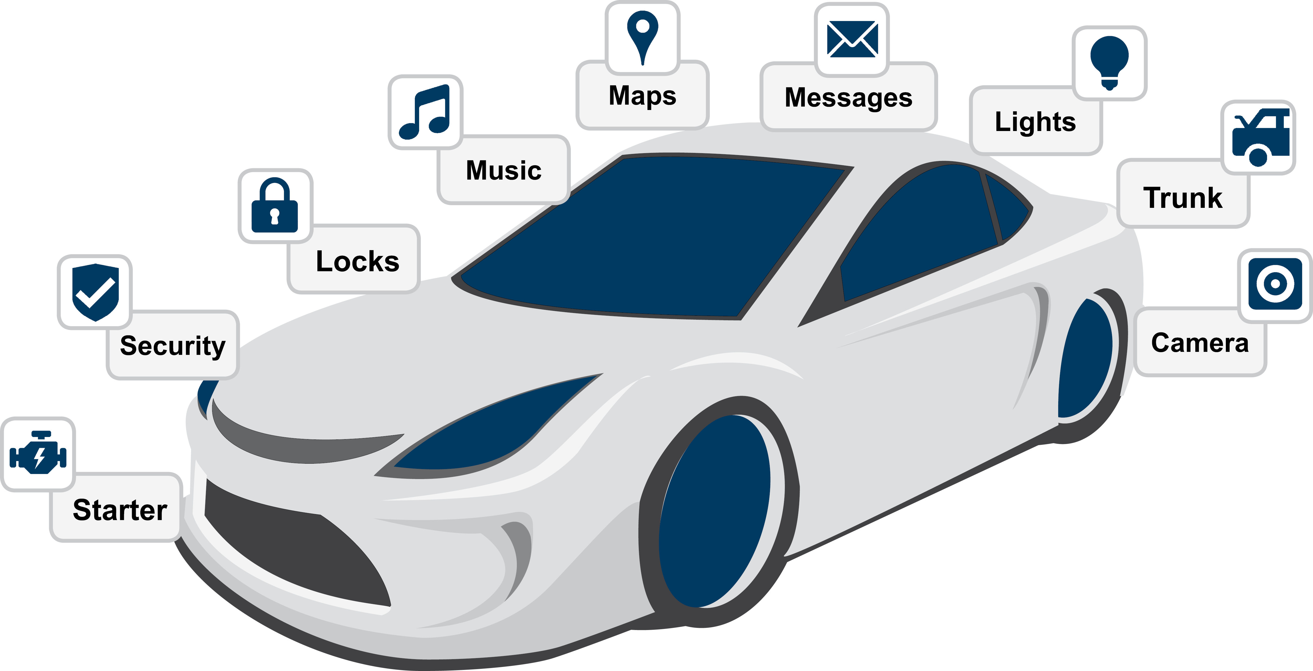
4.Cars
Nowadays the biggest and the most urgent problem of all car owners is security. Security when a driver is in a car and when he or she isn't. Multiple built-in sensors can easily identify a driver defining such parameters as weight, height and arm length. If these parameters don't match the IoT car locks itself immediately. As well as that, sensors can also improve security on the road, when a driver is in a car. Simple distance measurements between cars can save lots of lives.

Slide 17
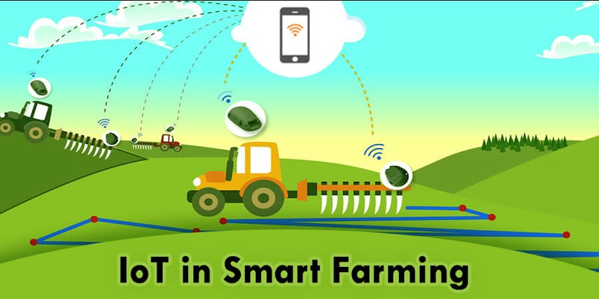
5. Territory IoT monitoring
In farming, IoT devices can do lots of tasks. They can measure the soil humidity and control the water supply. They can control how ripe fruit and vegetable are and inform the farmer about harvesting time and so on. Smart approaches reduce costs and advances forecasts, planning and harvesting processes

Slide 18
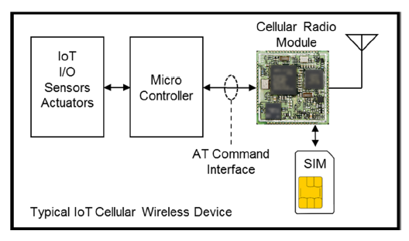
SIM-BASED AUTHENTICATION AND KEY AGREEMENT
The first critical element of the secure architecture is the subscriber identifier module (SIM). The SIM’s basic function is to protect authentication keys from being compromised

Slide 19
Approach
1)Smarter Analytics
More number of inter-connected devices means more data and applying analytics on all aspects of the business will provide an opportunity to improve strategy and the customer
experience. For example, Intel IoT Platforms solutions generate actionable information by running analytics software on data for industrial, retail, automotive industries etc.

Slide 20
2) Enhanced Security
The smart doorbells and surveillance systems will help identify & recognize the person which will boost security
3) Increased Productivity
IoT will facilitate optimal utilization of resource and time. For example if a printer is running low on ink, it will order more on its own & save precious time. And it will send notification if printer machine is not working properly.

Slide 21
4) Smart Inventory
Businesses will be able to trace goods in the supply chain with Internet-connected inventory. It will provide enhanced in-transit visibility.
5) Safer Travel
The Internet-connected cars can a better sense of real time traffic conditions and vehicle diagnostics which will make travel safer.
6) Real time demand visibility
The tightly coupled warehouse & order system provides better real time demand visibility.

Slide 22
CONCLUSIONS
According to research firm International Data Corporation (IDC) the fast growth of cloud and Internet connected devices is expected to boost IoT market. The Internet of Things (IoT) market is expected to hit $7.1 trillion by 2020.
The Vision Mobile Q1 2018 Developer Economics survey data reveals that 53% of mobile developers are working on Internet of Things (IoT) projects. And global population for Internet of Things (IoT) developer's is set to top 4.5 million by 2020.
The only way to make profit in the Internet of Things (IoT) market is to create unique value on top of commodity hardware, connectivity and cloud services. The major markets within the Internet of Things (IoT) field are smart homes and wearable devices.
This project also has set forth a multi-tiered solution for securely establishing end-to-end TCP/IP based Internet of Things communications over UMTS/LTE cellular-based networks.

Slide 23
REFERENCES
[1] Gartner Says a Thirty-Fold Increase in Internet-Connected Physical
Devices by 2020 Will Significantly Alter How the Supply Chain Operates,http://www.gartner.com/newsroom/id/2688717
[2] IBM Connects “Internet of Things” to the Enterprise, http://www03.ibm.com/press/us/en/pressrelease/46453.wss
[3] IDC: 30 Billion Autonomous Devices By 2020,https://securityledger.com/2013/10/idc-30-billion-autonomous-devicesby-2020/
[4] Seize New Product and Revenue Opportunities with the Internet of Things, http://www.cisco.com/web/solutions/trends/iot/portfolio.html
[5] Forecast: The Internet of Things, Worldwide,2013,https://www.gartner.com/doc/2625419/forecast-internet-thingsworldwide-

