Slide 1
Distributed Dataset
Statistics using MPI
Sequential and parallel computation of basic statistics
PGC Review Project | Lab Evaluation
Name / Team members: add your details here

Slide 2
1. Problem Definition and Objectives
• Calculate the sum, average, minimum, and maximum of a dataset.
• Implement a sequential baseline and an MPI-based parallel version.
• Divide dataset indices among processes to distribute computation.
• Combine partial results with MPI_Reduce.
• Measure execution time for different dataset sizes and process counts.
Distributed Dataset Statistics using MPI
2

Slide 3
2. MPI Parallel Design
1
Initialize MPI
MPI_Init
4
Compute local
sum, min, max
2
Discover rank
and process count
5
Combine with
MPI_Reduce
3
Assign each process
a portion of indices
6
Rank 0 computes average
and prints results
Only process 0 prints the global statistics.
Distributed Dataset Statistics using MPI
3

Slide 4
3. Algorithm and Implementation
Sequential algorithm
Parallel algorithm
• Initialize statistics.
• Visit each generated value.
• Update sum, minimum, and maximum.
• Compute average = sum / N.
• Partition indices among MPI processes.
• Compute local statistics.
• Reduce sum with MPI_SUM.
• Reduce minimum with MPI_MIN.
• Reduce maximum with MPI_MAX.
Generated values repeat from 1 to 1000: value = (index % 1000) + 1
Distributed Dataset Statistics using MPI
4

Slide 5
4. Experimental Setup
• Environment: Windows, GCC, Microsoft MPI, Python, Matplotlib.
• Dataset sizes: 100,000; 1,000,000; and 5,000,000 values.
• MPI process counts: 1, 2, and 4.
• Five timing trials were recorded for 1M and 5M values.
• One timing trial was recorded for each 100K configuration.
• Statistics were validated against the expected generated values.
Distributed Dataset Statistics using MPI
5

Slide 6
5. Mean MPI Runtime and Speedup
Dataset size | Processes | Mean time (s) | Speedup
100,000 | 1 | 0.000621 | 1.00x
100,000 | 2 | 0.000775 | 0.80x
100,000 | 4 | 0.001219 | 0.51x
1,000,000 | 1 | 0.004306 | 1.00x
1,000,000 | 2 | 0.001759 | 2.45x
1,000,000 | 4 | 0.001261 | 3.41x
5,000,000 | 1 | 0.015383 | 1.00x
5,000,000 | 2 | 0.007572 | 2.03x
5,000,000 | 4 | 0.004244 | 3.62x
Speedup is relative to the one-process MPI run for the same dataset.
Distributed Dataset Statistics using MPI
6

Slide 7
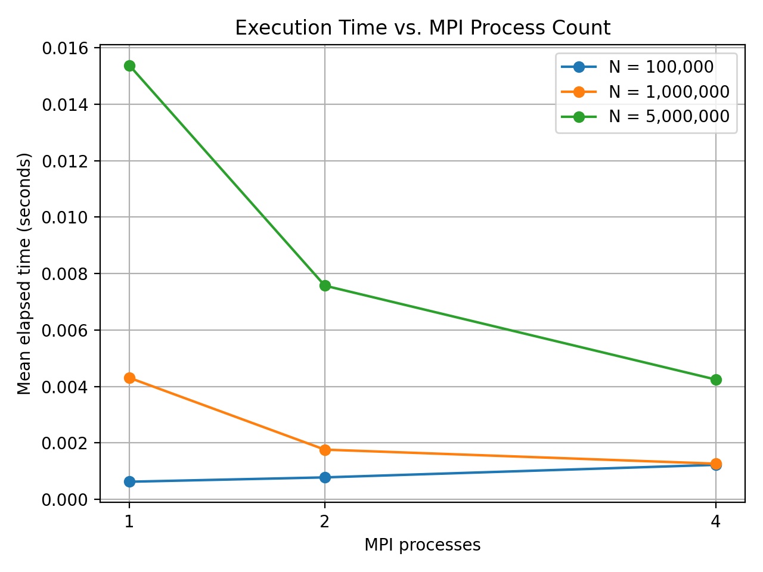
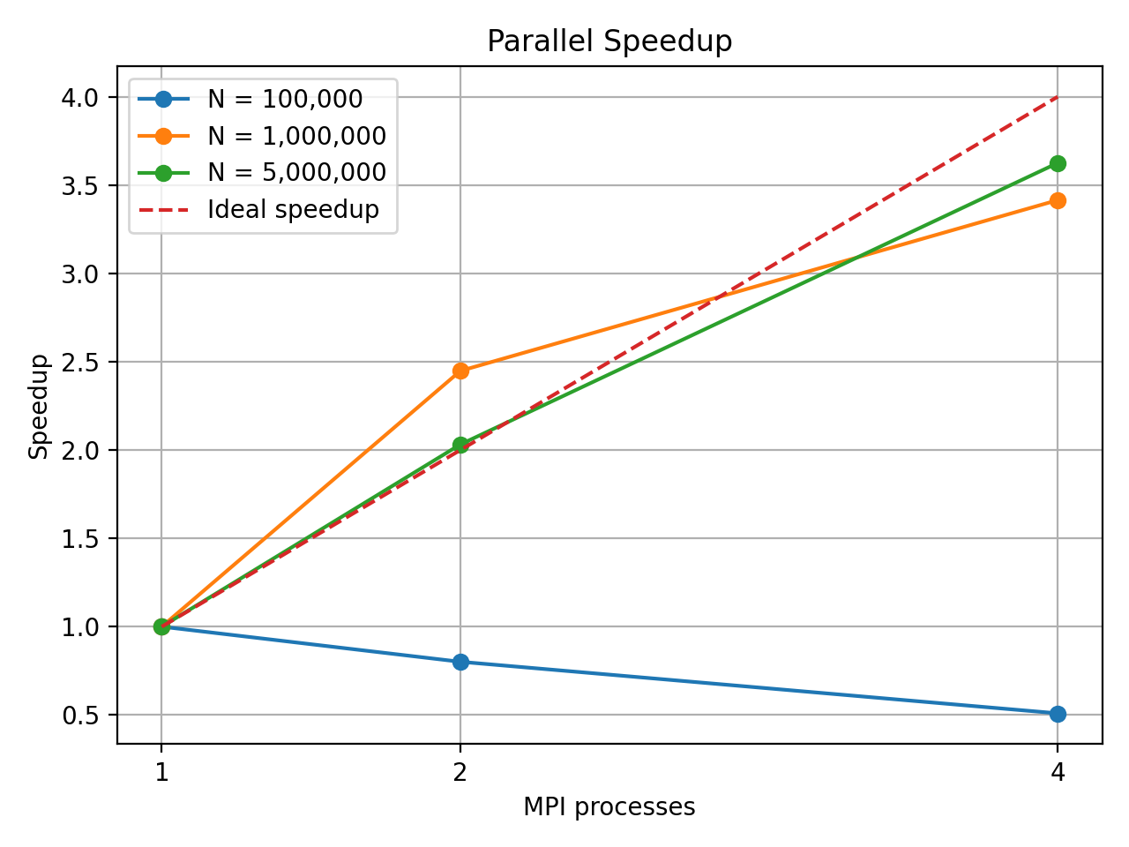
6. Performance Graphs
Mean execution time
Parallel speedup
Distributed Dataset Statistics using MPI
7

Slide 8
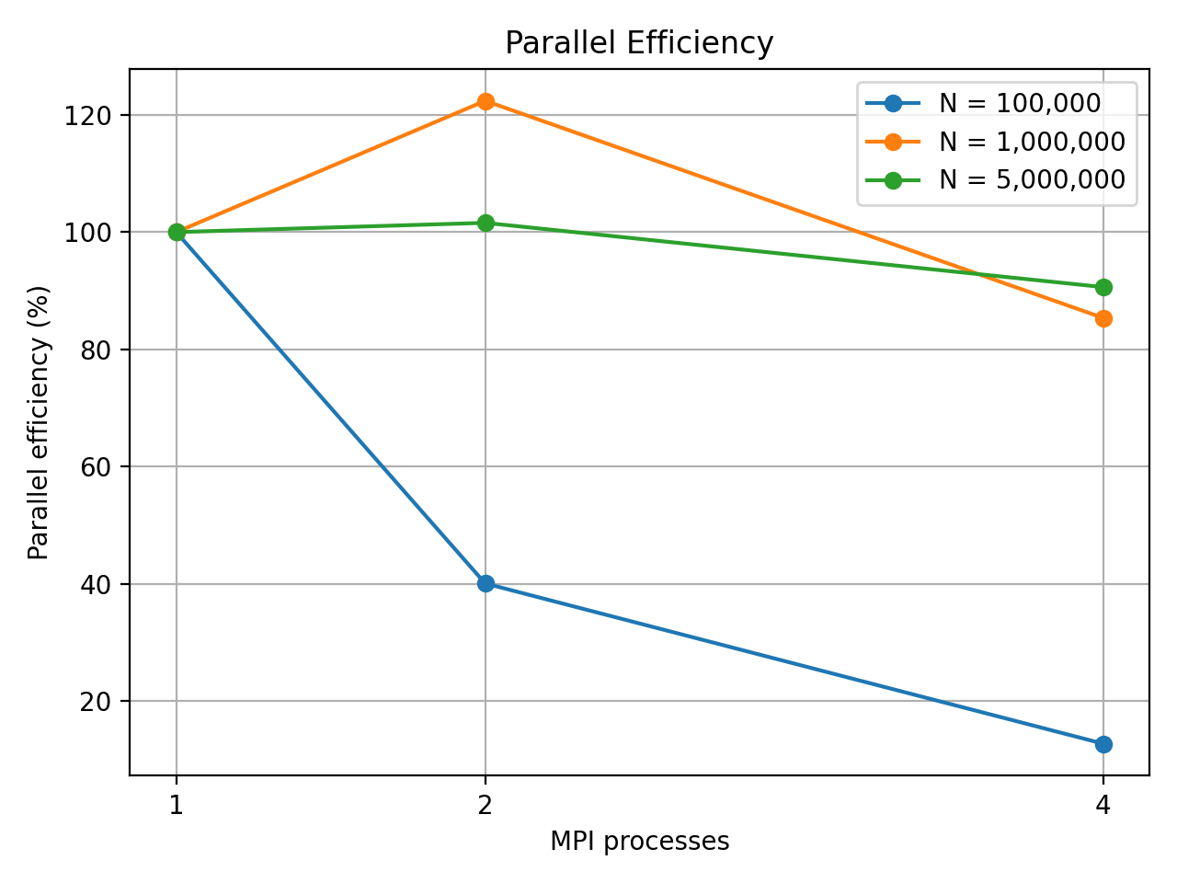
7. Efficiency and Interpretation
Key observations
• For 100K values, more processes did not improve runtime.
• For 1M and 5M values, four processes had the lowest measured mean runtime.
• Small timing values and system scheduling create variability.
• One 100K trial per configuration limits confidence.
Results are preliminary; additional repeated trials would improve reliability.
Distributed Dataset Statistics using MPI
8

Slide 9
8. Conclusion and Demonstration
• The MPI program computes sum, average, minimum, and maximum correctly.
• The workload is distributed and local results are combined with MPI_Reduce.
• Larger tested datasets benefited from additional processes in the recorded runs.
• MPI overhead can outweigh parallel gains for small workloads.
• Demo: compile, then run the MPI program with 1, 2, and 4 processes.
Compile: mpicc src\mpi_statistics.c -o mpi_statistics.exe
Run: mpiexec -n 4 mpi_statistics.exe 1000000
Distributed Dataset Statistics using MPI
9

