Slide 1
INFO 5082: SEMINAR IN RESEARCH AND RESEARCH METHODOLOGY
Prof: Dr. Angel Durr

Slide 2
FAKE NEWS DETECTION
By
Vishnu Boddeboina
Anvesh Veeramalla
Vamsi Malla

Slide 3
Introduction:
There is so much information online that it is becoming impossible to decipher the truth from the false. Thus, this leads to the problem of fake news. Although the classification of a text/news as fake or genuine is a challenging task given the diversity of content and source, it can be worth researching.
As this is a potential problem on the digital media and doesn’t have a correct solution yet, conducting research on this topic would give us exposure to many data science concepts, starting from background research, data collection, cleaning, analysis, applying the machine learning algorithms, validating the existing models, and visualizing the results. Existing state of art models are using machine learning models with NLP. We are planning to ensemble these machine learning models.

Slide 4
The main purpose of the research project is to detect fake news. So, we are going to follow the entire data science project life cycle, starting from identifying the right data, extracting data, data preprocessing, applying NLP algorithms to text cloud, and interpreting the results.
Data analysis different textual properties which can be used to distinguish fake contents from real contents, by using those properties, we can train a combination of different machine learning algorithms using various ensemble methods using scikit libraries using python.

Slide 5
Dataset
We have collected the data from Kaggle website. One can access the data from the below link. https://www.kaggle.com/competitions/fake-news/data
It consist of two types of datasets which are train.csv and test.csv
train.csv: A full training dataset with the following attributes:
id: unique id for a news article title: the title of a news article author: author of the news article text: the text of the article; could be incomplete label: a label that marks the article as potentially unreliable
1: unreliable
0: reliable
test.csv: A testing training dataset with all the same attributes at train.csv without the label.

Slide 6
RESEARCH DESIGN AND Methodologies:
There are many layers of work involved in detecting fake news. We will start checking the source of the content, headline of the content, body text of the content, and image/video of the content. Mainly, fake news uses specific language in order to attract the readers, and this news sticks to a different language and moral formal. We will use different textual properties which can be used to distinguish fake contents from real contents. With the help of those properties, we can train a combination of different machine learning algorithms using various ensemble methods using scikit libraries using python. Below are the algorithms which may use in our research project. Fake news needs to be analyzed that what features are used to classify.

Slide 7
Algorithms used:
Natural Language Tool Kit (NLTK)
Logistic Regression
Support Vector Machine Algorithm
Naïve Bayes Algorithm
TF-IDF
Random Forest Algorithm
Ensemble learners

Slide 8
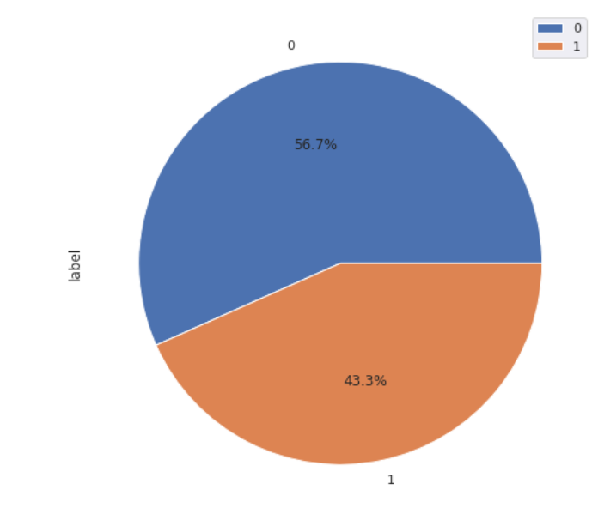
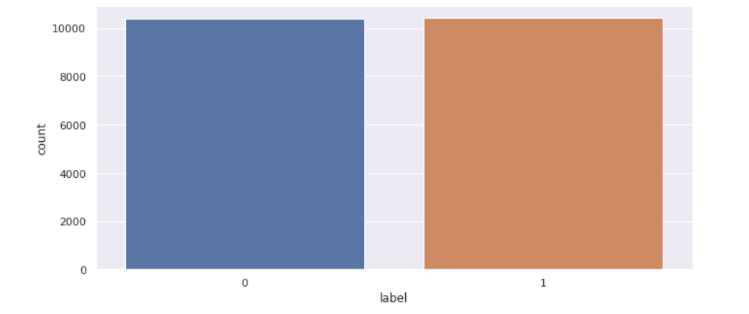
DATA ANALYSIS:
Frequency distribution of the true and fake news:

Slide 9
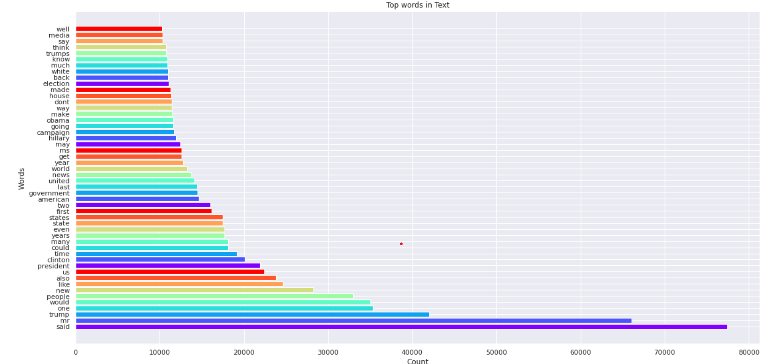
DATA ANLAYSIS:
Words that repeated mostly in the news:

Slide 10
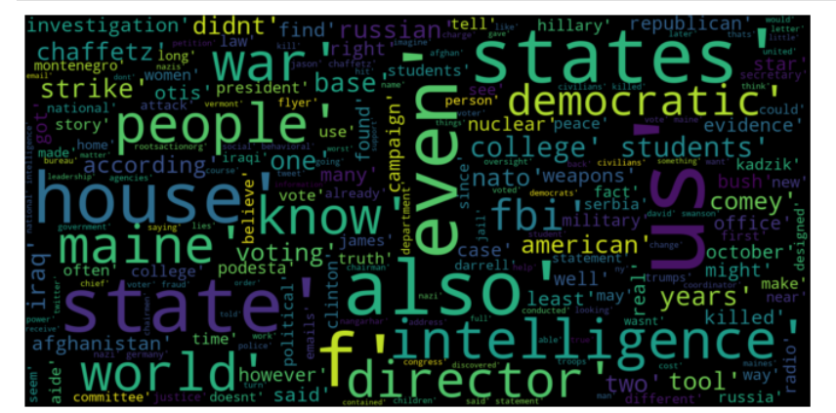
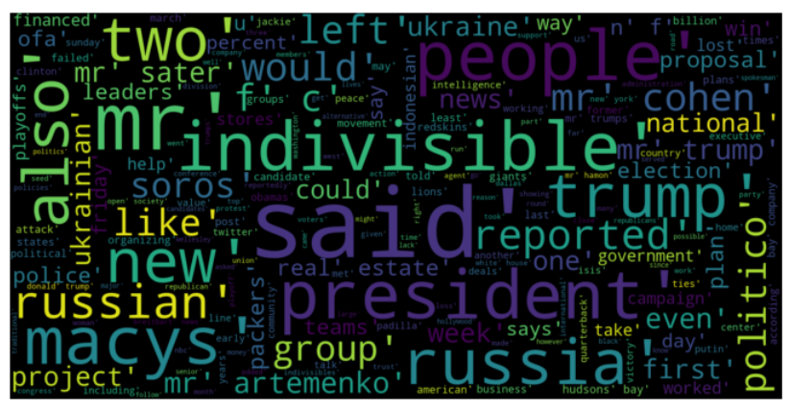
DATA ANLAYSIS:
Words cloud in the true and fake news:
True News
Fake news
There are many similar words in both, so this shows that there is some distinguishing feature between most real and fake news titles, and including titles in our analysis

Slide 11
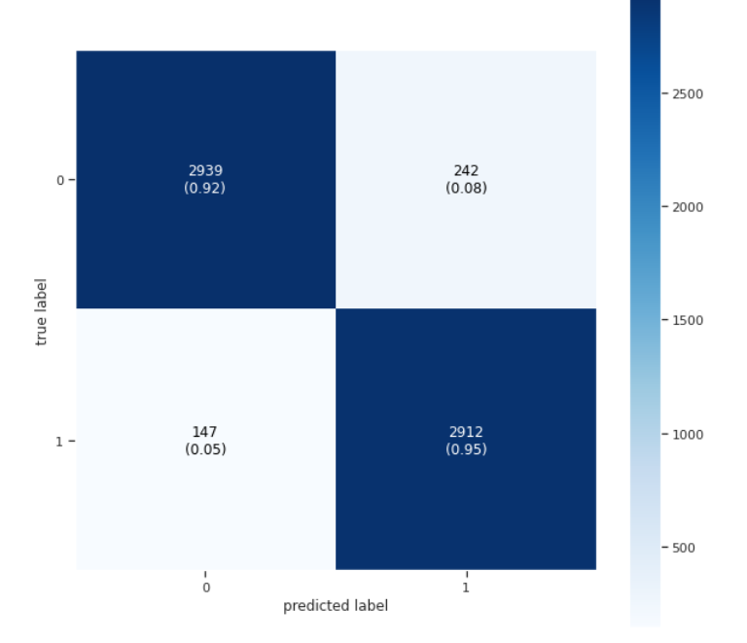
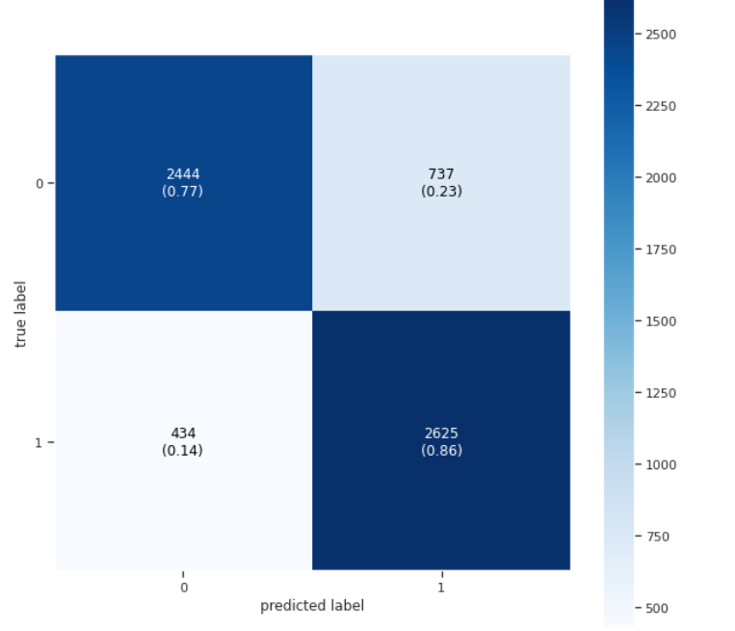
DATA ANLAYSIS:
Support vector Machine Algorithm confusion Matrix:
Naïve Bayes Algorithm confusion Matrix:

Slide 12
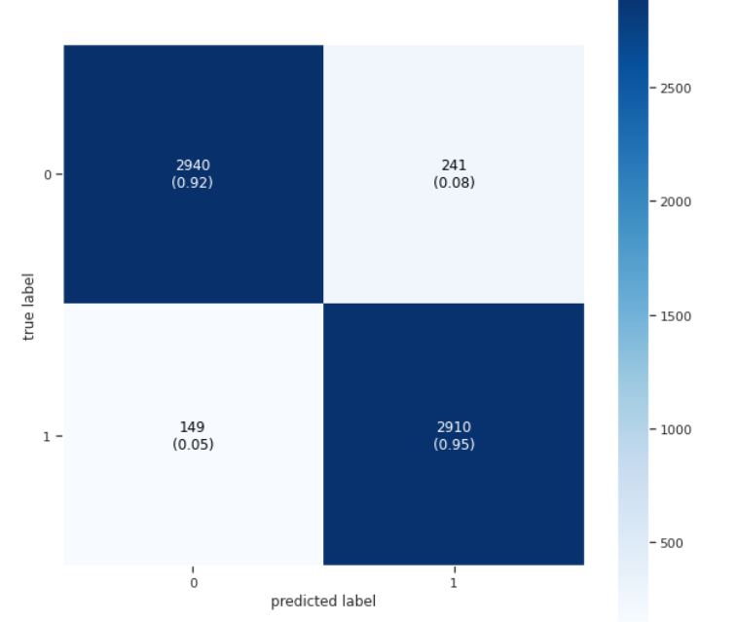
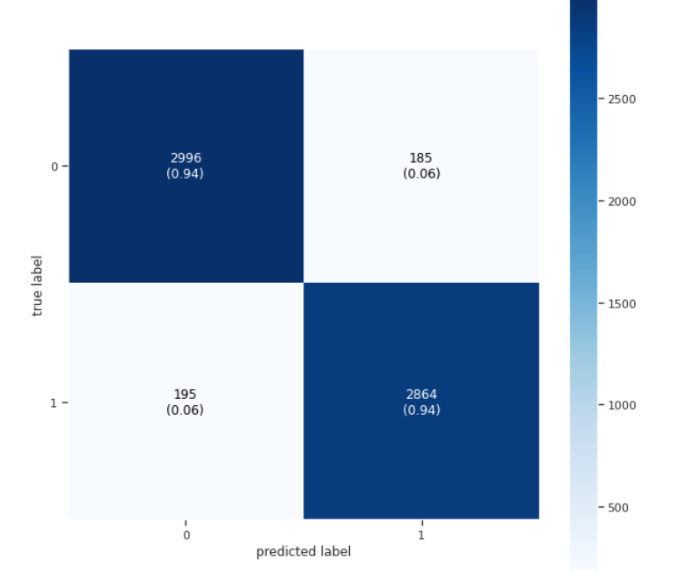
DATA ANLAYSIS:
Logistic Regression confusion Matrix:
Ensemble Technique confusion Matrix:

Slide 13
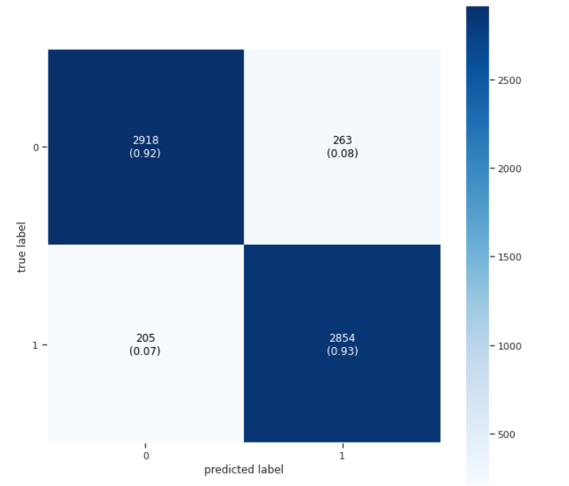
DATA ANLAYSIS:
Random forest confusion Matrix:

Slide 14
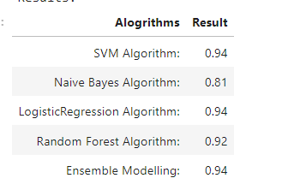
DATA ANLAYSIS:
Comparing all the algorithm results:

Slide 15
References:
Iftikhar Ahmad, Muhammad Yousaf, Suhail Yousaf, Muhammad Ovais Ahmad, "Fake News Detection Using Machine Learning Ensemble Methods", Complexity, vol. 2020, Article ID 8885861, 11 pages, 2020. https://doi.org/10.1155/2020/8885861
Junaed Younus Khan, Md. Tawkat Islam Khondaker, Sadia Afroz, Gias Uddin, Anindya Iqbal,A benchmark study of machine learning models for online fake news detection,Machine Learning with Applications,Volume 4,2021,100032,ISSN 2666-8270,https://doi.org/10.1016/j.mlwa.2021.100032. (https://www.sciencedirect.com/science/article/pii/S266682702100013X)
Torabi Asr, F., & Taboada, M. (2019). Big Data and quality data for fake news and misinformation detection. Big Data & Society. https://doi.org/10.1177/2053951719843310
Raza, S., Ding, C. Fake news detection based on news content and social contexts: a transformer-based approach. Int J Data Sci Anal (2022). https://doi.org/10.1007/s41060-021-00302-z
Xichen Zhang, Ali A. Ghorbani, An overview of online fake news: Characterization, detection, and discussion, Information Processing & Management, Volume 57, Issue 2,2020,102025, ISSN 0306-4573, https://doi.org/10.1016/j.ipm.2019.03.004.
Kai Shu, Suhang Wang, and Huan Liu. 2019. Beyond News Contents: The Role of Social Context for Fake News Detection. In Proceedings of the Twelfth ACM International Conference on Web Search and Data Mining (WSDM '19). Association for Computing Machinery, New York, NY, USA, 312–320. https://doi.org/10.1145/3289600.3290994

Slide 16
Thank You

