Slide 1
Weather Forecasting with Ensemble Machine Learning
using Big Data
Group 14:
Kavisha Madani (202318007)
Vishaka Nair (202318041)
Srushti Bhagchandani (202318047)

Slide 2
PROJECT OBJECTIVE:
The objective of our project is to develop an enhanced and reliable weather forecasting technique that utilizes weather data analysis and machine learning techniques.
Specifically, we aim to use Decision Tree, Random Forest, Naive Bayes Bernoulli, K-means clustering, and KNN Algorithm to anticipate weather conditions.
The goal is to improve the accuracy of weather forecasting, especially in remote areas, and provide timely predictions to help plan agricultural activities and mitigate disasters.

Slide 3
PROJECT SCOPE:
Develop a weather forecasting system that uses ensemble methods to improve prediction accuracy.
Utilize weather data analysis and machine learning techniques to predict weather conditions using precipitation, wind speed, humidity, wind direction, air pressure, and temperature.
Implement Decision Tree, Random Forest, Naive Bayes Bernoulli, and KNN Algorithm to analyze and predict weather conditions.

Slide 4
PROJECT DATASET:
https://huggingface.co/datasets/syntaxnoob/weather-prediction-prototype-aws
Train dataset size : 284024 rows
Test dataset size: 31586 rows
Features include : timestamp, air_pressure, relative_humidity, precipitation, wind_speed, wind_direction,air_temperature

Slide 5
DATASET SCHEMA AND DATATYPE:
•timestamp_1: timestamp
•air_pressure_1: double
•air_temperature_1: double
•relative_humidity_1: double
•precipitation_1: double
•wind_speed_1: double
•wind_direction_1: double

Slide 6
APPROACH:
Data Preprocessing
Visualization
Machine Learning Pipeline
Comparison
Comparison with best model resuts.
A series of visualizations including heatmaps for correlation analysis, scatter plots for trend identification, and bar charts for comparative assessments.
Data analysis and exploration.
Data encoding
Training machine learning models using PySpark MLlib.
Evaluation and best model selection

Slide 7
IMPLEMENTATION
The proposed framework has been implemented with all components including pre-processing, EDA, visualization using plots, correlation analysis, feature selection, and ensemble-based evolutionary model building.
The algorithms are implemented using MLlib and PySpark.
The reference of the research paper named: “Weather Forecasting Prediction Using Ensemble Machine Learning for Big Data Applications” is also taken into consideration. This will lead to better prediction of weather forecasting compared to single machine-learning algorithms.

Slide 8
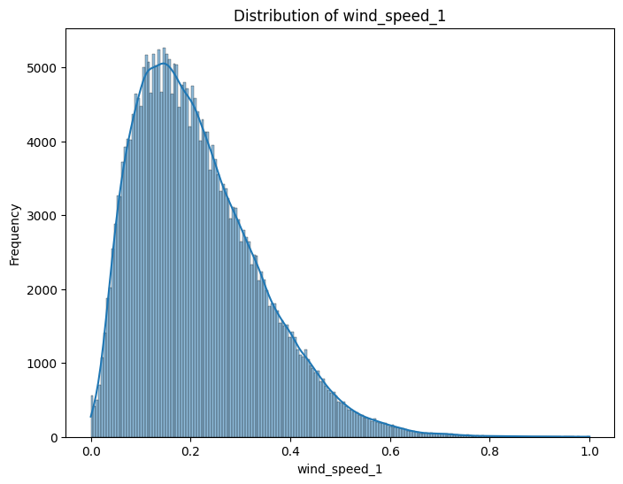
EDA:
The graph highlights the predominance of moderate wind speeds with occasional higher gusts within the dataset.the dataset reveals a unimodal and right-skewed distribution of wind speeds.

Slide 9
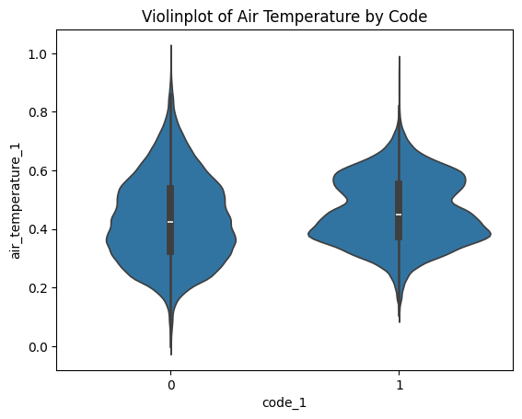
EDA:
This visualization underscores that while the central tendencies of air temperature are similar across categories, there are minor differences in their overall distributions, which could be significant for detailed statistical analysis or operational applications. .

Slide 10
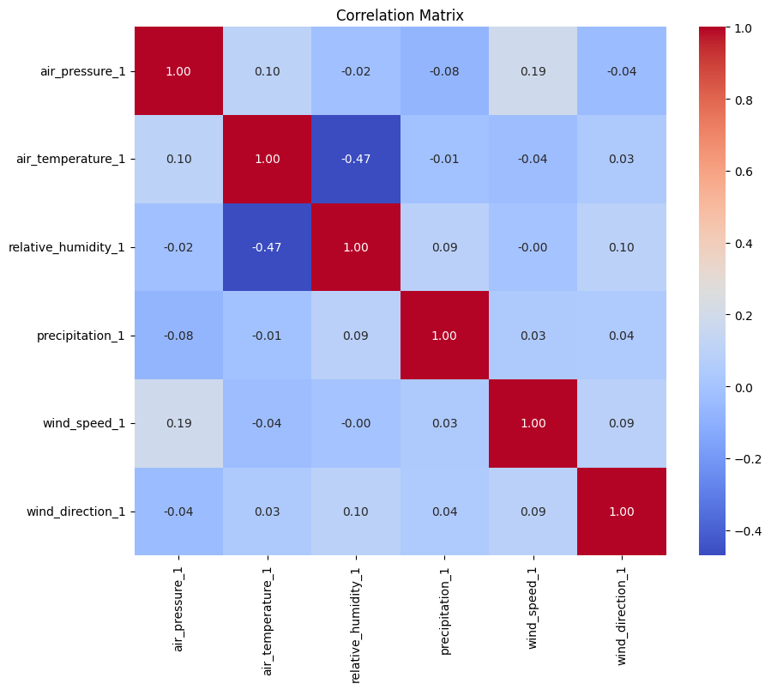
EDA:
The correlation matrix does not show significant relation between any two features apart from air temperature and relative humidity which is moderately negatively correlated.

Slide 11
MACHINE LEARNING PIPELINE:
1. Train and test split
• 70% data for train set.
•30% data for test set.
2.Data Encoding Pipeline
•VectorAssembler
3. Machine Learning Model
Decision Tree
Random Forest
Naïve Bayes
K Means Clustering
KNN
4. Evaluation
•RMSE

Slide 12
Model Descriptions:
Decision Tree: A simple model that makes decisions based on asking a series of questions based on feature values. It's used to predict specific weather conditions like temperature and precipitation from historical data.
2. Random Forest: An ensemble of decision trees that improves prediction accuracy by averaging multiple trees' results. This model is particularly effective in handling the complex patterns in weather data, providing more reliable forecasts.

Slide 13
3. Naive Bayes: A fast and effective probabilistic model that predicts based on the likelihood of an event, using prior knowledge of conditions. It's ideal for classifying weather patterns, such as determining whether a day will be sunny or rainy based on atmospheric conditions.
4. K Means Clustering: A method that groups data into clusters with similar features, often used to discover patterns or groupings in the data. In weather forecasting, it helps identify common weather patterns, aiding in the segmentation of climate zones or typical weather scenarios.

Slide 14
EVALUATION:
Decision Tree
Naive-Bayes:
Best Max Depth: 5
Best Max Bins: 20
Test Error: 0.421588
Test Accuracy: 0.999988221
Random Forest
K-means Clustering:
Test Error = 0.09376134785441982
Silhouette with squared Euclidean Distance: 0.218394

Slide 15
ENSEMBLE METHOD:
Two of many results:
Root Mean Squared Error (RMSE) for air_temperature_1 with features ['hour_2', 'hour_1', 'month_2', 'air_temperature_1', 'air_temperature_2', 'precipitation_1', 'relative_humidity_1', 'day_of_week_1', 'code_1', 'air_pressure_2'] = 0.00804373128970814
Root Mean Squared Error (RMSE) for air_temperature_1 with features ['code_1', 'hour_2', 'hour_1', 'wind_speed_1', 'precipitation_1', 'wind_direction_1', 'air_pressure_2', 'month_1', 'precipitation_2', 'relative_humidity_2'] = 0.05718314529111583
The averageRMSE of ensemble model is: 0.023262440921341533

Slide 16
DATASET LINK:
https://huggingface.co/datasets/syntaxnoob/weather-prediction-prototype-aws
RESEARCH PAPER LINK
https://www.academia.edu/81972605/Weather_Forecasting_Prediction_Using_Ensemble_Machine_Learning_for_Big_Data_Applications

Slide 17
Thank you!
Group 14:
Kavisha Madani (202318007)
Vishaka Nair (202318041)
Srushti Bhagchandani (202318047)

