Slide 1
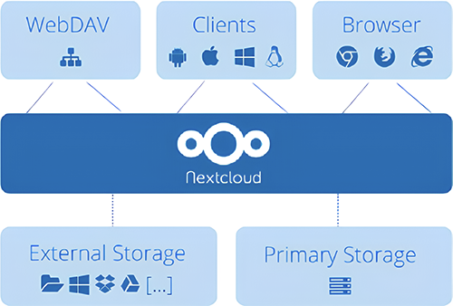
Cloud Based File Storage System via Nextcloud
Nigam Vishal
University of Trieste
July 2024

Slide 2
Objective
Design Choice
Tools and Methodologies
Discussion on Results
Challenges Faced
Scalability
Some thoughts for Improvement!!

Slide 3
1. Design Choice
cost-effective, secure, and flexible solution
full control over data and customization options
use of Docker for deployment ensures consistency, scalability, and efficient resource utilization
Nextcloud and Docker, you gain a powerful combination of open-source innovation and modern containerization technology,
Scalability on Your Terms:
Data Sovereignty and Privacy
Open source and Community Support

Slide 4
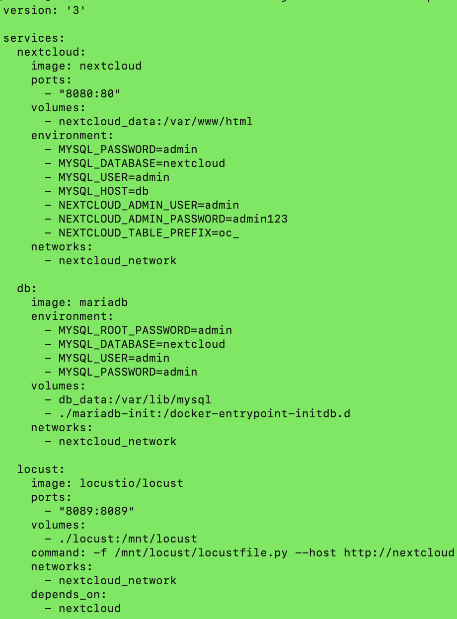
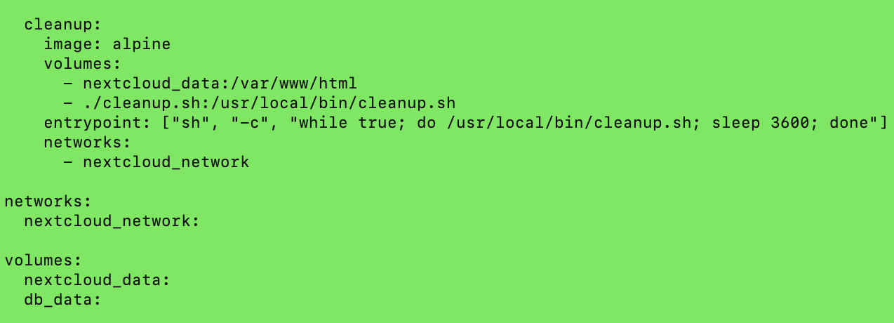
2.Tools &Methods
Docker-compose.yml

Slide 5
Security measures
Enable server-side data encryption
Stronger password requirements
Possibility to enable two factor authentication
docker exec --user www-data cloudbasicproject-nextcloud-1 /var/www/html/occ app:enable encryption
docker exec --user www-data cloudbasicproject-nextcloud-1 /var/www/html/occ encryption:enable
echo "yes" | docker exec -i --user www-data cloudbasicproject-nextcloud-1 /var/www/html/occ encryption:encrypt-all

Slide 6
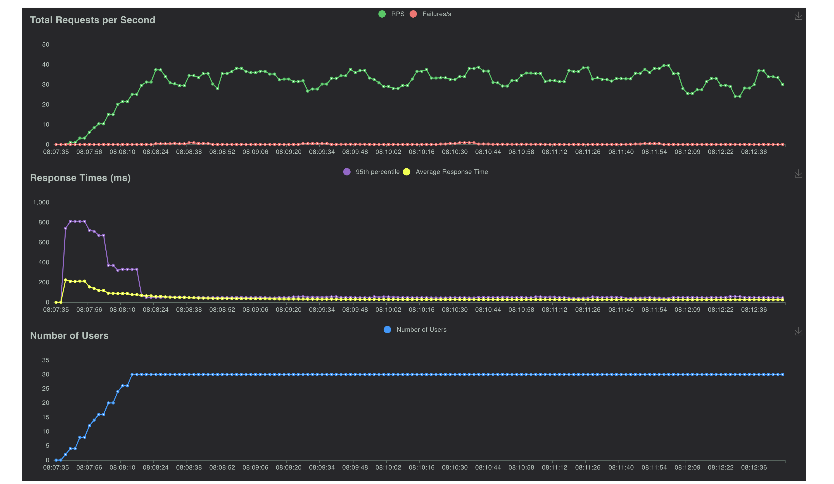
3.Locust Tests
1Mb file Get/Put/Delete (30 users)

Slide 7
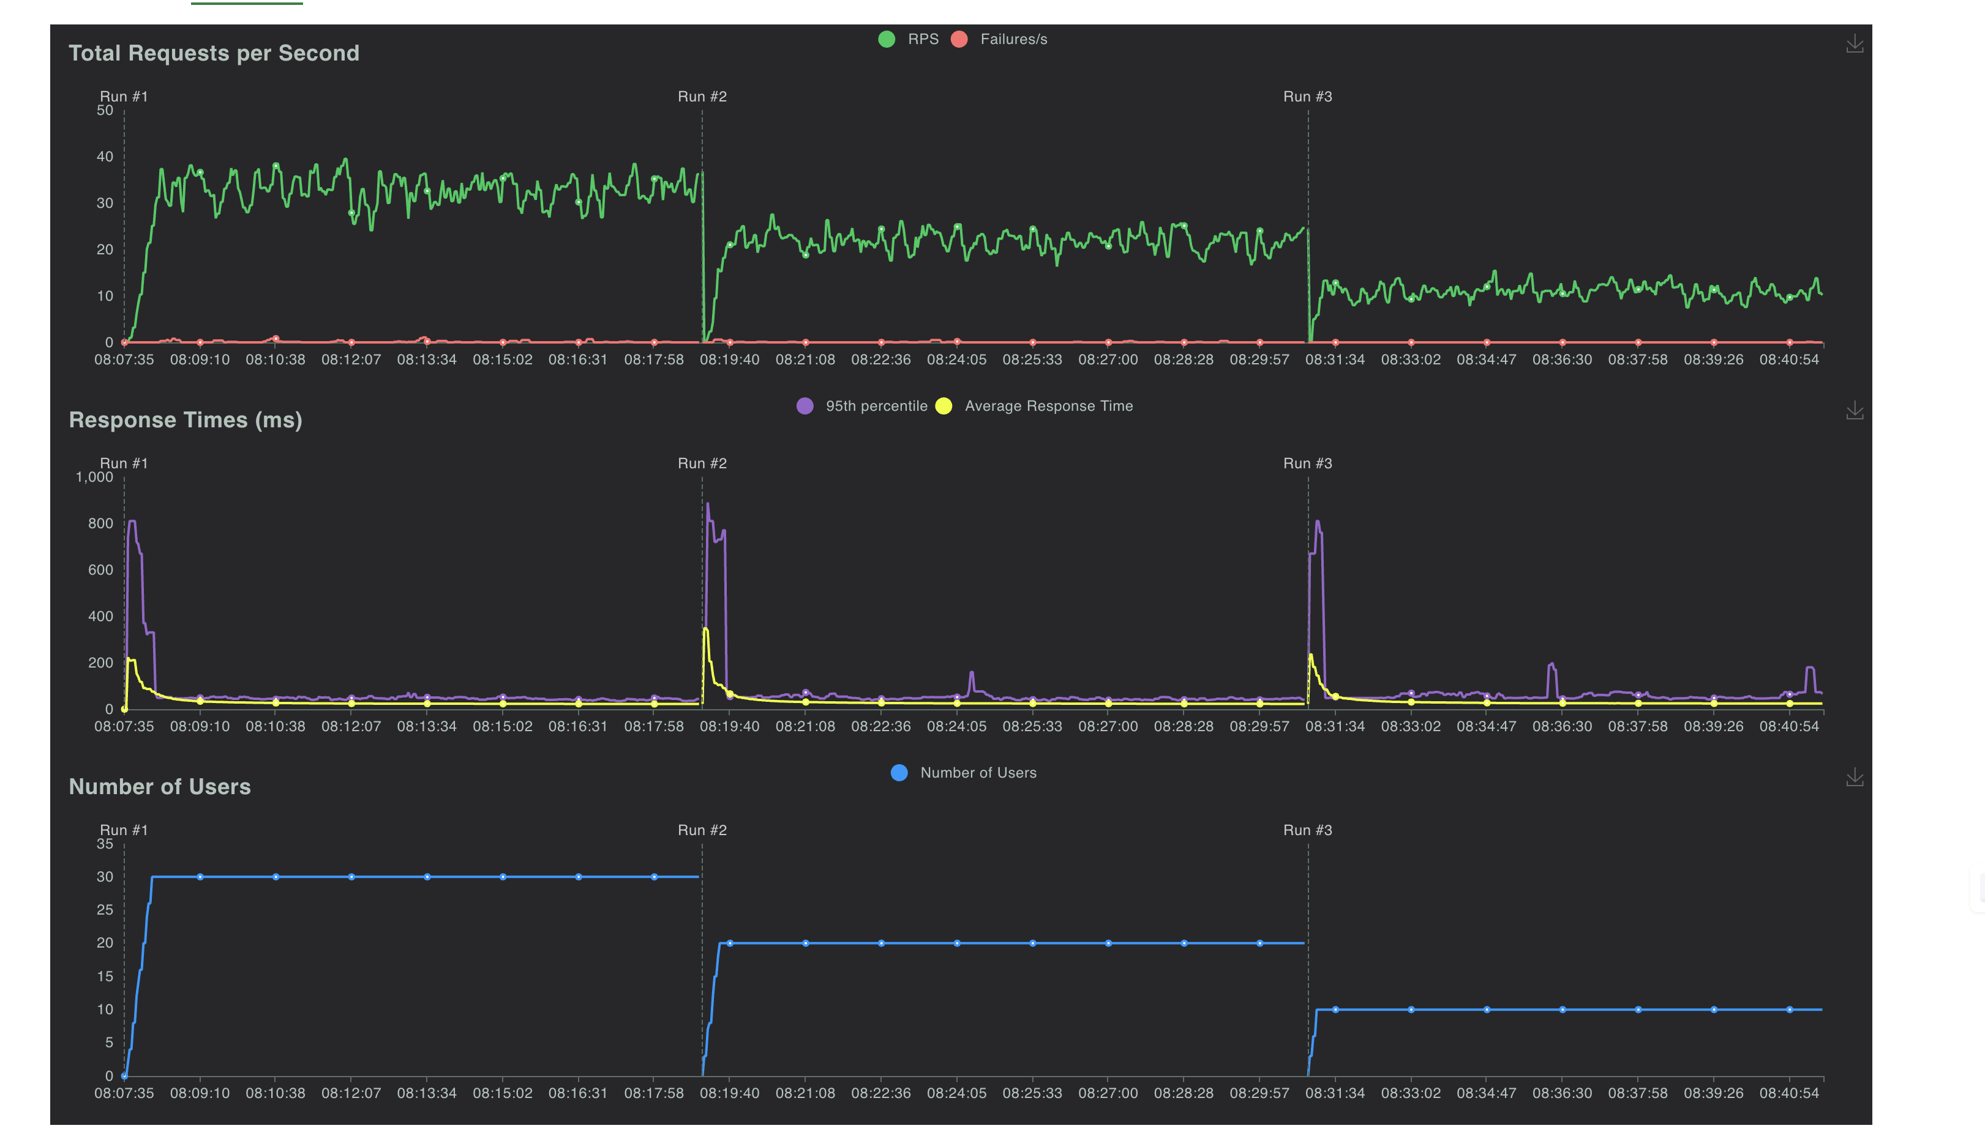
1 mb file comparison between 3 runs(users-30/20/10)

Slide 8
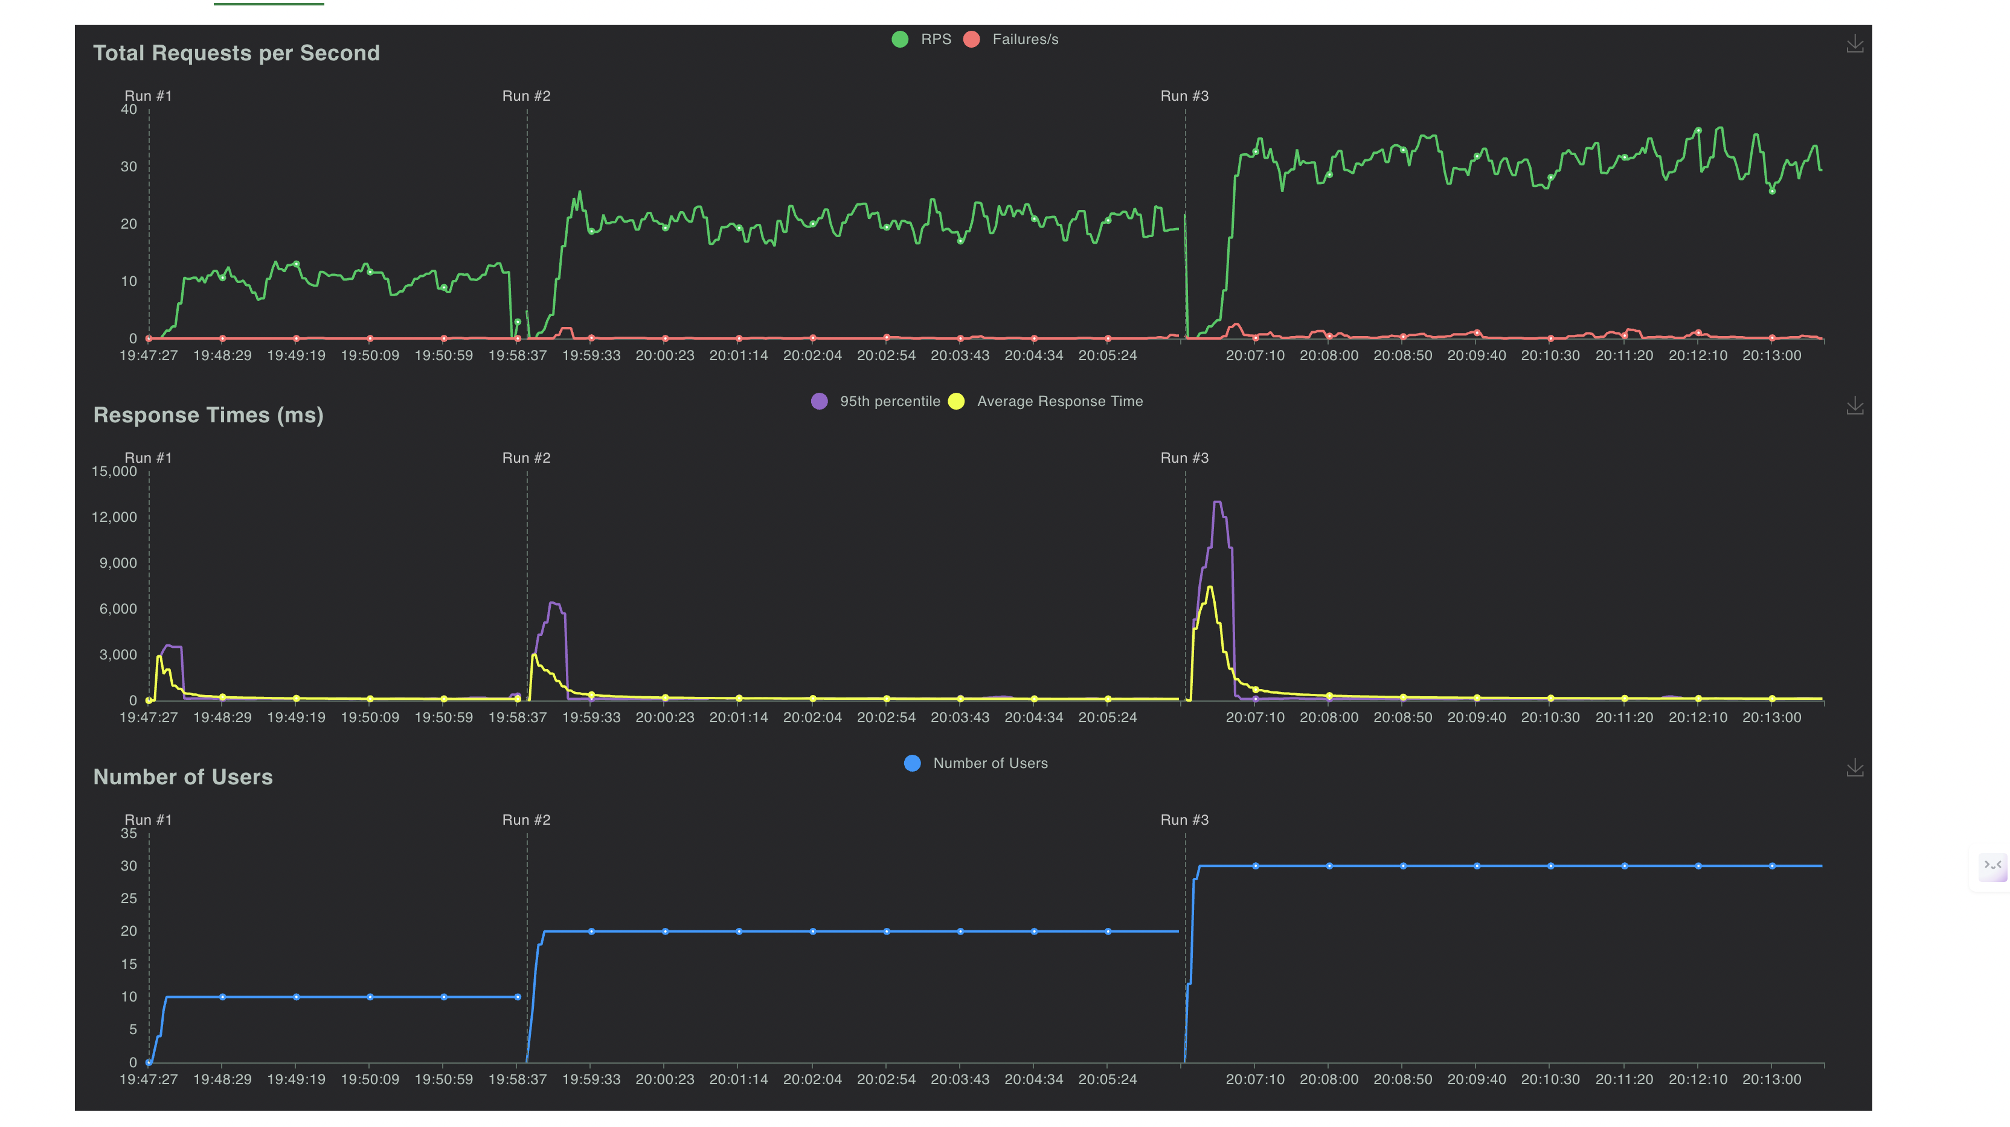
5Mb file across 3 runs(10/20/30 users)

Slide 9
4. Challenges
Container Identification issues
Nginx configuration issues
Locust Testing Challenges-HTTPError('404 Client Error’), HTTPError(‘423 Client Error’)
Storage issues on container side

Slide 10
5.Scalability
Horizontal Scaling
Vertical Scaling
Load Balancing
Caching
Auto Scaling
CDN

Slide 11
6.Future improvements
Use tags for testing different kind of files instead of editing the locust file each time.
Explore options for seamless integration with other cloud services and platforms for different business cases
Consider integrating with dedicated monitoring platforms like Prometheus, Grafana, or ELK Stack for more advanced monitoring and visualization capabilities.

