Slide 1
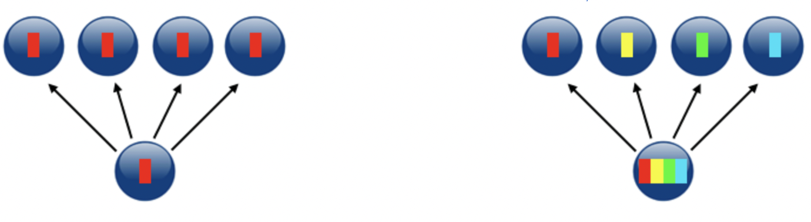
Performance Assessment of MPI Collective Operations
Nigam Vishal
University of Trieste
July 2024

Slide 2
Objective
Performance Comparison of MPI algorithms for below operations:
Broadcast->MPI_Bcast (default,chain,pipeline and binary tree)
Scatter->MPI_Scatter (default,linear,binomial,non-blocking linear)
*Usage of osu benchmark tool to collect latencies of these operations
And analysis of performance model

Slide 3
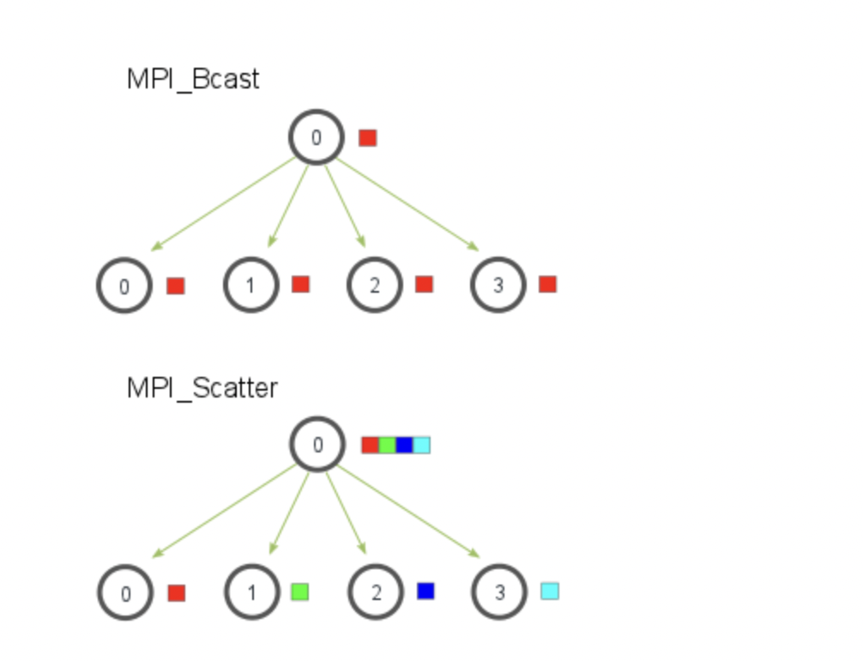
Algorithms

Slide 4
Experimental Plan
ORFEO CLUSTER
CPU ->2 x AMD EPYC 7H12
EPYC partition
2 nodes -> 256 cores
Choice of map by core vs others
Bash script for benchmark data collection for fixed and varying data sizes
Python script for plots and images
Slurm jobs for above 2
Assessment of performance model

Slide 5
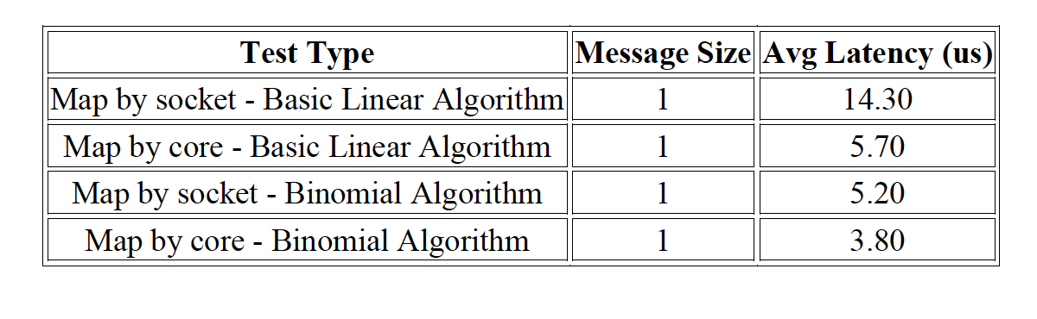
OMB Mapping Policy
Choice of the algorithm significantly influenced the optimal map-by strategy
mpirun --mca coll_tuned_use_dynamic_rules true --mca coll_tuned_${operation}_algorithm $alg_num --map-by core -np $np $MPI_DIR/$EXECUTABLE -m ${sizes[0]} -x $WARMUP_ITERATIONS -i $TOTAL_ITERATIONS

Slide 6
Task-1
Ran algorithms for both broadcast and scatter operations and collected benchmark latencies data for full and fixed benchmark types.
Parameters used:
Message sizes: from 1 to 2¹⁹ bytes
Mapping policy: by core
Number of processes: 2 to 256 step 2
Some Visualizations ahead….

Slide 7
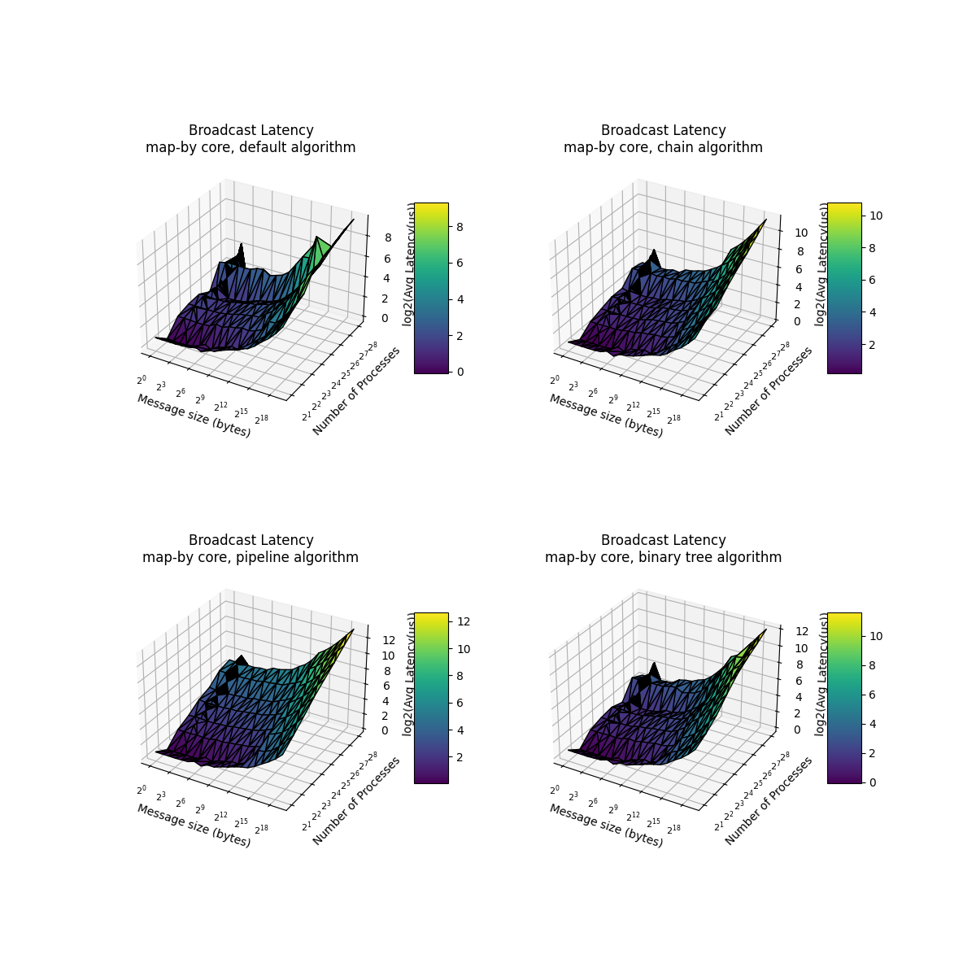

Slide 8
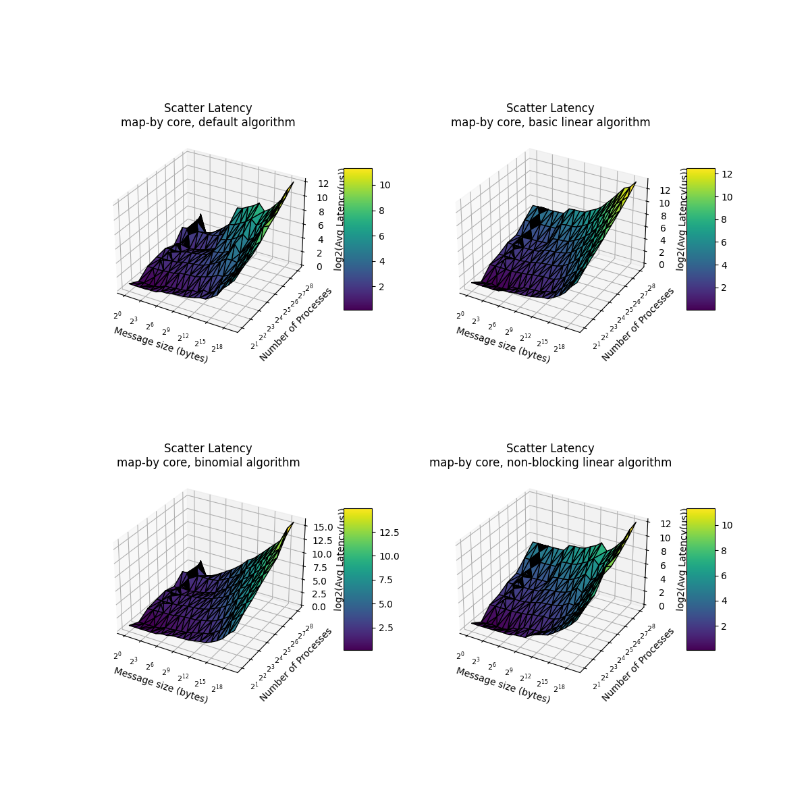

Slide 9
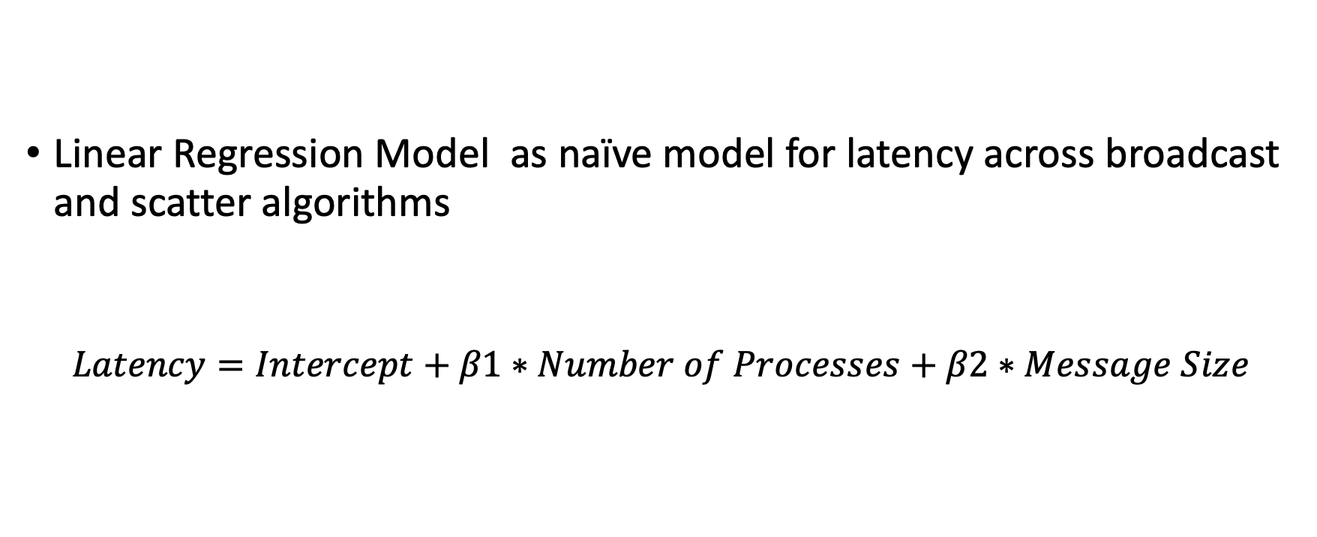
Performance Model
Linear Regression Model as naïve model for latency across broadcast and scatter algorithms
$$Latency=Intercept+β1∗Number of Processes+β2∗Message Size$$

Slide 10
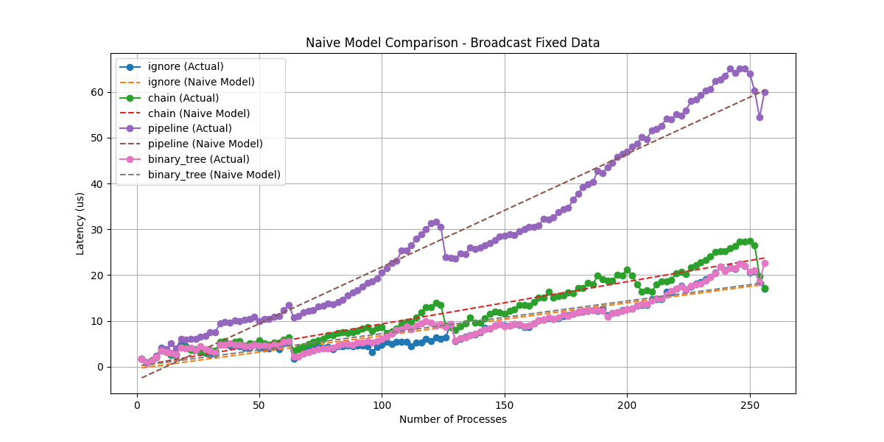

Slide 11
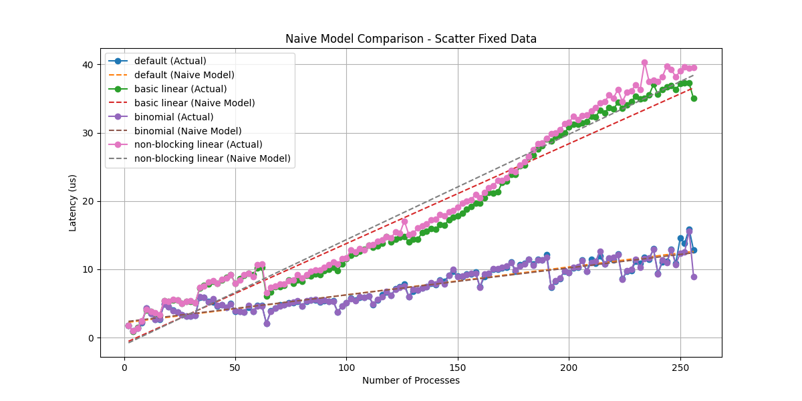

Slide 12
Conclusion
Naive Models: Provide a simplified estimation of latency trends but lack the precision needed for detailed performance predictions.
Actual Data: Shows that real-world performance varies significantly due to additional overheads and optimizations not captured by naive models.
Estimation: The naive models tend to overestimate the latency for both broadcast and scatter operations, especially as the number of processes increases.

