Slide 1
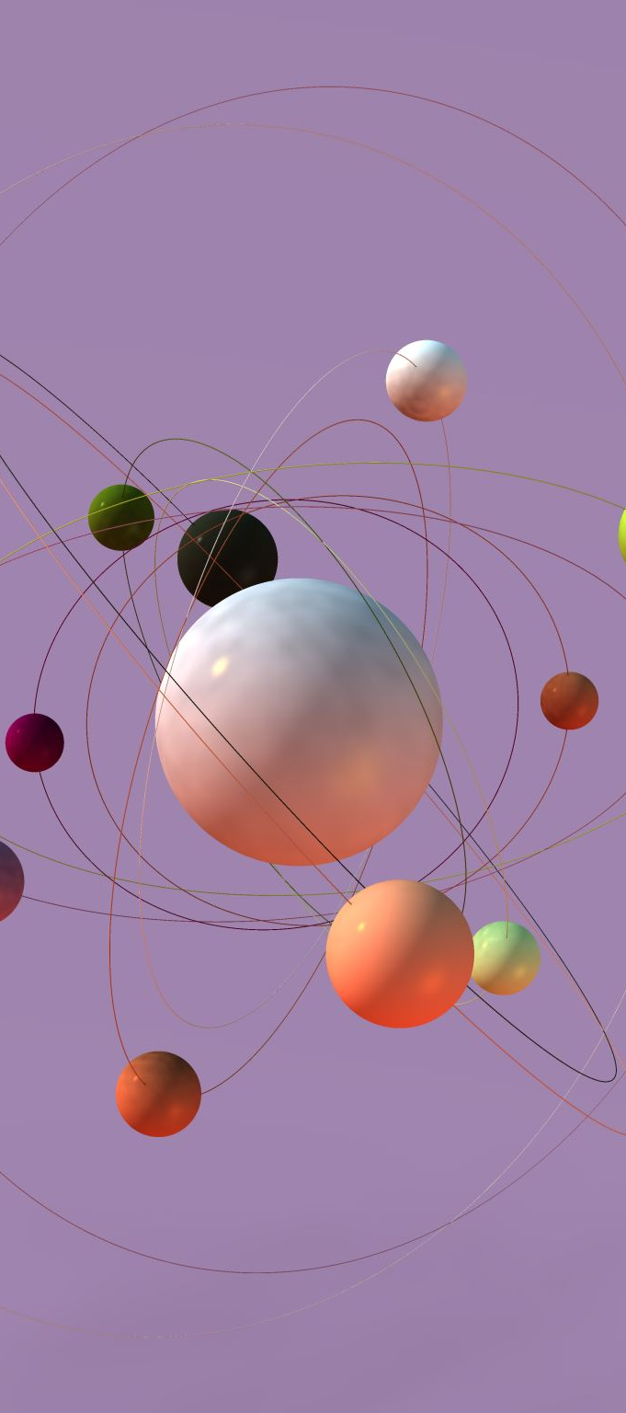
Vector Space Model- IR Project
Vishal Nigam
University of Trieste
SM3800014

Slide 2
Motivation & Objective
Why IR matters: Search engines, recommendation systems, academic search.
My goal: Build a functional IR system using VSM from scratch.
Techniques tested: Multiple retrieval strategies including feedback mechanisms.

Slide 3
Pipeline Overview
Indexing
Query + Pre-processing
Retrieval
Feedback
Evaluation
Load Raw Artifacts

Slide 4
Load Raw Artifacts
Step 1: Document Extraction
Step 2: Query Extraction
Step 3: Relevance Judgments

Slide 5
Indexing
Document Pre-processing: Tokenize & clean 400 Cranfield docs
TF–IDF Computation: TF, DF, IDF, and TF-IDF vectors
Inverted Index: Term → [doc, weight] mappings
Champion Lists: Top-5 docs per term by TF-IDF score
Cluster Pruning: √N leaders + follower assignment (cosine similarity)
Static Quality Scores: Higher score for lower doc numbers
Impact-Ordered Index: Posting lists sorted by term weight
Index Files Saved: All JSON files stored in /index folder

Slide 6
Query + Pre-Processing
1. User Query:
Input query read from .txt file (e.g., query1.txt)
2. Pre-processing Pipeline:
Lowercasing (to normalize casing)
Tokenization (extract alphabetic tokens)
Stop-word Removal (remove common filler words)
Stemming (reduce words to their base/root form)
3. Query Vector Construction:
After pre-processing, each token is mapped to its TF-IDF weight using the idf.json index
Final query vector is formed as a sparse weighted vector aligned with document vector space
Used for cosine similarity in retrieval
4. Final Output:
Cleaned, weighted query vector
Ensures alignment with document vectors for effective matching

Slide 7
Retrieval
Workflow
1.Choose Retrieval Strategy (via method argument)
2.Ranking
Documents are scored and ranked based on cosine similarity or combined scores
Top-k results returned
3.Output:
List of top-k documents with scores
Supports modular evaluation and performance comparison

Slide 8
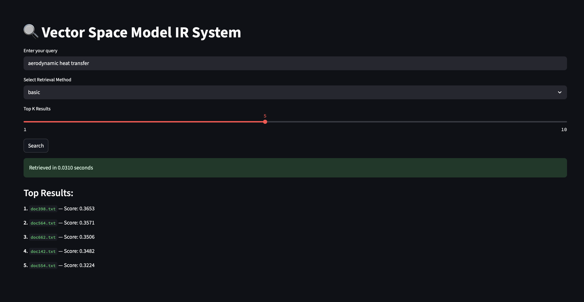
Streamlit App

Slide 9
Feedback
Manual Relevance Feedback using Rocchio Algorithm
Pseudo-Relevance Feedback (Blind Rocchio)

Slide 10
Feedback @Rocchio Algorithm
Objective:
Improve retrieval by modifying the query using user-labled relevant and non-relevant documents.
How It Works:
Original Query Vector
User selects:
Relevant docs
(Optional) Non-relevant docs
Rocchio Formula: with parameters
α=1.0 (original query weight)
β=0.75 (relevant doc boost)
γ=0.25 (non-relevant doc penalty)
Used In:
search_with_feedback() in search.py
Uses rocchio_feedback() from relevance_feedback.py
Key Advantage:
Interactive and user-controlled improvement of query focus

Slide 11
Pseudo Feedback
Objective:
Enhance query automatically by assuming top-ranked documents are relevant.
Procedure:
Run initial search using basic cosine similarity.
Select top k results as pseudo-relevant.
Apply Rocchio update with:
Only relevant component (no user input)
Same formula as manual feedback, but:
Used In:
search_with_pseudo_feedback() in search.py
Internally calls rocchio_feedback() with non_relevant_docs=None
Key Benefit:
No human input required, fully automatic refinement.

Slide 12
PR curve Analysis & Evaluation

Slide 13
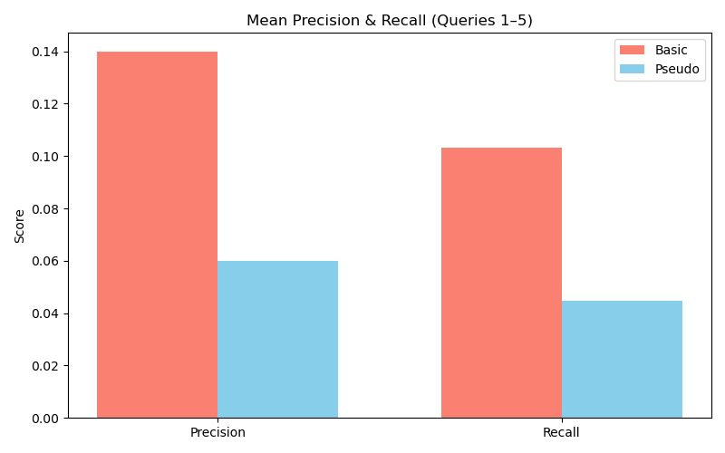
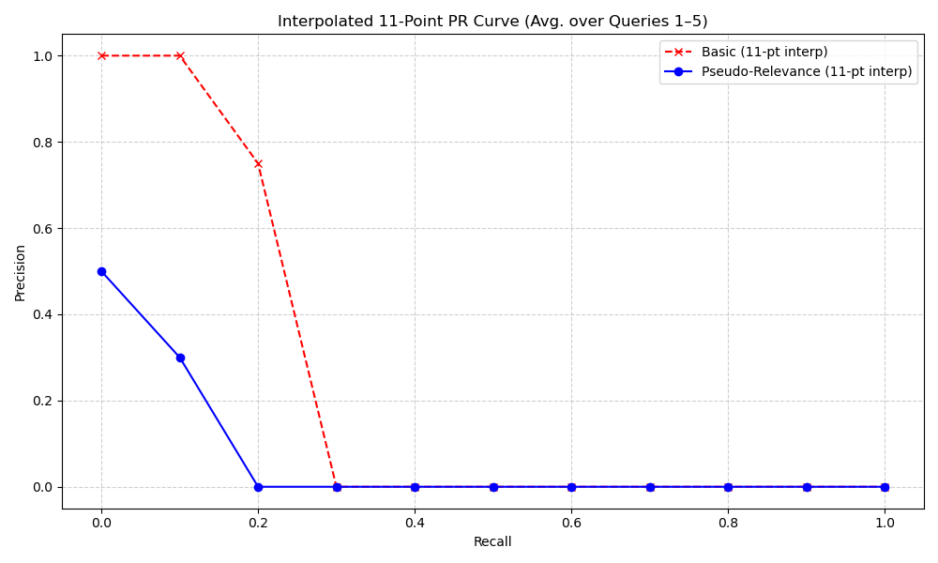
Precision-Recall Curve (Query1-Query5)
with 11-Point Interpolation

Slide 14
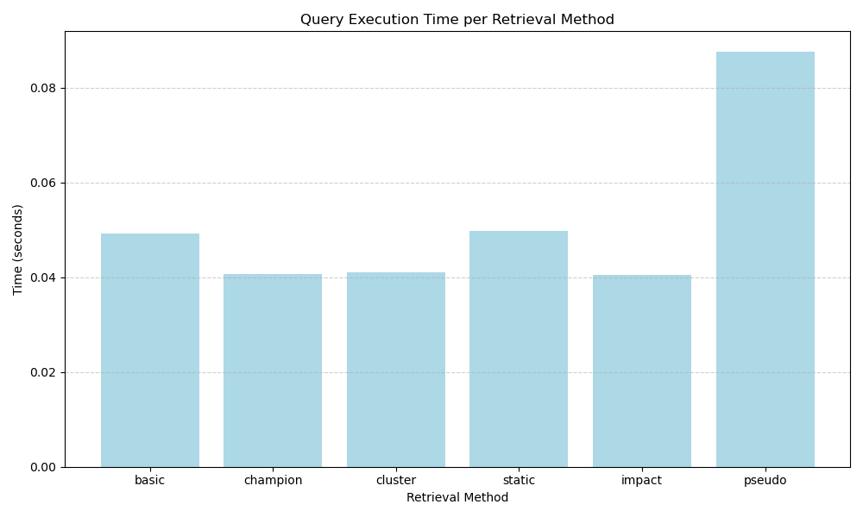
Query Execution Time Bar Chart

Slide 15
Conclusion
Implemented a Vector Space Model (VSM) based Information Retrieval system with multiple retrieval strategies
Designed custom index structures and retrieval methods from scratch for full control and explainability.
Future Work
Selecting better relevance documents
Integrate more robust evaluation metrics: eg: Mean Average Precision (MAP)
🕸️ Extend system to support:
Boolean and phrase queries using biword or positional indexes
Real-time query correction using k-gram and edit distance

Slide 16
Question Time

Slide 17
Thank you

