Slide 1
Café Fausse
Web Application & Interface Design Project Presentation
By: Vishant Prasad

Slide 2
Introduction
My name is Vishant Prasad and I am presenting my implementation and development of the Café Fausse web application web site project.
Built with React, Flask and PostgreSQL.

Slide 3
Technical Implementation
Built with React for the Front End promoting code reusability.
The backend is developed with Flask with Python (lightweight and flexible RESTful API.
The database schema is PostgreSQL and includes TWO tables: customers and reservations.
Business logic rule is implemented with the 30-table system.
Form validation is implemented with use of regex patterns for immediate feedback and server-side validation in Flask.
Responsive design addressed using CSS Grid and Flexbox.

Slide 4
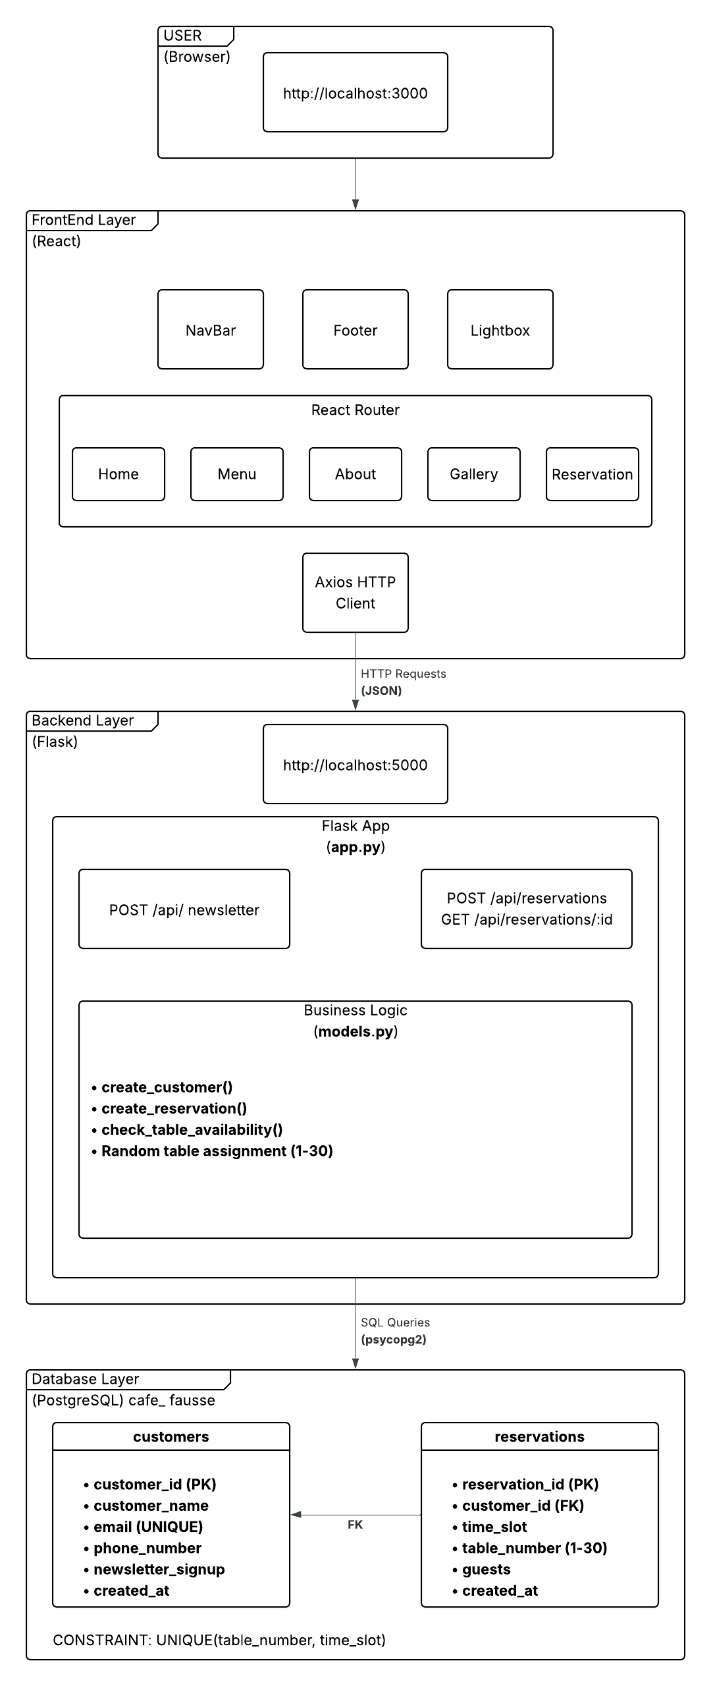

Architecture Diagram
Key implementation of the program and system runtime depicted in a high-level system architecture diagram.

Slide 5
Responsive Design Demo
Demonstration on Google Chrome DevTools

Slide 6
Summary
Five fully functional pages with seamless navigation.
A complete menu display with categorized items and pricing.
A working reservation system with table availability checking.
Newsletter signup with email validation.
Database integration storing both reservations and newsletter subscriptions.
Responsive design that works across all devices.
Modern UI with smooth animations and transitions.

Slide 7
Future Enhancements
Potential future enhancements could include:
email confirmations for reservations
an admin dashboard for restaurant staff to manage bookings
online payment integration
customer accounts for viewing reservation history
integrated code testing
staging and deployment

Slide 8
Thank You
By: Vishant Prasad
Quantic - Masters of Science of Software Engineering (MSSE)
Web Application & Interface Design Project Presentation
8

