Slide 1
Binary Division
Nilanjan Byabarta
University of Engineering and Management
Kolkata

Slide 2
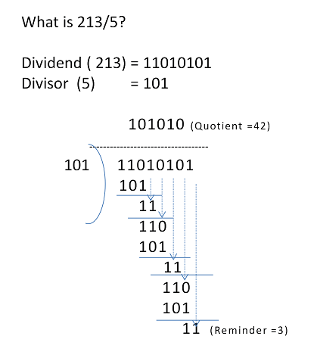
Binary Division

Slide 3
Restoring Division
Restoring division is a method wherein, by default, without identifying the magnitude of the dividend set, the divisor is subtracted.
This is called trial subtraction
If the result of trial subtraction is positive, then the quotient is marked '1' and also the subtraction becomes the desired step.
However, if the trial subtraction result is negative then this becomes an undesired step necessitating a correction; and hence the step is reverted or restored by adding the divisor.
Subsequently, the quotient is marked '0. For this reason, this method of division algorithm is called Restoring Division method.

Slide 4
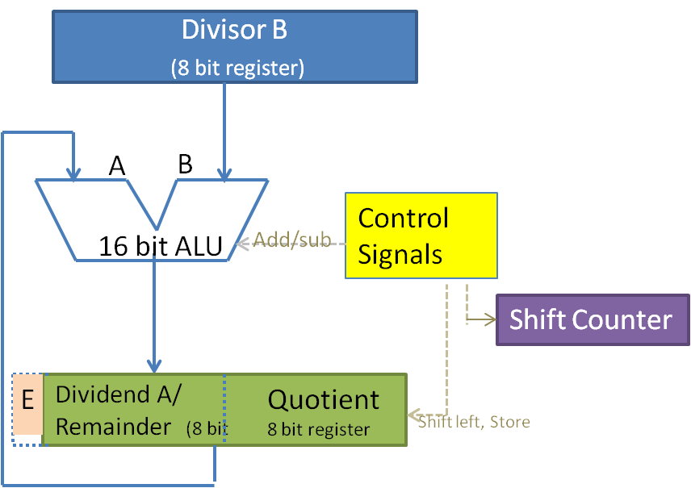

Slide 5
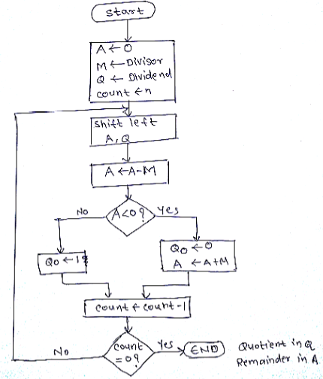

Slide 6
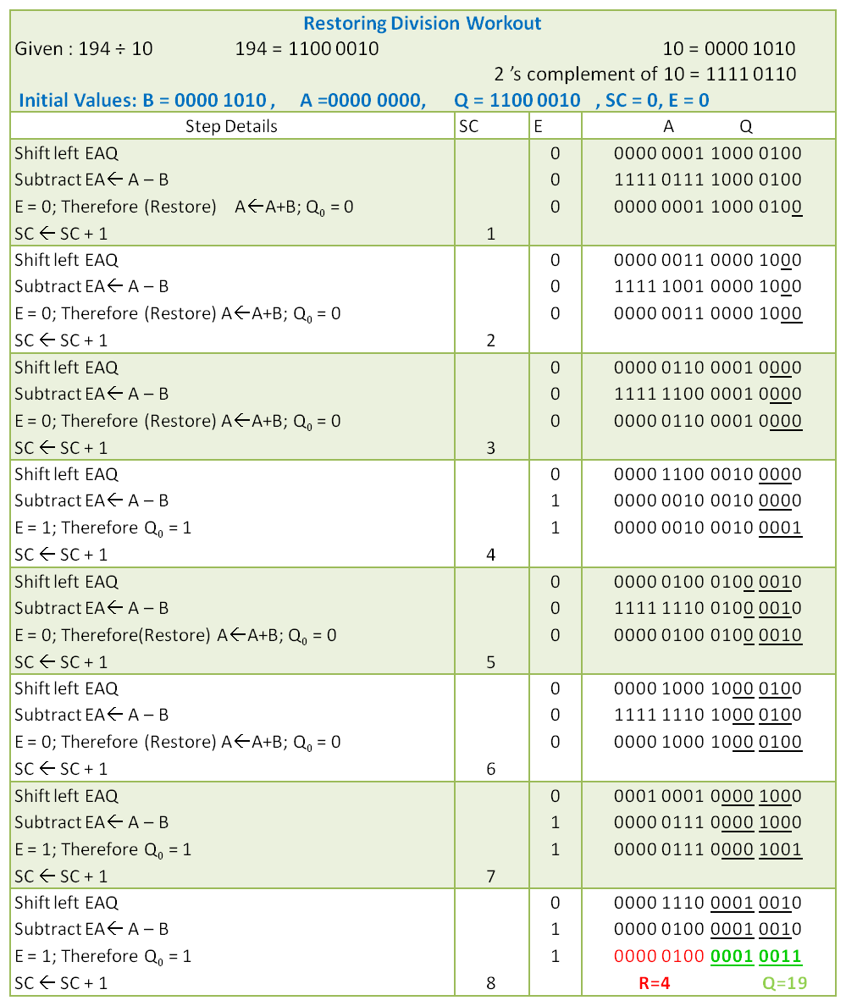
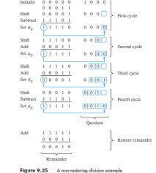

Slide 7
Non-Restoring Division
The non-restoring division is expected to eliminate the 50% overhead due to restoration.
In restoring algorithm on finding A-B to be negative, restoration was done by adding B. we have (A-B+B = A) then left shift was done (we have 2A). In the subsequent iteration, A-B will be found out. (making it 2A-B).
In the non-restoring algorithm, on finding A-B to be negative, B is not added right then. Instead, it proceeds with shift left (making it 2(A-B) ). In the next time around the loop B is added (making it 2A-2B+B=2A-B).

Slide 8
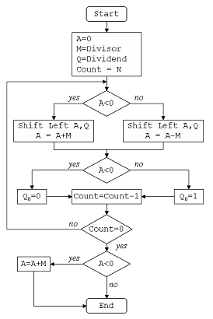

Slide 9
Basic steps of non-restoring division:
Initialize E and A to zero. Load Dividend in Q, divisor in B. Load shift register with word size (n) value.
Shift Left EAQ by 1.
If E value is '0' find A-B else find A+B
If the new E value is '0' set Quotient to '1' else '0‘
Reduce shift counter by '1‘
Repeat steps 2 to 5 until the shift counter > 0
Correction is required for the final remainder if E value is '1' i.e. A is negative. Do the correction using A = A+B
The final remainder in A register. Final Quotient in Q register.

Slide 10
