Slide 1
MUTUAL FUND ANALYTICS PLATFORM
End-to-End ETL, Performance Analytics & Dashboard Solutions
Prepared For: Bluestock Fintech Pvt. Ltd. Project Type: Capstone Presentation Presented By: Intern / Data Analyst Date: June 2026

Slide 2
The Industry Problem Landscape
Retail investors and advisory firms struggle due to several gaps:
Data Fragmentation
NAV, AUM, portfolio and inflows are split in static forms (TXT/PDF).
Performance Benchmarking Gaps
Hard to compare multi-AMC funds on a risk-adjusted basis.
Outperformance Blind Spot
Investors lack easy tracking of fund returns vs. benchmark indices.
Static Reports
Reliance on static spreadsheets that take days to compile manually.

Slide 3
Project Objectives & Outcomes
Goal: Build an institution-grade financial analytics pipeline.
Data Engineering Pipeline
Automate ingestion from APIs and structure a SQLite DB schema.
Quantitative Risk Metrics
Calculate CAGR, Sharpe, Sortino, Alpha, Beta, VaR, and CVaR.
Interactive Insights Dashboard
Streamlit multi-page web app with real-time slicing and filters.
Advanced Behavioral Analytics
Perform investor cohorts and predict transaction lapse risks.

Slide 4
Platform System Architecture
Classic ETL (Extract, Transform, Load) Pipeline:
Extract Layer (Ingestion)
Scrape mfapi.in API and merge with 10 provided AMFI datasets.
Transform Layer (Processing)
Standardize dates, handle holidays via forward-fill in Pandas.
Load Layer (SQLite DB)
Load cleaned datasets into an 8-table relational Star Schema.
Expose Layer (BI Dashboard)
Power the Streamlit Web Application with fast SQLite connections.

Slide 5
Data Ingestion & Quality Reports
Programmatic Inspection & Verification of 10 CSVs:
Fund Master (40 schemes) & NAV history (~64k rows) validated.
Cross-verification checked: All 40 AMFI codes successfully mapped.
Missing Values: Handled null values (e.g. yoy_growth_pct) in raw files.
Live Scrapers: Coded live_nav_fetch.py to request real-time historical NAV tables from API endpoints.

Slide 6
Data Cleaning & Reindexing Details
Ensuring clean, analytical datasets:
Holiday & Weekend NAV Gaps
Reindexed dates daily and forward-filled missing NAV rates.
Transaction Formatting
Standardized types (SIP, Lumpsum, Redemption) and KYC flags.
Constraint Validations
Verified positive transaction amounts and expense ratio ranges.
Database Execution
Populated dim_date lookup tables, computing daily return rates.

Slide 7
SQL Analytical Queries
10 core business queries executing on our Star Schema database:
Top 5 Funds by AUM: Mirae Asset Emerging Bluechip leads at Rs. 49,046 Cr.
Monthly average NAV for SBI Bluechip computed over 53 months.
YoY SIP Inflows Growth calculated dynamically using SQL window LAG.
Investor transactions by payment mode and state volume summaries.
Low expense ratio direct funds (expense < 1.0%) sorted.
Compliance volumes verified (KYC verified vs pending split).

Slide 8
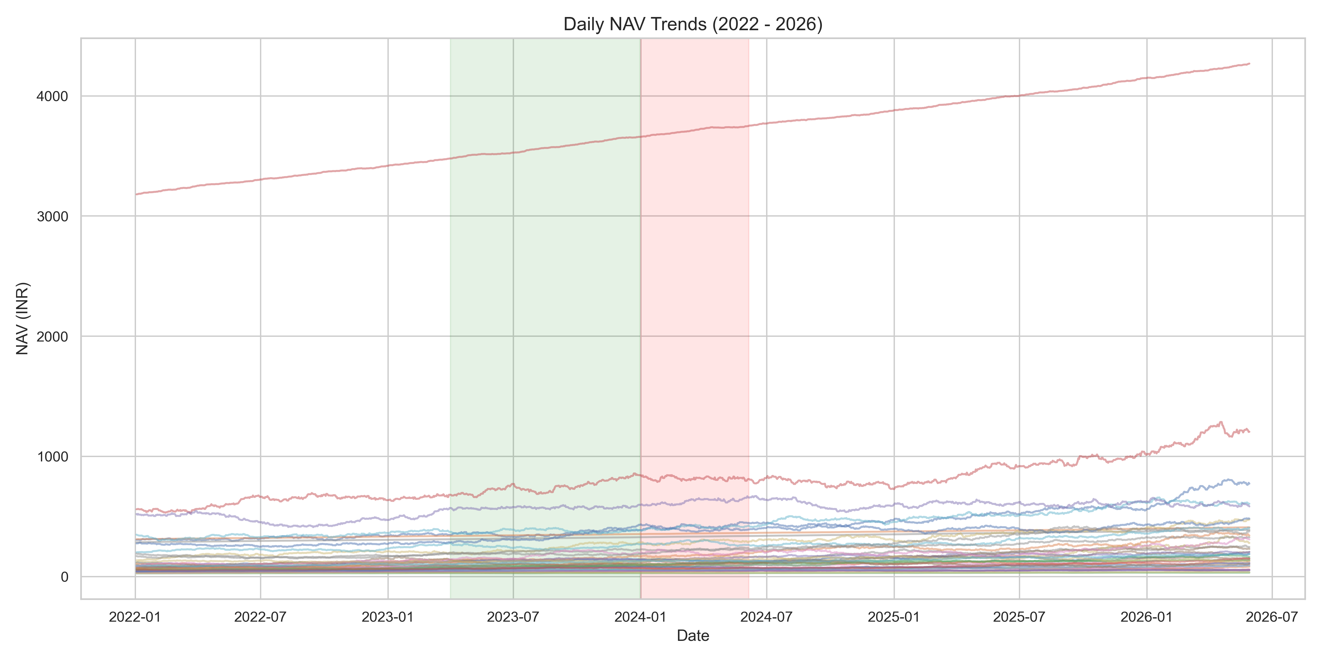
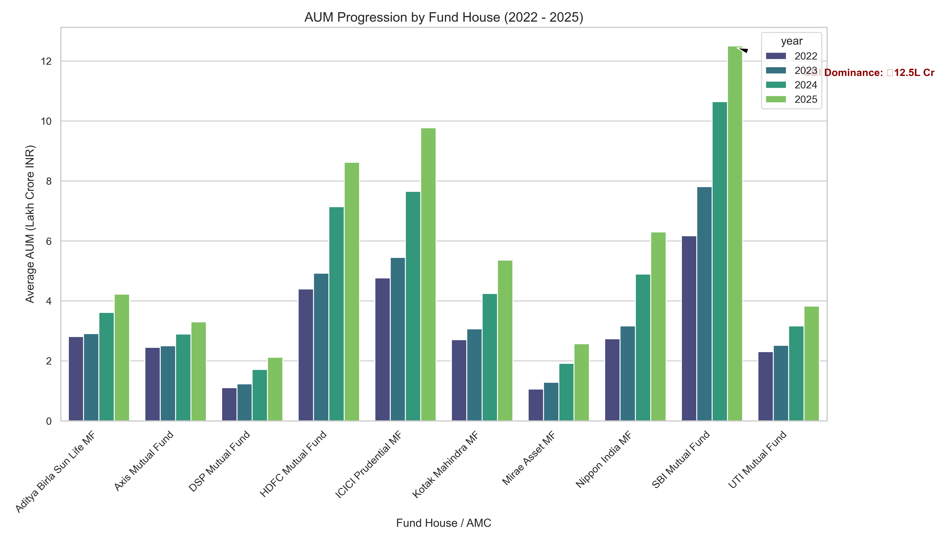
EDA: NAV Trends & AUM Growth
Historical NAV Trends:
Visualizes daily NAV for all 40 schemes (2022-2026).
Highlights the 2023 Bull Run and 2024 Corrections.
Assets Under Management Progression:
Tracks average yearly AUM by fund house.
Highlights SBI MF's dominance, touching ₹12.5L Cr in 2025.

Slide 9
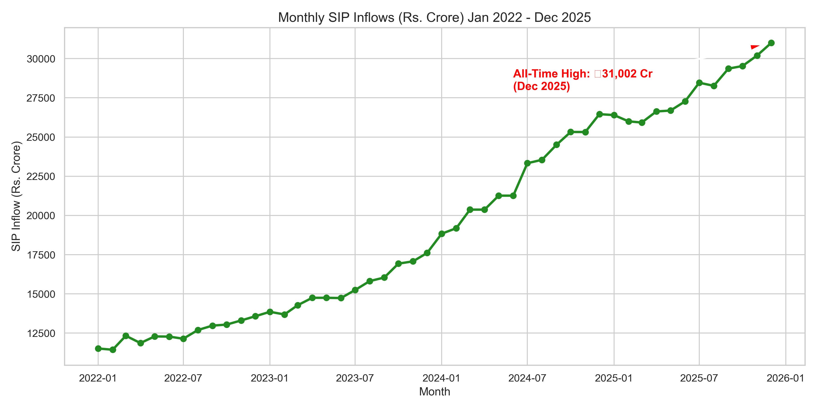
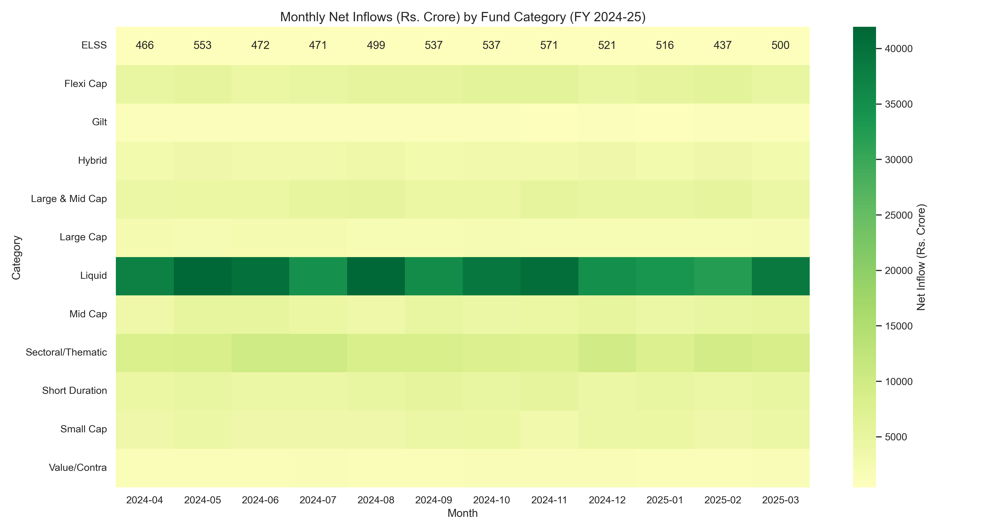
EDA: Inflows & Category Heatmap
Monthly Systematic Investment Plans (SIP):
Robust growth in retail industry SIP inflows.
Peaked at an all-time high of ₹31,002 Cr in Dec 2025.
Category Net Inflows Heatmap:
Reveals net inflow distribution across 12 fund categories.
Highlights Liquid funds as dominant short-term cash reserves.

Slide 10
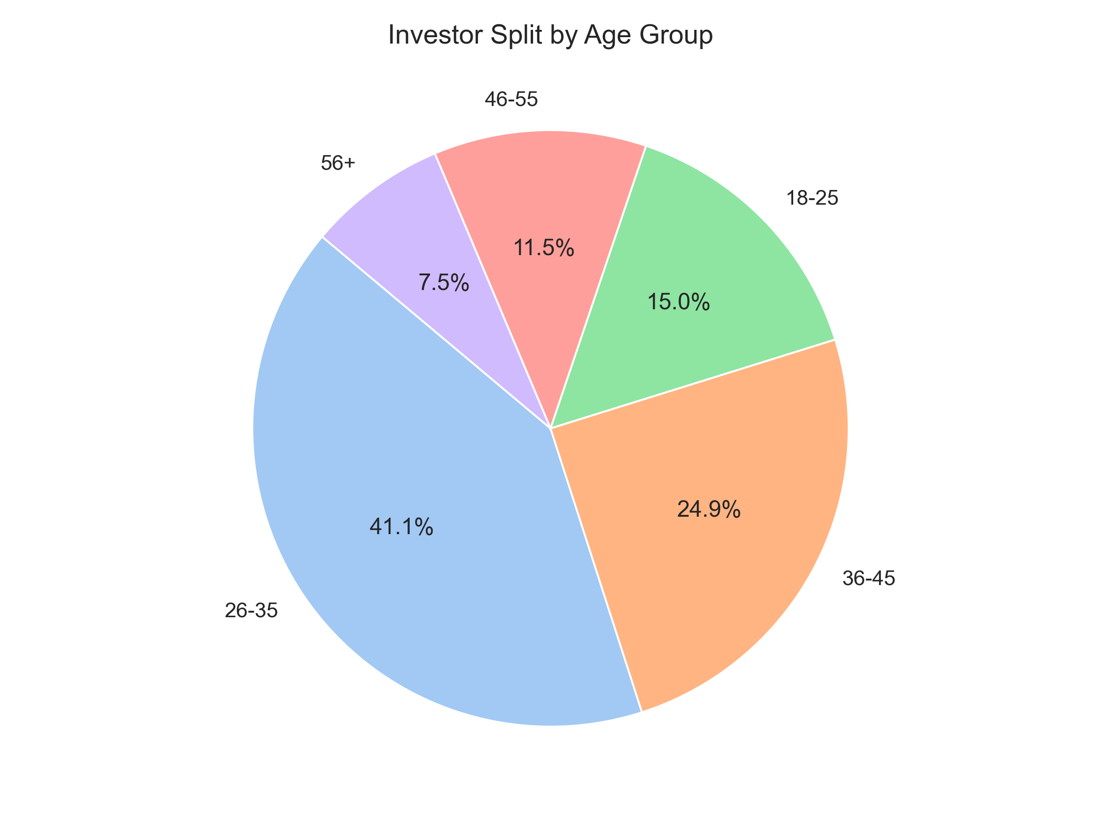
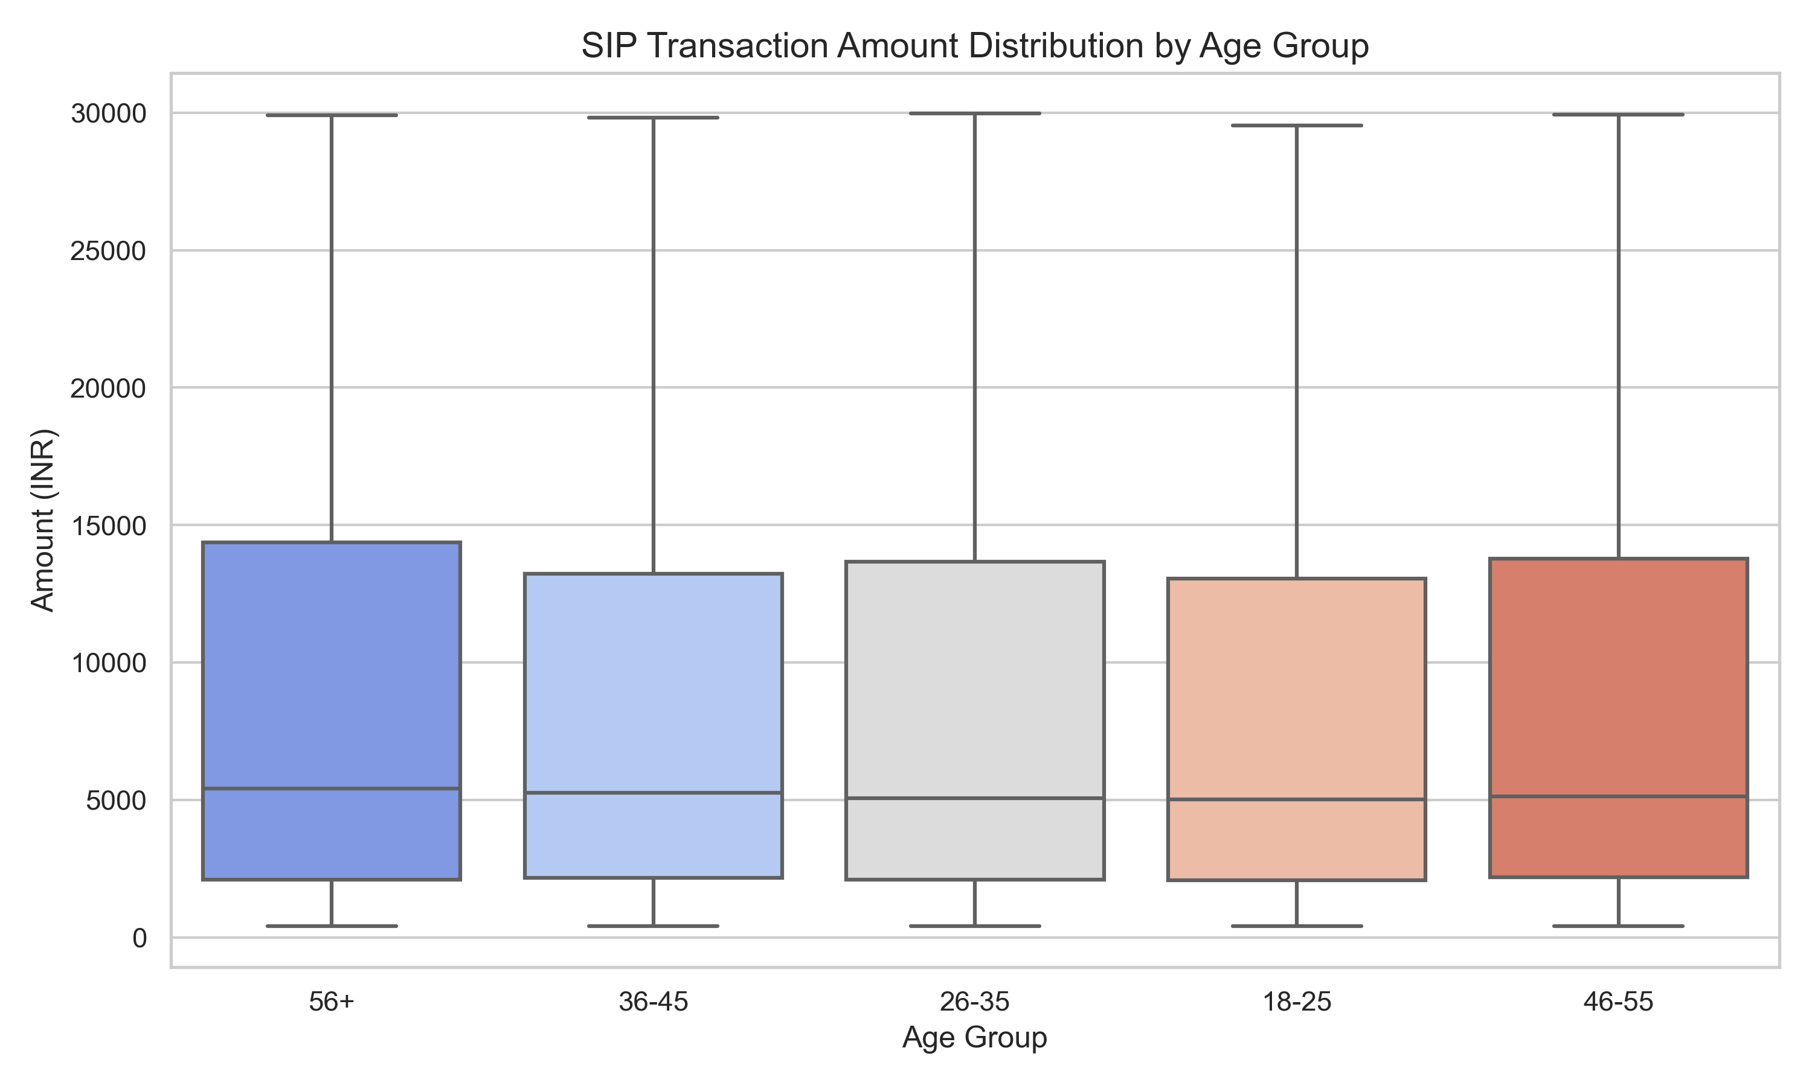
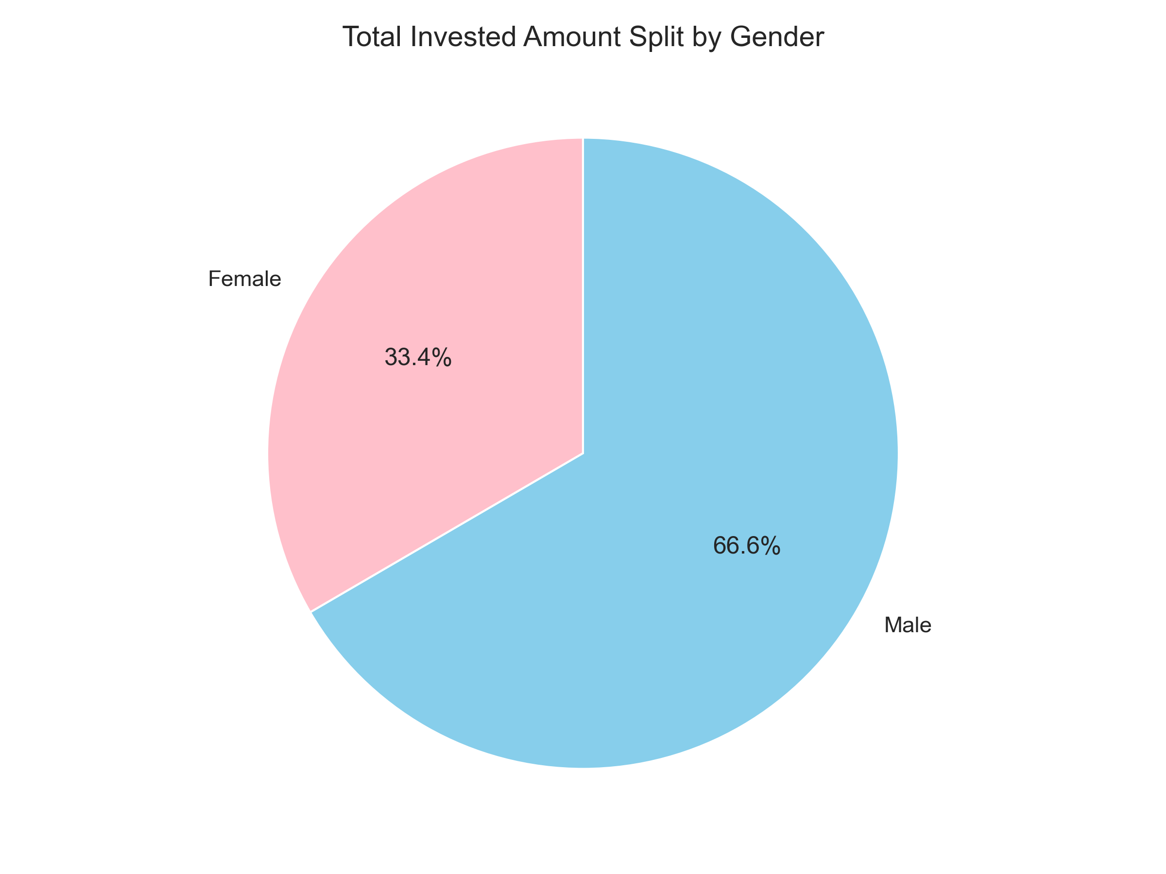
EDA: Investor Segmentation & Demographics
Age splits: 26-35 bracket dominates (36% count).
Ticket sizes: 46-55 group displays the highest average SIP amount.
Gender split: Men contribute ~66% vs. Women ~34% of total investments.

Slide 11
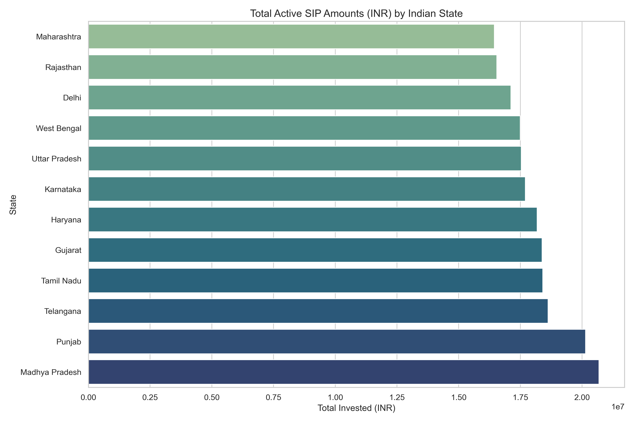
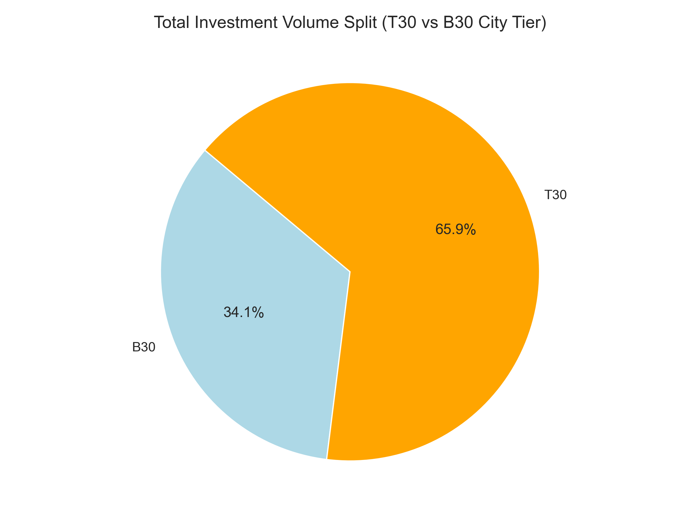
EDA: Geographic & City Tier Analysis
State SIP Inflows:
Madhya Pradesh, Punjab and Telangana lead active SIP amounts.
Reflects growing wealth in tier-2/3 state capitals.
T30 vs. B30 City Tier splits:
Top 30 (T30) cities still hold the lion's share of investments (66%).
Beyond-30 (B30) cities represent a massive growth opportunity (34%).

Slide 12
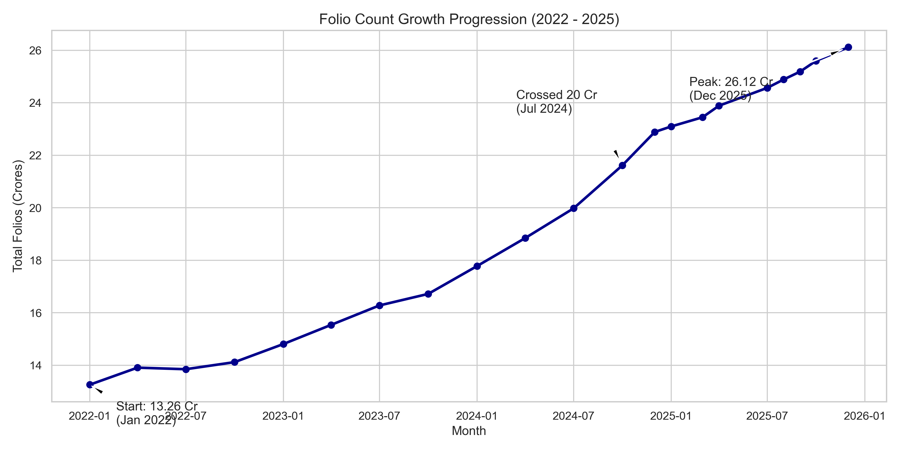
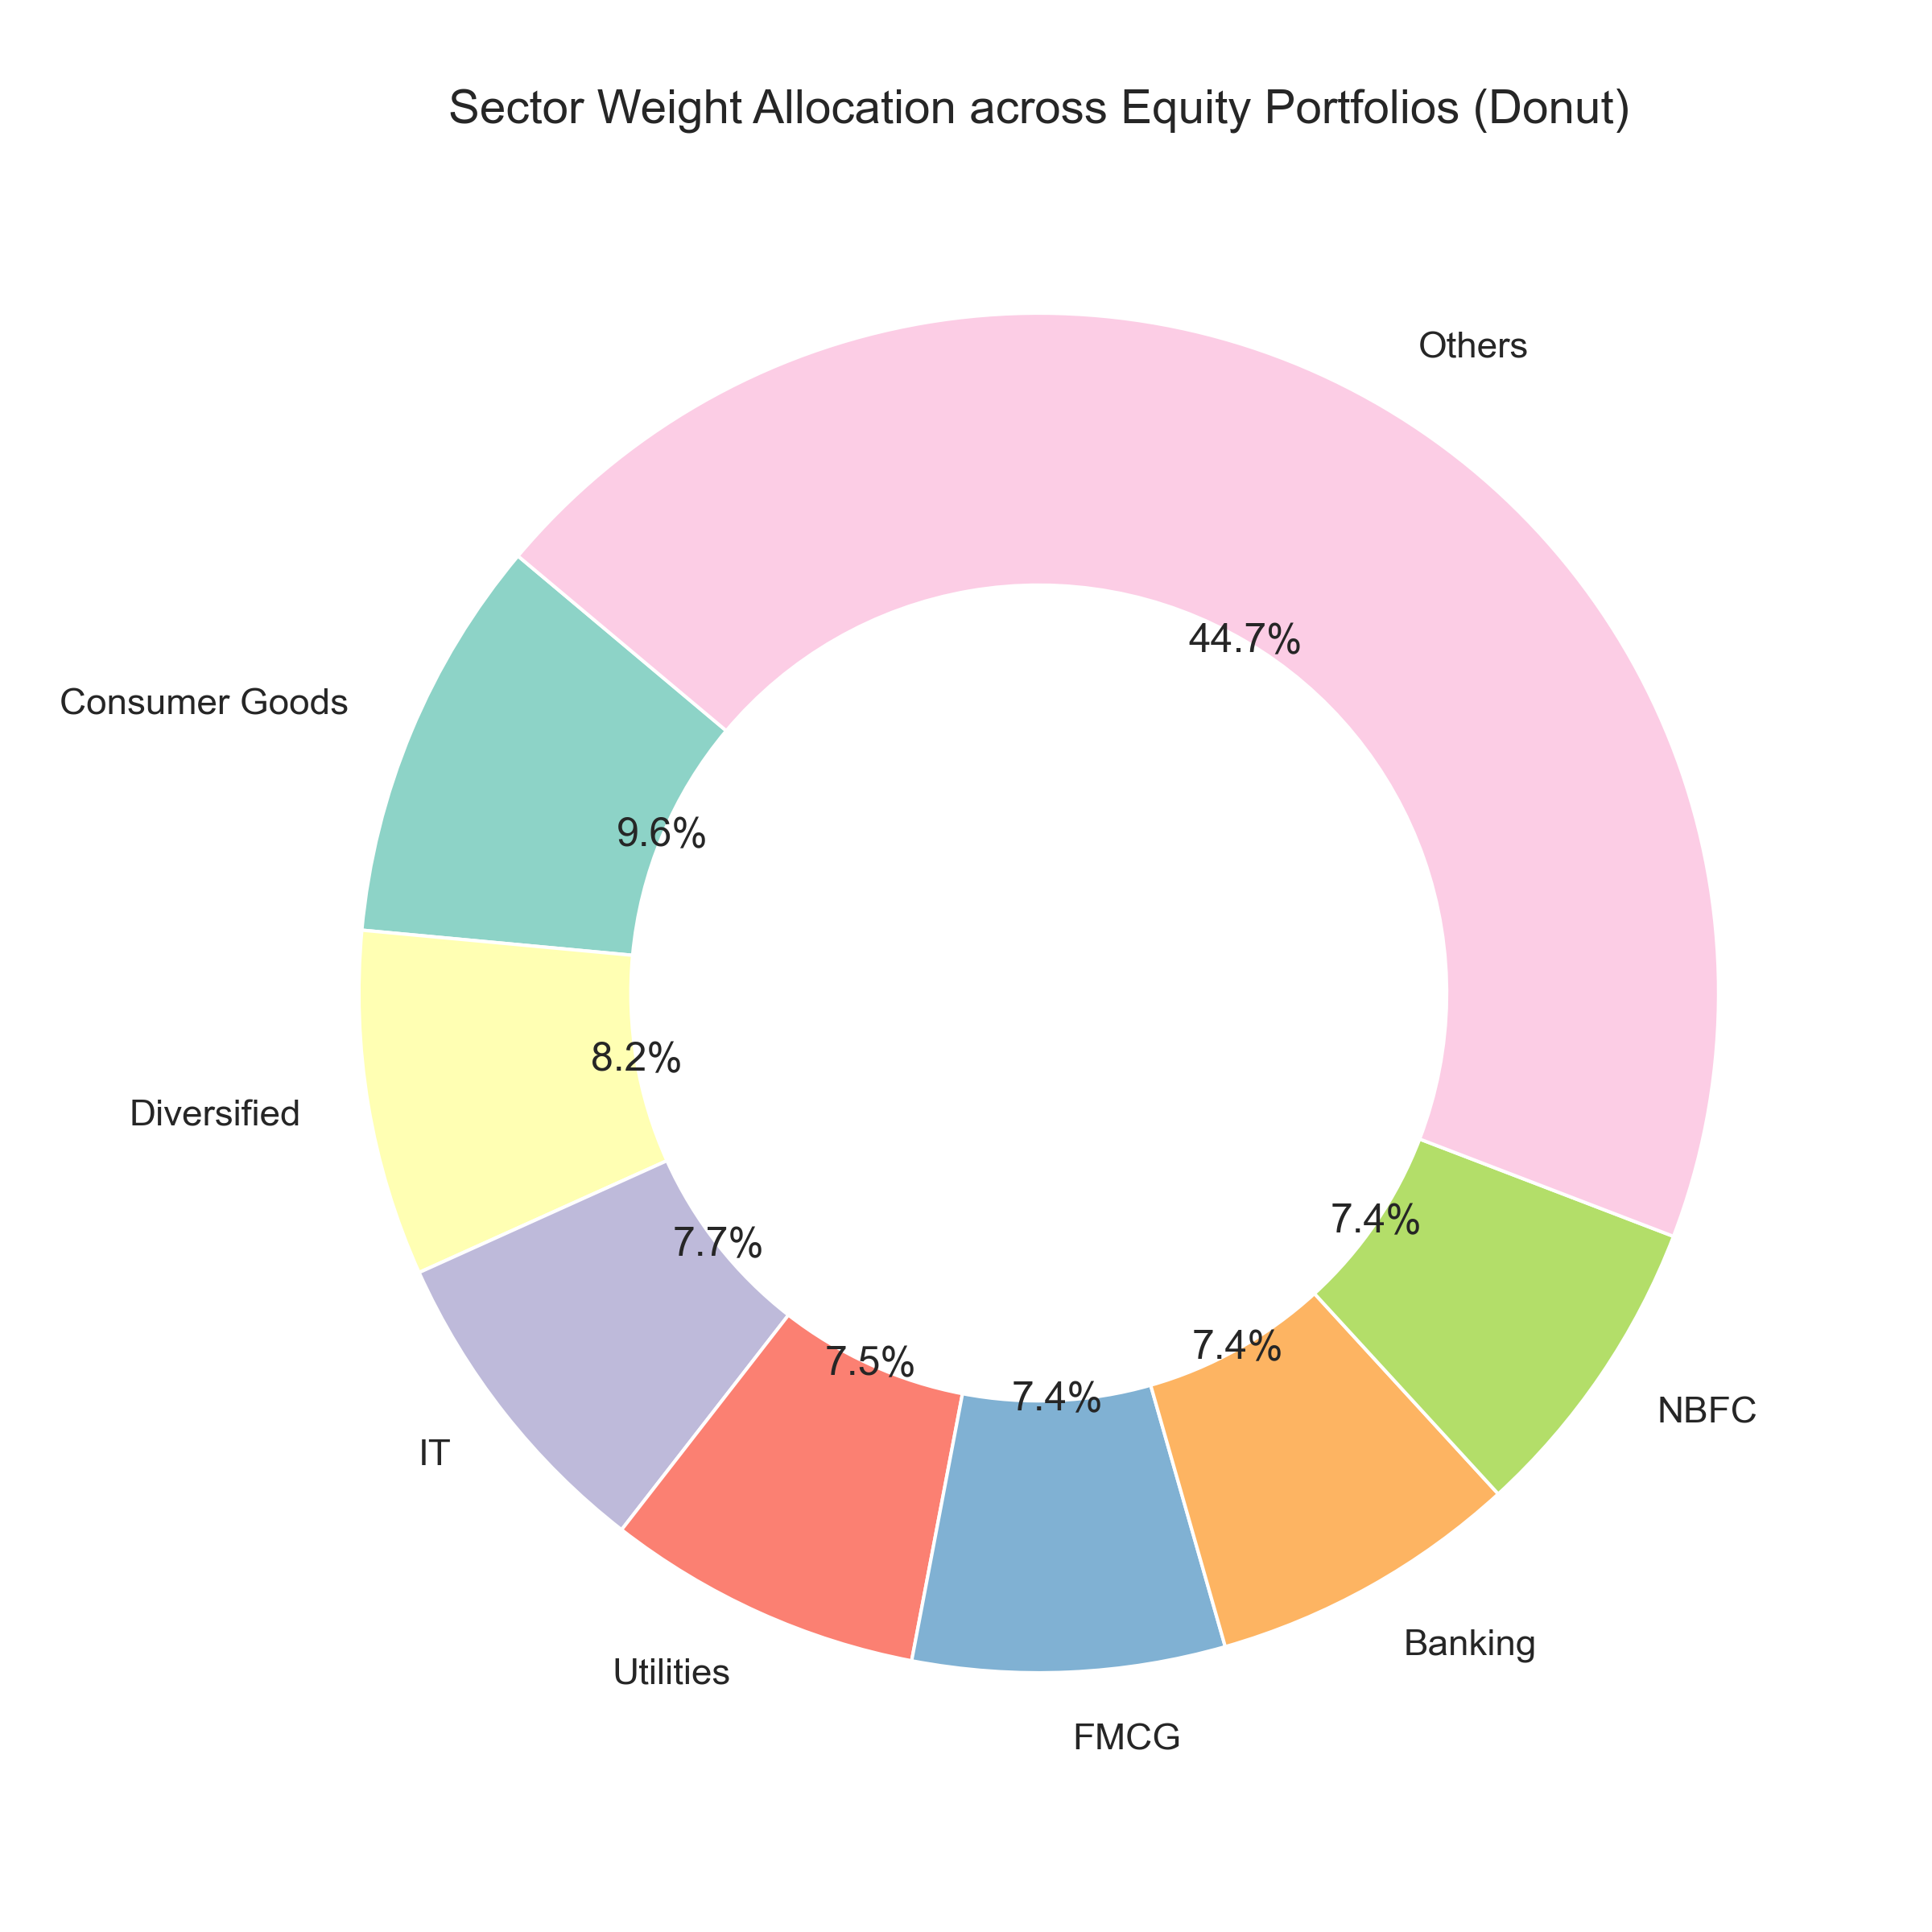
EDA: Folio Progression & Sector Weights
Folio Expansion:
Doubled from 13.26 Cr (Jan 2022) to 26.12 Cr (Dec 2025).
Crossed the 20 Crore milestone in July 2024.
Sector Weights Allocation (Equity Donut):
High concentration in Financial Services (> 25%).
Reflects major benchmarks (Nifty 50/Nifty 100) sector dominance.

Slide 13
Quantitative Fund Performance
Key mathematical returns and risk indicators calculated:
CAGR Returns: Calculated for 1-year, 3-year, and 5-year periods.
Sharpe Ratio: Measures risk-adjusted excess returns over 6.5% Rf rate.
Sortino Ratio: Penalizes only downside volatility (negative returns).
Beta & Alpha: Aligned index prices to regress fund performance.
Maximum Drawdowns: Traced worst-case peak-to-trough drop rates.
Scorecard: Weighted ranks to construct a composite score out of 100.

Slide 14
Advanced Analytics & Risk Modules
Value at Risk (VaR 95%) & CVaR
Daily historical worst-case expected loss metrics for each fund.
HHI Sector Concentration Index
Quantifies portfolio concentration risk. Financial services average > 25%.
SIP Churn Prediction Model
Flags investors with transaction gaps > 35 days as 'at-risk'.
Risk Recommender Engine (recommender.py)
Programmatic lookup matching risk appetites to top Sharpe ratio funds.

Slide 15
Strategic Business Recommendations
Actionable insights derived for Bluestock Fintech:
1. Deploy proactive reminder campaigns for flagged 'at-risk' SIP clients.
2. Establish direct-fund distribution outlets in B30 geographical tiers.
3. Highlight direct low-expense schemes to promote platform loyalty.
4. Embed the automated risk recommender engine into the client facing UI.
THANK YOU — QUESTIONS & DISCUSSION

