Slide 1
MUTUAL FUND ANALYTICS PLATFORM
End-to-End ETL, Performance Analytics & Dashboard Solutions
Prepared For: Bluestock Fintech Pvt. Ltd. Project Type: Capstone Presentation Presented By: Intern / Data Analyst Date: June 2026

Slide 2
The Industry Problem Landscape
Retail investors and advisory firms struggle due to several gaps:
Data Fragmentation
NAV, AUM, portfolio and inflows are split in static forms (TXT/PDF).
Performance Benchmarking Gaps
Hard to compare multi-AMC funds on a risk-adjusted basis.
Outperformance Blind Spot
Investors lack easy tracking of fund returns vs. benchmark indices.
Static Reports
Reliance on static spreadsheets that take days to compile manually.

Slide 3
Project Objectives & Outcomes
Goal: Build an institution-grade financial analytics pipeline.
Data Engineering Pipeline
Automate ingestion from APIs and structure a SQLite DB schema.
Quantitative Risk Metrics
Calculate CAGR, Sharpe, Sortino, Alpha, Beta, VaR, and CVaR.
Interactive Insights Dashboard
Streamlit multi-page web app with real-time slicing and filters.
Advanced Behavioral Analytics
Perform investor cohorts and predict transaction lapse risks.

Slide 4
Platform System Architecture
Classic ETL (Extract, Transform, Load) Pipeline:
Extract Layer (Ingestion)
Scrape mfapi.in API and merge with 10 provided AMFI datasets.
Transform Layer (Processing)
Standardize dates, handle holidays via forward-fill in Pandas.
Load Layer (SQLite DB)
Load cleaned datasets into an 8-table relational Star Schema.
Expose Layer (BI Dashboard)
Power the Streamlit Web Application with fast SQLite connections.

Slide 5
Data Ingestion & Quality Reports
Programmatic Inspection & Verification of 10 CSVs:
Fund Master (40 schemes) & NAV history (~64k rows) validated.
Cross-verification checked: All 40 AMFI codes successfully mapped.
Missing Values: Handled null values (e.g. yoy_growth_pct) in raw files.
Live Scrapers: Coded live_nav_fetch.py to request real-time historical NAV tables from API endpoints.

Slide 6
Data Cleaning & Reindexing Details
Ensuring clean, analytical datasets:
Holiday & Weekend NAV Gaps
Reindexed dates daily and forward-filled missing NAV rates.
Transaction Formatting
Standardized types (SIP, Lumpsum, Redemption) and KYC flags.
Constraint Validations
Verified positive transaction amounts and expense ratio ranges.
Database Execution
Populated dim_date lookup tables, computing daily return rates.

Slide 7
SQL Analytical Queries
10 core business queries executing on our Star Schema database:
Top 5 Funds by AUM: Mirae Asset Emerging Bluechip leads at Rs. 49,046 Cr.
Monthly average NAV for SBI Bluechip computed over 53 months.
YoY SIP Inflows Growth calculated dynamically using SQL window LAG.
Investor transactions by payment mode and state volume summaries.
Low expense ratio direct funds (expense < 1.0%) sorted.
Compliance volumes verified (KYC verified vs pending split).

Slide 8
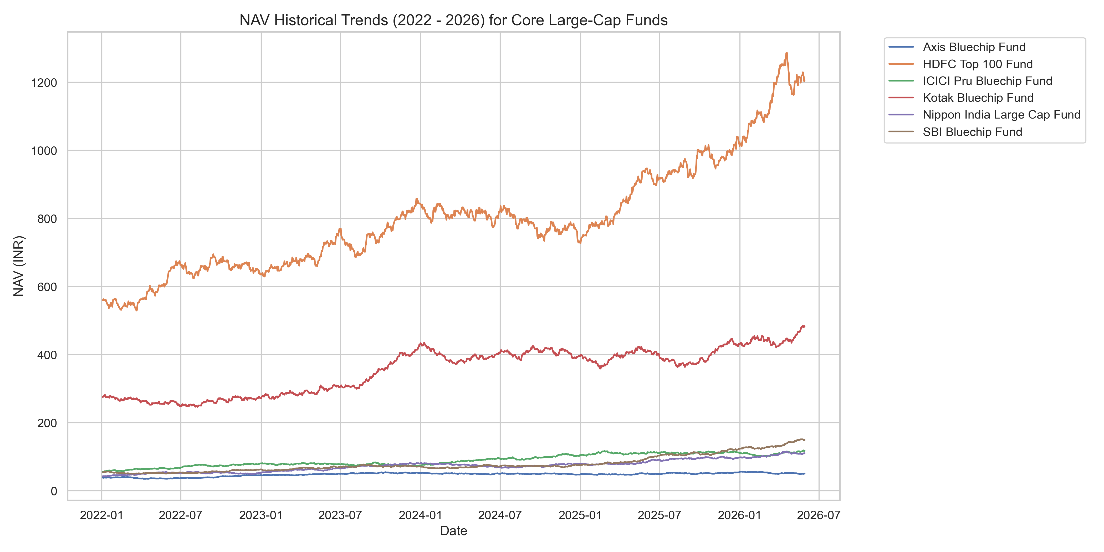
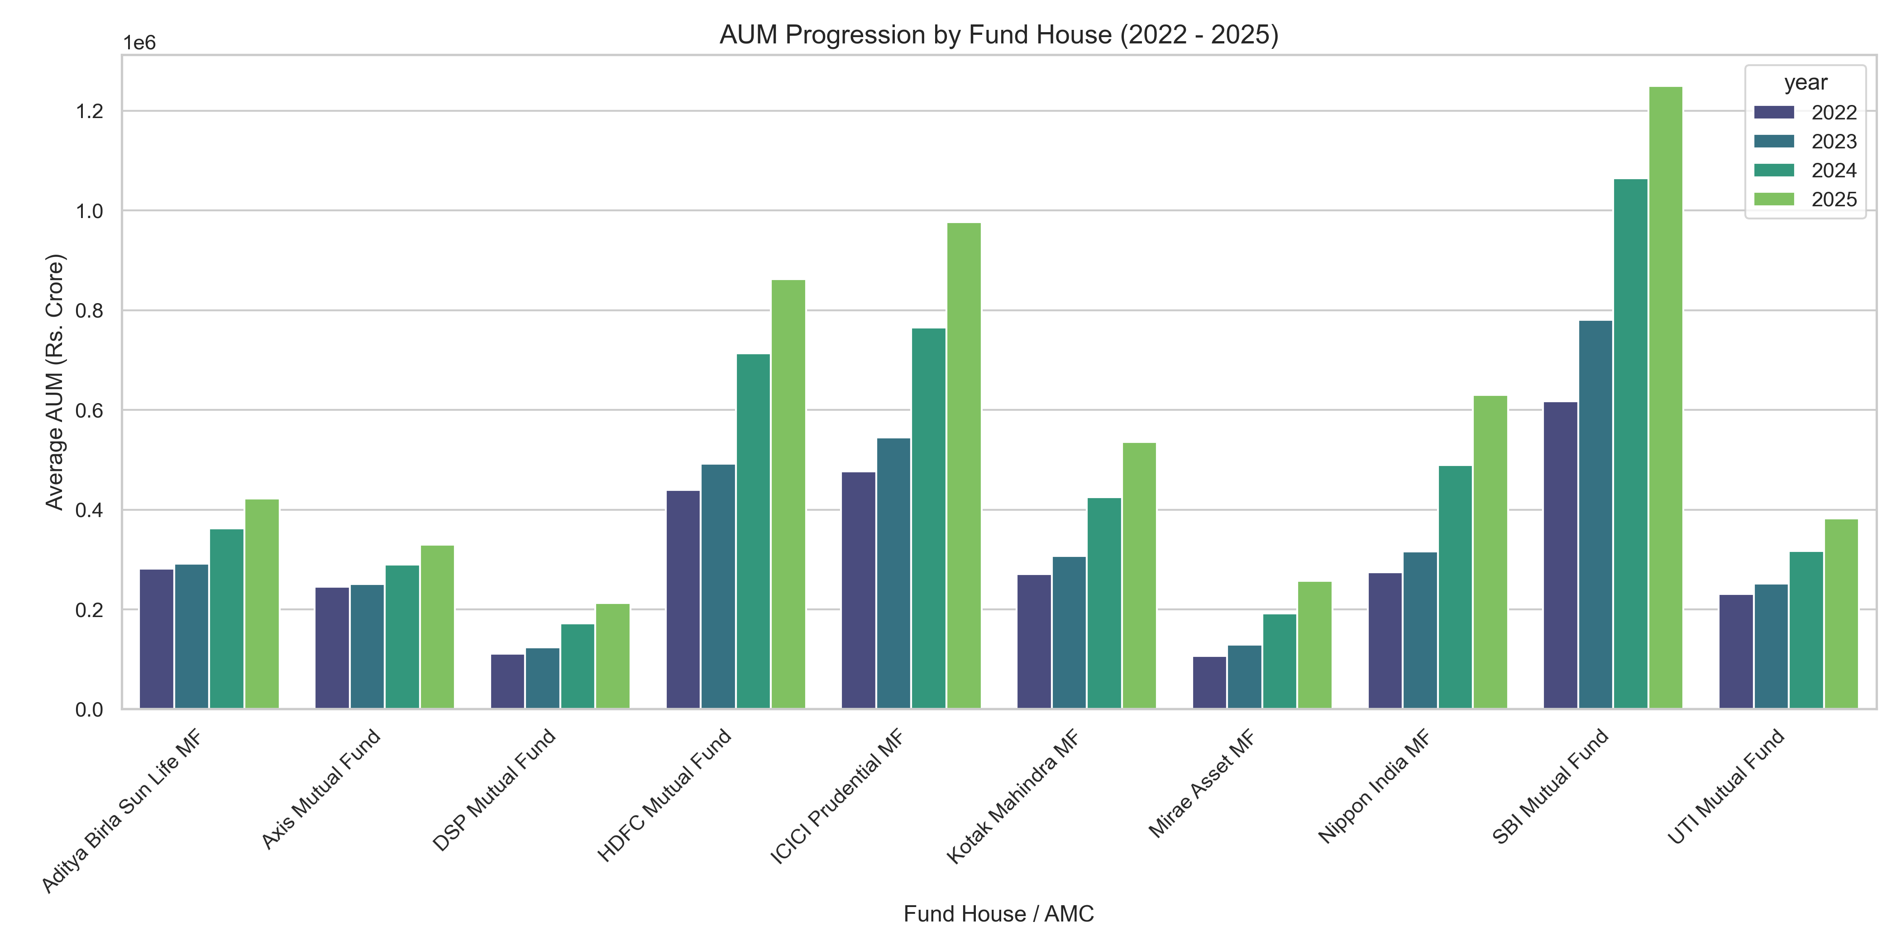
EDA: NAV Trends & Market Growth
NAV Historical Movement:
Solid post-2023 rally seen across Large Cap schemes.
AMC AUM comparison:
SBI MF leads, followed by ICICI Pru and HDFC MF.
Category Heatmap:
Net inflows heavily concentrate in Liquid cash funds.

Slide 9
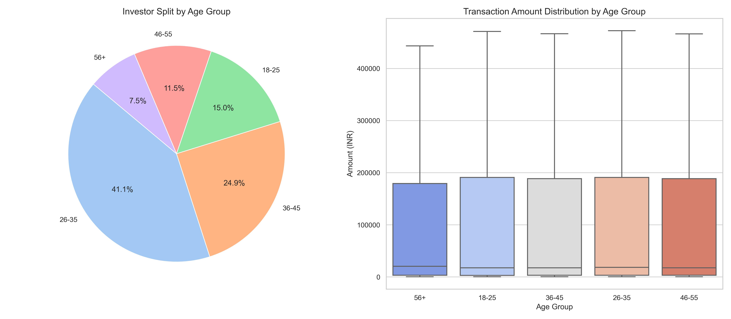
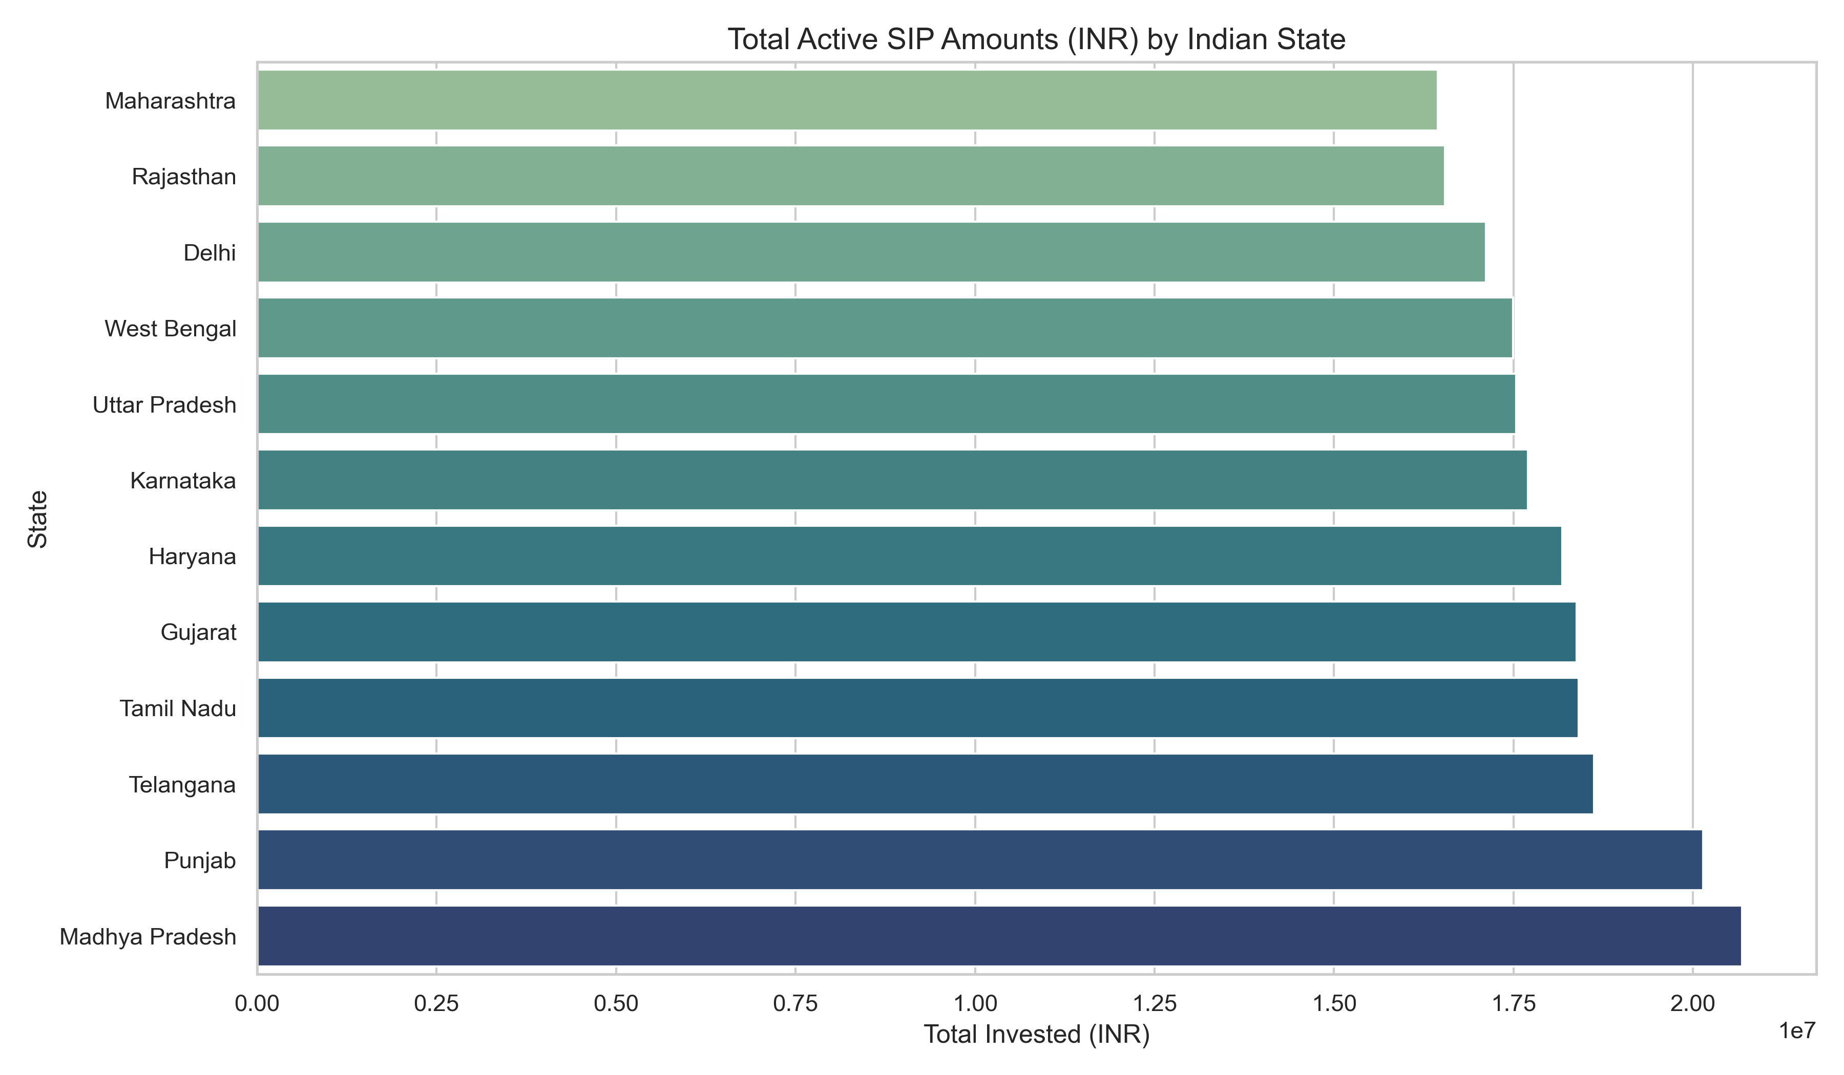
EDA: Investor Segmentation
Age Group Splits:
26-35 age bracket dominates active count (36%).
Geographic analysis:
Punjab, Tamil Nadu and Rajasthan have top SIP volumes.
Folio Expansion:
Total folios doubled from 13.26 Cr (2022) to 26.12 Cr (2025).

Slide 10
Quantitative Fund Performance
Key mathematical returns and risk indicators calculated:
CAGR Returns: Calculated for 1-year, 3-year, and 5-year periods.
Sharpe Ratio: Measures risk-adjusted excess returns over 6.5% Rf rate.
Sortino Ratio: Penalizes only downside volatility (negative returns).
Beta & Alpha: Aligned index prices to regress fund performance.
Maximum Drawdowns: Traced worst-case peak-to-trough drop rates.
Scorecard: Weighted ranks to construct a composite score out of 100.

Slide 11
Advanced Analytics & Risk Modules
Value at Risk (VaR 95%) & CVaR
Daily historical worst-case expected loss metrics for each fund.
HHI Sector Concentration Index
Quantifies portfolio concentration risk. Financial services average > 25%.
SIP Churn Prediction Model
Flags investors with transaction gaps > 35 days as 'at-risk'.
Risk Recommender Engine (recommender.py)
Programmatic lookup matching risk appetites to top Sharpe ratio funds.

Slide 12
Strategic Business Recommendations
Actionable insights derived for Bluestock Fintech:
1. Deploy proactive reminder campaigns for flagged 'at-risk' SIP clients.
2. Establish direct-fund distribution outlets in B30 geographical tiers.
3. Highlight direct low-expense schemes to promote platform loyalty.
4. Embed the automated risk recommender engine into the client facing UI.
THANK YOU — QUESTIONS & DISCUSSION

