Slide 1
PROPCHAIN-AI BLOCKCHAIN-BASED AI SYSTEM FOR PROPERTY ANALYSIS
Group Members:
1. Nadaf MohammadAzhar
2. MohammadAli Shaikh
3. Vishal Sahani Guided By: Prof. Hrushikesh Ingole

Slide 2
index
Project Title
Index
Research Gap Identified
Problem Statement
Methodology
Literature Survey
Scope & Objectives
Project Contribution in Society
Future Scope
Conclusion
References
Group Members:
1. Nadaf MohammadAzhar
2. MohammadAli Shaikh
3. Vishal Sahani
Guided By: Prof. Hrushikesh Ingole

Slide 3
Research Gap Identified
Property records are spread across multiple documents and systems.
Manual verification is time-consuming and error-prone.
Existing systems lack integrated AI-based document comparison and ownership analysis.
Limited automation exists for risk detection and legal-rule evaluation.
Need for blockchain-based tamper-evident document verification.
Research Gap
No unified system combines AI document analysis, ownership-chain verification, legal risk detection, and blockchain integrity verification.

Slide 4
Problem Statement
Property verification involves checking multiple documents and records.
Manual verification is time-consuming and error-prone.
Identifying ownership gaps and document mismatches is difficult.
Existing systems have limited AI-based analysis and risk detection.
A secure method is needed to verify document integrity.
Problem Statement:
To develop an AI and blockchain-based system that analyses property documents, verifies ownership, detects inconsistencies and risks, and provides a secure verification report.

Slide 5
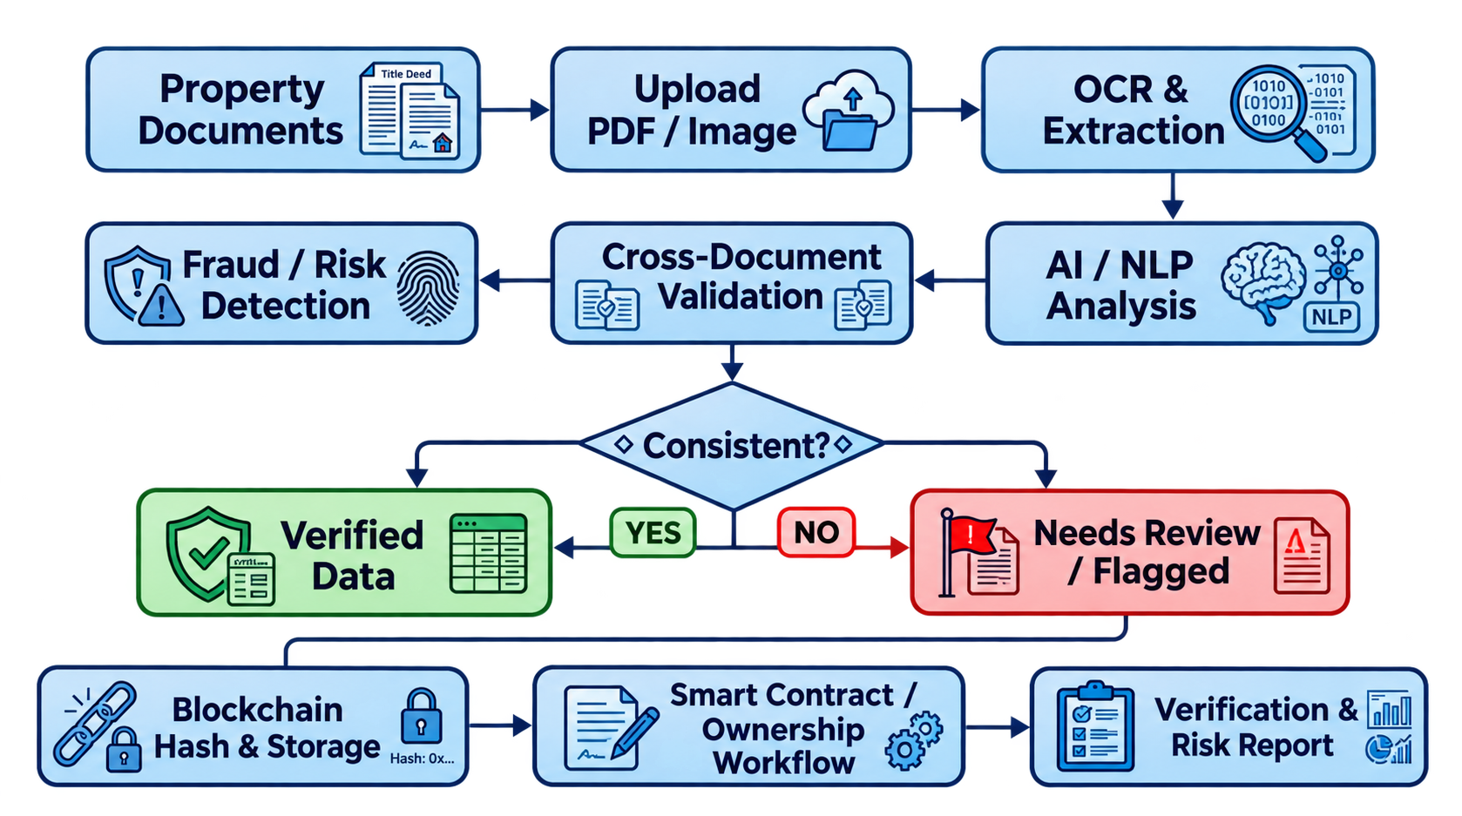
Methodology - system flow
.

Slide 6
Literature Survey
Ref. no. | Title of the Paper | Author / Publication / Year | Technique Used | Summary
1 | Land records on Blockchain for implementation of Land Titling in India | Vinay Thakur et al. / International Journal of Information Management / 2020 | Blockchain, smart contracts, land records | Discusses fragmented Indian land records, transparency and security issues, and proposes blockchainbased land-record and land-titling architecture.
2 | Blockchain as a tool to facilitate property rights protection in the Global South: lessons from India’s Andhra Pradesh state | Third World Quarterly / 2022 | Blockchain, land administration, property rights | Studies an Indian blockchain landregistry initiative and discusses benefits, adoption barriers and institutional requirements.
3 | A systematic review of the institutional success factors for blockchain-based land administration | Land Use Policy / 2022 | Systematic review, blockchain land administration | Shows that successful blockchain land administration depends not only on technology but also on regulative, normative and institutional support.
4 | Design and Implementation of a Geospatially Enabled Blockchain Application for Land Record Management | ISPRS Annals / 2025 | Blockchain, GIS, hashing, smart contracts | Combines geospatial data with blockchain for land-record integrity, transaction traceability and stakeholder confidence.
5 | Blockchain-enabled secure land record management system with a new lightweight cryptosystem | Blockchain: Research and Applications / 2026 | Blockchain, IPFS, encryption, land records | Presents a privacy-oriented blockchain land-record framework and reinforces the value of protecting sensitive land data while maintaining integrity.

Slide 7
Scope & Objective
Scope
Document Upload: Accept property documents in PDF/image format.
OCR & Data Extraction: Extract names, dates, survey numbers, property area, ownership details, etc.
AI/NLP Analysis: Understand and analyze the extracted legal/property information.
Cross-Document Validation: Compare information across multiple property documents.
Fraud & Risk Detection: Identify mismatched, suspicious, missing, or potentially manipulated information.
Blockchain Security: Store document hashes and verification records on blockchain to ensure tamper evidence.
Ownership Workflow: Support a structured property ownership/transfer verification process.
Risk Report: Generate a clear Verified / Needs Review / Flagged result with reasons.
Objective
To develop an AI + Blockchain-based Property Document Verification System that automatically analyzes property documents, detects inconsistencies or fraud, and provides a secure, tamper-proof ownership verification record.
Main Goal
“Make property-document verification faster, more transparent, secure, and resistant to document tampering.”

Slide 8
Project Contribution in Society
🌍 Social Contribution
Reduces Property Fraud: Helps identify forged, manipulated, and inconsistent property documents.
Improves Transparency: Provides a clear verification trail for property-related transactions.
Saves Time & Cost: Automates document analysis and reduces dependency on lengthy manual verification.
Protects Citizens: Helps buyers, sellers, and property owners identify potential risks before transactions.
Secure Digital Records: Blockchain creates a tamper-evident record of verification.
Supports Legal & Financial Sectors: Can assist lawyers, banks, real-estate agencies, and government authorities in preliminary document verification.
Promotes Digital Governance: Encourages secure and technology-driven property management.
💡 Social Impact
“Safer property transactions, fewer fraudulent deals, and greater trust in digital property records.”

Slide 9
Future Scope
🚀 Future Scope of the Project
Government Record Integration: Connect with authorized land and property databases for real-time verification.
Advanced AI Fraud Detection: Use Machine Learning to detect sophisticated document forgery, alteration, and suspicious ownership patterns.
Multilingual Document Support: Analyze property documents in English, Hindi, Marathi, and other regional languages.
Smart Legal Assistance: Integrate an AI chatbot to explain property-document issues and verification results in simple language.
GIS & Property Mapping: Link verified properties with location, survey maps, and GIS data.
Smart Contracts: Automate ownership transfer and transaction workflows using blockchain smart contracts.
Mobile Application: Provide property verification services through a secure Android/iOS application.
Scalable Blockchain Network: Expand the system for use by banks, legal firms, real-estate companies, and government agencies.
🔮 Long-Term Vision
Create a trusted digital ecosystem for secure, transparent, and intelligent property verification and ownership management.

Slide 10
Concusion
The proposed system combines AI, OCR, NLP, and Blockchain to make property document verification faster, safer, and more transparent. It helps detect document inconsistencies and potential fraud while maintaining a secure, tamper-evident verification record.
🎯 Final Outcome
A secure, intelligent, and transparent approach to property document verification that can help build greater trust in digital property transactions.

Slide 11
References
Department of Land Resources, Government of India – DILRMP
https://dolr.gov.in/en/
India Code – Registration Act, 1908
https://www.indiacode.nic.in/
India Code – Transfer of Property Act, 1882
https://www.indiacode.nic.in/
Ministry of Electronics & Information Technology (MeitY), Government of India
https://www.meity.gov.in/
Ethereum Documentation – Smart Contracts & Blockchain
https://ethereum.org/developers/docs/smart-contracts/
Tesseract OCR – Official Documentation
https://tesseract-ocr.github.io/

