Slide 1
SMART AUTOMATED BANKING LOCKER SECURITY SYSTEM
GUIDED BY-Dr.Kapil Dev Tyagi
SUBMITTED BY-
AMAN SRIVASTAVA
KARTIKEY TRIPATHI
VISHAD PRAJAPATI

Slide 2
INTRODUCTION
Advancement of technology , banking system is getting digitalized.
Smart automated banking locker system with varied level of security levels.
Using Sensors,Bluetooth,RFID.
Operations with the help of android application

Slide 3
NEED
Safety has becomes an essential issue.
To make the system more secure.
Reduces manual work
To promote the initiative of DIGITAL INDIA.

Slide 4
SOFTWARE USED
MICROCONTROLLER PROGRAMMING-ATMEL STUDIO 6.2
VIRTUAL SIMULATION- PROTEUS 7
ANDROID PROGRAMMING-ANDROID STUDIO

Slide 5
Hardware Requirements
POWER SUPPLY-
7805 Voltage Regulator IC
103,104 CERAMIC CAPACITOR
LED
RESISTANCE
DPDT(SWITCH)
COMPONENT USED
MICROCONTROLLER ATMEGA8
LCD(16X2) DISPLAY
10K POTENTIOMETER
BUZZER
NPN TRANSISTOR(BC 547)
BLUETOOTH(HC05)
PIR SENSOR MODULE
RELAY MODULE
RFID MODULE
PROGRAMMER

Slide 6
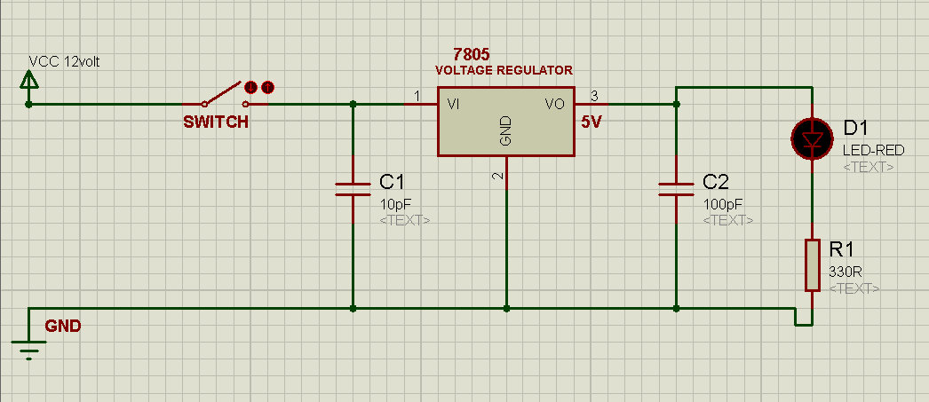
CIRCUIT DIAGRAM
Fig:- Power supply

Slide 7
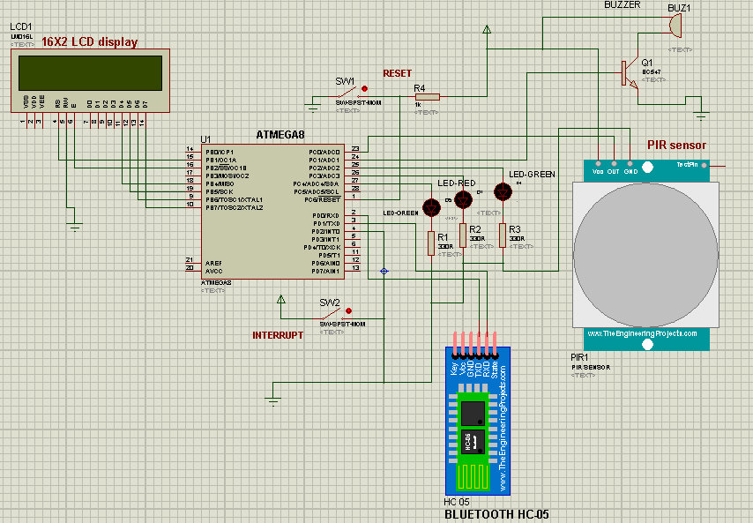
Schematic of ATMEGA-8

Slide 8
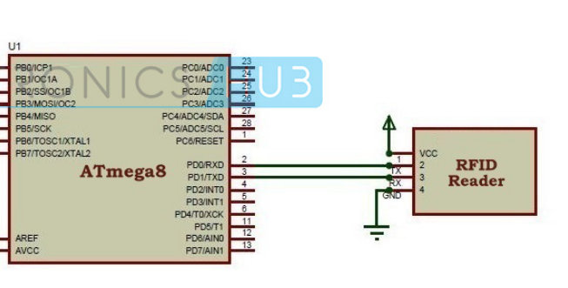
RFID Connection with Microcontroller

Slide 9
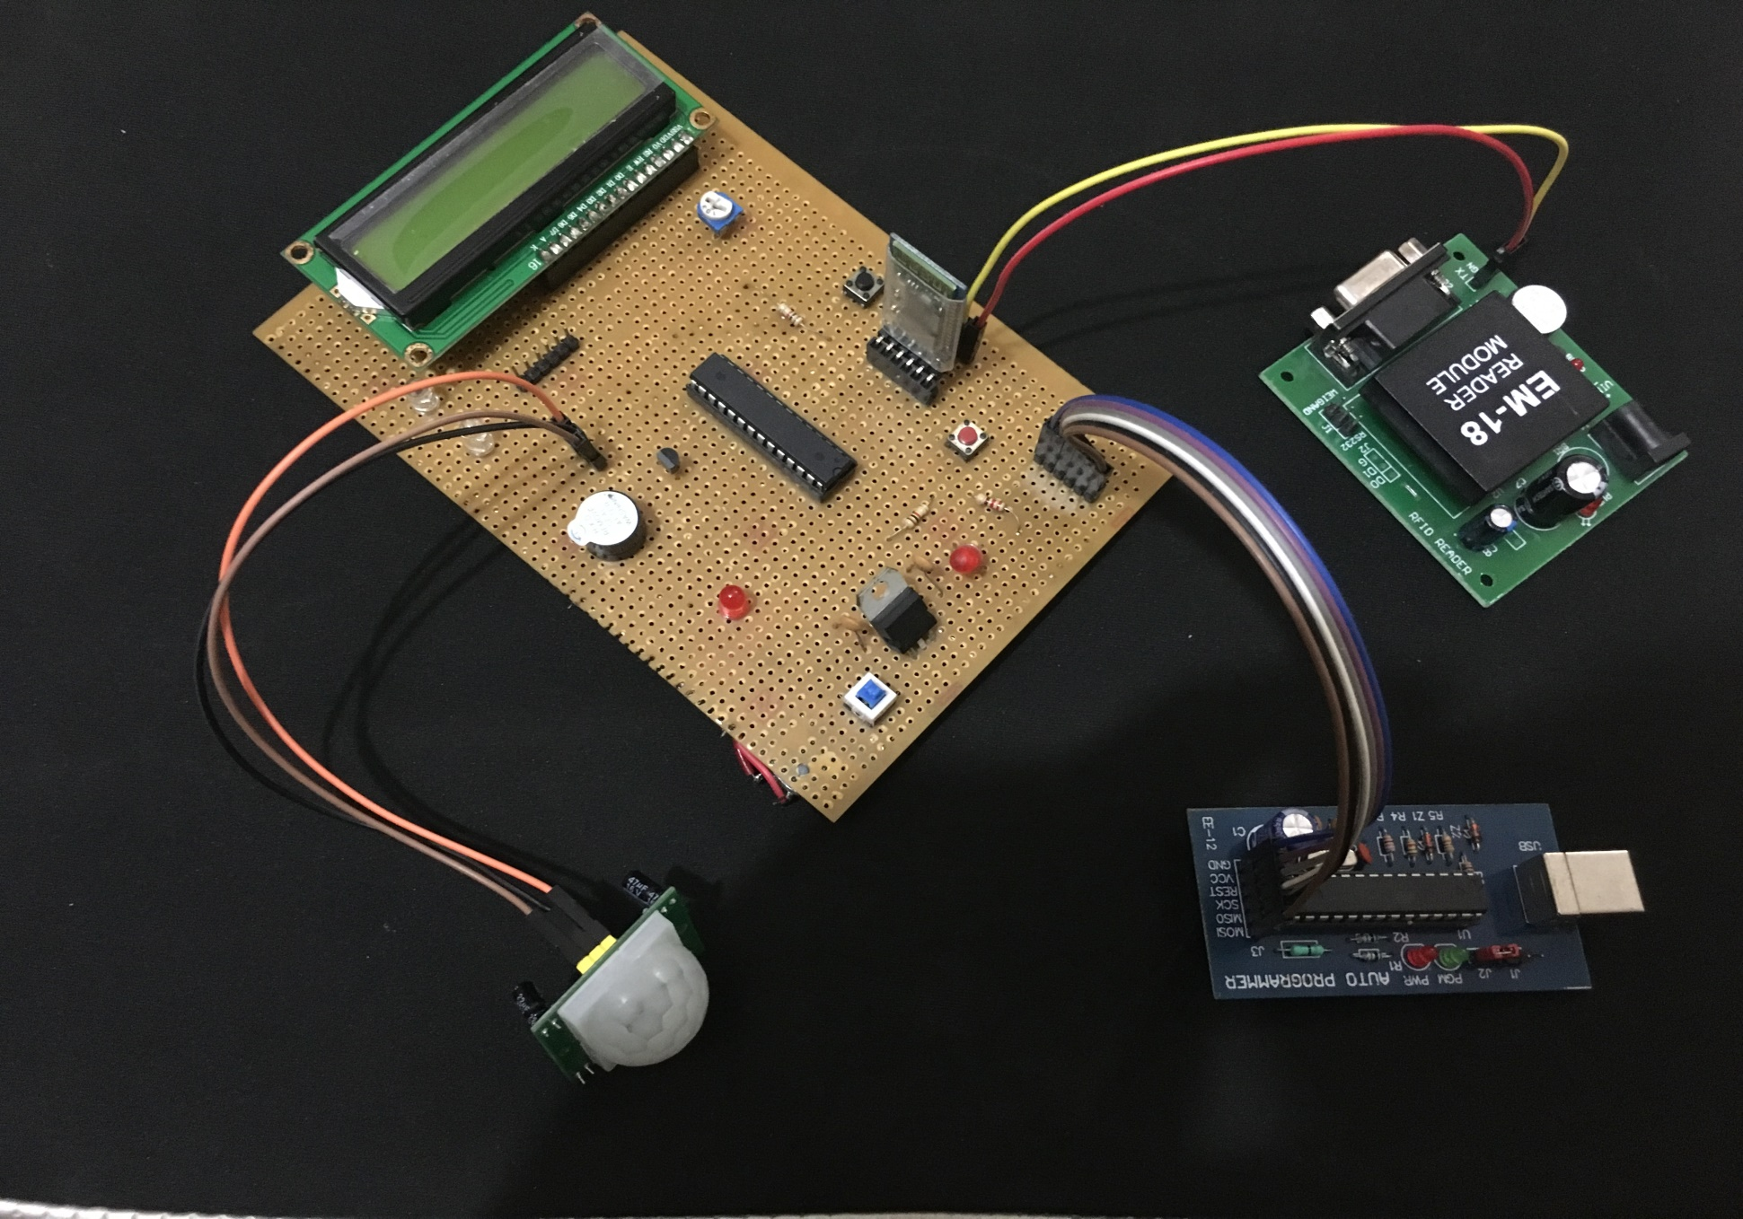

Slide 10
BLOCK DIAGRAM
POWER
SUPPLY
LCD 16X2
BUZZER
ATMEGA 8
MICROCONTROLLER
PIR SENSOR
BLUETOOTH
RFID
RESET
INTERRUPT

Slide 11
FLOW CHART
Green 1 led turn ON
Green 2 led tuns ON
If he/she is not able to enter the details correctly in 3 attempts,buzzer and red led will get automatically activated
Bank employee will enter login credintials through app
Now the user will enter his/her bank locker no.
If the RFID card details does not match with the locker number entered in 3 attempts,buzzer and red led will get activated and an alert message will be send to user’s email
Now the user will be asked to scan his/her RFID card
‘Access Granted ‘will be displayed on the LCD
The led light will get ON located above the entered locker no.

Slide 12
CONTD.
The user will have to scan his/her RFID card for secured exit.
Finally the bank employee will have to logout.

Slide 13
FLOW CHART(APP)
SPLASH SCREEN
Regisration Form(if user is not registered)
If user is already registerd he/she can directly login
Enter one Time Transaction Password or Pattern
Fetching Bank Details
Want to Access your Bank Locker

Slide 14
CONTD.
Fetching Bank Details
Want To Access Your Bank Locker
Banking
Payment
Services
Enter your one time Transaction Password or Pattern
If Successful ,Employ have to submit his credentials
If not,an alert mail to user and bank is automatically send
If Successful ,User has to enter his correct locker number
Buzzer gets on

Slide 15
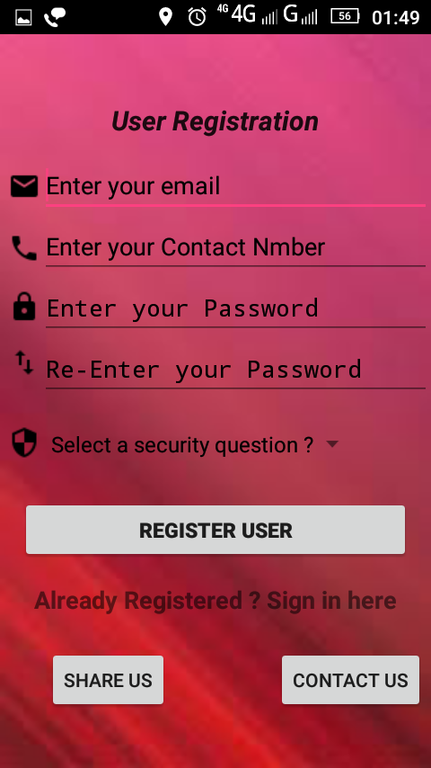
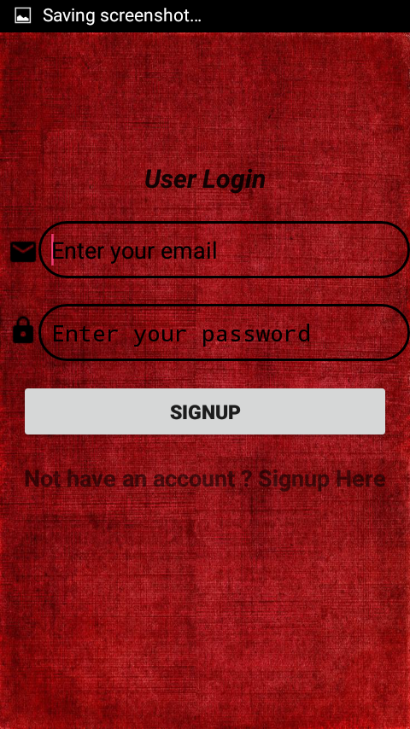
SCREENSHOT(APP)

Slide 16
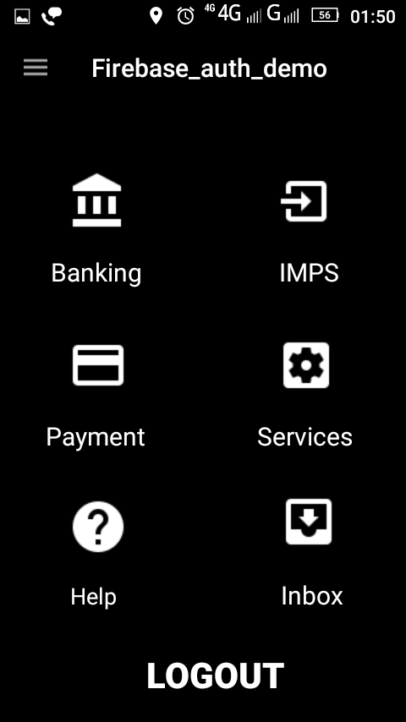
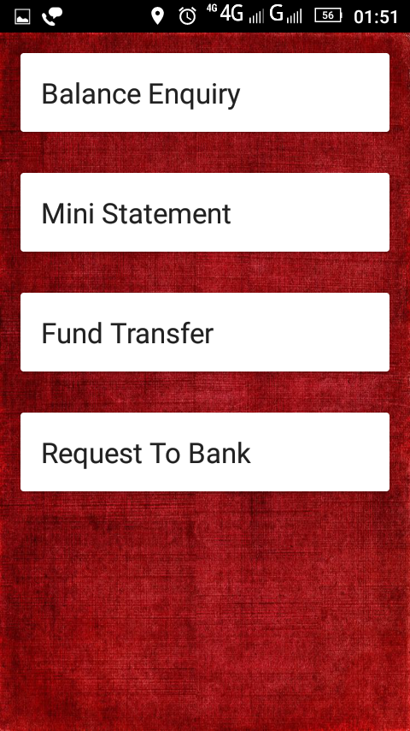
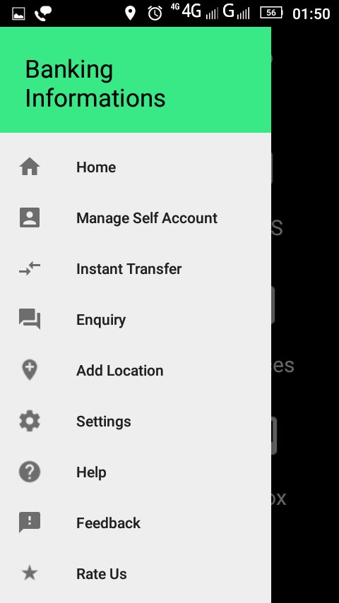
CONTD.

Slide 17
REFERENCES
We have taken help from the following sources:-
www.electroschematics.com
www.youtube.com
www.simplifiedcoding.com

Slide 18
THANK YOU

