Slide 1
Customer Churn Prediction Using Machine Learning
Data Science Internship – Week 4 Capstone Project Name: Vishaga Priya V

Slide 2
Problem Statement
Problem Statement
Customer churn causes revenue loss for businesses.
Goal: Develop a machine learning model that predicts whether a customer is likely to leave the company's services.

Slide 3
Dataset Overview
Dataset: Telco Customer Churn Dataset
Total Records: 7043
Features: • Gender • Senior Citizen • Partner • Dependents • Tenure • Contract • Monthly Charges • Total Charges
Target Variable: Churn (Yes/No)

Slide 4
Data Preprocessing
Converted TotalCharges to numeric
Handled missing values
Encoded categorical features
Converted Churn to binary values
Prepared data for machine learning

Slide 5
Exploratory Data Analysis
Majority of customers did not churn
Longer tenure customers were less likely to churn
Contract type influenced churn significantly
Monthly charges showed correlation with churn

Slide 6
Machine Learning Tools
Logistic Regression
Random Forest Classifier
Train-Test Split:
80% Training
20% Testing

Slide 7
Model Performance
Model | Accuracy
Logistic Regression | 81.83%
Random Forest | 79.49%

Slide 8
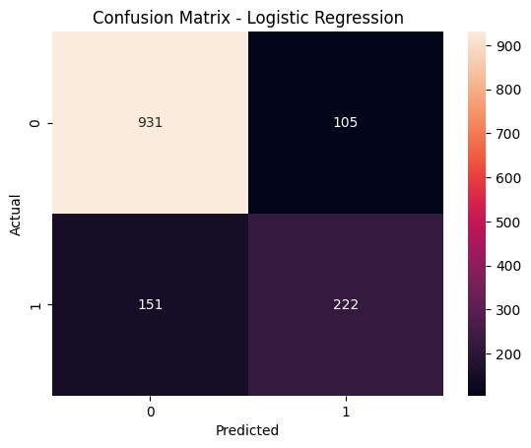
Confusion Matrix Results
True Negatives: 931 False Positives: 105 False Negatives: 151 True Positives: 222

Slide 9
Recommendations
Improve customer retention strategies
Identify high-risk customers early
Offer personalized promotions
Enhance customer support services

Slide 10
Conclusions
Successfully developed a churn prediction model
Logistic Regression achieved 81.83% accuracy
Model can support business decision-making
Future improvements can include advanced algorithms

