Slide 1
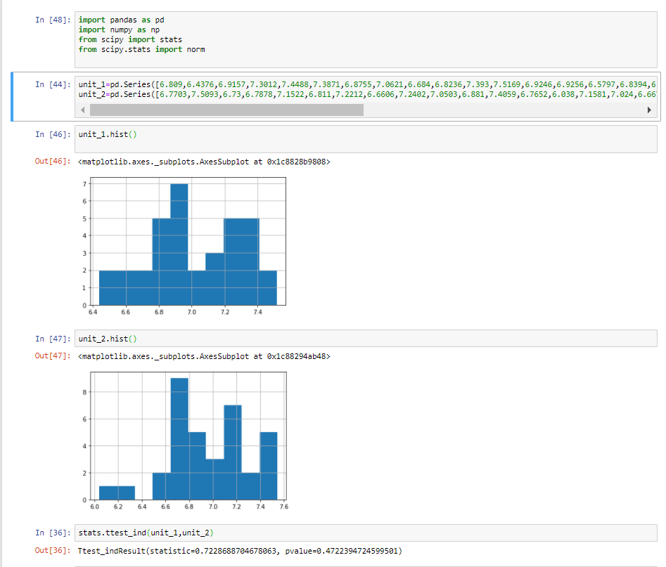
Hypothesis Testing Exercise
A F&B manager wants to determine whether there is any significant difference in the diameter of the cutlet between two units. A randomly selected sample of cutlets was collected from both units and measured? Analyze the data and draw inferences at 5% significance level. Please state the assumptions and tests that you carried out to check validity of the assumptions.
Minitab File : Cutlets.mtw
HO= there is no significant diff in diameter
H1=there is difference in diameter
Inputs are Diameter 1 and Diameter 2
that is Discrete in two categories
Output is continuous as we are trying
to see the difference in diameter and
diameter is a continuous variable
We go with 2-sample t test
P value=0.472 which is greater than 0.05 so
We fail to reject our null hypothesis.
Hence we conclude that there is no
Significant difference in the diameters.

Slide 2
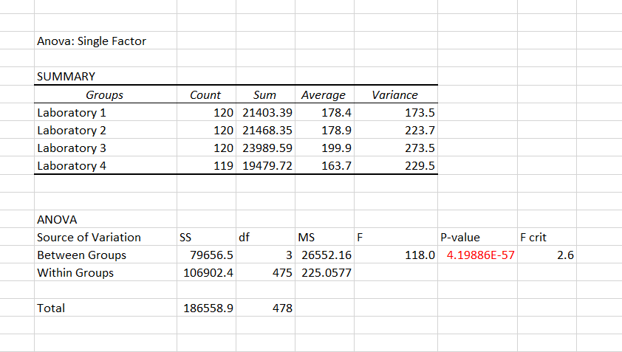
A hospital wants to determine whether there is any difference in the average Turn Around Time (TAT) of reports of the laboratories on their preferred list. They collected a random sample and recorded TAT for reports of 4 laboratories. TAT is defined as sample collected to report dispatch.
Analyze the data and determine whether there is any difference in average TAT among the different laboratories at 5% significance level.
Minitab File: LabTAT.mtw
Inputs are 4 lab reports. So Input is Discrete in more than 2 categories. Output is continuous as we are trying to see the difference in average TAT.We proceed with ANOVA test.
H0=no difference in average TAT Ha=significant difference in average TAT.
P value less than 0.05 so we reject null hypothesis.
Hence there is difference in average TAT

Slide 3
Sales of products in four different regions is tabulated for males and females. Find if male-female buyer rations are similar across regions.
 | East | West | North | South
Males | 50 | 142 | 131 | 70
Females | 550 | 351 | 480 | 350
Check p-value
If p-Value < alpha, we reject Null Hypothesis
H0
All proportions are equal
Ha
Not all Proportions are equal
Buyer Ratio.mtw

Slide 4
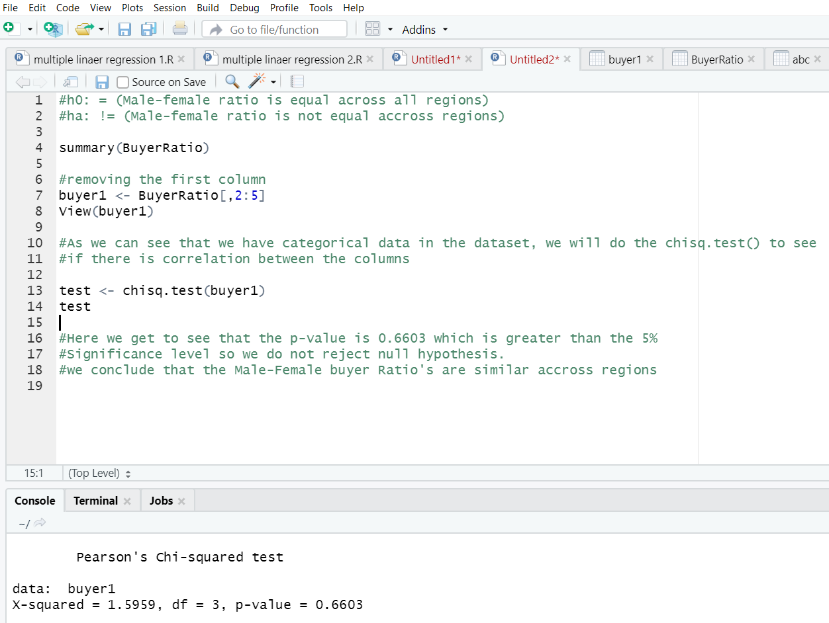
Inputs are 4 discrete variables.
Output is also discrete. We are trying to find out if proportions of male and female are similar or not across the regions. We proceed with chi-square test
Create hypothesis
Ho= Proportions of Male and Female are same
Ha= Proportions of Male and Female are not same

Slide 5
TeleCall uses 4 centers around the globe to process customer order forms. They audit a certain % of the
customer order forms. Any error in order form renders it defective and has to be reworked before processing. The
manager wants to check whether the defective % varies by centre. Please analyze the data at 5% significance level
and help the manager draw appropriate inferences Minitab File: CustomerOrderForm.mtw

Slide 6
