Slide 1
Age-Memory Trade-off in Read-Copy-Update
Vishakha Ramani, Jiachen Chen, and Prof. Roy D. Yates
May 20, 2024

Slide 2
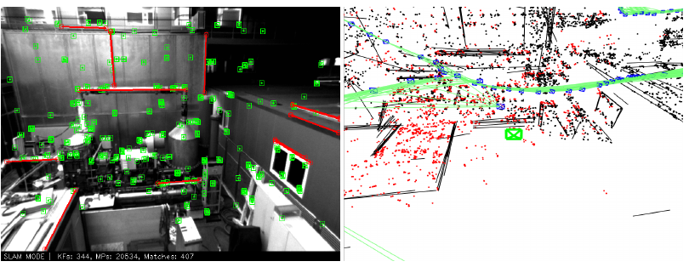
Visual Simultaneous Localization and Mapping (SLAM)
Technique to obtain
3D structure (map) of unknown environment, and
location of a mobile device within the map
Real time application used in
augmented reality (AR)-based visualization,
self-driving cars
Seamless interaction with the real world
desirable to run SLAM systems on mobile phone
Notes:
Consider a technology called as Visual Simultaneous Localization and Mapping (SLAM). It is a technique for obtaining the 3D structure of an unknown environment while simultaneously determining the location of a mobile device within that map.
Visual SLAM based applications are real time applications such as augmented reality (AR)-based visualization, and self-driving cars.
And so one of the important requirements of these systems is real-time response to seamlessly and interactively merge real and virtual objects. To achieve the response, it is desirable to run SLAM on a light-weighted handheld device which has a limited computational resource.

Slide 3
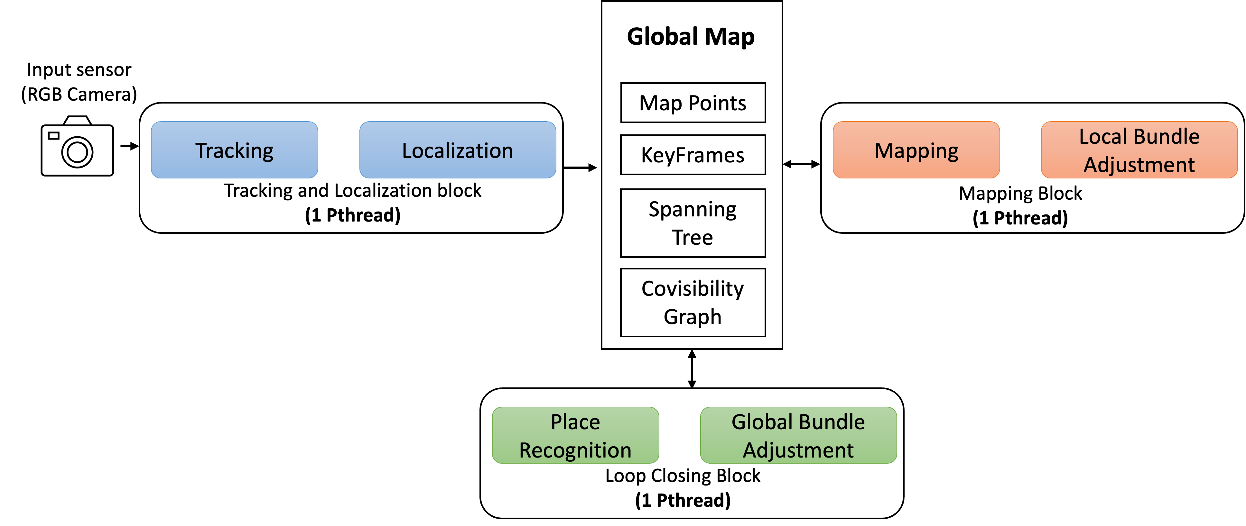
Visual SLAM– Multi-Threaded Application
Basic Modules
Tracking
Mapping
Loop closing
Modular approach with concurrent modules
Shared data structures comprise global map
Modules frequently access global map
Protected by some synchronization primitive
Read Copy Update (RCU): a favorable synchronization primitive
Notes:
A typical SLAM workflow uses three basic modules: tracking, mapping and loop closing. Basically, incoming images are processed to track the device’s location, and this location information is then incorporated into a global map, with ongoing optimization of the map structure.
The good thing about SLAM systems is that they adopt a modular approach where the modules run concurrently and in parallel with each other in order to keep up-to-date with real-time camera streams and to perform these operations as quickly as possible. But there is a tight coupling between modules. All modules operate on the global map, implemented as a shared data structure, and engage in computationally intensive operations, frequently accessing and updating the map.
Shared memory access is usually regulated by a synchronization primitive and there is a lock-less synchronization primitive called as Read Copy Update (RCU) that is favorable to SLAM systems. But what is RCU?

Slide 4
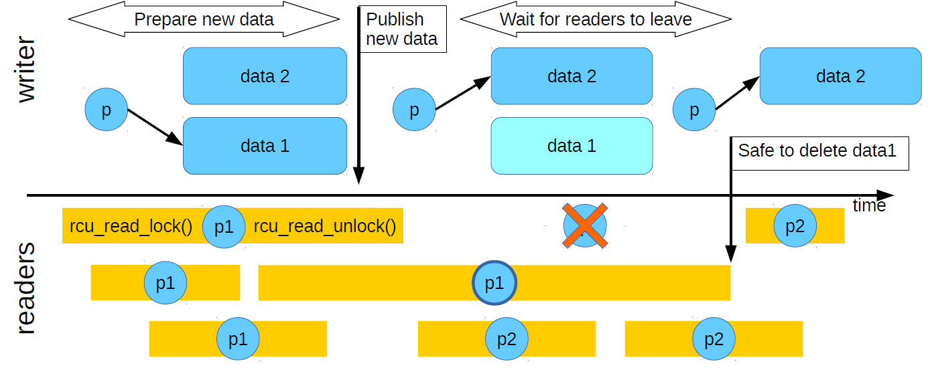
Synchronization Primitive: Read-Copy-Update (RCU)
Grace Period
Lock-less concurrency construct:
Concurrent forward progress of both readers and writer
RCU maintains multiple time-stamped versions of each data item
a current version
and prior “stale” versions in their respective grace periods
[1] “Read, Copy, Update… Then What?” Fedor G Pikus, CppCon 2017
Notes:
1. Read-Copy-Update (RCU) is a synchronization primitive that allows concurrent forward progress for both writers and readers.
2. The figure shows the workings of RCU protocol. In the figure, the current update marked by data 1 is referenced by pointer p. To publish a newer version of a data item, the writer creates a copy of the RCU protected data item, modifies this copy with the newer version of this data item, and atomically replaces the old reference with a reference to this newer version. Notice that the pointer p now references new update item marked by data 2. Notice that this publishing process runs concurrently with ongoing read processes that continue to read the old copy/version using the old reference. However, new read requests read the most recent version.
3. Since some readers in progress hold reference to “stale” data, for example in this figure it is the fourth reader, the system defers memory reclamation of old data until after each reader in progress has finished executing its read-side critical section. Therefore, at any point of time, RCU can maintain multiple time-stamped versions of a data item that are concurrently read by readers in the system.

Slide 5
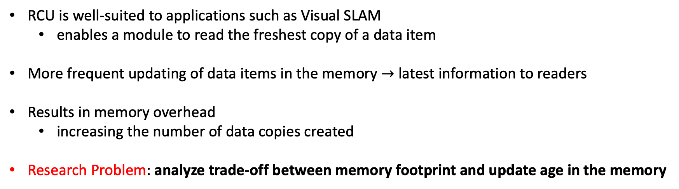
Real Time Applications and RCU
RCU is well-suited to applications such as Visual SLAM
enables a module to read the freshest copy of a data item
More frequent updating of data items in the memory $→$ latest information to readers
Results in memory overhead
increasing the number of data copies created
Research Problem: analyze trade-off between memory footprint and update age in the memory
Notes:
RCU is well-suited to applications such as Visual SLAM because it enables a module to read the freshest copy of a data item. From a timeliness perspective, more frequent updating of data items in the memory provides the latest information to readers but this results in memory overhead by increasing the number of data copies created. While Visual SLAM serves as an illustrative example, the broader motivation is to explore the trade-off between memory usage and update age in real-time systems.

Slide 6
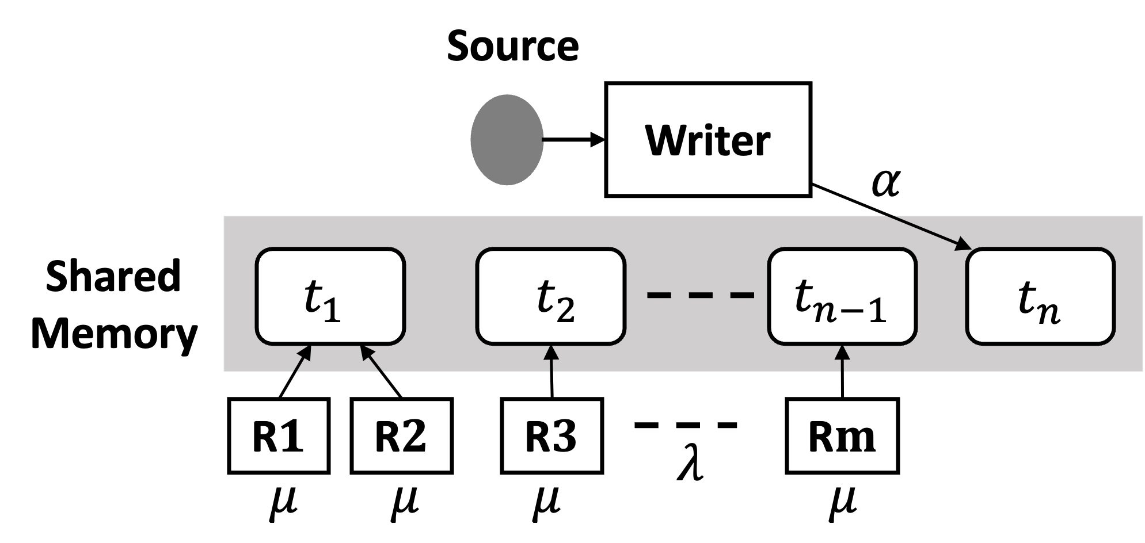
System Model
Writer writes/publishes source updates to the memory
creating a new copy for each fresh update
Reader reads source updates from the memory for a client
Multiple “old” readers concurrently access distinct versions of update copies
Memoryless RCU model
write initiations and read requests are memoryless Poisson point processes
Notes:
In this work, we focus on a class of systems as shown in the figure in which a source generates time-stamped updates, which are stored in shared memory. The writer queries this source for fresh measurements to update the memory, creating a new copy therein. Concurrently, a reader serves clients’ requests for these measurements by accessing the memory. Multiple ‘old’ readers may concurrently access distinct versions of data copies, depending upon the time of their request.
We assume a memoryless RCU model where both write initiations and read requests are memoryless Poisson point processes.

Slide 7
RCU Memory Footprint Analysis
Memoryless RCU model
write initiations and read requests are memoryless Poisson point processes
Memoryless read times
Birth-death process of read locks is an$M/M/∞$queue
Challenge: birth-death process of update copies in memory not $M/M/∞$
update $n$ tagged by number of read requests that depends on write time of update $n + 1$
Notes:
There are a couple of important things to note here. Since read requests arrive as a Poisson process and the reads have exponential holding/service times independent of the number of concurrent read requests of an update, the birth-death process of read locks is an M/M/∞ queue.
However, from the perspective of the birth-death process of update copies in memory, the RCU system is complicated because update n is tagged by a number of read requests that depends on the write time of update n + 1. This implies that the service/active time of an update depends upon the inter-arrival time of the next update; this is not an M/M/∞ queue.

Slide 8
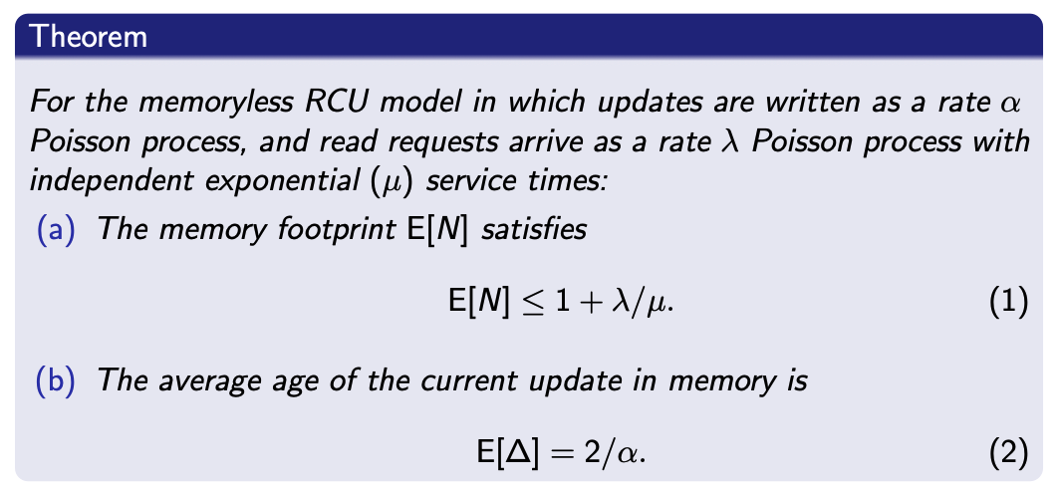
RCU Memory Footprint Analysis
Challenge: birth-death process of update copies in memory not an $M/M/∞$
update $n$ tagged by number of read requests that depends on write time of update $n + 1$
Notes:
One of the main results of the paper provides a theorem describing the exact analytical expression for the memory footprint E[N] and the average age E[∆] of an update in memory in terms of the system parameters λ, μ and α. Here, for the ease of discussion, we only show an upper bound that we derived, that is given by equation 1. The average age expression is a canonical age expression as the writer starts writing a fresh update as soon as it finishes its previous write.

Slide 9
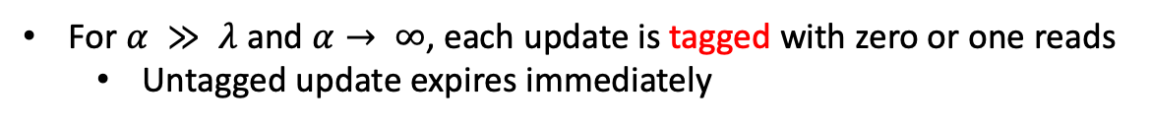
RCU Memory Footprint Analysis
For $α ≫ λ$ and $α→ ∞$, each update is tagged with zero or one reads
Untagged update expires immediately
Tagged updates have a one-to-one correspondence with the reads
A tagged update enters a grace period with duration $exp (μ)$of read time.
Number of tagged updates $↔$ Number of reads in system $↔$ $M/M/∞$ queue with arrival rate $λ$ and service rate $μ$
Number of tagged updates in the system follows a Poisson distribution with mean $\frac{λ}{μ}$
Notes:
We now give some intuition for the upper bound to E[N] as given in equation 1.
When write rate α is much larger than read request rate λ, each update is tagged with zero or one reads. As α → ∞, an untagged update expires immediately as it is replaced by the next update. On the other hand, a tagged update enters a grace period with duration corresponding to the exponential (μ) service time required by its read. Hence tagged updates have a one-to-one correspondence with the reads in the system.
The number of tagged updates is described by the M/M/∞ queue process with an arrival rate λ and service rate μ that characterizes the number of reads in the system.
Therefore, in the limiting case of really fast write process, the number of tagged updates in the system follows a Poisson distribution with mean \lambda/\mu.
Furthermore, there is always one untagged update that is perpetually being replaced. Hence, the average number of updates holding a read lock is E[N ] = 1+λ/μ.

Slide 10
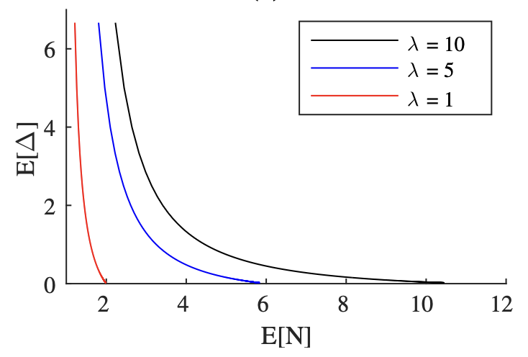

Memory footprint and Age Trade-off
Trade-off between the average age and number of update copies as a function of writing rate $α$
Read service rate $μ=1$
Notes:
The figure plots age-memory trade-off over writing rate between (0, ∞), showing that minimal average age at the readers is achieved when updates are written as fast as possible, but this is at the expense of an increased memory footprint.
Notice that average age = 0 corresponds to when writing rate tends to infinity. We just discussed this case, and notice that the the average number of update copies is approaching \lambda, since read service rate \mu is set to 1 here.

Slide 11
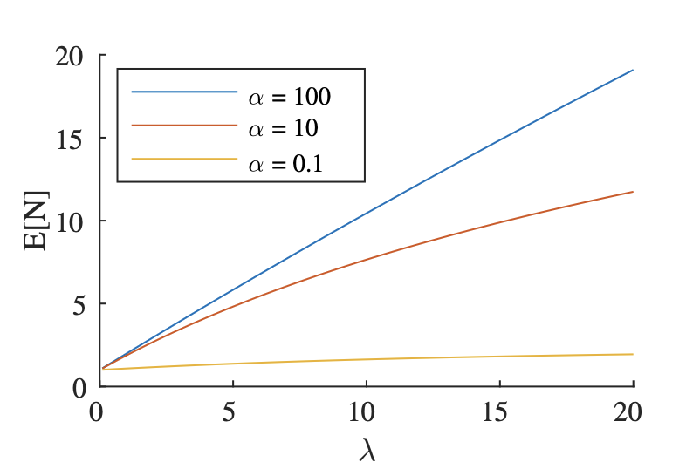
Memory Footprint Analysis
for a fixed write rate $α$, memory footprint is an increasing function of the read request rate λ
Notes:
However, for a fixed write rate α, the memory footprint is an increasing function of the read request rate λ as shown in this figure. We see that both the analysis and numerical evaluation highlight the trade-off between age and memory observed in the RCU mechanism

Slide 12
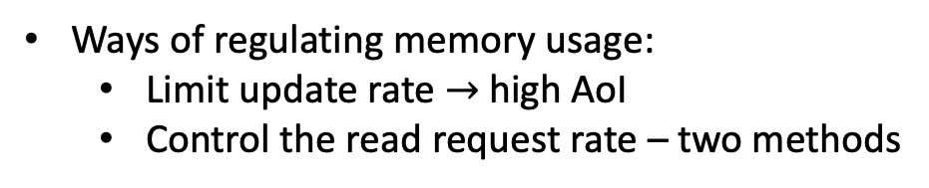
Conclusion
Central question : whether frequent updating $→$ excessive memory consumption in RCU?
Finite memory footprint given finite average read time and read request rate
Ways of regulating memory usage:
Limit update rate $→$ high AoI
Control the read request rate – two methods
Method 1: Sequential operation
but sequential operation slows the overall update processing rate
Method 2: Use of local copies
but local copy stale if the main memory has been updated
Future Work: Structuring application execution for timeliness
Notes:
To conclude, in this work, we focused on a central question that revolves around whether frequent updating can induce excessive memory consumption. The results provide a reassuring finding — given finite average service/read time and read request rate, the average number of updates in the system is finite.
Given that systems like SLAM run on mobile phones, this study is important since we need to find ways to regulate memory usage.
One way the memory usage can be regulated is by limiting the update rate of the writer, albeit at the expense of high AoI.
Alternatively, the memory footprint can be reduced by controlling the read request rate
Sequential operation can effectively reduce the read request rate. But sequential operation slows the overall update processing rate.
An alternate approach utilizes local copies where the application makes a
single read to store the current data item in a local copy. This local copy is then utilized by the subsequent module executions.
We conclude that timeliness analysis of these proposals for structuring the execution of the updating application is likely to be application-specific and remains as future work.

