Slide 1
Lock-based or Lock-less: Which is Fresh?
Vishakha Ramani, Jiachen Chen, Roy D. Yates
{vishakha, jiachen, ryates}@winlab.rutgers.edu
WINLAB, ECE Dept.
IEEE INFOCOM 2023
May 18, 2023
Notes:
Hello, I am Vishakha Ramani and today I’ll be talking about our paper on Lock-based and Lock-less concurrency constructs that impact the timeliness in status updating systems. This is a joint work with my wonderful collaborators at Rutgers: Jiachen Chen and Professor Roy Yates

Slide 2






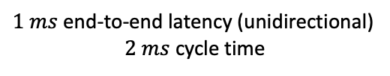
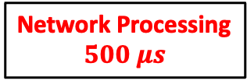


Understanding the behavior of a single network node
Master Control
Network Domain
Slave Robot
End devices want fresh information
$1 ms$ end-to-end latency (unidirectional)
$2 ms$cycle time
Application Processing
$$250 μs$$
Robotic Device Processing
$$250 μs$$
Network Processing
$$500 μs$$
Notes:
The question is does the current network architecture support a low-latency application. For example, let’s consider this cyber-physical system application. We have a Master control on left hand side, and it generates a movement update. This application processing takes around 250 us. The update travels through the network and it is received by the slave robot. The robotic device processing takes around 250 us to process the movement update and generate the corresponding movement in the robotic arm. For this application, the end-to-end latency requirement is 1ms. So, the leeway for the network or in other words, the network processing time limit is around 500 us. This means that the network cannot afford to lose more than say 100 us in processing on each node. So, it is important to understand different components that introduce delay.

Slide 3
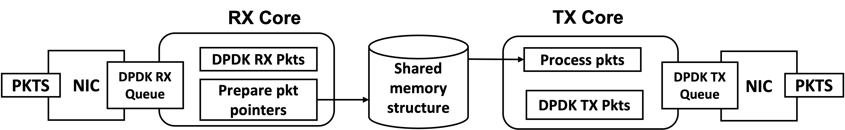

High Performance Packet Processing
Propagation delay is negligible:
Widespread – 10 Gbps,
Gaining traction – 25, 40, 100 Gbps
Bottleneck in packet handling:
I/O processing limits networks performance
Key bottleneck: Synchronization between multiple processors accessing shared memory
Notes:
With widespread adoption of extremely high bandwidth links, the propagation delay is almost negligible.
However, we contend that the bottleneck is in the packet handling. It is the input output processing that is limiting the future network performance.
And in the router, this is the application that typically runs on it. You have packets that are received on the NIC that are received by the receive core. The Rx core does some sort of a processing using the shared memory structure, meaning it updates the shared memory based on the data in the packet, The transmit core uses this update in memory to modify a packet and sends it out. Now there is a critical success factor in these applications. It is the synchronization between multiple processors accessing shared memory. And we would like to study this aspect.

Slide 4

Synchronization Primitive: Readers-Writer Lock (RWL)
R
Source
Writer
Reader
W
Source
Writer
Reader
Enforces mutual exclusion between readers and writer.
Notes:
I am now going to present some of the most common concurrency constructs used in any network software library. First is Readers-Writer Lock(RWL)
So, if you have a reader. It puts a read lock and reads from the memory,
and when the writer comes in and requests a write lock,
then its request is denied.
Next, when the writer holds a write lock, meaning that the writer is updating the memory,
Then if the reader tries to access the memory,
this access is denied.
In essence, RWL enforces mutual exclusion between readers and writers to regulate the access to the shared memory region

Slide 5


Synchronization Primitive: Read-Copy-Update (RCU)
Source
Writer
$$u(t_{1})$$
$$u(t_{0})$$
Reader
Lock-less concurrency construct:
Concurrent forward progress of both readers and writer.
Notes:
An alternative lock-less concurrency construct is called as Read-Copy-Update (RCU).
If you have a reader that is reading a value of a particular data item,
The writer when it obtains a newer value of data item, essentially makes a copy of the previous item, and starts updating this copy with the new value.
So, RCU is a lock-less synchronization primitive that allows concurrent forward progress of both readers and writer.

Slide 6
Synchronization Primitive: Read-Copy-Update (RCU)
Source
Writer
$$u(t_{1})$$
$$u(t_{0})$$
Reader
Reader
New read request reads the most recent update
Notes:
So now what we have is that the reader is reading the older value, and the writer has published a new value of the data item. So when a new read request comes in, it reads the most recent update.

Slide 7

Synchronization Primitive: Read-Copy-Update (RCU)
Source
Writer
$$u(t_{1})$$
$$u(t_{0})$$
Reader
Reader
Memory of the old copy reclaimed after at the end of grace period
Notes:
So now what we have is that the reader is reading the older value, and the writer has published a new value of the data item. So when a new read request comes in, it reads the most recent update.

Slide 8
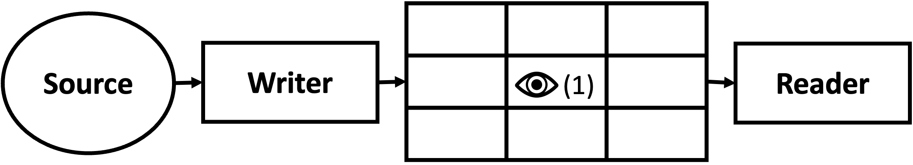
Information Freshness In Shared Memory
Shared Data Structure
Synchronization primitives on shared data structures:
Avoid race conditions
Ensure data correctness
Impact of synchronization primitives
Delay in packet processing
Timeliness of the data accessed from shared memory
Performance metric: Age of Information (AoI)
Notes:
We would like to compare the performance of RWL ad RCU on the shared data structure in the network software library. So we take this real-life application and try to model it in this way where we have source that sends updates to the writer and the writer tries to write to the shared memory and you can imagine that there is client that request the reader to read from the memory.
1. For that, we would have to use synchronization primitives. The primitives avoid race conditions and ensure data correctness. Now synchronization primitives have been a topic of study in computer science for many years now. However, the impact of these constructs on the packet processing and timeliness of information in the memory has not been studied.

Slide 9
Update Age X(t)
X(t) = age of the most recently received update
Update
Submission
Delivery
X(t)
Average Age
T
t
Notes:
The age process of most recently received update at the destination is a stochastic process that behaves like a sawtooth process.
At time 0 the age of most recent update has some value, and it grows linearly with unit rate. At at some time, an update is created and inserted into the system by a source. At the later time, this update is received by the monitor, the age at the monitor drops, and it drops to the value equal to the time elapsed since this update was generated, and then nothing happens and the age grows. Again….
The average at the monitor is

Slide 10




Timely Update Forwarding
App updates
Forwarding Table
Location update
Destination | Port
101 | 3
102 | 0
103 | 3
104 | 2
105 | 1
Application Server
4
Network
Update forwarding with coupled updating processes:
Location Updates from mobile terminals stored/written in FIB.
App Server Updates addressed (by reading from FIB) and forwarded to mobile terminal.
Notes:
To understand the effects of concurrency constructs on timeliness, we consider a practical example of packet forwarding in a mobile user environment. The example works as follows:
An application server in the network is sending “app updates” regarding a process of interest to a mobile terminal.
The application sends its update packets to a forwarding node in the network.
This forwarder maintains a Forwarder Information Base (FIB) that tracks the location (i.e. point of attachment network address) of the mobile terminal.
At the forwarder, app updates are addressed using the FIB and forwarded to the mobile terminal.
Now the user moves
It sends it new location to the forwarder And this newer location is updated in the forwarding table.
Now when the application server sends the application update to the user, at the forwarder, this is addressed appropriately.
So we have these coupled age processes over here. You have location updates that are sent from the mobile terminal and that are written into the forwarding table. And then there are app server updates that initiate the reader process in the forwarder so that they can be addressed properly. So we can see that there is a contention to access FIB.

Slide 11
Timely Update Forwarding
App updates
Forwarding Table
Location update
Destination | Port
101 | 3
102 | 0
103 | 3
104 | 2
105 | 1
Application Server
Network
What can go wrong?
If a FIB read returns an outdated address, the misaddressed app update is lost in transit → increased age at the mobile
Notes:
But what could go wrong in such systems?
So suppose an application server sent an app update. But the app update is misaddressed because it read the old location. The app update is never received at the mobile, resulting in increased age at the mobile.

Slide 12
Timely Update Forwarding: RWL States
1. Write lock active, reader idle
3. Write lock active, Read lock pending
W
W
Writer
Reader
Writer
Reader
2. Read lock active, writer idle
4. Read lock active, Write lock pending
R
R
Writer
Reader
Writer
Reader
Notes:
So let’s consider different states in the packet forwarding example when RWL is used
A new location update arrives at the packet forwarder. The writer process puts a write lock. There are no app updates at the forwarder, so the reader is idle.
Alternatively, a new app update arrives at the forwarder to be addressed. The reader process puts a read lock. There are no location updates, so the writer is idle.
A forwarder can be in a state where a new location update is currently written to the FIB (so the write lock is active), and meanwhile an app update arrives. Because of the mutual exclusion, The read lock request is now pending and the app update is queued at the reader.
Alternatively, the forwarder can be in a state where the new app update is getting addressed (so the read lock is on), and meanwhile a new location update arrives. Again because of mutual exclusion, the write lock request is pending and the location update is queued at the writer.

Slide 13
RWL States: Consequences on App Update Age
1. Write lock active, reader idle
3. Write lock active, Read lock pending
W
W
No Effect
Delay in App Update
Writer
Reader
Writer
Reader
2. Read lock active, writer idle
4. Read lock active, Write lock pending
R
Addressed Properly
R
Misaddressed
Writer
Reader
Writer
Reader
Notes:
Given all possible states the system can be in. we can now see how each state in the forwarder affects the app update age at the mobile.
In the first case, there is no app update at the forwarder, meaning there is nothing the forwarder can do, and there is no effect on app update age due to the forwarder.
In the second case, the app update is addressed with the most recent location in the FIB. This app update will arrive at the mobile, hence resetting the age.
In the third case,

Slide 14
Timely Update Forwarding: RCU States
1. Writer active, reader idle
3. Both writer and reader active
Writer
Reader
Writer
Reader
2. Writer idle, Reader reading fresh location
4. Writer idle, Reader reading stale location,
Writer
Reader
Writer
Reader
Notes:
let’s consider different states in the packet forwarding example when RCU is used

Slide 15
Timely Update Forwarding: RCU States
1. Writer active, reader idle
3. Both writer and reader active
No Effect
Misaddressed
Writer
Reader
Writer
Reader
2. Writer idle Reader reading fresh location
4. Writer idle, Reader reading stale location,
Addressed Properly
Misaddressed
Writer
Reader
Writer
Reader

Slide 16

Timely Mobile Routing: An Analytical Study
Forwarding Table
Destination | Port
101 | 3
102 | 0
103 | 3
104 | 2
105 | 1
Freshness of app update at mobile depends on:
App updates
Synchronization primitive
update addressed correctly
Application Server
Location update
!
Update processing at router
using preemption to serve freshest update
User mobility
Analysis based on Stochastic Hybrid Systems for AoI.
Network
Performance Metric: Age of app update at the mobile terminal
Notes:
Looking at the different states arising with RWL and RCU, we can see that the factors which dictate the freshness of app update at mobile clients are:
1. which synchronization primitive you use for FIB. It influences if the app update is addressed correctly
2. Queuing discipline at the reader process
There are certain design choices for the updates that are queued at the router. So suppose you have two updates that are queued at the router i.e. they are waiting to be addressed. With respect to AoI performace, don’t serve the first update, instead serve the freshest one. You can model this scenario using preemption such that the router can preempt an update that it is currently serving and starts serving the newly arrived update.
Looking at different states in RCU and RWL, It is hard to tell which one is better in terms of AoI and when preemption helps.
So we develop an analysis based on Stochastic Hybrid Systems to analyze the average age of app update at the mobile terminal. In the interest of time, I am skipping the introduction of Stochastic Hybrid Systems and how this magical mechanism helps us keep track of age of app update in each state and age resets with each state transition.

Slide 17
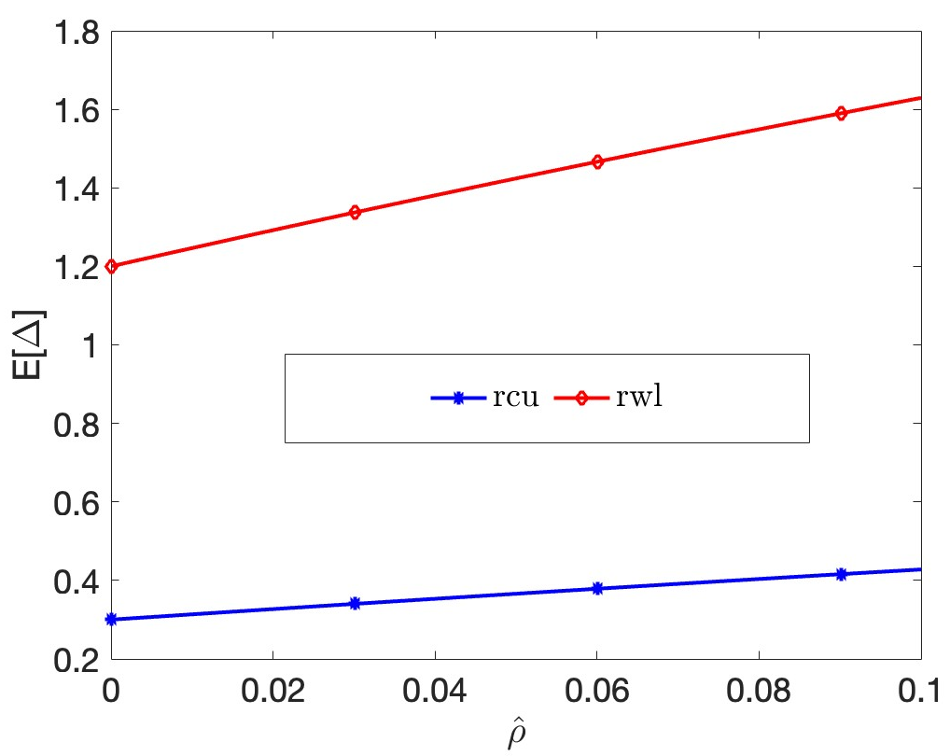
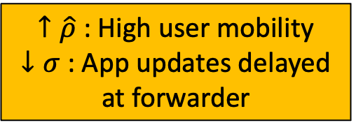
Numerical Results: RCU vs RWL
Freshness of app update at mobile depends on:
$\hat{ρ}$ : user mobility rate
Synchronization primitive
update addressed correctly
When RWL reads are 10 times slower than RCU
$↑\hat{ρ}$ : High user mobility
$↓σ$ : App updates delayed at forwarder
Avg age at mobile user
Notes:
I now present some of the results obtained by solving SHS equations numerically.
Our results are normalized with respect to write service times.
our evaluations will vary user mobility rate ρˆ over the interval [0, 0.1]. At ρˆ = 0, the mobile terminal is stationary and never changes its network address. On the other hand, the upper limit ρˆ = 0.1 represents an extreme value in that the average time between location changes 10× faster than the average time to write to shared memory. While this would be an extreme level of user mobility in a traditional wireless network environment, there may be other network scenarios in which the mobile user is perhaps a software agent, for which this is appropriate.
we plot the average app age E[∆] as a function of ρˆ where the RWL read times are 10 times slower than RCU. A larger ρˆ means that the mobile is moving faster and changing its location more frequently, and so more app update packets are misaddressed, resulting in increased app age at the mobile terminal for both RCU and RWL.
we notice the effect of slower reads in RWL on app age. The slower read corresponds to slower service time of app updates at the forwarder meaning that app updates are delayed. Additionally, a slower read with a read lock activated corresponds to the writer being locked out without being able to write a fresher location update.

Slide 18
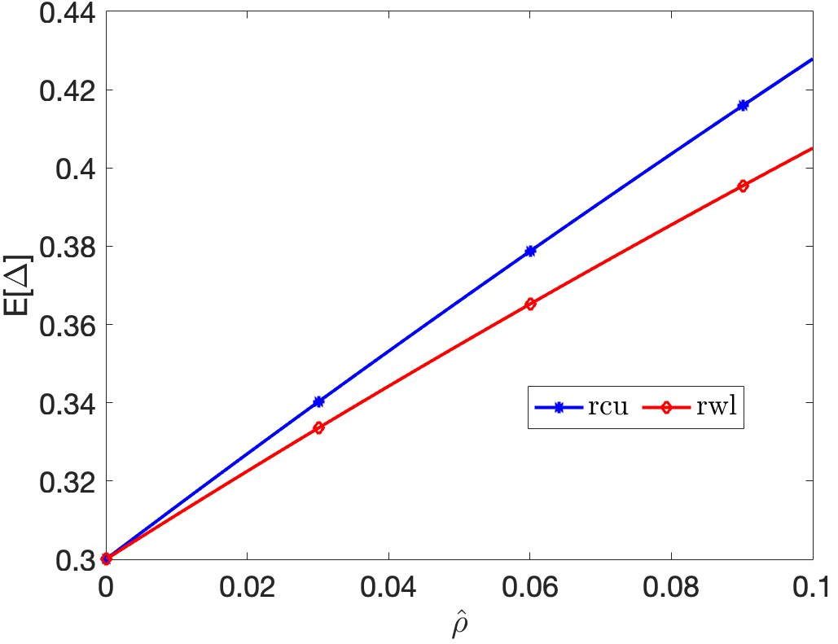
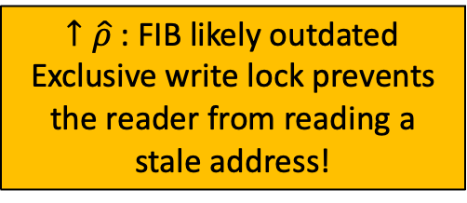

Numerical Results: RCU vs RWL
Freshness of app update at mobile depends on:
$\hat{ρ}$ : user mobility rate
Synchronization primitive
update addressed correctly
When RWL and RCU read times are similar
$↑\hat{ρ}$ : FIB likely outdated
Exclusive write lock prevents the reader from reading a stale address!
Avg age at mobile user
Notes:
RWL system with fast reads performs better than RCU especially at higher values of ρˆ In this case, larger ρˆ corresponds to a greater likelihood that the FIB address is outdated, but an exclusive write lock prevents the reader from reading a stale address. The lock-less operation of RCU on the other hand enables the reader to read the outdated FIB.

Slide 19
Numerical Results: Preemption
Freshness of app update at mobile depends on:
Update processing at router
using preemption to serve freshest update
Notes:
Next we consider the timeliness gain achieved by employing preemption of app updates held by the reader. This gain is almost 15% for RCU as demonstrated in left hand plot and 45% for RWL as demonstrated in right hand plot. From the AoI perspective, preemption helps more in RWL. For slow RWL reads, preemption allows the reader process to service the most recent app update. Nevertheless, we note that preemption mechanisms generally reduce AoI.

Slide 20
Numerical Results: Update Delivery
$\hat{ρ}$ : user mobility rate
App update delivered if read finishes:
before a location update occurs, or
before it gets preempted by a fresher app update.
When RWL reads are 10 times slower than RCU
Notes:
It is instructive to look at the probability that an app update arriving at the FIB is delivered to the mobile user.
We see that the app update is delivered if the update addressing finishes before a location update occurs or before this app update gets preempted by a fresher update.
The plot shows that probability of delivery for both RCU and RWL. The probability decreases as a function of normalized write request rate. In fact we saw that for both RCU and RWL that the average age E[∆] becomes worse as the delivery probability decreases.
The slower reads of RWL correspond to app update being frequently preempted by the fresher update as compared to RCU where reads are fast, hence the probability of app update delivery in RWL is less than that in RCU when reads are slower.

Slide 21
Numerical Results: Update Delivery
$\hat{ρ}$ : user mobility rate
App update delivered if read finishes:
before a location update occurs, or
Before it gets preempted by a fresher app update.
When RWL and RCU reads are similar
Notes:
When RWL reads are faster, the probability of app update delivery in RWL is more than in RCU, especially at high mobility rates. Since the exclusive write lock prevents the reader to read the stale address.

Slide 22
Conclusion
This work explored the impact of synchronization primitives on timely updating.
Tension between writer and reader
Timeliness of the location updates in the table is desirable
excessive updating at the expense of timely reading of the table.
Notes:
We modeled and developed a packet forwarding scenario in which location updates from a mobile terminal are written to a forwarding table and application updates need to read the forwarding table in order to ensure their correct addressing for delivery to a mobile terminal.

Slide 23
Final Thoughts
For software engineers – be careful in choosing synchronization primitive
Application requirements, degree of contention for memory
For network engineers - know what makes your system slow, and not favorable to timeliness!
optimize packet processing frameworks for timely updating systems
For researchers – Considerable work to be done
in exploring timeliness in other applications and systems employing shared memory.

