Slide 1


Database Connectivity and Display Plugin
Guided By: Prepared By:
Prof. Hemant Yadav Patel Vishakha(16it093)
Yadav Aastha(16it147)

Slide 2
Contents:
Objective
What is plugin?
How it works?
Screenshots
Future Plan

Slide 3
Objective:
Plugin will connect to database and retrieve the data and display the same on webpage.

Slide 4
What is plugin?
A plugin is a software add-on that is installed on a program, enhancing its capabilities.
Installing this plugin will be of great use to wordpress user to deal with database connection and display the data .

Slide 5
How it works?
WordPress plugin installed on your site is registered in your WordPress database. You can activate and deactivate them at any time you want.
And after installing plugin user has to write shortcode of plugin.

Slide 6
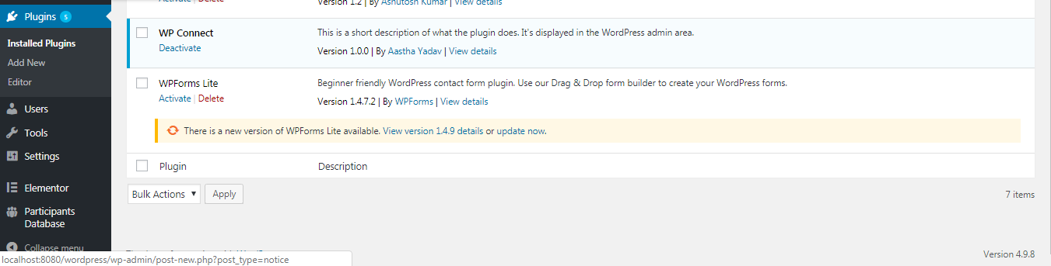

Slide 7
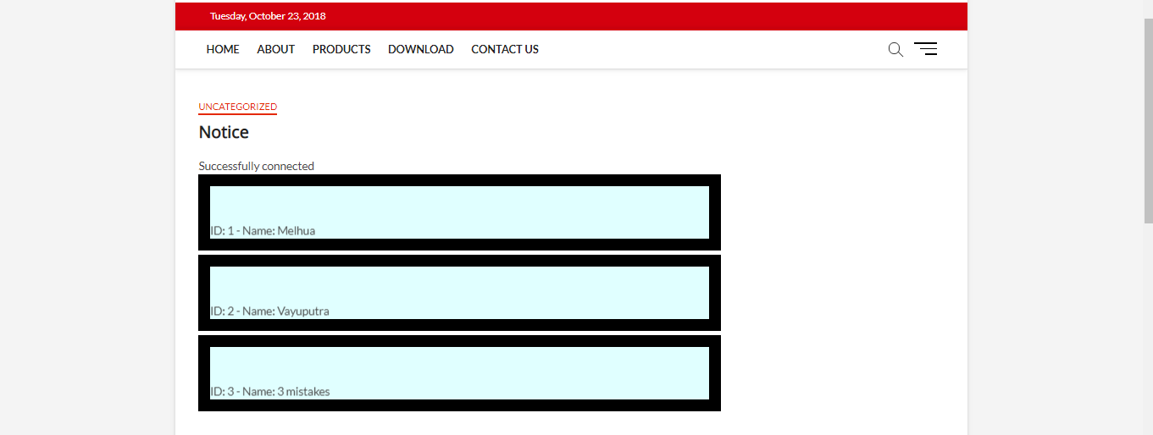
Screenshots:

Slide 8
Future Plan:
So the future enhancement is to make it more user friendly and deploy it on Charusat E-notice board website

Slide 9
Thank You

