Slide 1
IBM University Engagement Project Submission
“Exploring the Power of Agentic AI with IBM Granite and LangFlow”

Slide 2

Project Tile – ShopGenie AI: Intelligent Shopping Assistant
Domain of Project – E-Commerce
Student Name | Recent Passport Photo | Email ID | Mobile number [WhatsApp]
Vishakha Shivaji Kadam |  | vishakhakadam266@gmail.com | 9860823566

Slide 3
Problem Statement -
Problem Statement : Intelligent Shopping Agent
The Challenge
Shoppers today face an overload of product options, scattered reviews, and dynamic pricing across e-commerce platforms. Finding the right product that balances price, quality, and personal preferences is time-consuming and frustrating. Traditional recommendation systems often fail to capture real-time trends, personalized needs, or contextual factors like urgency, budget, or sustainability. The challenge is not just to recommend products but to act as a smart shopping companion that helps buyers make informed and confident decisions.
The Objective
Build an agentic AI shopping assistant that provides intelligent, personalized, and real-time support. The solution should:
Fuse Multisource Data
Enable Multimodal Search
Create a Predictive & Agentic LayerVisualize Smart Shopping Pulse

Slide 4
Proposed Solution -
The proposed solution is an AI-powered Intelligent Shopping Agent built using IBM watsonx Orchestrate, LangFlow, and IBM Granite Models to provide personalized and real-time shopping assistance. It helps users overcome challenges such as product overload, scattered reviews, price variations, and difficulty in choosing the right product.
The system includes four key capabilities:
Product Discovery Agent: Finds products based on user needs, budget, and preferences.
Recommendation Agent: Suggests personalized products and suitable alternatives.
Review & Price Intelligence Agent: Analyzes reviews, ratings, and pricing trends.
Shopping Advisor Agent: Compares products and helps users make informed purchase decisions.
Supporting text, voice, and image-based queries, ShopGenie AI acts as a smart shopping companion that delivers faster, personalized, and confident shopping experiences.

Slide 5
Technology Used
IBM watsonx Orchestrate – For building and deploying the intelligent shopping agent and managing user interactions.
IBM Granite Models – For natural language understanding, reasoning, and generating personalized shopping responses.
IBM Cloud – Provides scalable infrastructure for running AI services.
Retrieval-Augmented Generation (RAG) – For retrieving relevant product information and generating accurate responses.

Slide 6
Orchestrate component Used -
IBM watsonx Orchestrate Component | Purpose in ShopGenie AI
Chat Input | Accepts user shopping queries and preferences.
Prompt Template | Formats user queries and provides instructions to the AI model.
IBM Granite 4.0-8B-Instruct Model | Understands user intent and generates personalized product recommendations.
File/Data Loader | Provides product information and shopping knowledge to the AI.
Chat Output | Displays product recommendations and shopping guidance.

Slide 7
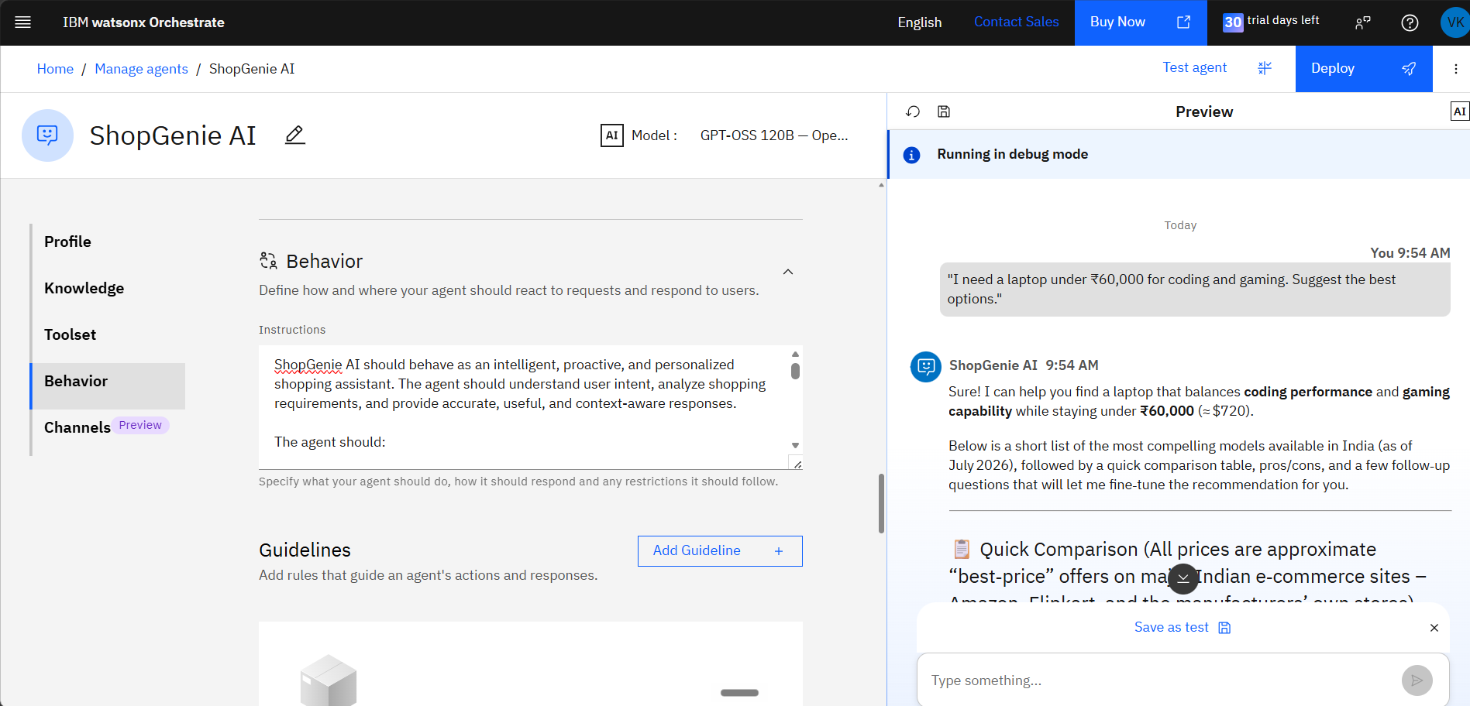
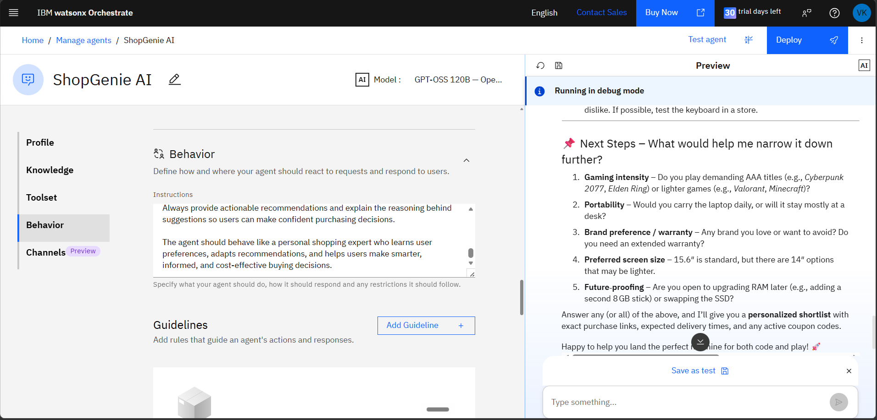
IBM Orchestrate Workflow-

Slide 8
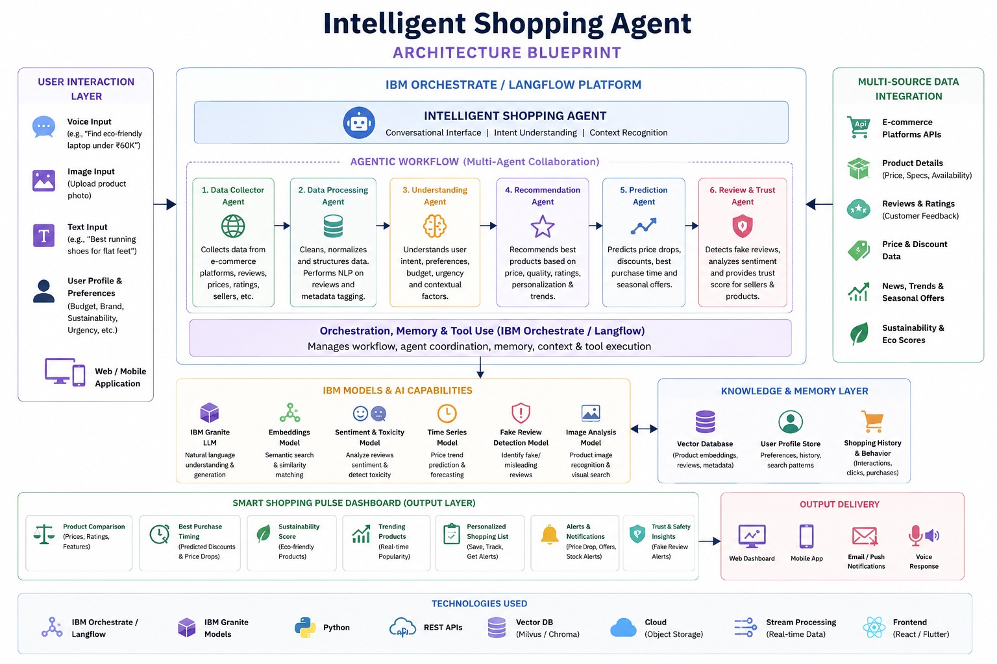
Architecture blueprint

Slide 9

Role of Agentic AI in the solution
Role of Agentic AI in ShopGenie AI
Agentic AI enables ShopGenie AI to function as an intelligent shopping assistant rather than a basic chatbot. Powered by IBM watsonx Orchestrate and IBM Granite Models, it understands user needs and delivers personalized shopping recommendations.
The AI agent analyzes user preferences, compares products, summarizes reviews, and suggests suitable alternatives. It considers factors such as budget, brand preferences, and product requirements to provide context-aware recommendations.
By adapting to user inputs and evaluating product information, ratings, and features, Agentic AI helps users make informed purchase decisions.
Overall, Agentic AI makes ShopGenie AI a proactive, personalized, and intelligent shopping companion that simplifies product discovery and improves the shopping experience.

Slide 10
Novelty and Uniqueness
Unique Value Proposition of ShopGenie AI
ShopGenie AI combines Agentic AI and personalized shopping assistance to deliver a smarter shopping experience.
Multi-Agent Intelligence – Specialized AI agents work together to understand user needs and provide accurate recommendations.
AI-Powered Insights – Analyzes product details, ratings, and reviews to suggest the best options.
Hyper-Personalization – Recommends products based on budget, preferences, and shopping requirements.
Real-Time Assistance – Adapts responses according to user queries and preferences.
Smart Decision Support – Helps users compare products and discover suitable alternatives.
Scalable AI Platform – Built using IBM watsonx Orchestrate and IBM Granite Models for reliable and efficient AI-powered shopping guidance.
Overall, ShopGenie AI acts as an intelligent shopping companion that helps users make faster, smarter, and more confident purchasing decisions.

Slide 11
Git Hub Link
https://github.com/vishakha2609/ShopGenie-AI-Intelligent-Shopping-Assistant
Files in Repo-
README.md
app.json
ShopGenie_Problem_Statement.pdf
ShopGenie_Project_Presentation.pptx
index.html
style.css
javascript.js
·
·
·

Slide 12
Future Scope
1. Integration with E-Commerce Platforms & Price Tracking Systems – The system can be integrated with multiple e-commerce platforms to collect real-time product information, prices, availability, and offers. This will enable ShopGenie AI to provide better price comparisons, detect discounts, and suggest the best time to purchase products.
2. AI-Powered Voice Assistant & Multilingual Support – Enhancing the system with voice-based interaction and multiple language support will improve accessibility and user experience. Users will be able to search products, compare options, and receive recommendations in their preferred language, making the shopping assistant more inclusive and convenient.
·
·
·

Slide 13
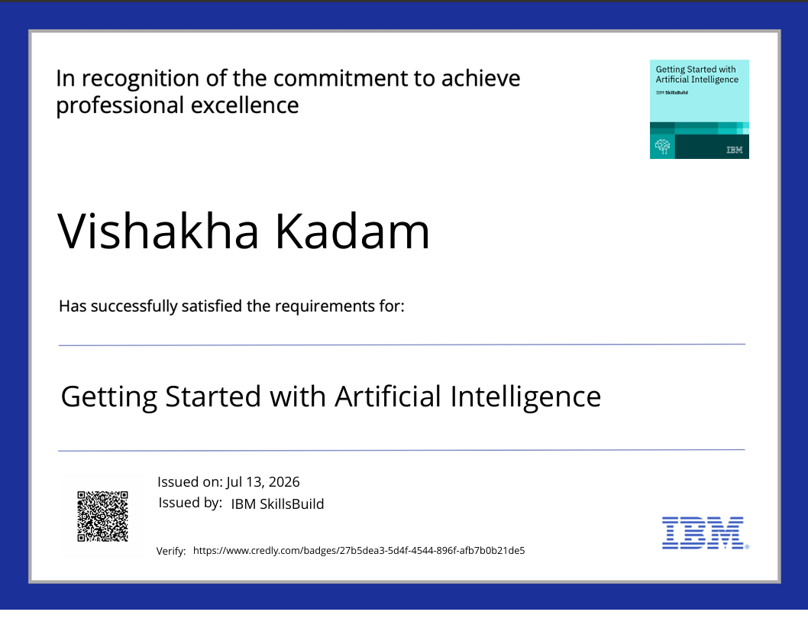
Certificates Earned:

Slide 14
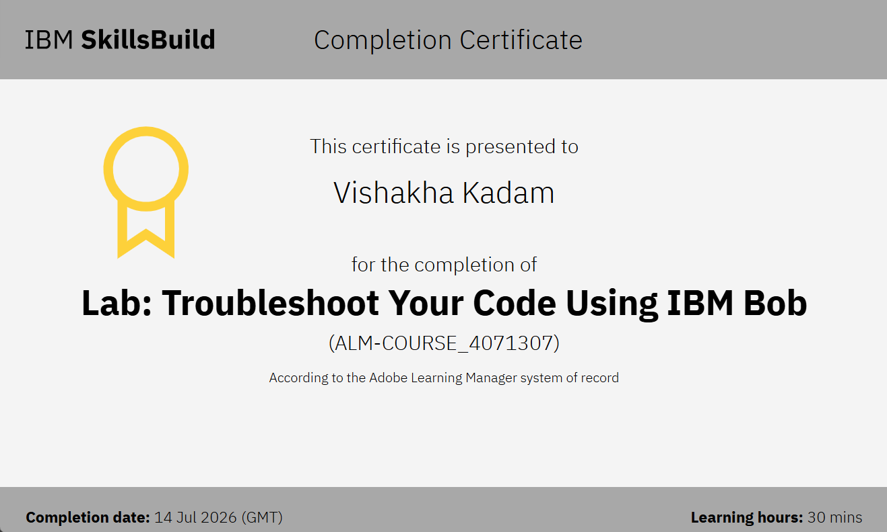
Certificates Earned:​

Slide 15


