Slide 1
Enhance Your Editing Experience
MRUH-D

Slide 2
Contents
01
02
03
04
Introduction
Project Description
Demonstration
Impact and Future

Slide 3
01
Introduction
Project Overview
Motivation

Slide 4
Project Overview
Our projects purpose is to improve the editing experience for users.
This project aims to develop a browser extension that involves highlighting spelling errors to make editing more user-friendly.

Slide 5
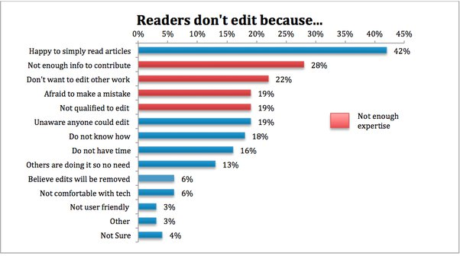
Motivation
Explain why this project is important?
Makes editing feasible
Encourages participation
Who it benefits?
Editors
Wiki community

Slide 6
Project Description
02
The Challenge
Our Solution
Key Features

Slide 7

Challenges
Familiarity Blindness
Selective attention
We often become blind to errors in text we’ve written or read multiple times. Our brains tend to fill in the gaps and assume words are spelled correctly, even if they’re not
“Our brains prioritize meaning over mechanics”. While editing, we’re so focused on conveying ideas that typos and spelling errors can slip by unnoticed

Slide 8


Solution
Detect spelling errors
Chrome Extension
Dictionary Lookup

Slide 9
Key Features
User Friendly Extension
Check Spelling Errors
Can use with any wiki text editor

Slide 10
03
Demonstration
Live Demo
Screenshots

Slide 11
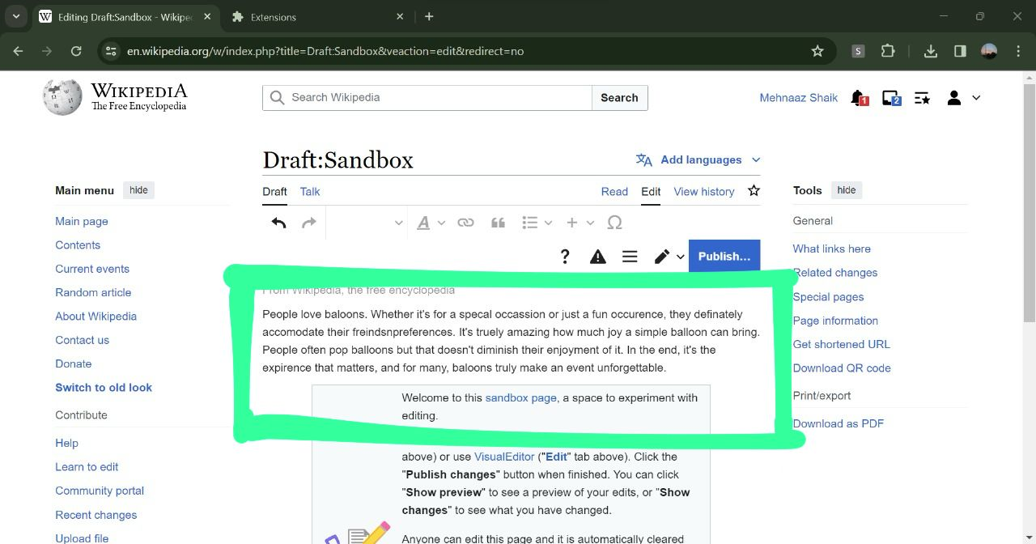

Slide 12
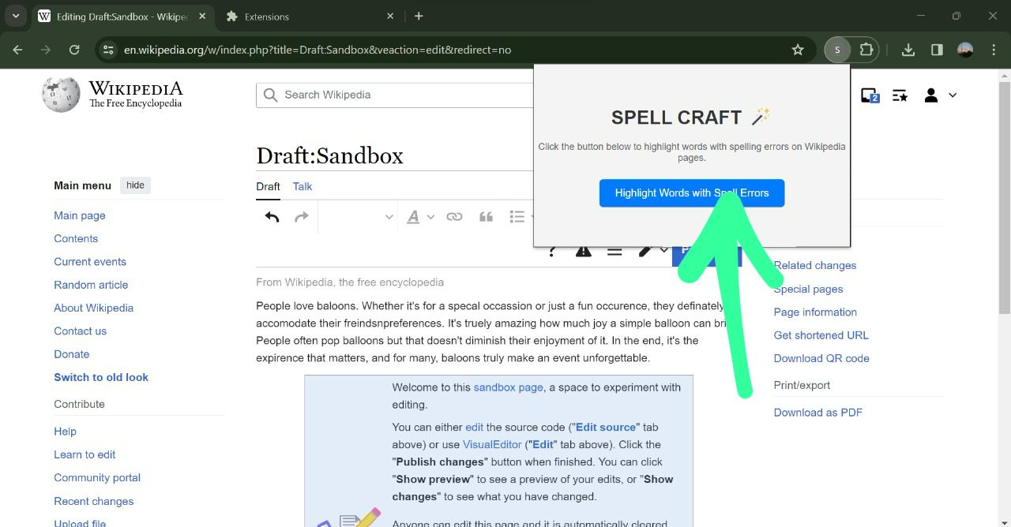

Slide 13
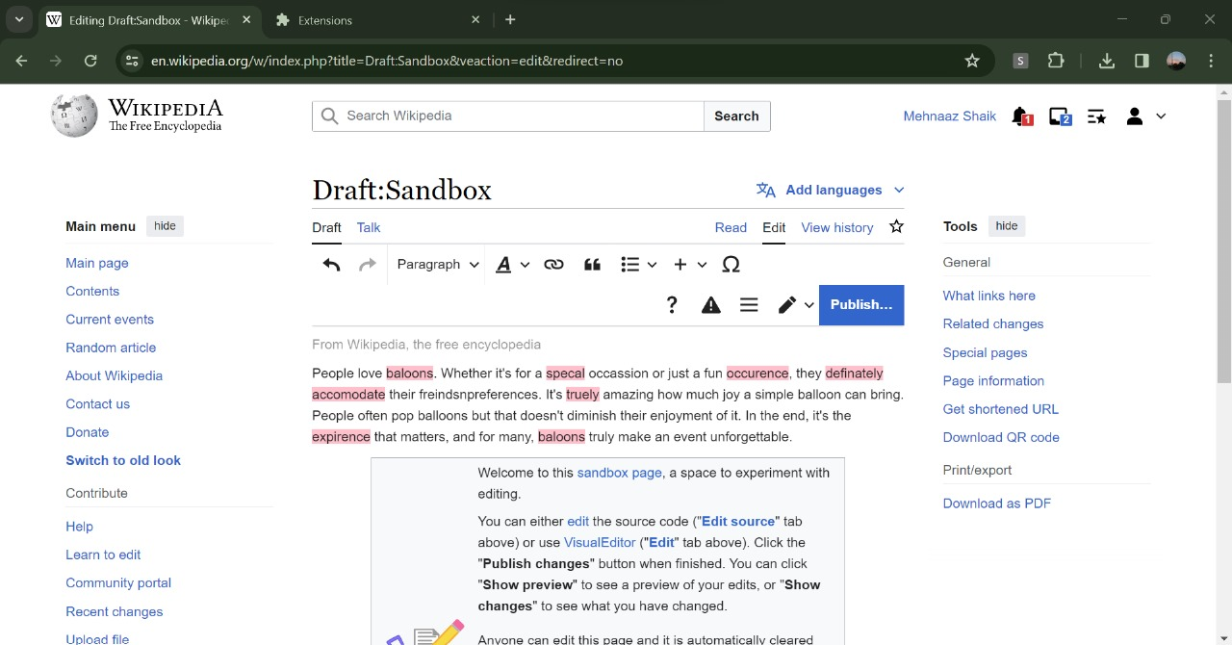

Slide 14
04
Impact and Future Scope
Potential Impact
Future Work

Slide 15
Potential Impact
Future
Work
Autocomplete
Grammar check
Link suggestions
Vocabulary enhancer
Auto summarization
Enhanced accuracy
More contribution
Boosts content quality

Slide 16
THANKYOU!

