Slide 1
IBM Call For Code 2020
Track: Climate Change
Waste Segregation – Nip it in bud
Author: Vishakha Bhasin
Vishakha.bhasin@morganstanley.com

Slide 2
Content
1 | Problem Statement
2 | The idea
3 | Diagram
4 | Solution Description
5 | MVP 1 : Build Watson Assistant chatbot
6 | MVP 2 : Integration of chatbot

Slide 3
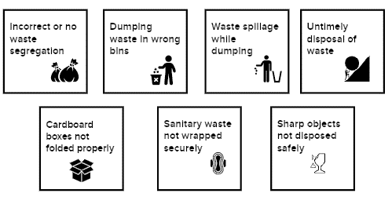
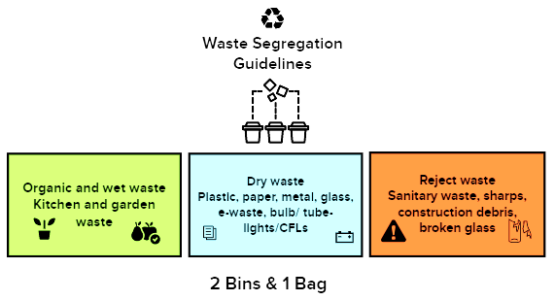
Problem Statement
General issues seen with Waste Segregation at home
Our household waste contributes to about 70-80 percent of the total Municipal Solid Waste (MSW) generated in a city.
Unsegregated waste in the form of trash becomes hazardous quantity cause land pollution, and makes the soil toxic.
There is also a growing need to decrease the amount of wastes thrown in landfills because of the increasing problem on the lack of available lands to dump trash.
Waste segregation at source is the dire need of the hour. The best place to start making a difference is right in your own home.
In order to save our environment and to improve the quality of the atmosphere we live in, it’s necessary that we make waste segregation a habit and not an obligation.

Slide 4
The idea
Using Watson Assistant, we will launch a ‘Nip it in the bud’ initiative where we will design a virtual assistant pre-loaded to educate and respond to common questions about waste segregation, scan the guidelines and articles using Watson Discovery, and create awareness with data from trusted sources.
With this Watson Assistant-powered communications starter kit, one can integrate a chatbot into the Call for Code solution in an IBM Cloud-hosted web server, using a Slack integration, or via a Node-RED dashboard.
It can:
Educate, create awareness and respond by sharing consistent, accurate waste segregation guidelines
Help citizens quickly and easily access the information through their channel of choice – voice, text, or collaborative tool
Free valuable resources by automating answers to common waste segregation questions
Dynamically update information with the latest developments and recommendations

Slide 5
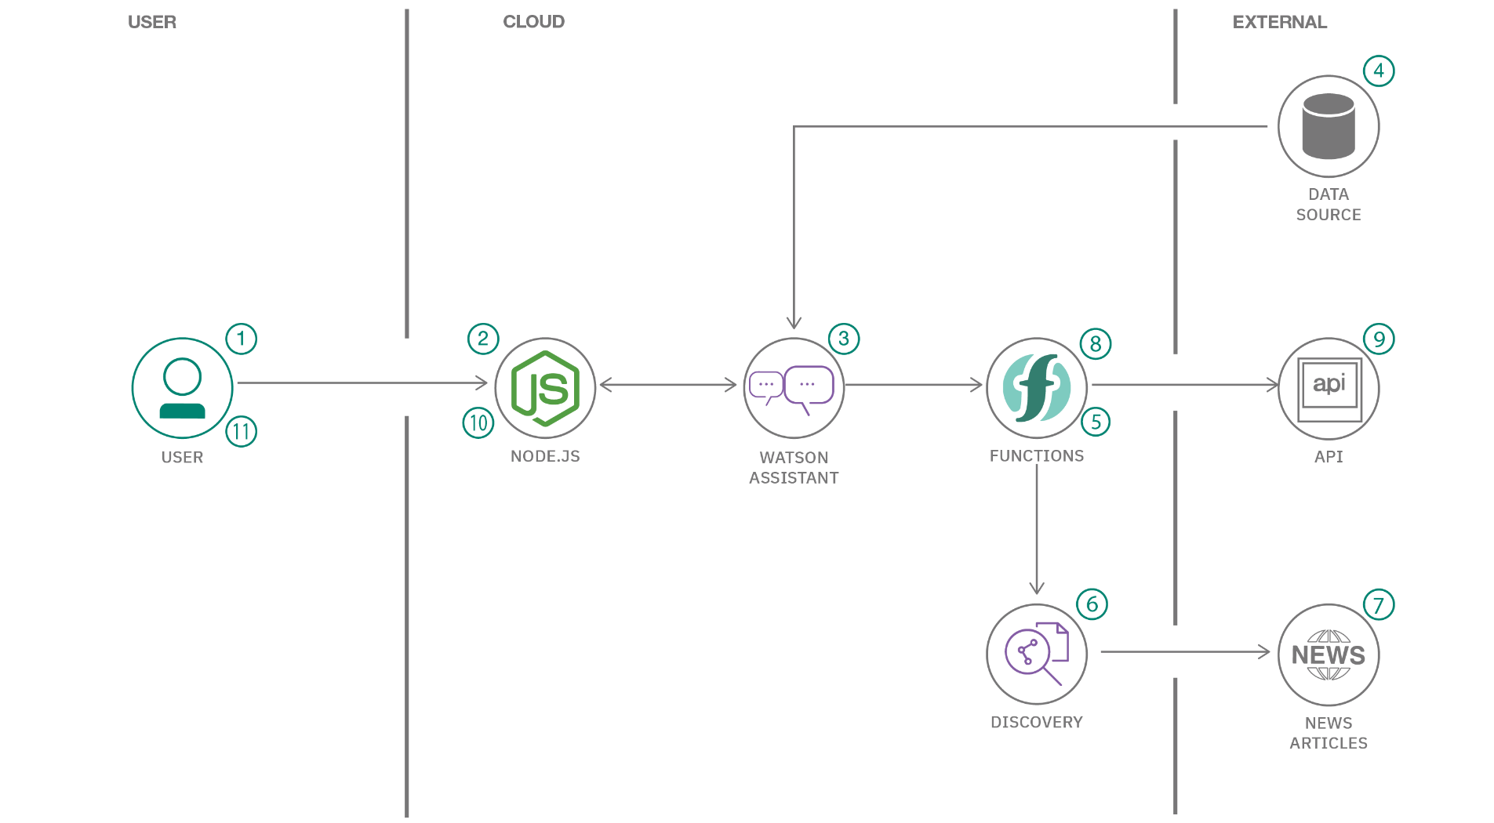
Diagram
WEB
ARTICLES

Slide 6
Solution Description
1. The user visits a website with the Waste Segregation chatbot and asks a question.
2. The Node.js web server calls Watson Assistant hosted in IBM Cloud.
3. Watson Assistant uses natural language understanding and machine learning to extract entities and intents of the user question.
4. The waste segregation FAQ is sourced from trusted data.
5. Watson Assistant invokes an OpenWhisk open source-powered IBM Cloud Function.
6. IBM Cloud Function calls Watson Discovery running in IBM Cloud.
7. Watson Discovery scans web and responds with relevant articles.
8. Watson Assistant invokes an OpenWhisk open source powered IBM Cloud Function.
9. IBM Cloud Function calls the Waste Segregation API to get statistics.
10. Watson Assistant replies to the user inquiry.
11. The Node.js web server displays the chat answer to the user.

Slide 7
MVP 1 : Build Watson Assistant chatbot
COMPLETE
Built up the content to communicate with the users on Waste Segregation to -
Educate user on waste segregation
Importance of waste segregation at home and our responsibility towards it
What happens if we don’t segregate the waste at source?
Different types of waste
Wet Waste
Dry Waste
E-Waste
Sanitary/ Reject Waste
Pre-requisites of waste segregation at home & steps to do waste segregation
Info on the management and disposal of different types of waste
Tips to Reduce Waste
Initiate waste management in a layout/ apartment complex
Registered for an IBM Cloud account
Created Watson Assistant Waste Segregation Manager, intents and dialog skills
Successfully asked the Watson Assistant chatbot some questions about Waste Segregation

Slide 8
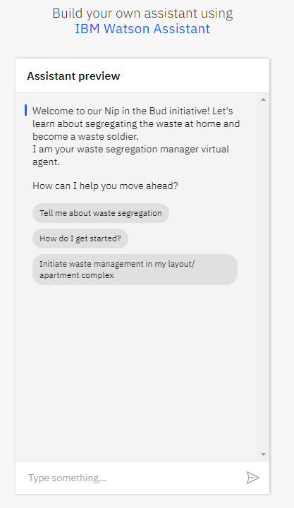
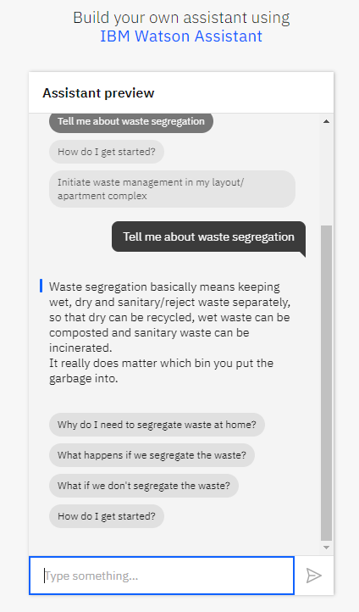
Watson Assistant Waste Segregation Manager

Slide 9
MVP 2 : Integration of chatbot
Connect the chatbot to data sources via a Watson Assistant Webhook to query for dynamic data and to provide user with more information from web
Integrate the chatbot with Slack, a cloud-based messaging application to help people collaborate with one another
Integrate the chatbot with Node-RED to to enable voice commands

