Slide 1

Presentation on “Online Gas Booking System” Presented by Shubham Kumar(2173) Vishakha Jadhav(2209)
Under the Guidance of
Mr. Akshay Parab

Slide 2
Outline
Problem statement
Objective
Purpose
Features
Introduction
Working of Online Gas Booking System

Slide 3
Problem Statement
Designing Effective Web Application for Online Gas Booking System

Slide 4
Objectives
To manage the details of Customers, Dealers, Connections, Delivery, Booking
The project is totally built at admin end thus only admin can access all details
To design effective web application which can retrieve data from database in efficient manner

Slide 5
Purpose
Build an web application to reduce the manual work for managing the gas connection, booking, customers, dealers
Our web application also track all details about gas and it’s delivery

Slide 6
Features
Online Gas Booking System manage the delivery details for booking details, gas connection
It tracks all information of connections, delivery, booking
Show the information of gas connections, customers and dealers to admin

Slide 7
Introduction
This web application is supported to eliminate and in some cases reduce the hardships faced by this existing system
No formal knowledge is needed for the user to use this system thus it is user friendly

Slide 8
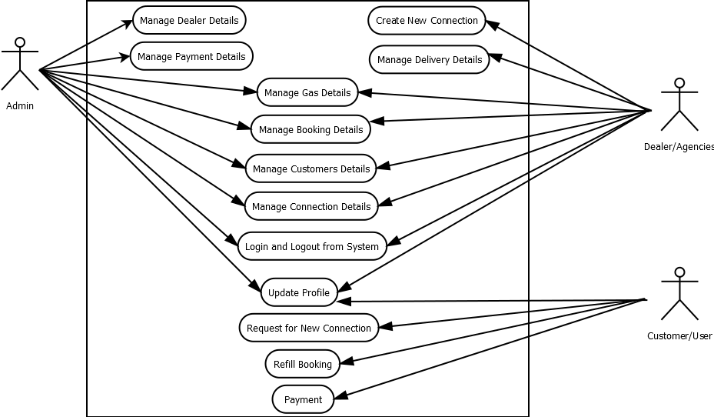
Working of Online Gas Booking System

Slide 9
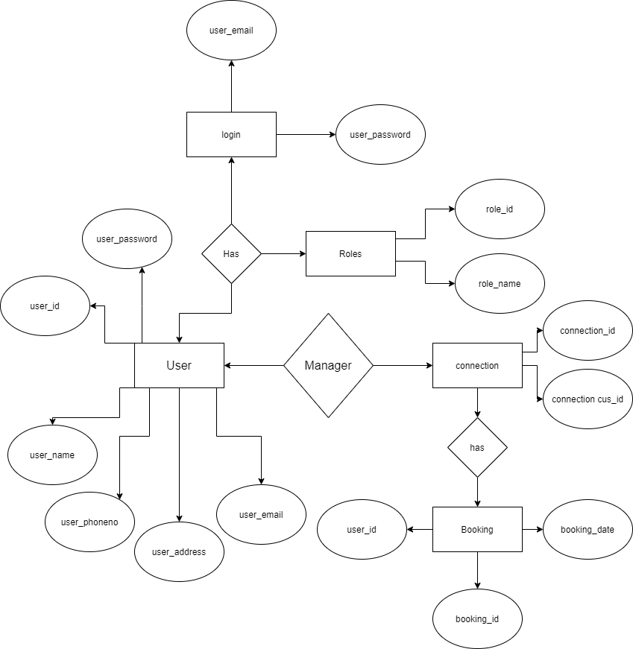

Slide 10
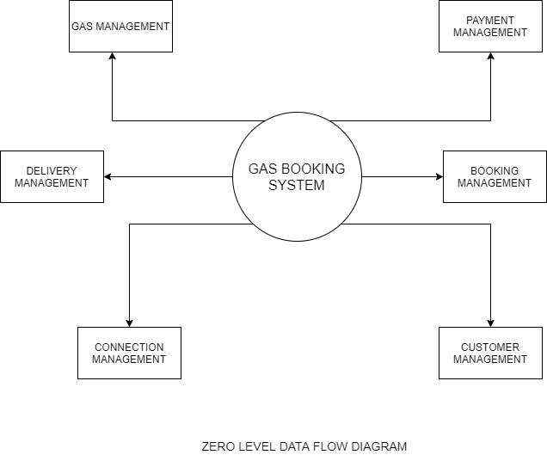

Slide 11
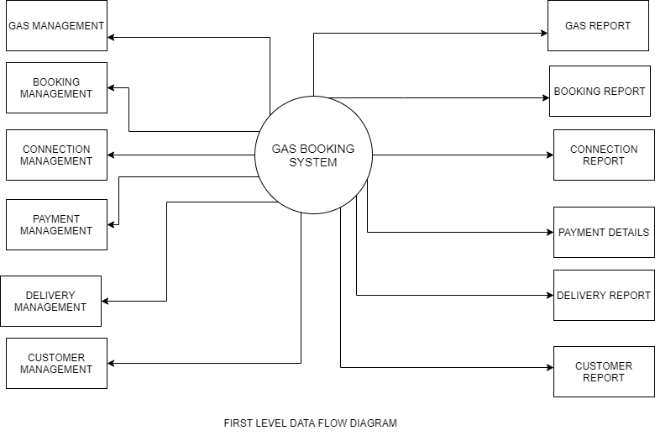

Slide 12
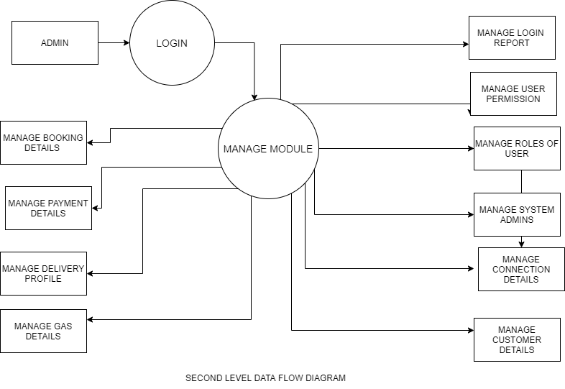

Slide 13
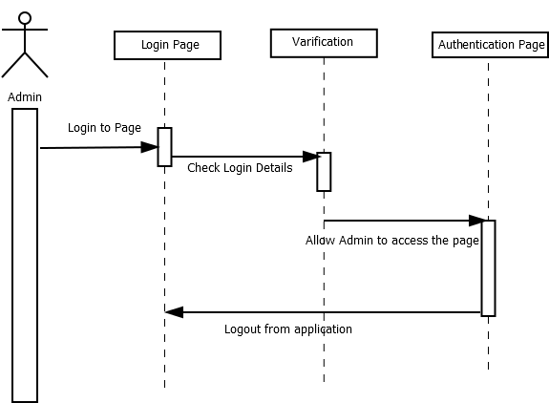

Slide 14
Output Screens

Slide 15
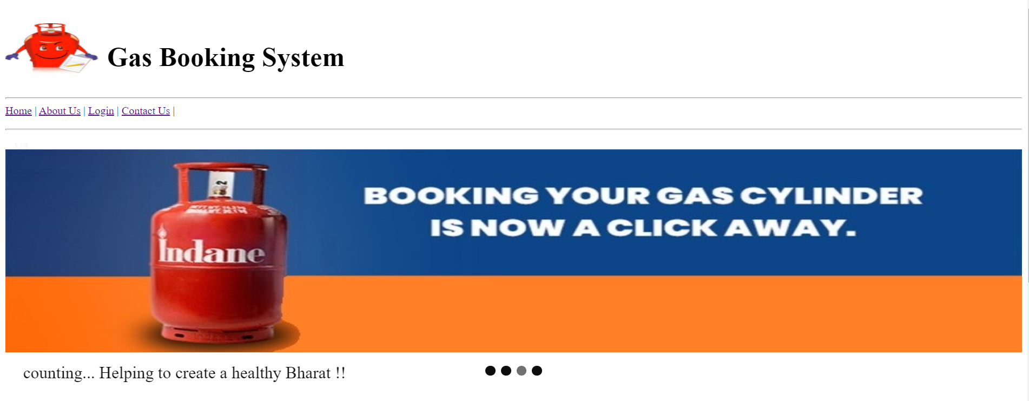
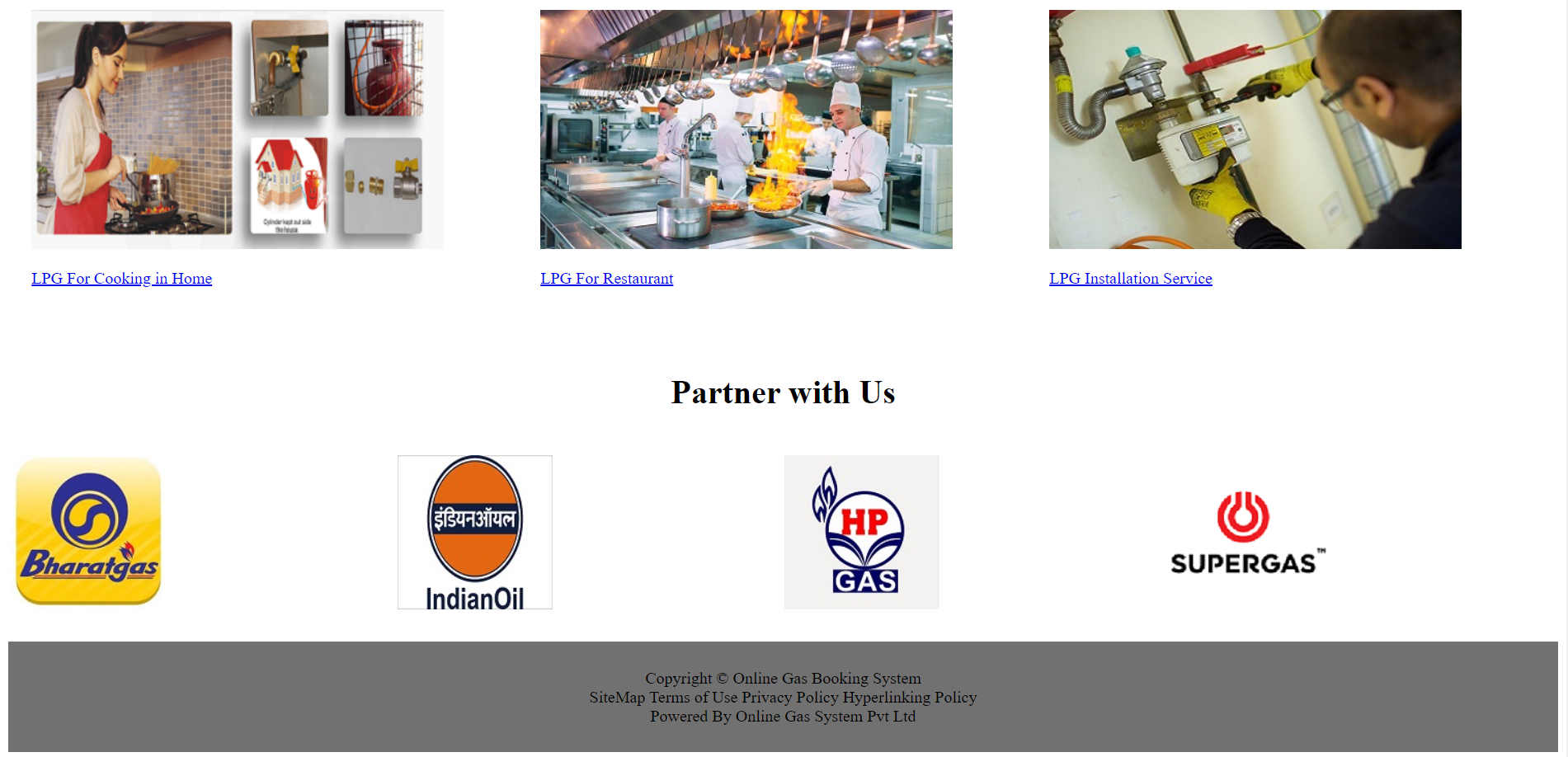

Slide 16
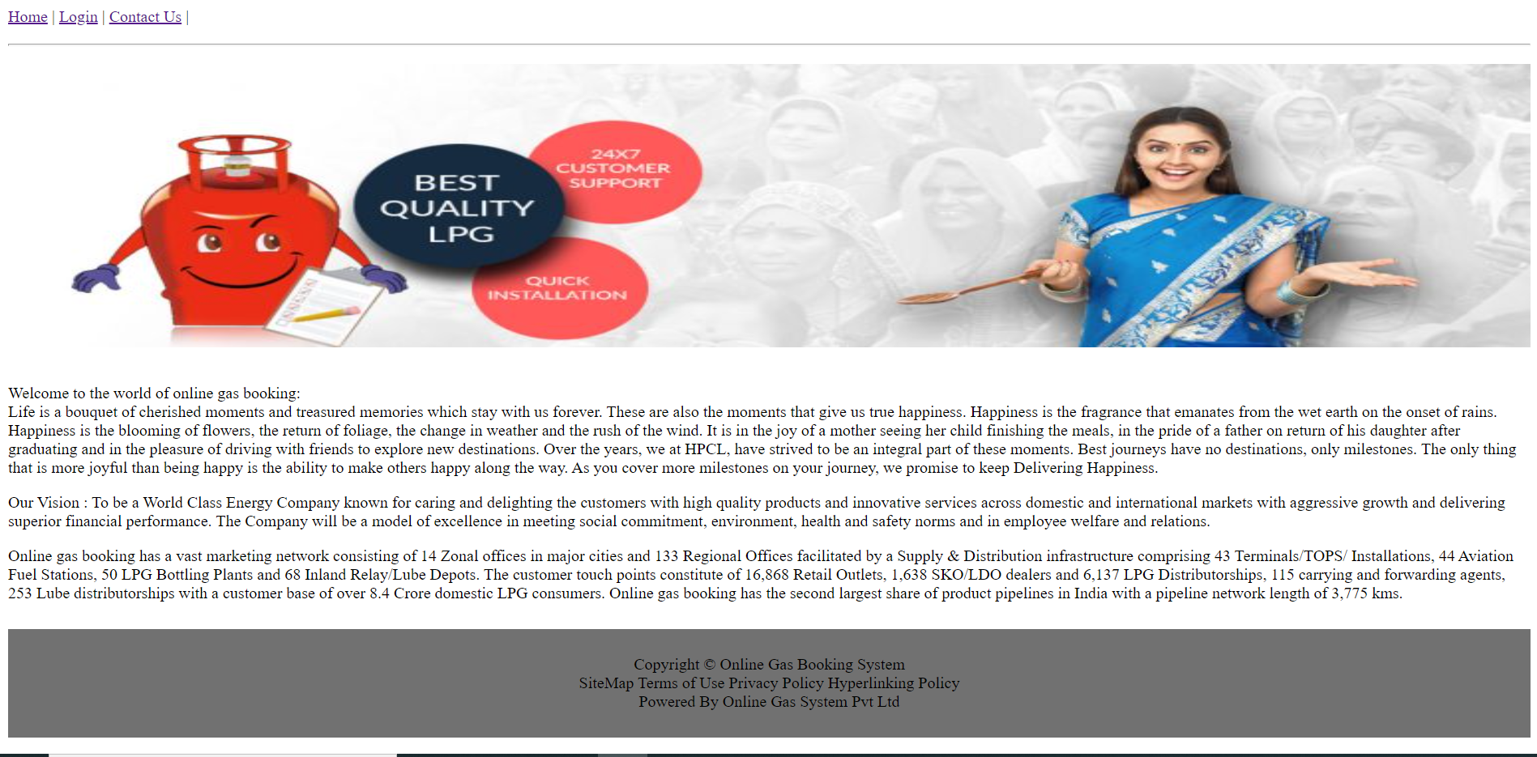
About Us

Slide 17
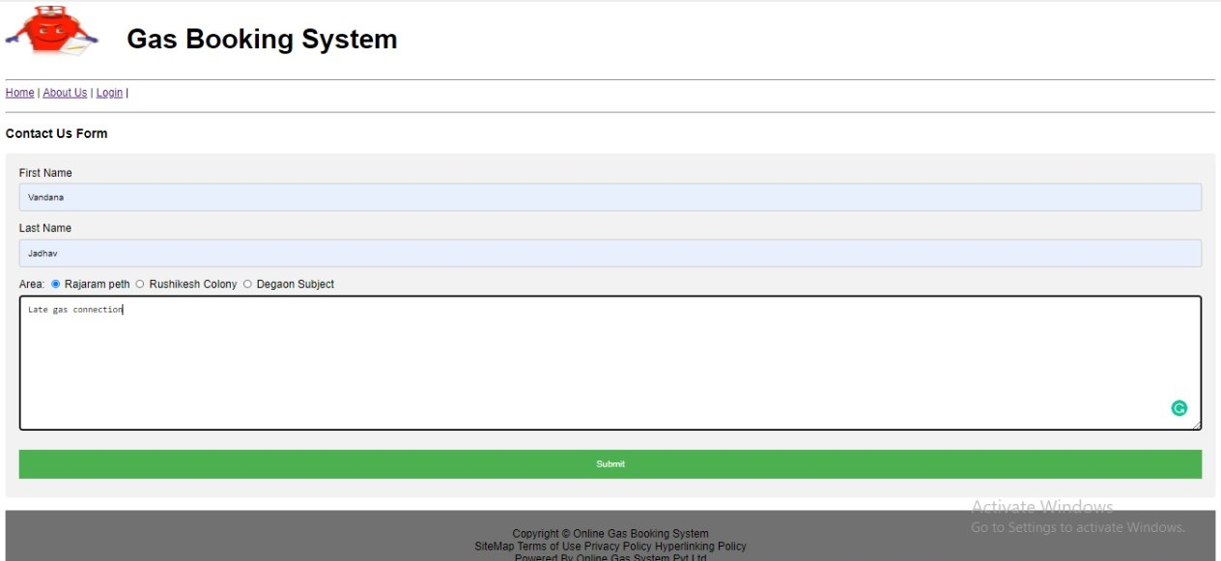
Contact Us Form

Slide 18
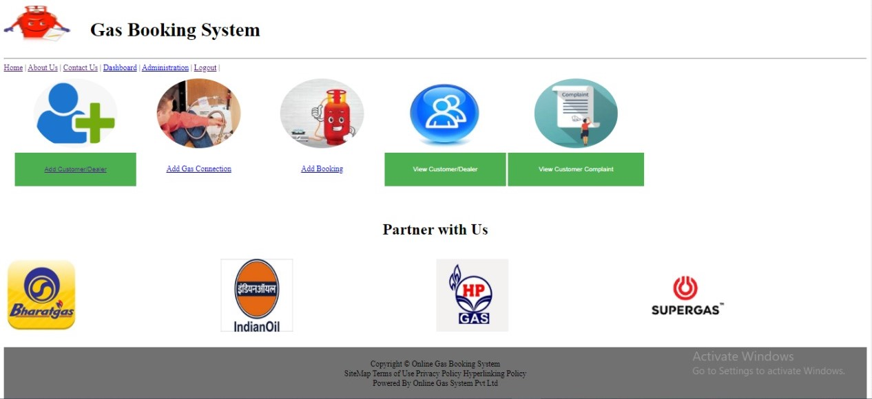
Admin Home

Slide 19
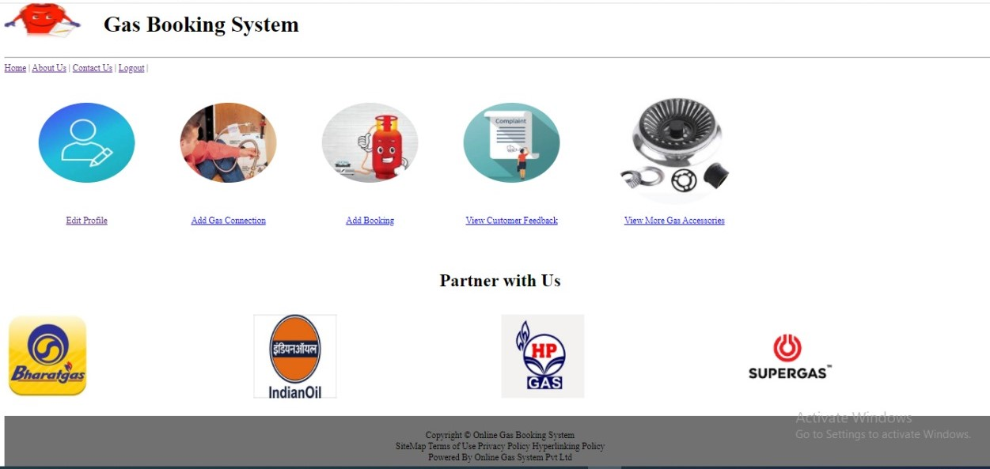
Customer Home

Slide 20
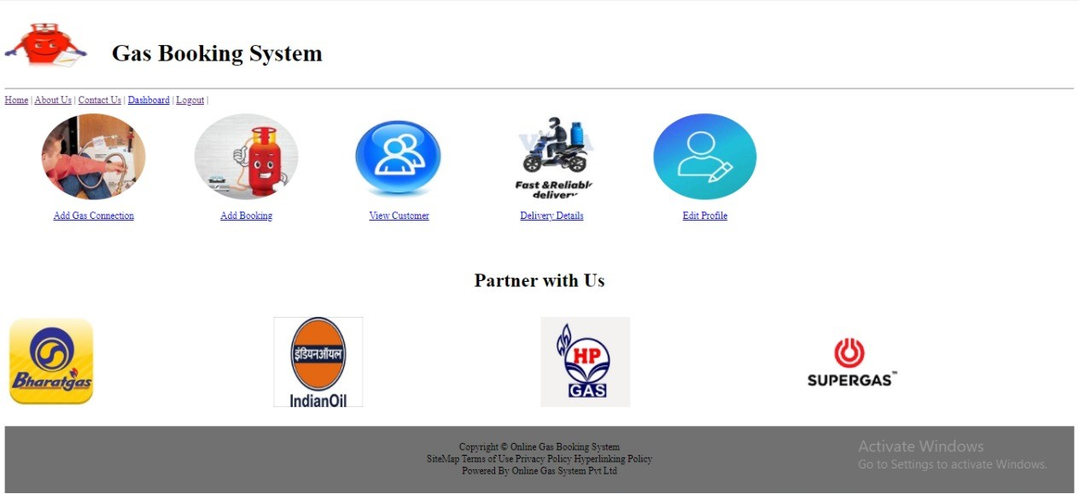
Dealer Home

Slide 21
Conclusions
This system is useful for all gas agencies
This system will is designed to save time and will reduce the complexity and is also user friendly

