Slide 1
Team :10
AI Agent for Personalized Healthcare: Medication Reminder and Interaction Checker

Slide 2
Objective
Reminds patients of their medications on time
Checks for potential drug interactions in real time
Offers personalized recommendations and alerts

Slide 3
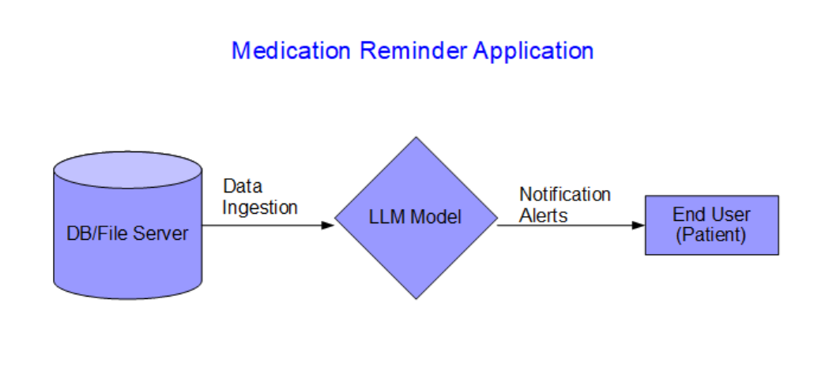
UML Diagram

Slide 4
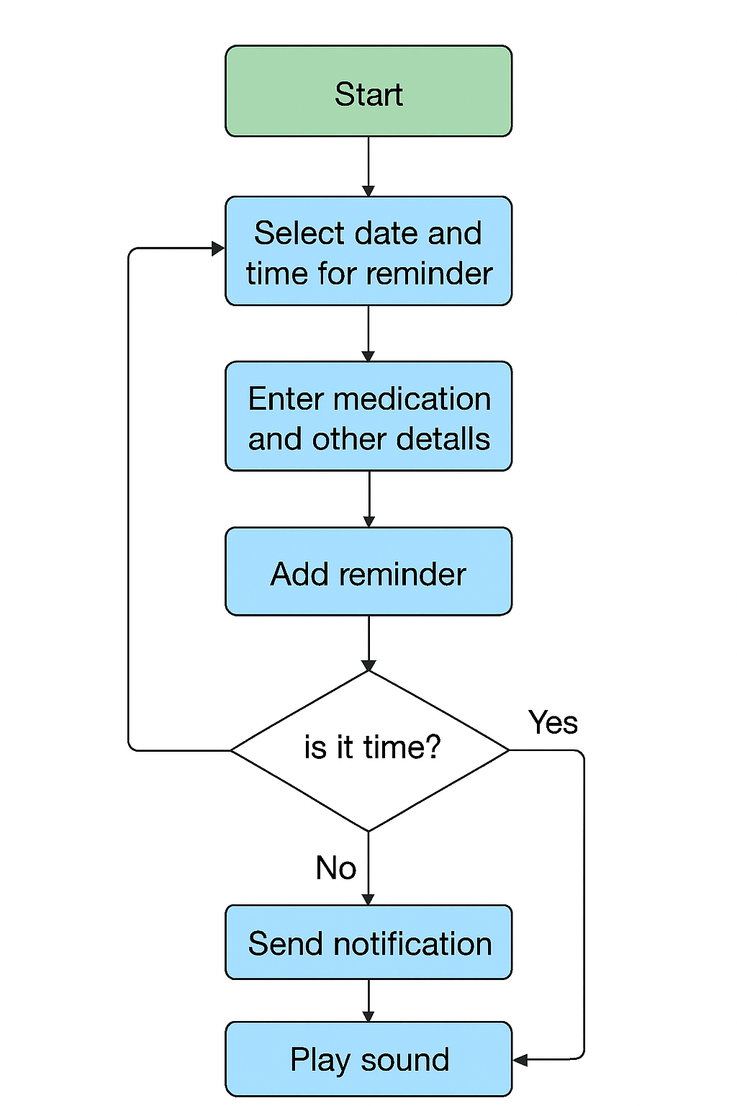
Flow Diagram

Slide 5
Problem Statement:
Patients often forget medication or are unaware of potential drug interactions risking health complications.

Slide 6
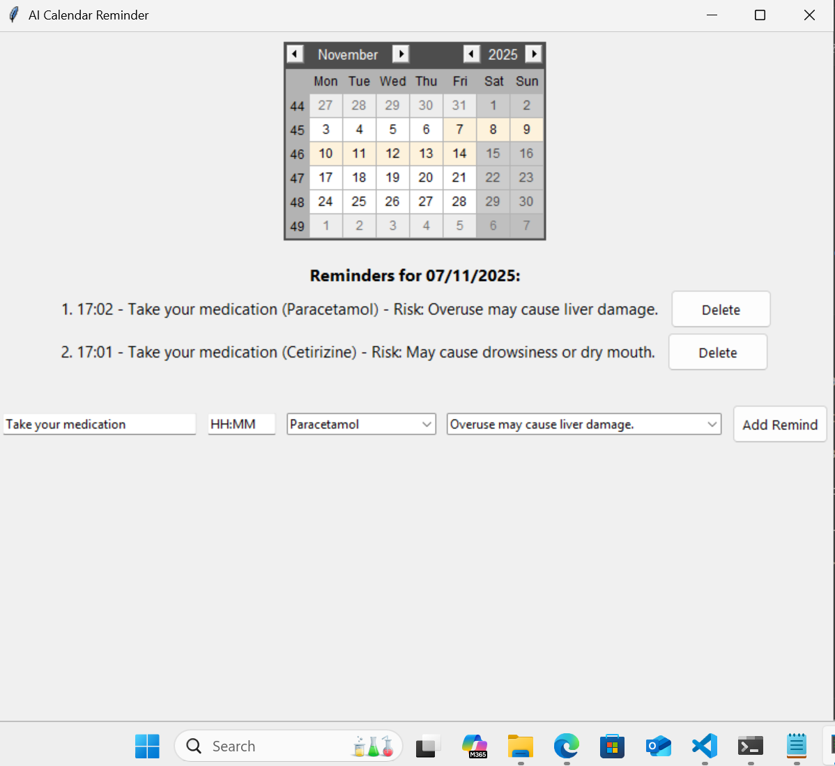
Solution:[1/2]

Slide 7
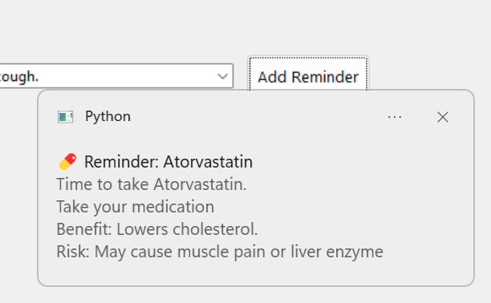
Solution:[2/2]

Slide 8
Limitations
Manual Data upload: Can be Automated by creating Mobile App and integrating it with clock
Voice assistance is missing: The app does not include voice based reminders or interaction capabilities
Only e-mail and SMS Notification are supported
No support for Push notification or app based alerts
Scalability: The app is designed for small scale use and may not handle large datasets efficiently. No cloud based deployment or multi user support

Slide 9
Future Enhancement
Integration with wearable devices or Mobile Apps
Predictive analytics for side effects
Multilingual and accessibility support (voice & large text)
Secure cloud integration with hospitals systems
Voice Integration

Slide 10
Benefits
Improved adherence, fewer hospitalizations
Accurate medication logs
Cost reduction from avoidable interactions
Safer and smarter medication culture

Slide 11
Privacy and Security consideration
Lot of privacy and protection: patient data encryption and Access control
File upload security: CSV file validation and file size limit
Notification security: E-mail security(avoid hard coding SMTP credentials in the code) and use secure e-mail protocols for sending e-mails

