Slide 1
Loyalty Program Performance Analysis – 2007
Business Context
The loyalty program has strong adoption across transactions. This analysis evaluates whether loyalty participation translates into incremental revenue performance.
Objective
Assess basket behavior and revenue contribution of loyal vs non-loyal customers to determine true business impact.

Slide 2
Methodology
* Transaction-level data analyzed for 2007
* Aggregated to basket level for behavioral comparison
* Compared loyal vs non-loyal baskets
* Calculated:
– Basket penetration
– Revenue penetration
– Average basket value
– Revenue uplift
* Validated calculations using SQL for scalability

Slide 3
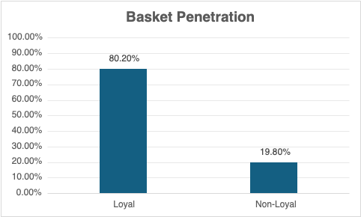
Loyalty Participation
Basket Penetration: 80.20%​
​
​
Loyalty members account for 80% of total baskets, significantly exceeding the 50% neutral threshold and indicating strong program adoption.

Slide 4
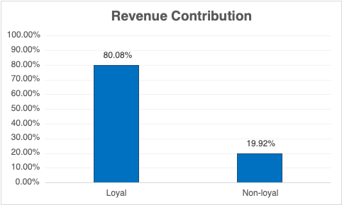
Revenue Performance
Revenue Penetration: 80.08%
Revenue share mirrors participation share, suggesting proportional performance rather than incremental lift.

Slide 5
Average Basket Value
Average Basket (Loyal): 1.7804
Average Basket (Non-Loyal): 1.7938
Revenue Uplift: –0.75%
Loyal customers do not exhibit higher spend per basket. The program appears to drive engagement but not transaction expansion.

Slide 6
Key Business Insight
* High participation (80%)
* Revenue proportional to basket share
* No measurable basket uplift
* Spend index ≈ 1
The loyalty program currently reinforces participation but does not increase spending intensity.

Slide 7
Strategic Recommendations
1.Introduce spend-based incentives to increase basket size
1
2.Test targeted promotions to drive incremental uplift
2
3.Evaluate customer frequency and lifetime value
3
4.Implement A/B testing to measure incremental impact
4

Slide 8

Future Analysis with Credit Card Linkage
Case question: How would analysis change if customer credit card data were available?
Customer-Level Tracking
• Link multiple baskets to the same customer
• Measure true frequency and lifetime value
Pre vs Post Enrollment Analysis
• Compare spend before joining loyalty vs after
• Estimate incremental revenue impact
Wallet Share Estimation
• Measure total spend across categories
• Identify cross-sell opportunities
Stronger Causal Measurement
• Build customer cohorts
• Enable A/B or quasi-experimental design

Slide 9
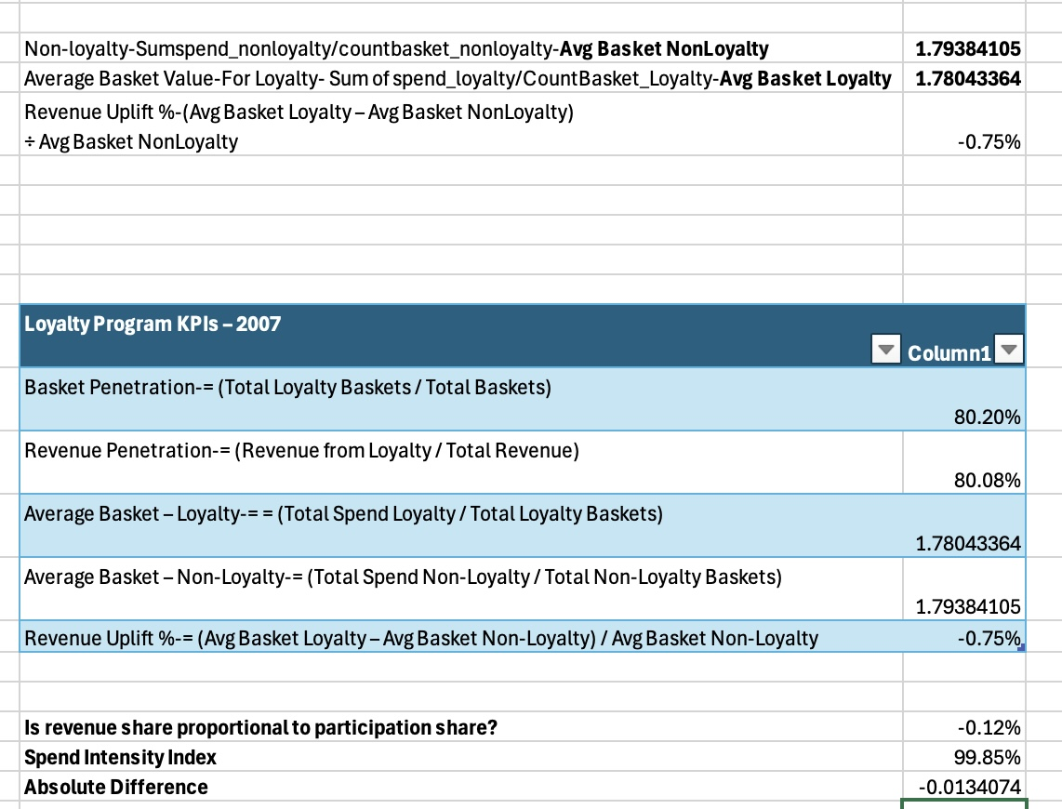
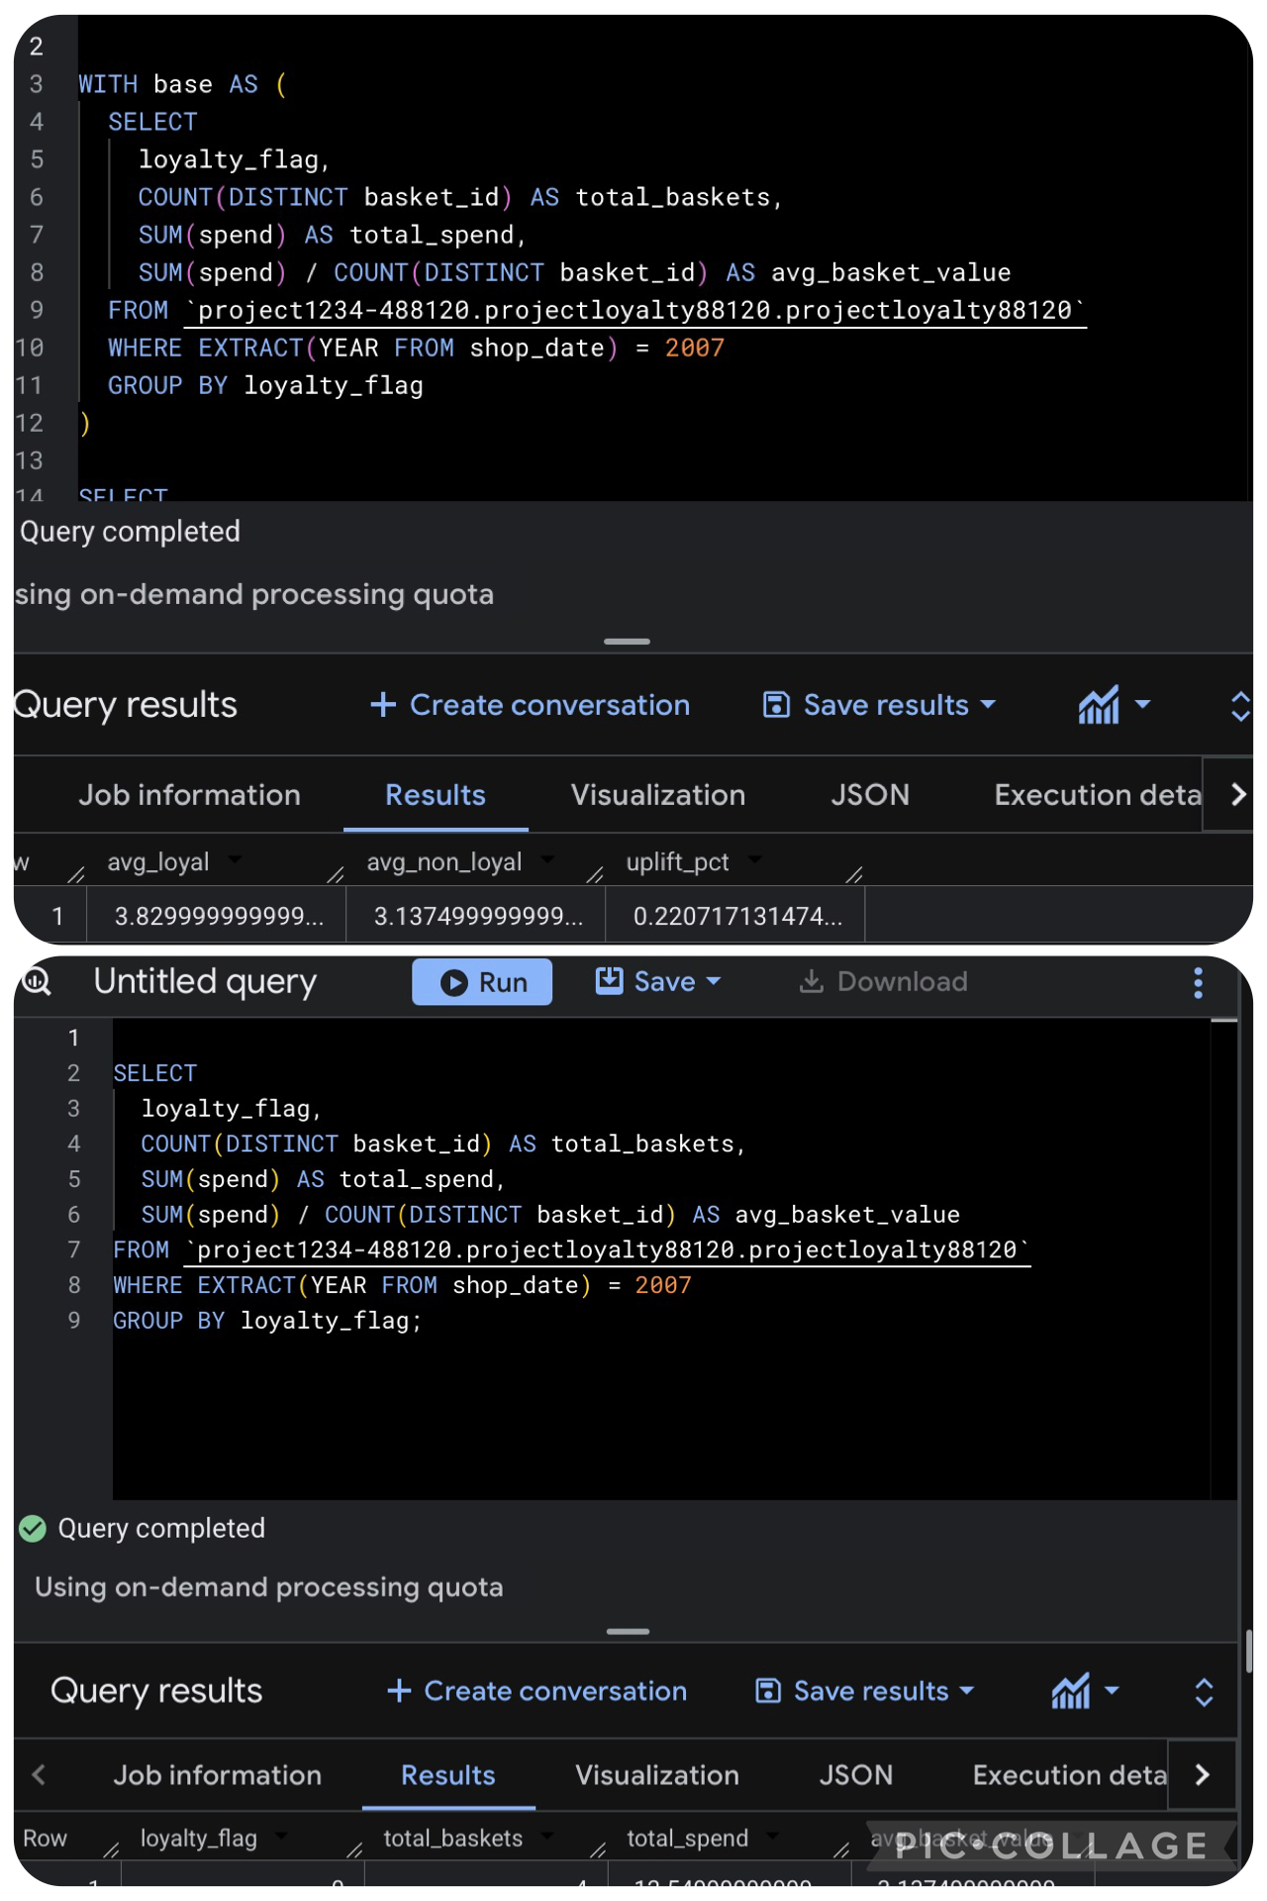
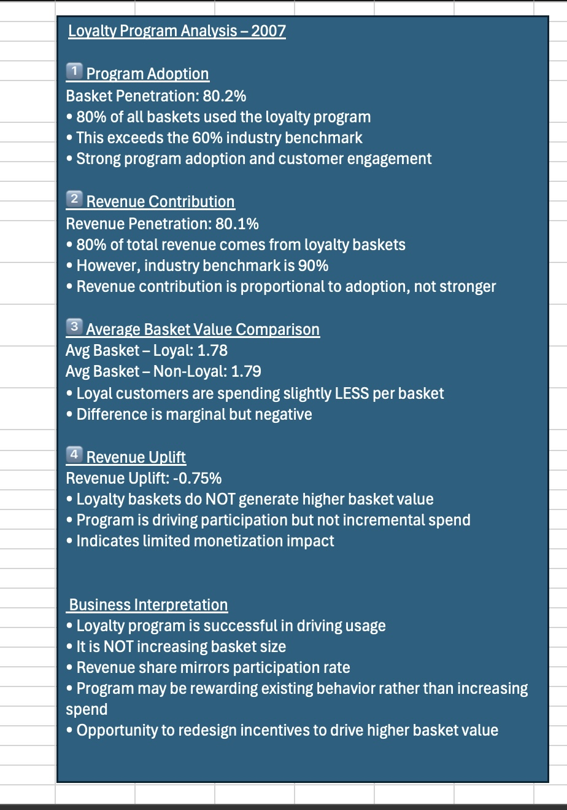
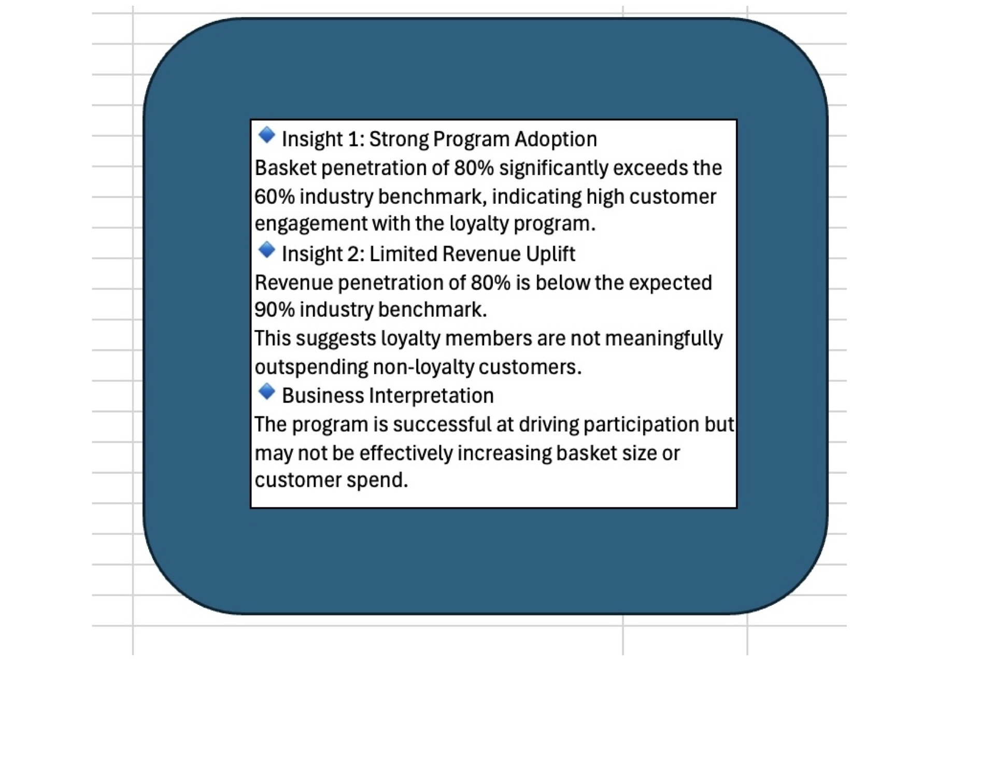
Appendix-Technical Validation

