Slide 1

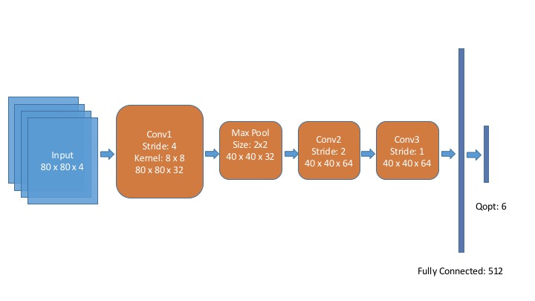
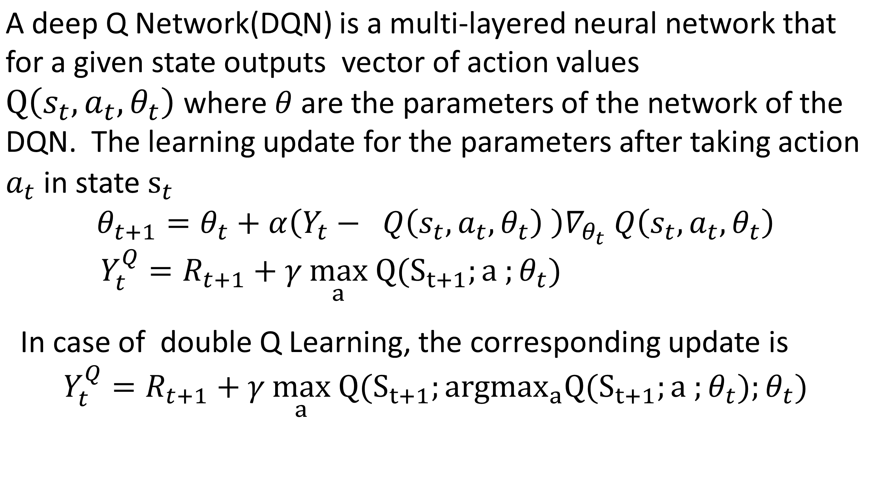
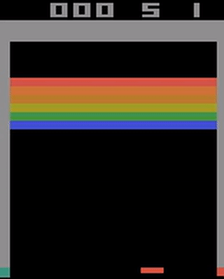
Reinforcement Learning Techniques for Atari Breakout
Vishakh Hegde, Rahul Makhijani, and Chiraag Sumanth
ABSTRACT
CNN Architecture
RESULTS
We aim to implement different RL algorithms on the Atari Breakout game and analyze performance over different algorithms on various metrics. The goal is to maximize the score in the Atari 2600 game Breakout. Since our inputs are images of the game screen, which are high dimensional inputs, we would like to get a low dimensional representation which encodes the core essence of the state of the game. For this, we are using a Deep Convolutional Neural Network built with Tensorflow, trained over different RL loss functions.
Algorithm Updates
FUTURE WORK
We plan to increase the training time for the current algorithms with access to more hardware.
We also hope to implement other algorithms such as TD Learning, and Policy gradient methods for the problem in the future.
SIMULATION ENVIRONMENT
Game Actions
Move paddle right
Move paddle left
Do not move paddle
RESULTS
REFERENCES
Playing Atari with Deep Reinforcement Learning (Deep Mind Technologies); Mnih et. al.
OpenAI Gym by Greg Brockman, Vicki Cheung, Ludwig Pettersson, et. Al.
Tensorflow: https://www.tensorflow.org/versions/r0.11/tutorials/deep_cnn/
We are using the OpenAI Gym environment for this project.
In this environment, every observation is an RGB image of the game screen, which is an array of shape: (210,160, 3). The pixel inputs encode the state of the game at any given moment.

