Slide 1
Course Information
Classroom Rules
Philosophy and Overview
Course Information
Course Objectives

Slide 2
Computers
During class or lab:
computers are to be used for in-class activities only, as directed by the instructor;
computers are NOT to be used for activities such as: browsing the web, checking email, “chatting”, playing games, …
No Food or Drinks in lectures and labs

Slide 3
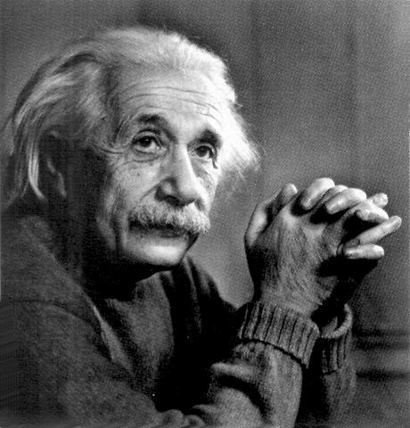
Philosophy
The psychical entities which seem to serve as elements of thought are certain signs and more or less clear images which can be ‘voluntarily’ reproduced or combined (Einstein, 1945).
Visualization – engineering concepts
Communication – visual, verbal, and written
Teamwork

Slide 4
Course Information
Syllabus
Weekly Schedule
See Web site: http://www.t-square.gatech.edu
Use your GT account User Name and Password to access the web site.

Slide 5
Overview
3 credit hours: 2 lecture, 3 hr. lab
Required for ME/AE majors
Lectures in SEB 121
Labs in SEB 102
TAs office: MRDC 3328
800 students/year
Sections: 9 in Fall, 9 in Spring, 2 in Summer
Personnel: 3 Faculty, 10 TA’s

Slide 6
Course Concepts/Processes
Ideas, designs, and manufacturing procedures/techniques are communicated by words, numbers, and visual images.
Freehand sketches and CAD are used to model 3 dimensional objects.
Engineering tasks are performed by teams.

