Slide 1
Dimensioning – General
Dimensioning Basics
Dimensioning Methods
Dimension Guidelines

Slide 2
Assignment
Read pages 53-68 in the textbook.

Slide 3
Dimensioning Basics
Standard: ASME Y14.5M-1994
Terminology
Units of Measure
Reading Direction

Slide 4
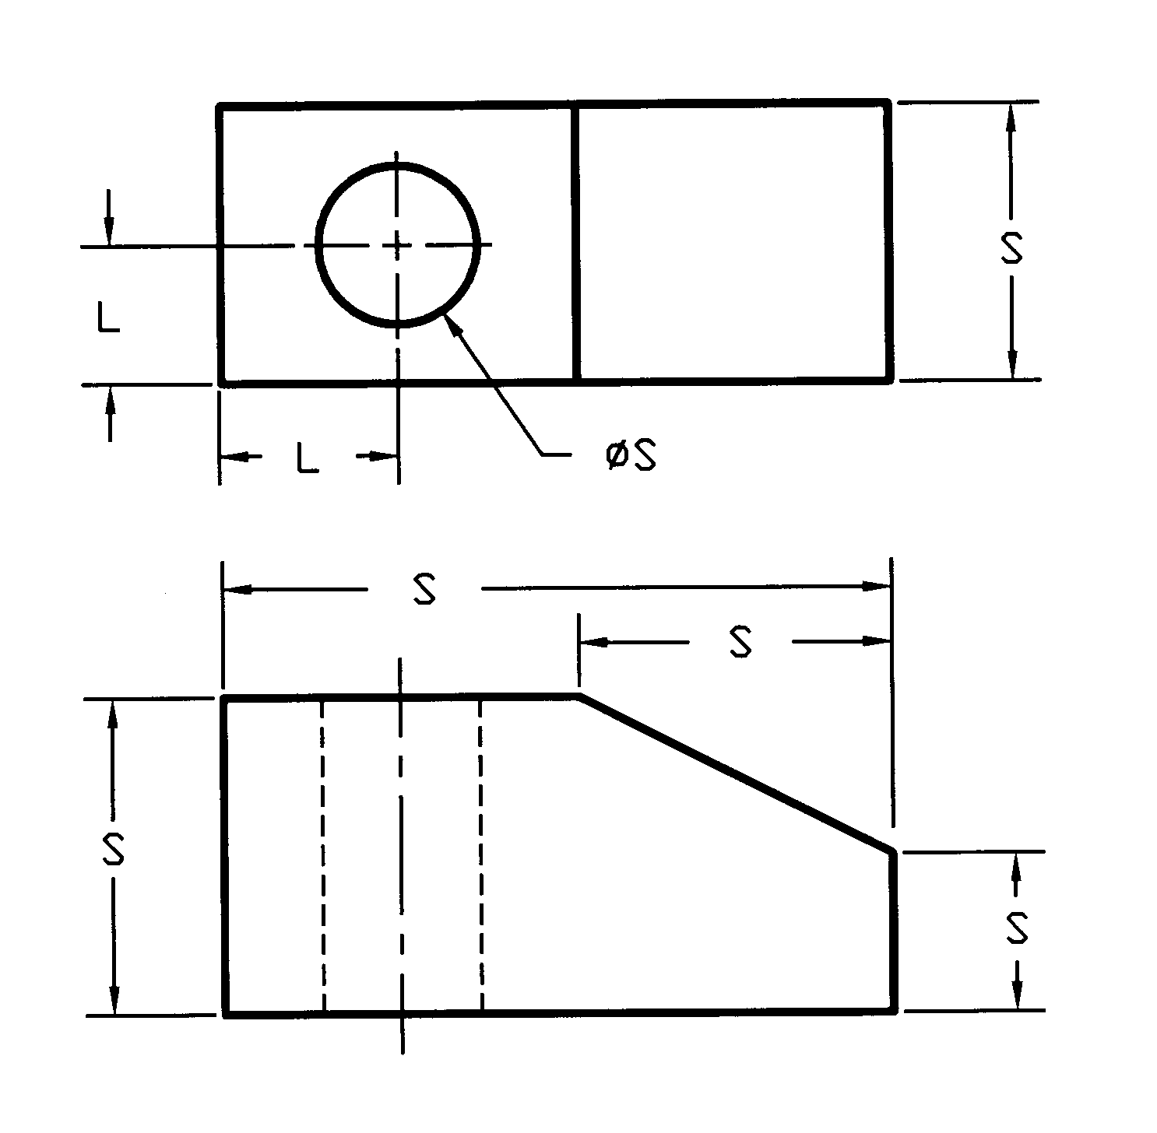
Size & Location
Add All dimensions necessary to fabricate.
Dimensions should communicate design intent.
(To check, try to draw a pictorial using the dimensions on your drawing.)
L
Always show overall dimensions.

Slide 5
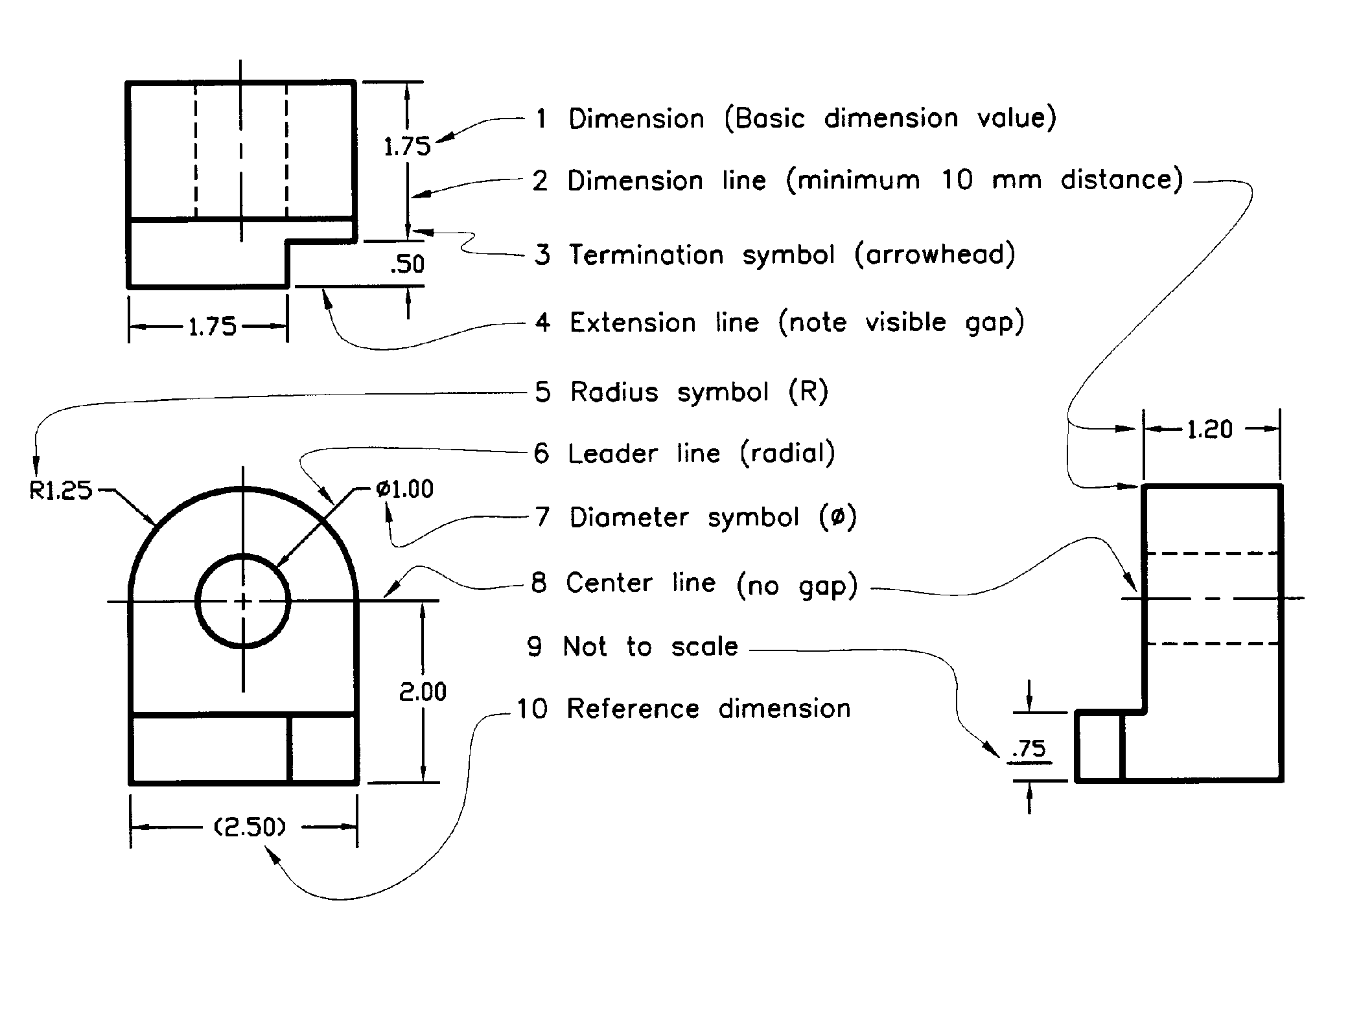
Dimensioning Terminology
Notes:
dimension size: 1/8 inch tall (3 mm), uniform throughout drawing
dimension, extension, leader, center, and hidden lines: ½ thickness of a visible line.
arrowheads: length = number height, width = 1/3 length
first row of dimensions 3xletter height from view, succeeding rows 2x letter height farther
minimum extension line gap = ½ letter height; minimum extension past last dimension line = letter height
leaders – begin at first or last word of a note, with a short horizontal line, then extend to feature described (note that leaders for radius or diameter would pass through center of arc or circle if extended)
A center line with a note (C.L. or L.O.S. or SYM) may be used to indicate a line of symmetry, reducing the number of required dimensions.

Slide 6
Units of Measure
decimal inches (preferred), fractional inches, feet and fractional inches, decimal feet
SI or metric – millimeter (mm)
leading zero: metric – yes; inches – no
If units (e.g., IN or mm) are not included with each dimension, specify the units used with a note on the drawing; for example
UNLESS OTHERWISE SPECIFIED, ALL DIMENSIONS ARE IN INCHES
or
SI
or
METRIC
Notes:
usually 2 decimal places for inches, none for mm (unless converted, see next slide)

Slide 7
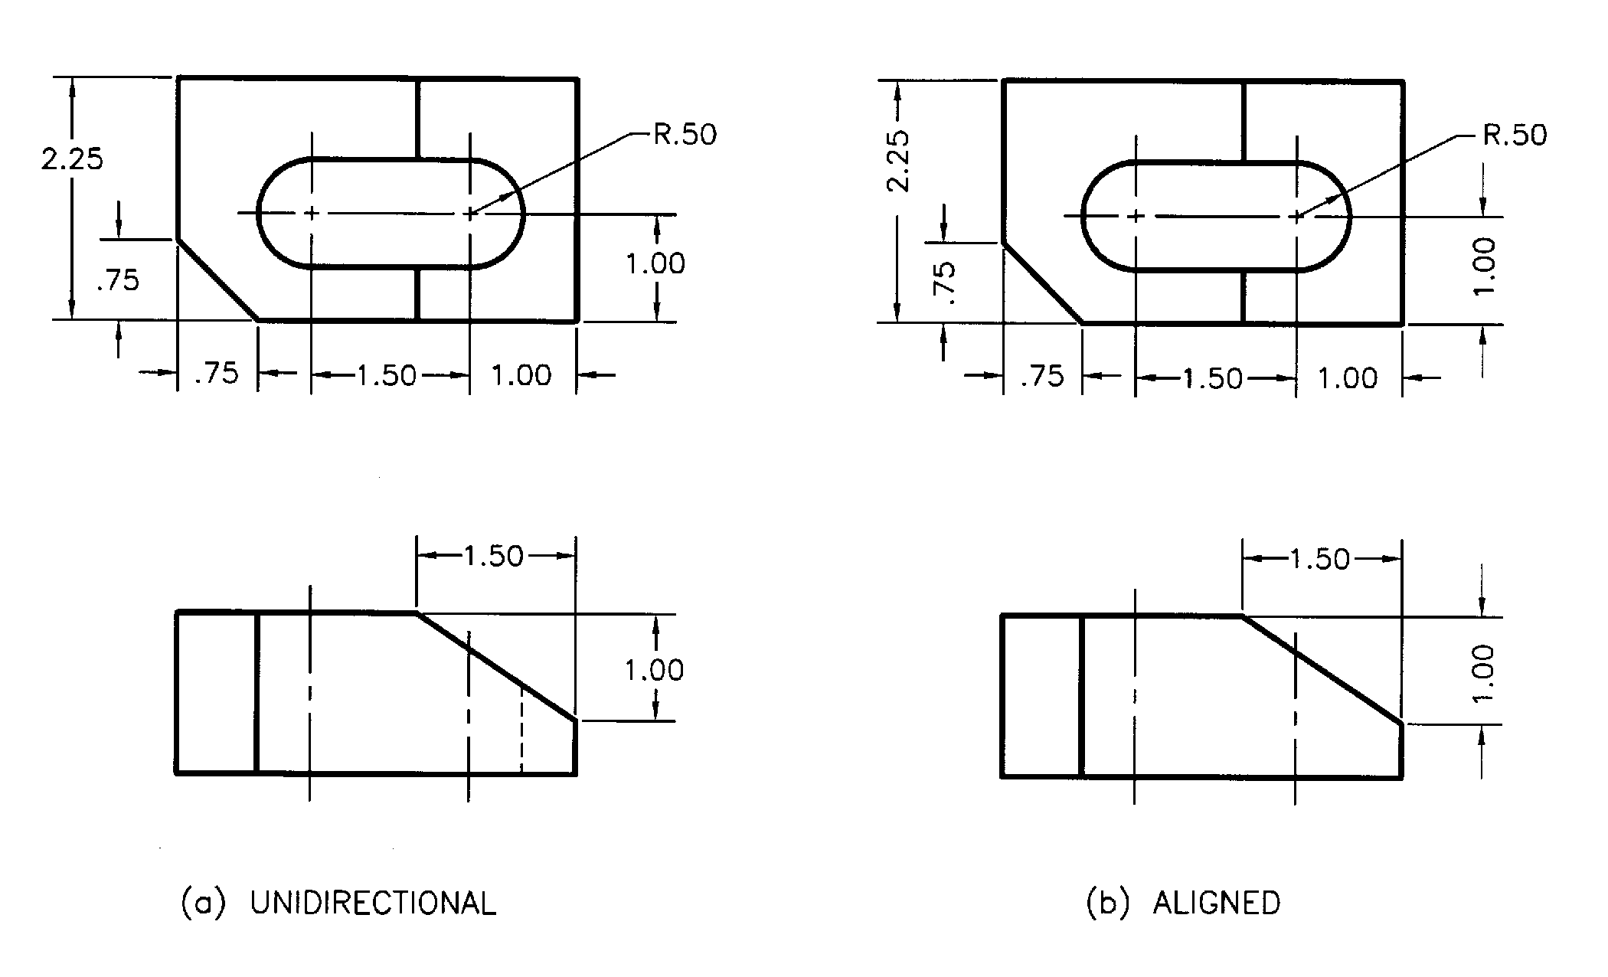
Reading Direction
Read from bottom (Preferred)
Read from bottom or right

Slide 8
How to Start Dimensioning
1. Identify each type of feature. If it is a circle, determine if it is a hole feature or a cylinder feature.
2. Find the view which shows that feature as true size and shape.
3. Dimension the location of that feature in that view. If it is a circular feature locate to the center of the hole or cylinder feature in the view that it appears as a circle or arc.

Slide 9
4. Dimension the size of the feature. If it is a hole feature, place a Diameter dimension on a leader to the circle which represents the hole.
If it is a cylinder feature, place a linear dimension in the view where the cylinder appears as a rectangular shape and add a “0” diameter symbol before the dimension text.
If the circular feature is represented by an Arc, then place a Radius dimension on a leader to the Arc which represents the circular feature.
5. Finish by placing the overall dimensions on which ever views have the fewest dimensions or where the extension lines will be the shortest.

Slide 10
Dimensioning Methods
  Chained
  Datum or Baseline
  Rectangular Coordinate *
  Tabular
  Arrowless
* useful for CNC machining - Computer Numerical Control

Slide 11
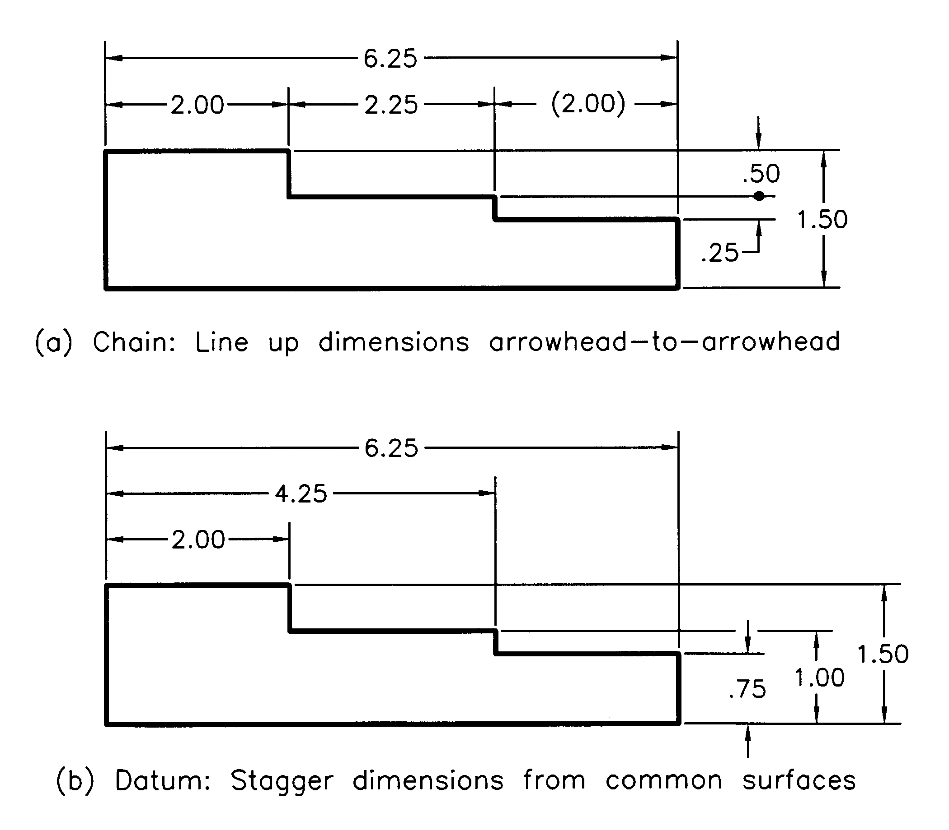
Chain & Datum Dimensioning
Chained
Datum
Notes:
Note extension line-extension line crossings, extension line crossing termination symbol, use of a dot for termination symbol, placement of larger dimensions farther from object, lining up of chained dimensions

Slide 12
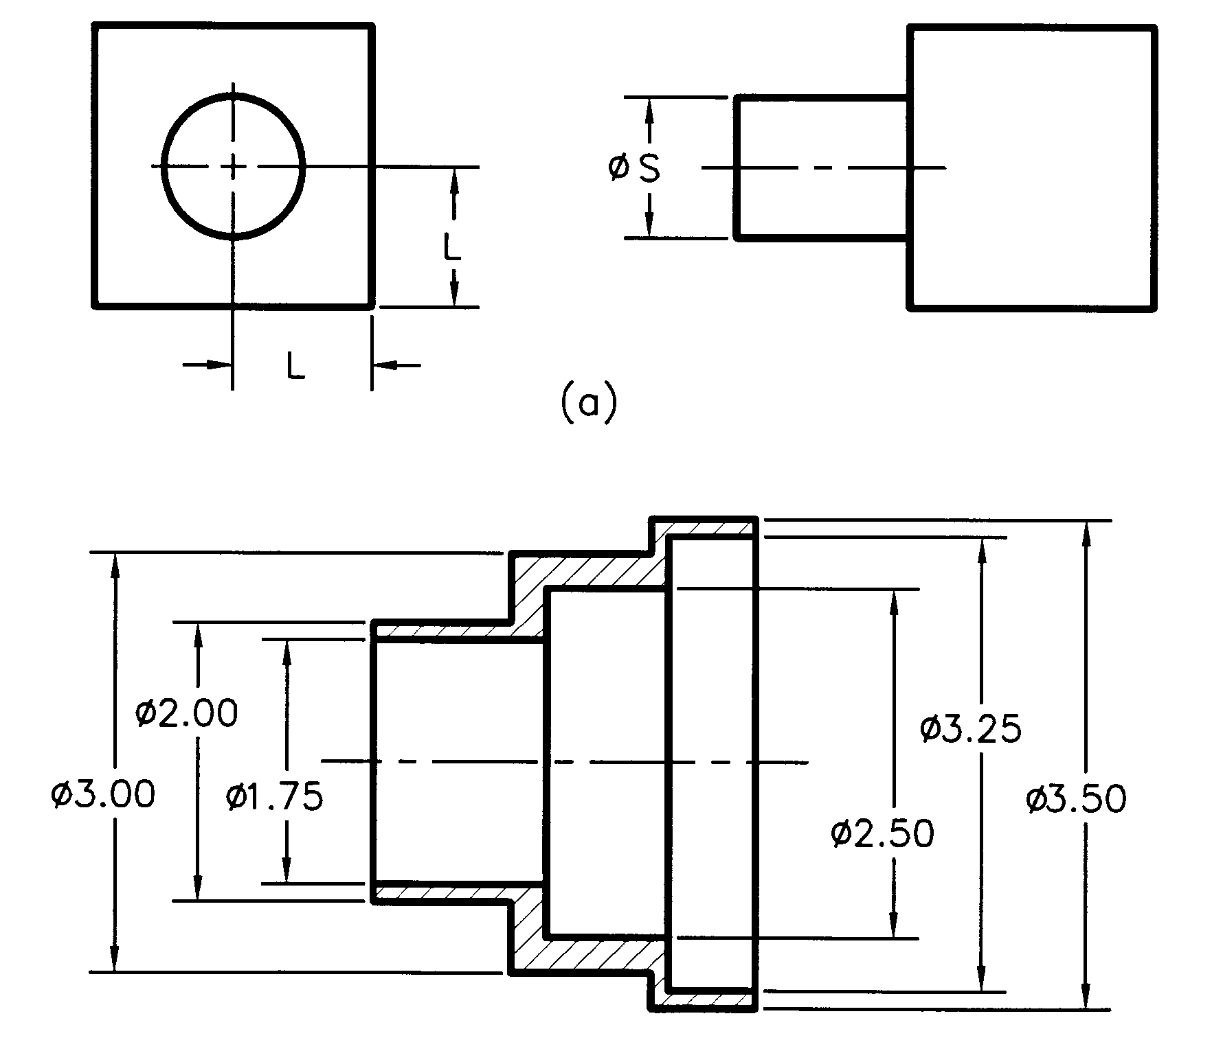
Dimensioning Cylinders
If two or more multiviews are used. Place location dimensions in the circle view.
Diameter dimension in the profile view as a linear diameter dimension.
If only 1 view is used.
Place all diameter dimensions as linear diameter dimensions.
Notes:
Positive cylinders are located in the “round” view, but the diameter is given in the profile view with extension lines.
Concentric cylinders (positive and negative) may be dimensioned in the profile view as if all were positive cylinders-- use diameter symbol on all diameters.

Slide 13
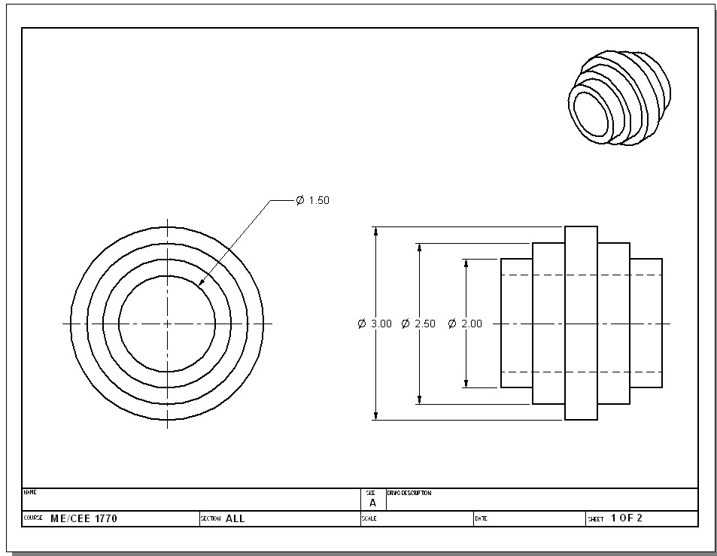
Dimension Hole where it shows as a circle. Always use the Diameter symbol.
Dimension Cylinder(s) where they show as a rectangle. Always use the Diameter symbol.

Slide 14
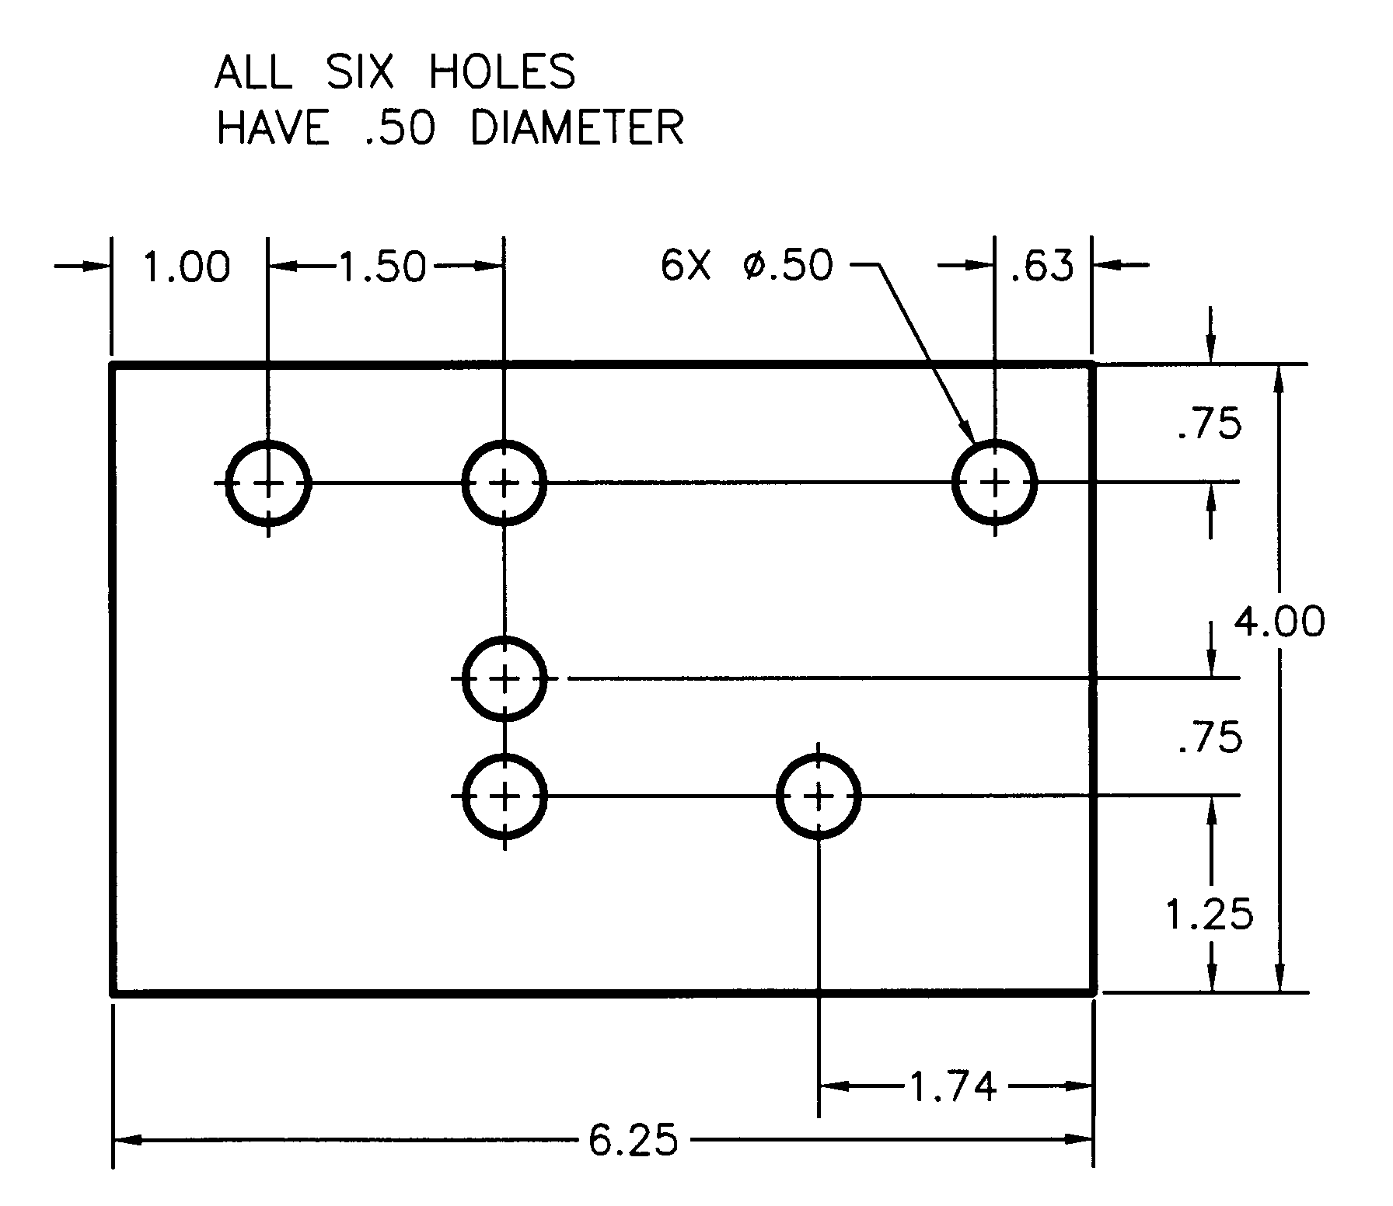
Use Repetitive Symbol & Notes
TYP or TYPICAL
4 PLACES or 4 PL
ALL FILLETS AND ROUNDS R.25
(if there are exceptions, add
“UNLESS OTHERWISE SPECIFIED”)
Notes:
Useful for arrays or patterns of features – for a circular pattern, use a centerline to draw a circle and dimension the diameter of the circular pattern.

Slide 15
Dimensioning Guidelines
Each shape – prism, cylinder, arc, etc. – has its own set of guidelines.
Guidelines may be violated due to part complexity, lack of available space, or because they conflict with other guidelines.
Notes:
What follows may be considered as guidelines. Sometimes they conflict with one another. Use them when possible.

Slide 16
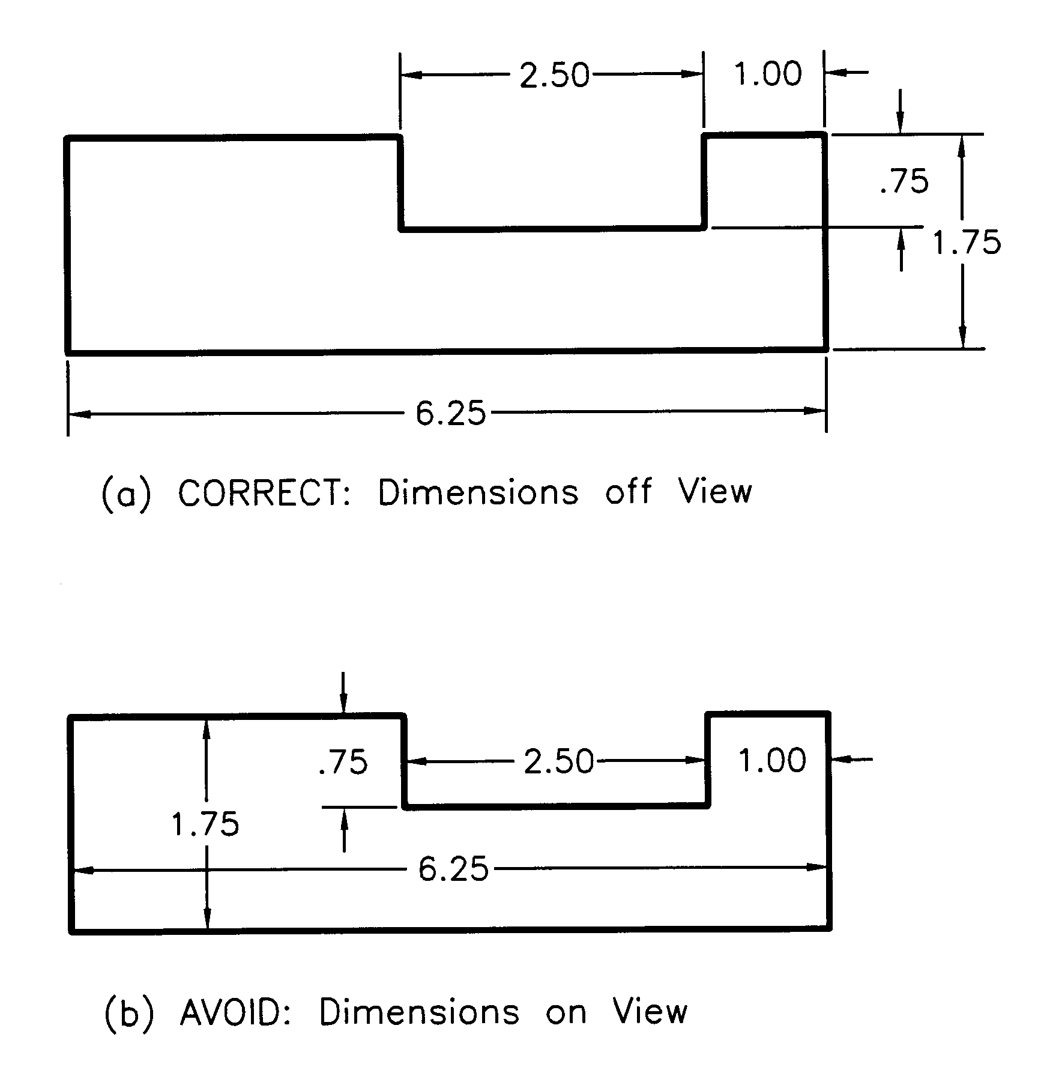
Place Dimensions OFF View
*
and don’t use visible boundary lines for extension lines*

Slide 17
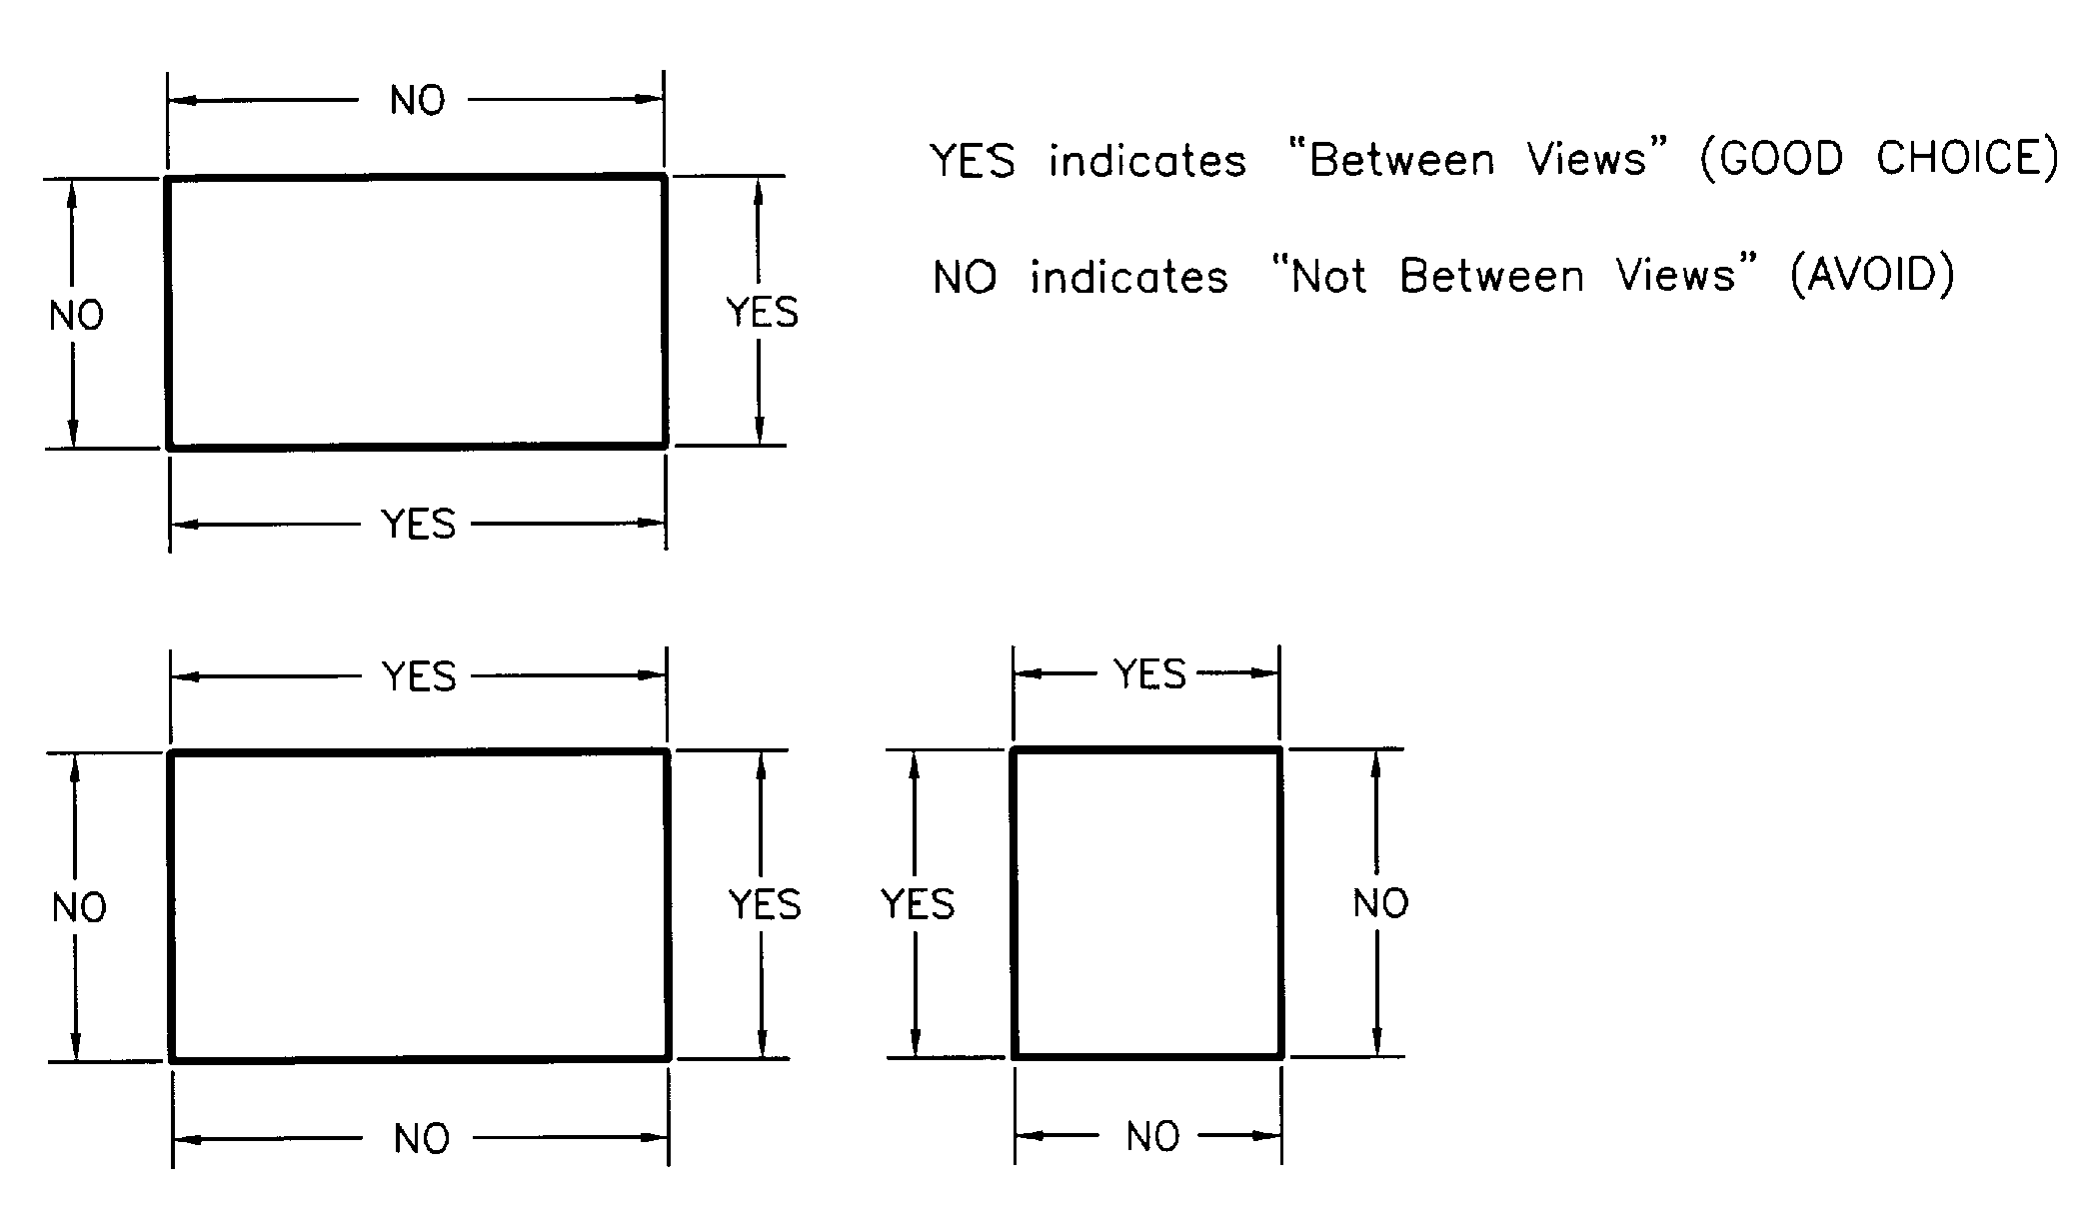
Place Dimensions BETWEEN Views

Slide 18
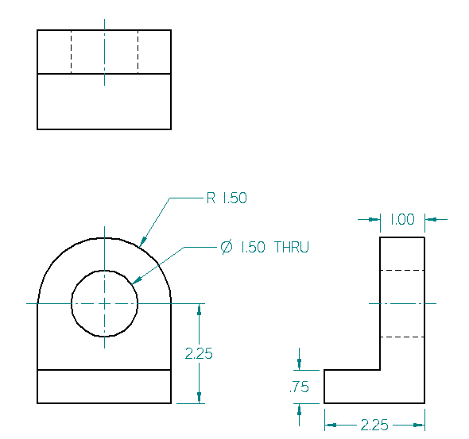
Contour Dimensioning Rule
(Where the Feature Shows)
Or Here?

Slide 19
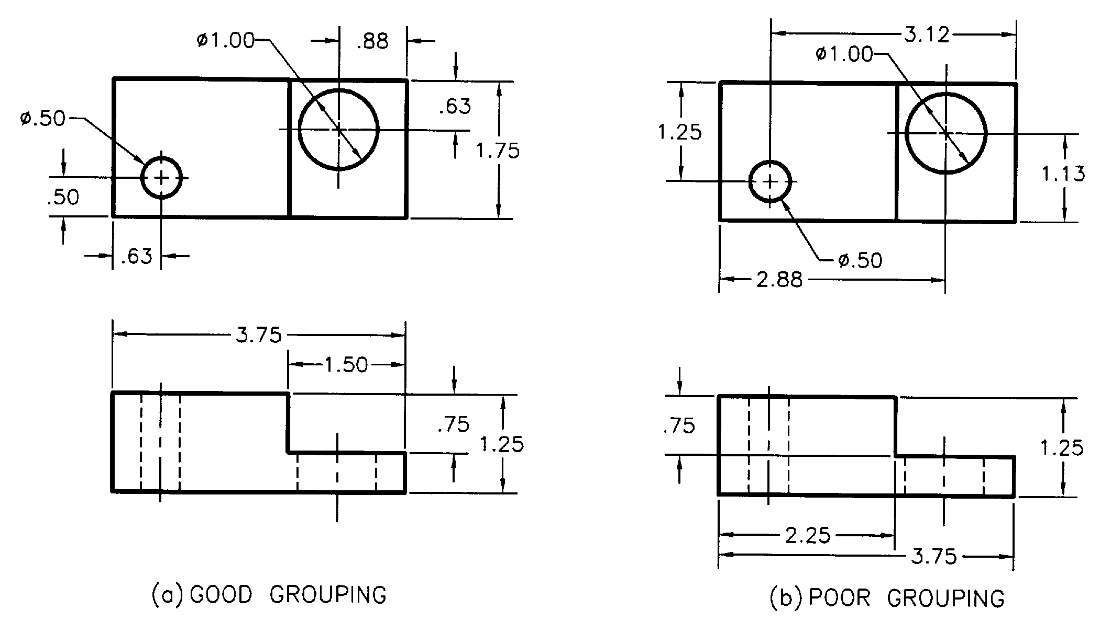
Group Dimensions

Slide 20
Other Guidelines
Place the largest dimension farthest from the part boundary.
Do not repeat dimensions.
Dimension from visible lines, never from hidden lines.
Avoid:
Long extension lines.
DO NOT!
Cross dimension lines with extension lines.

Slide 21
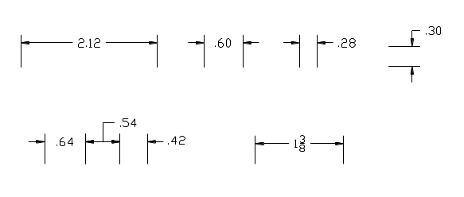
Placement with Dimension Lines -
Examples

Slide 22
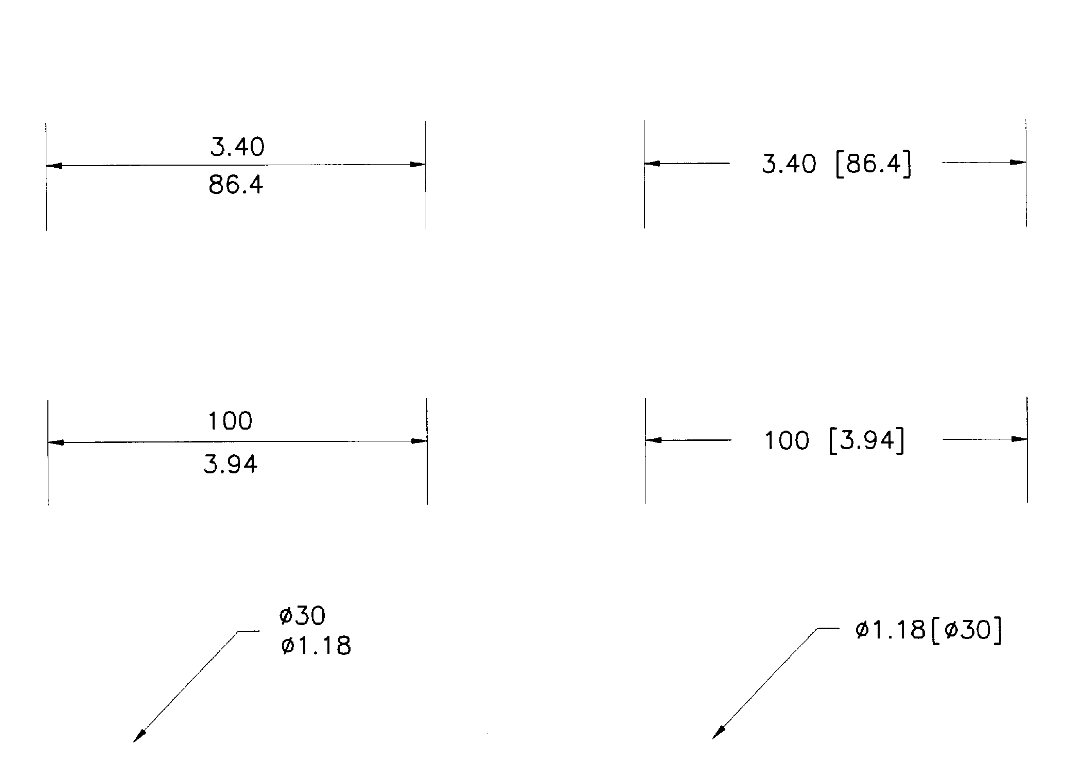
Dual Dimensioning
converted dimension beneath or bracketed to right
Notes:
converted dimension beneath or bracketed to right

Slide 23
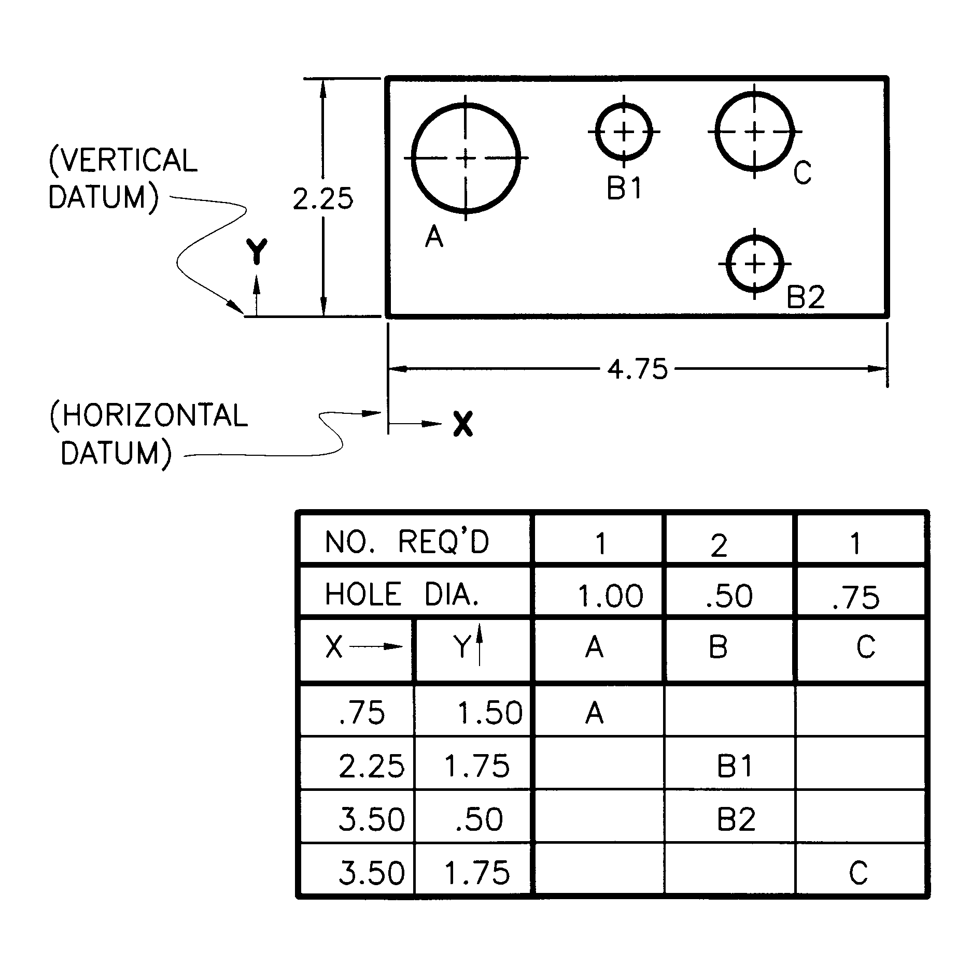
Tabular Dimensioning
Notes:
Used to locate a large number of similarly shaped features, such as holes.

Slide 24
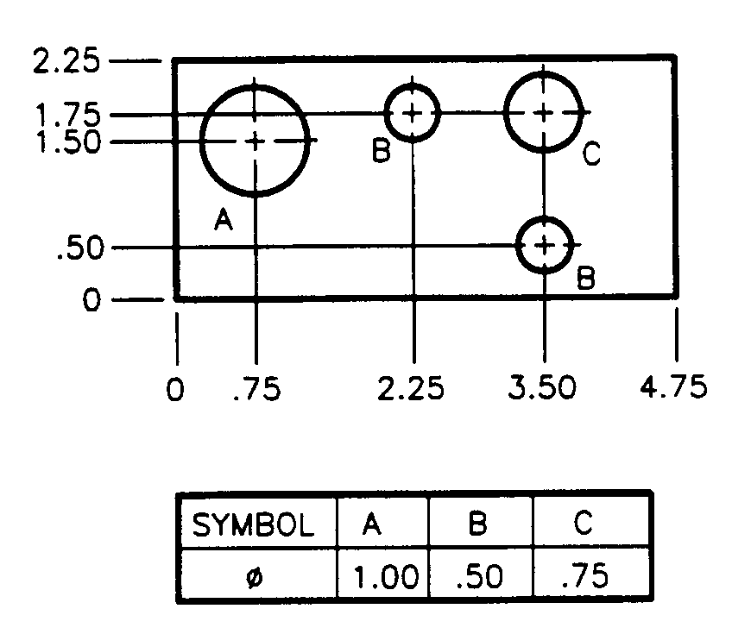
Coordinate Dimensioning
Notes:
Used to locate a large number of similarly shaped features, such as holes.

Slide 25
Dimensioning Holes
Through Holes
Blind Holes
Counterbored Holes
Countersunk Holes

Slide 26
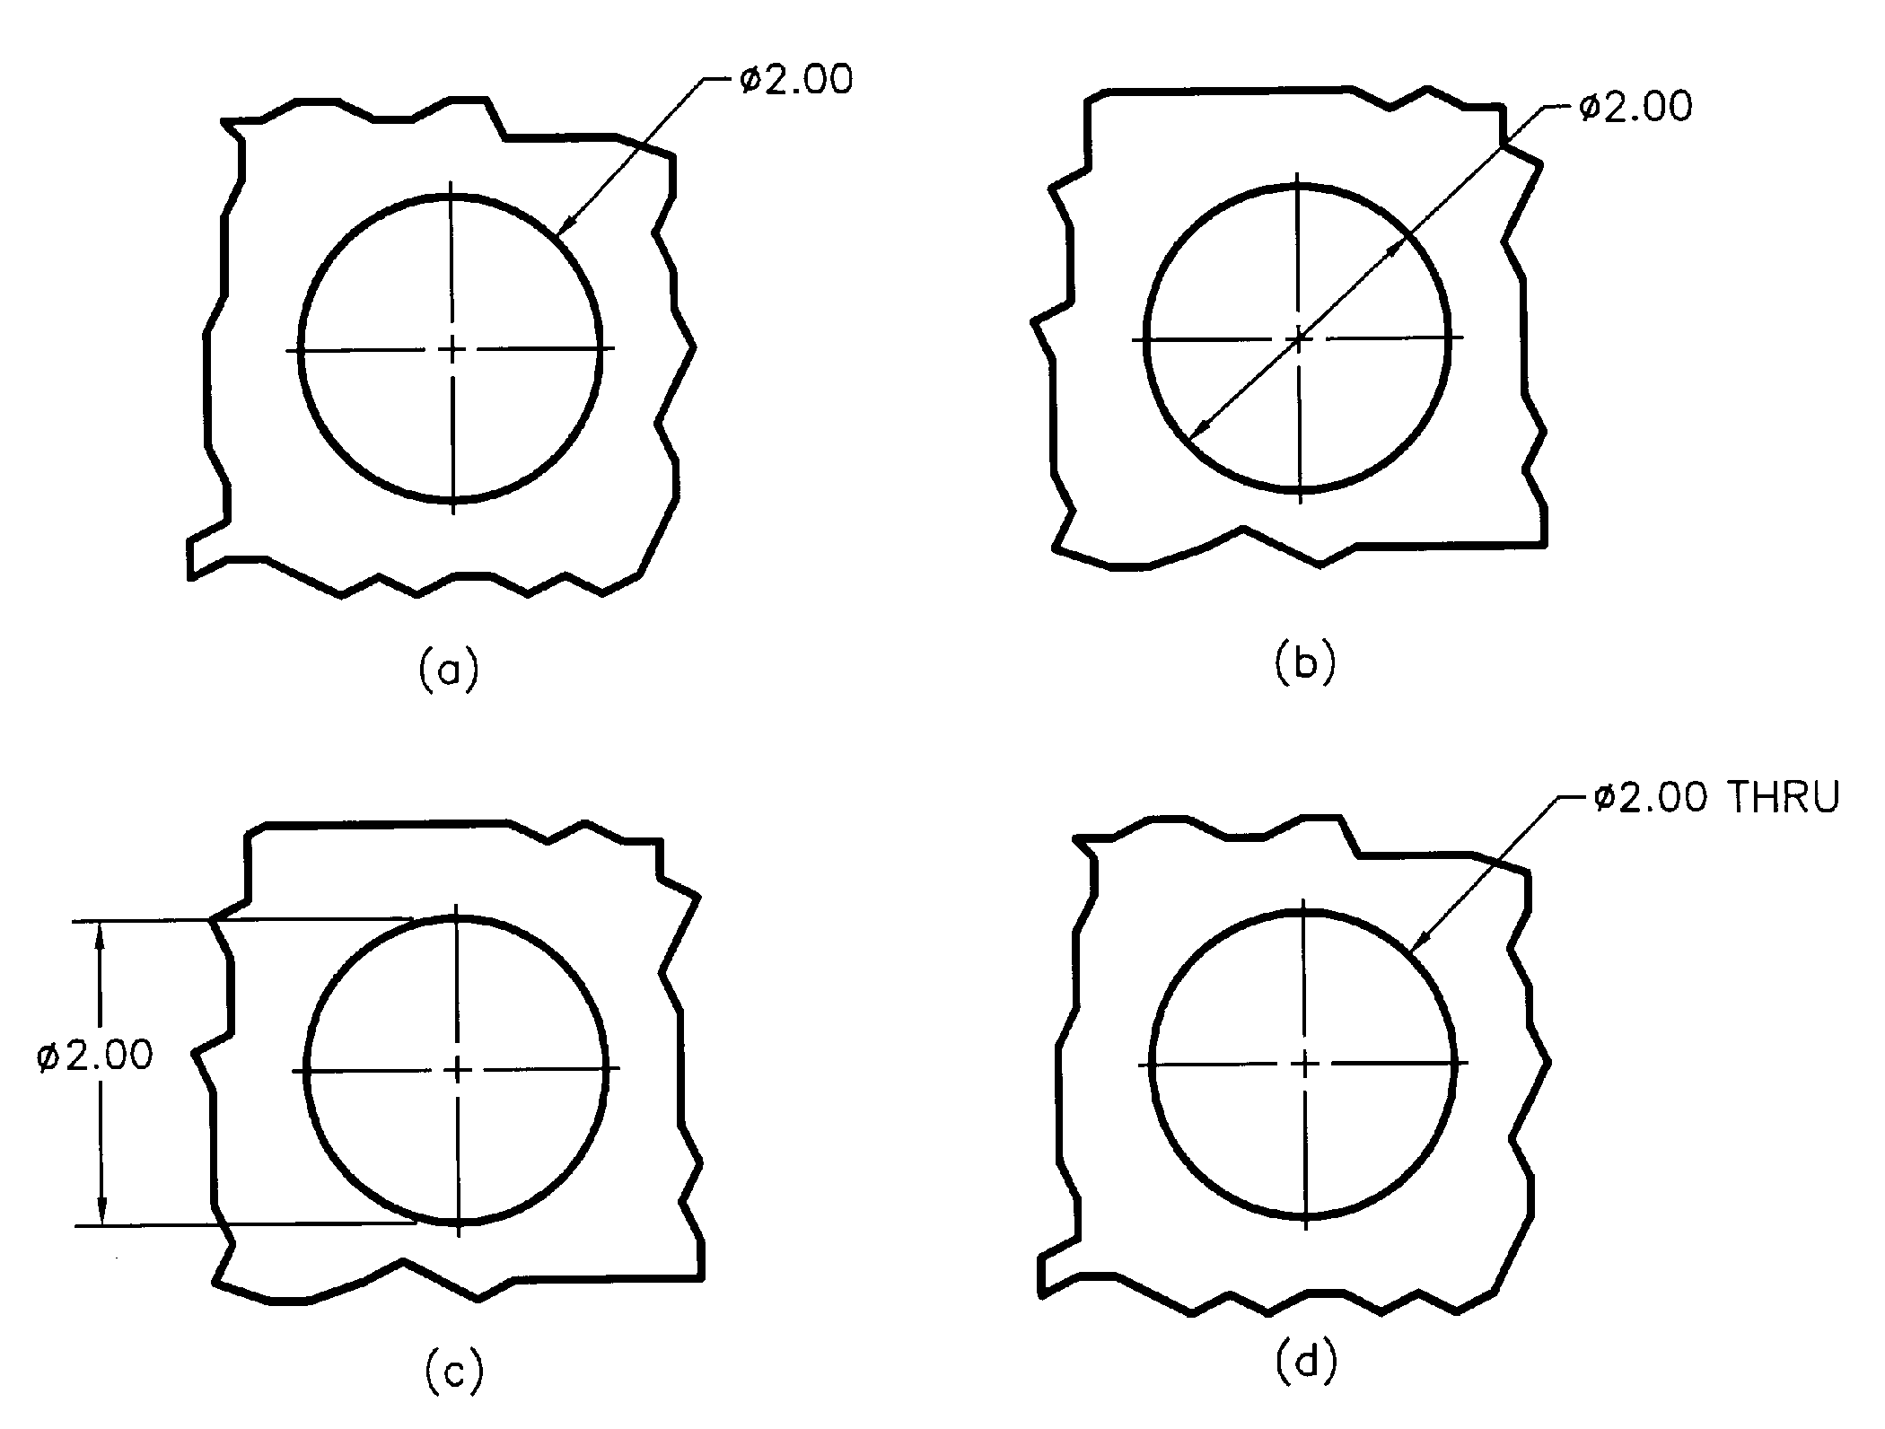
Dimensioning Through Holes
in “circle view”
diameter with leader and note
less used
Notes:
For holes (negative cylinders) both the location of the center and the diameter dimensions are normally given in the “round” view.
Figure (a) is most often used and (c) is almost never used.

Slide 27
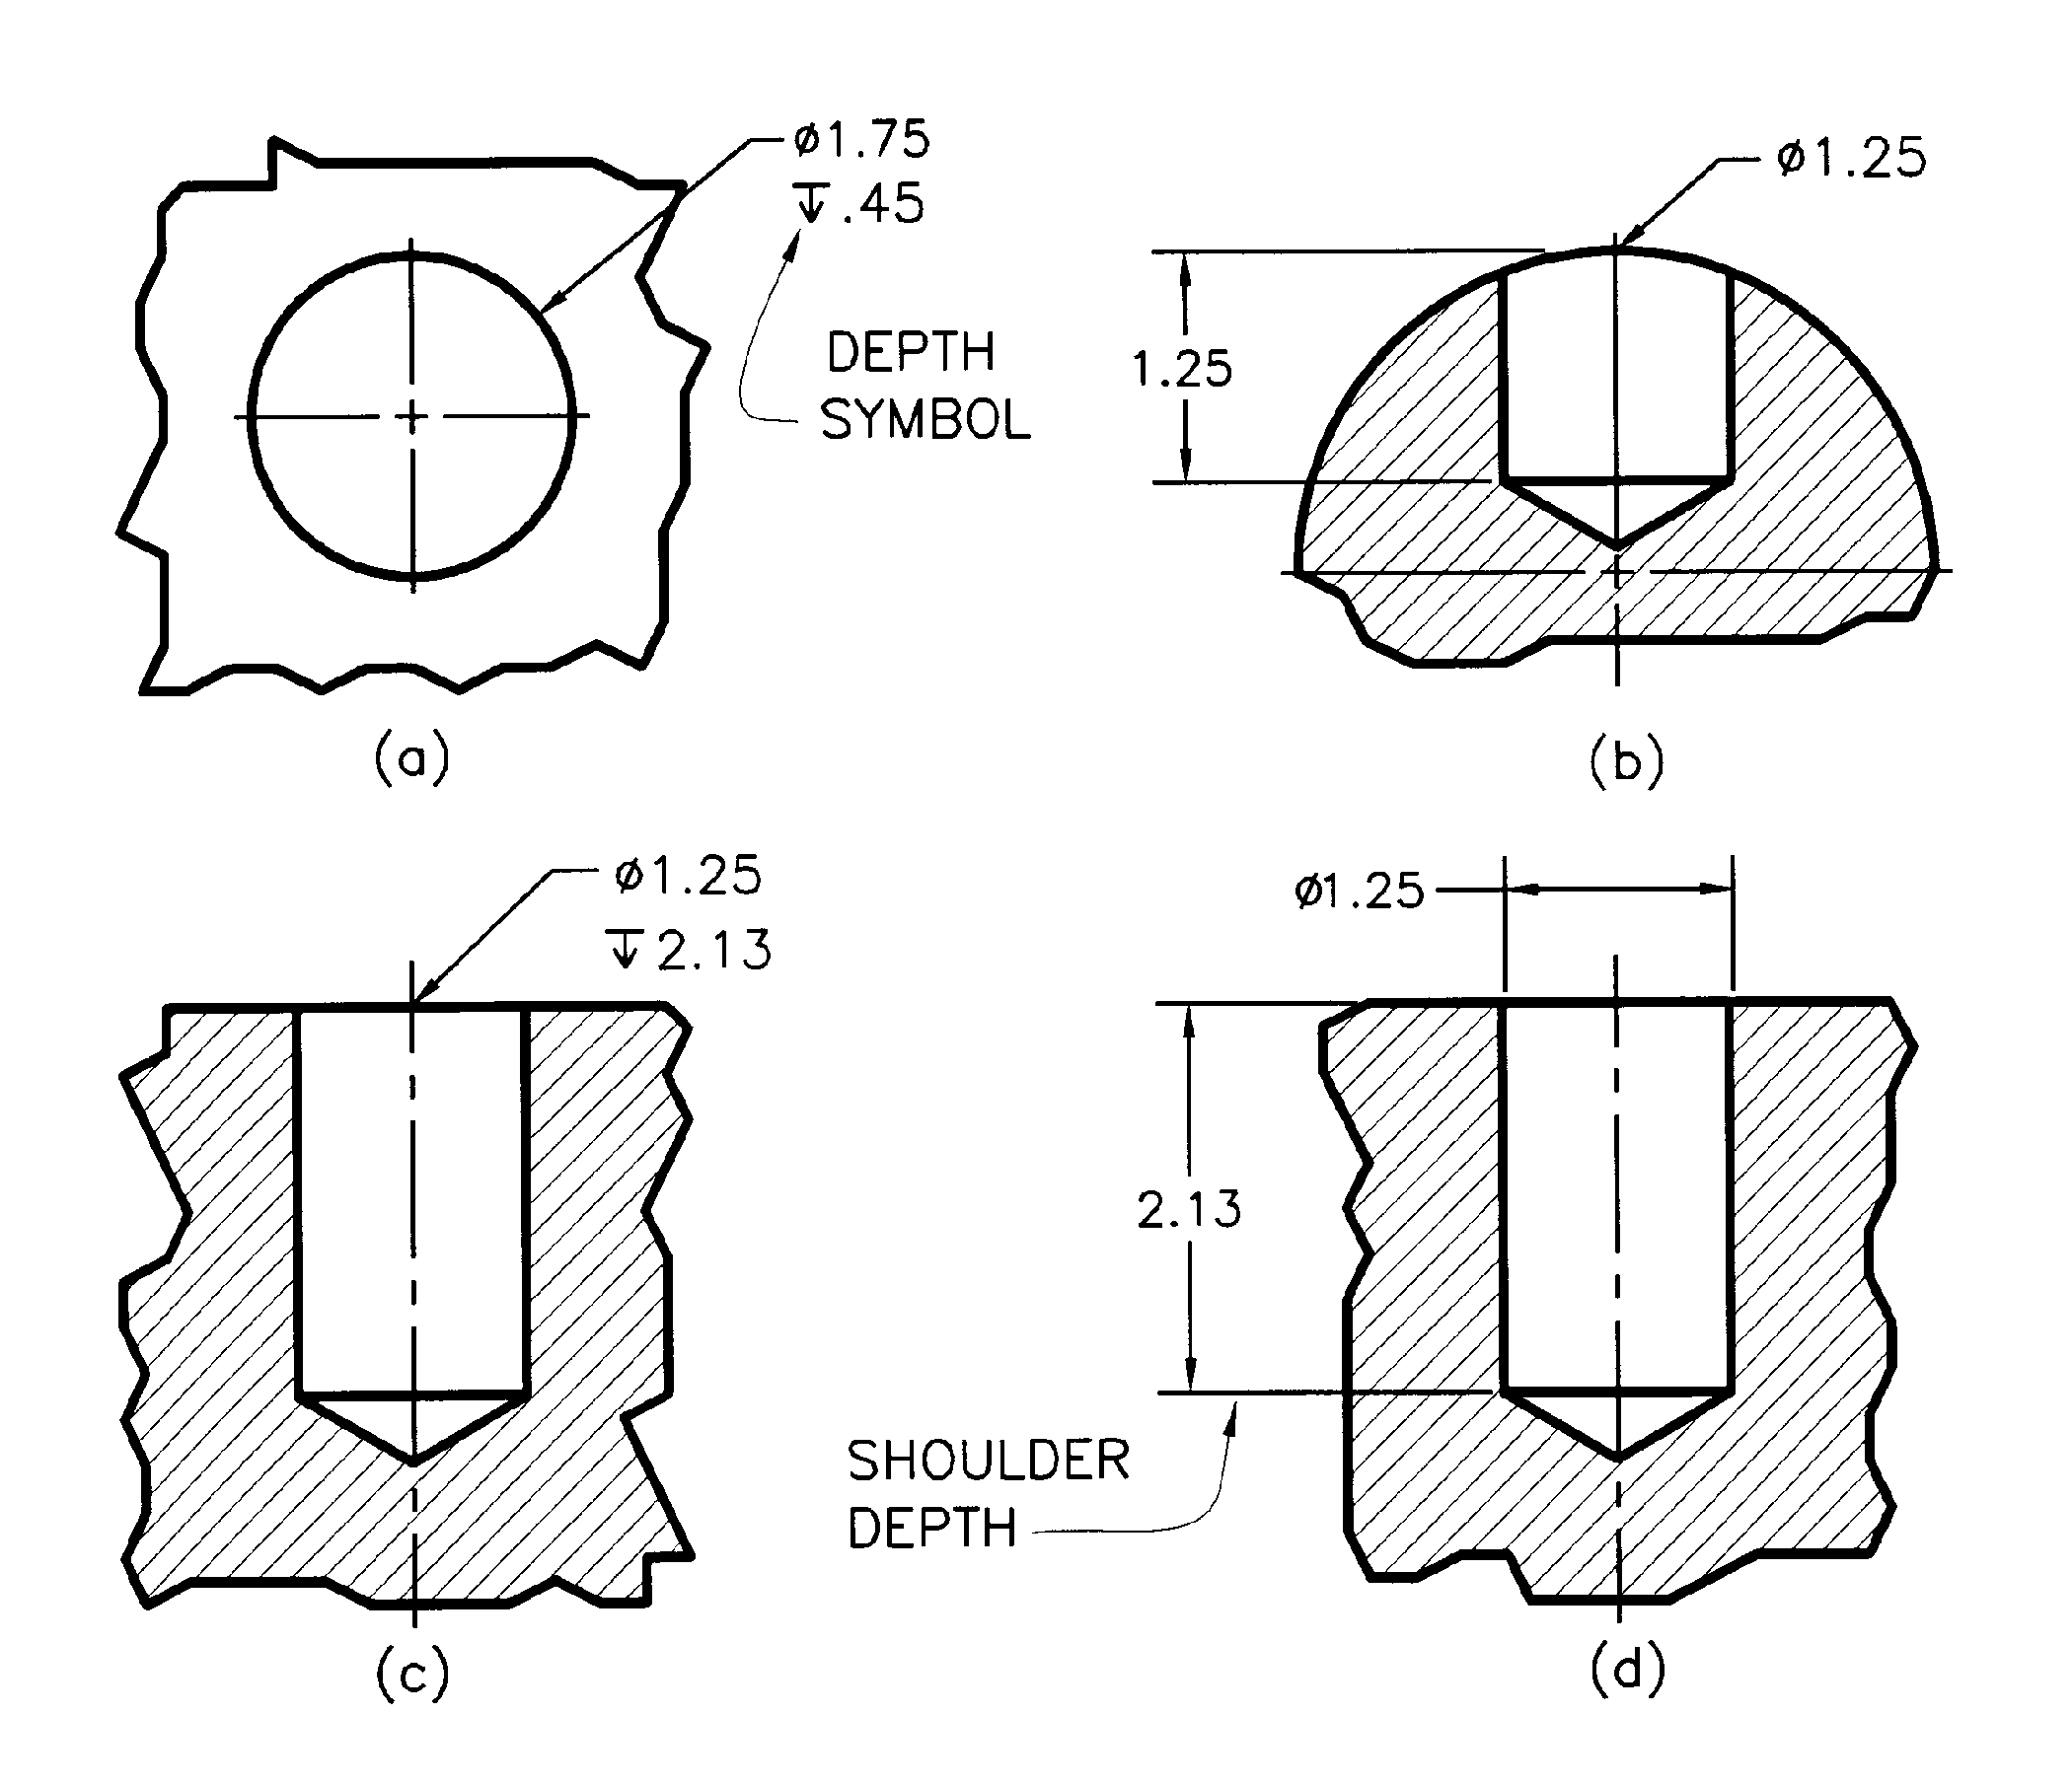
Dimensioning Blind Holes
depth dimension does not include drill tip
depth symbol height & width = letter height
most used
Notes:
Depth of a hole is to the shoulder and does not include the tip.
Figure (a) is most often used.

Slide 28
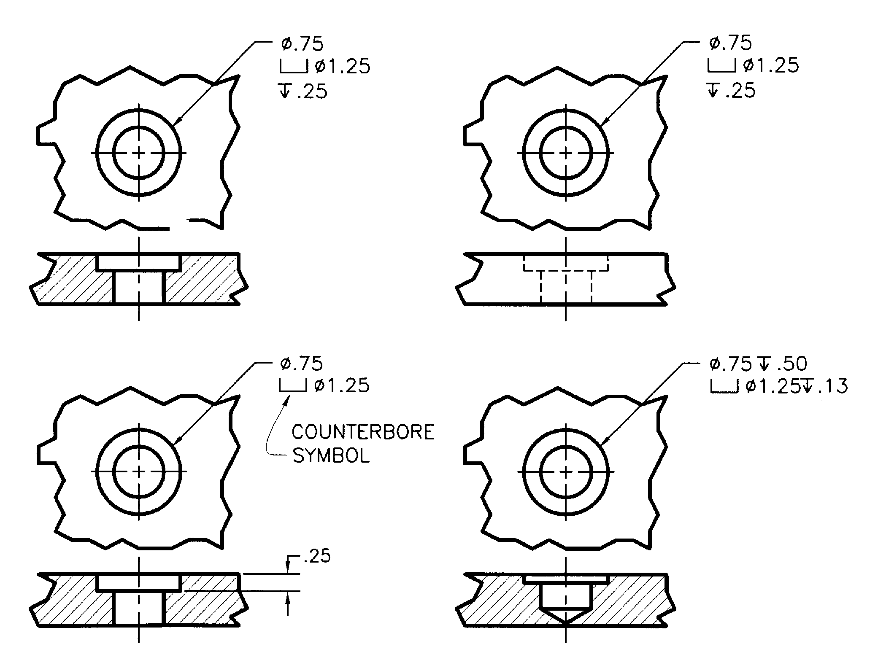
Dimensioning Counterbored Holes
Leader to counterbore, note from smallest to largest
BLIND
Notes:
Leader points to counterbore diameter, not the through hole.

Slide 29
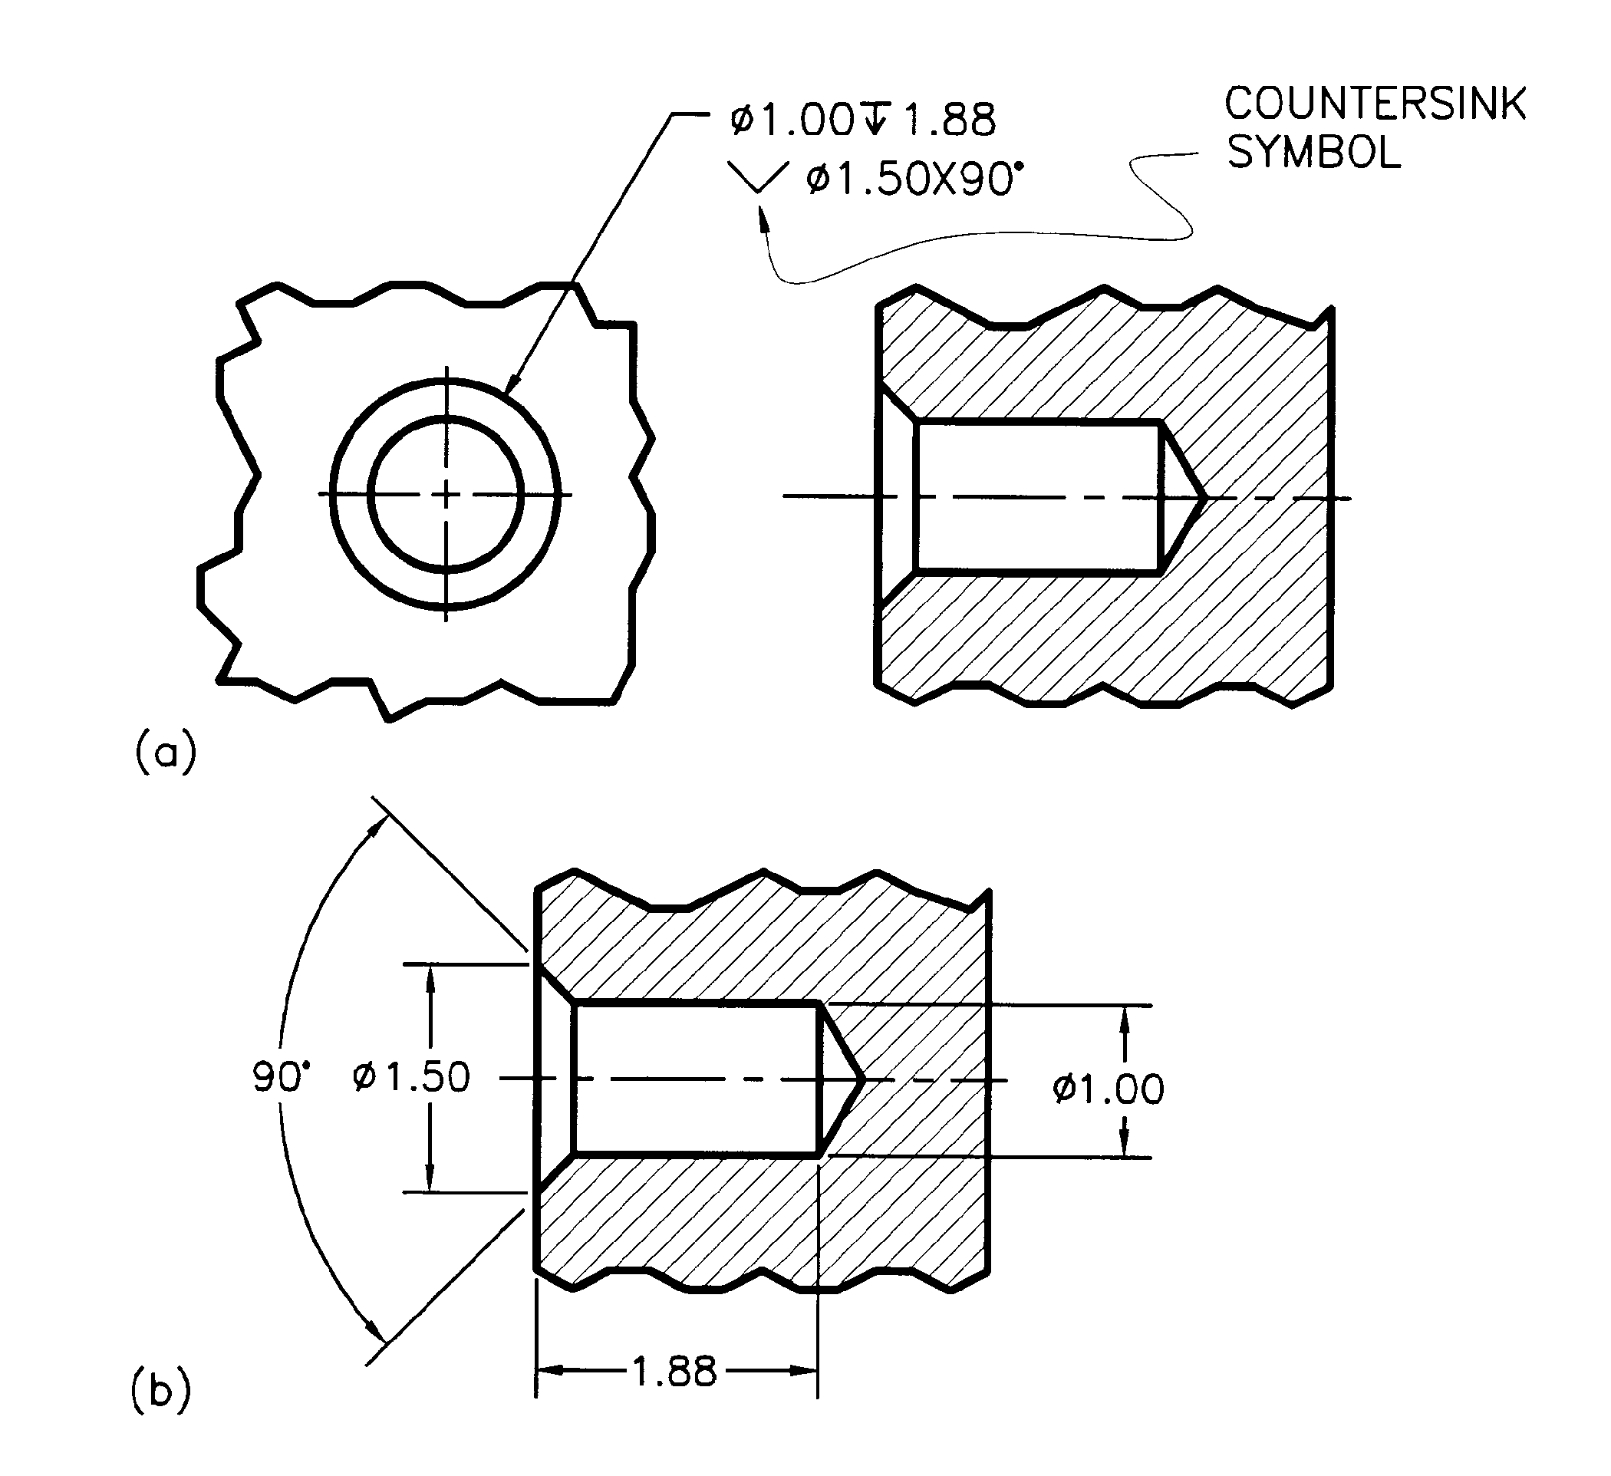
Dimensioning Countersunk Holes
Notes:
Leader points to countersink diameter, not the through hole.

Slide 30
Dimensioning Guidelines – Threads
Threads – on pipes, fittings, nuts, and bolts – are standardized
See pages 127-135 in the text for examples of thread schematics and notes.

Slide 31
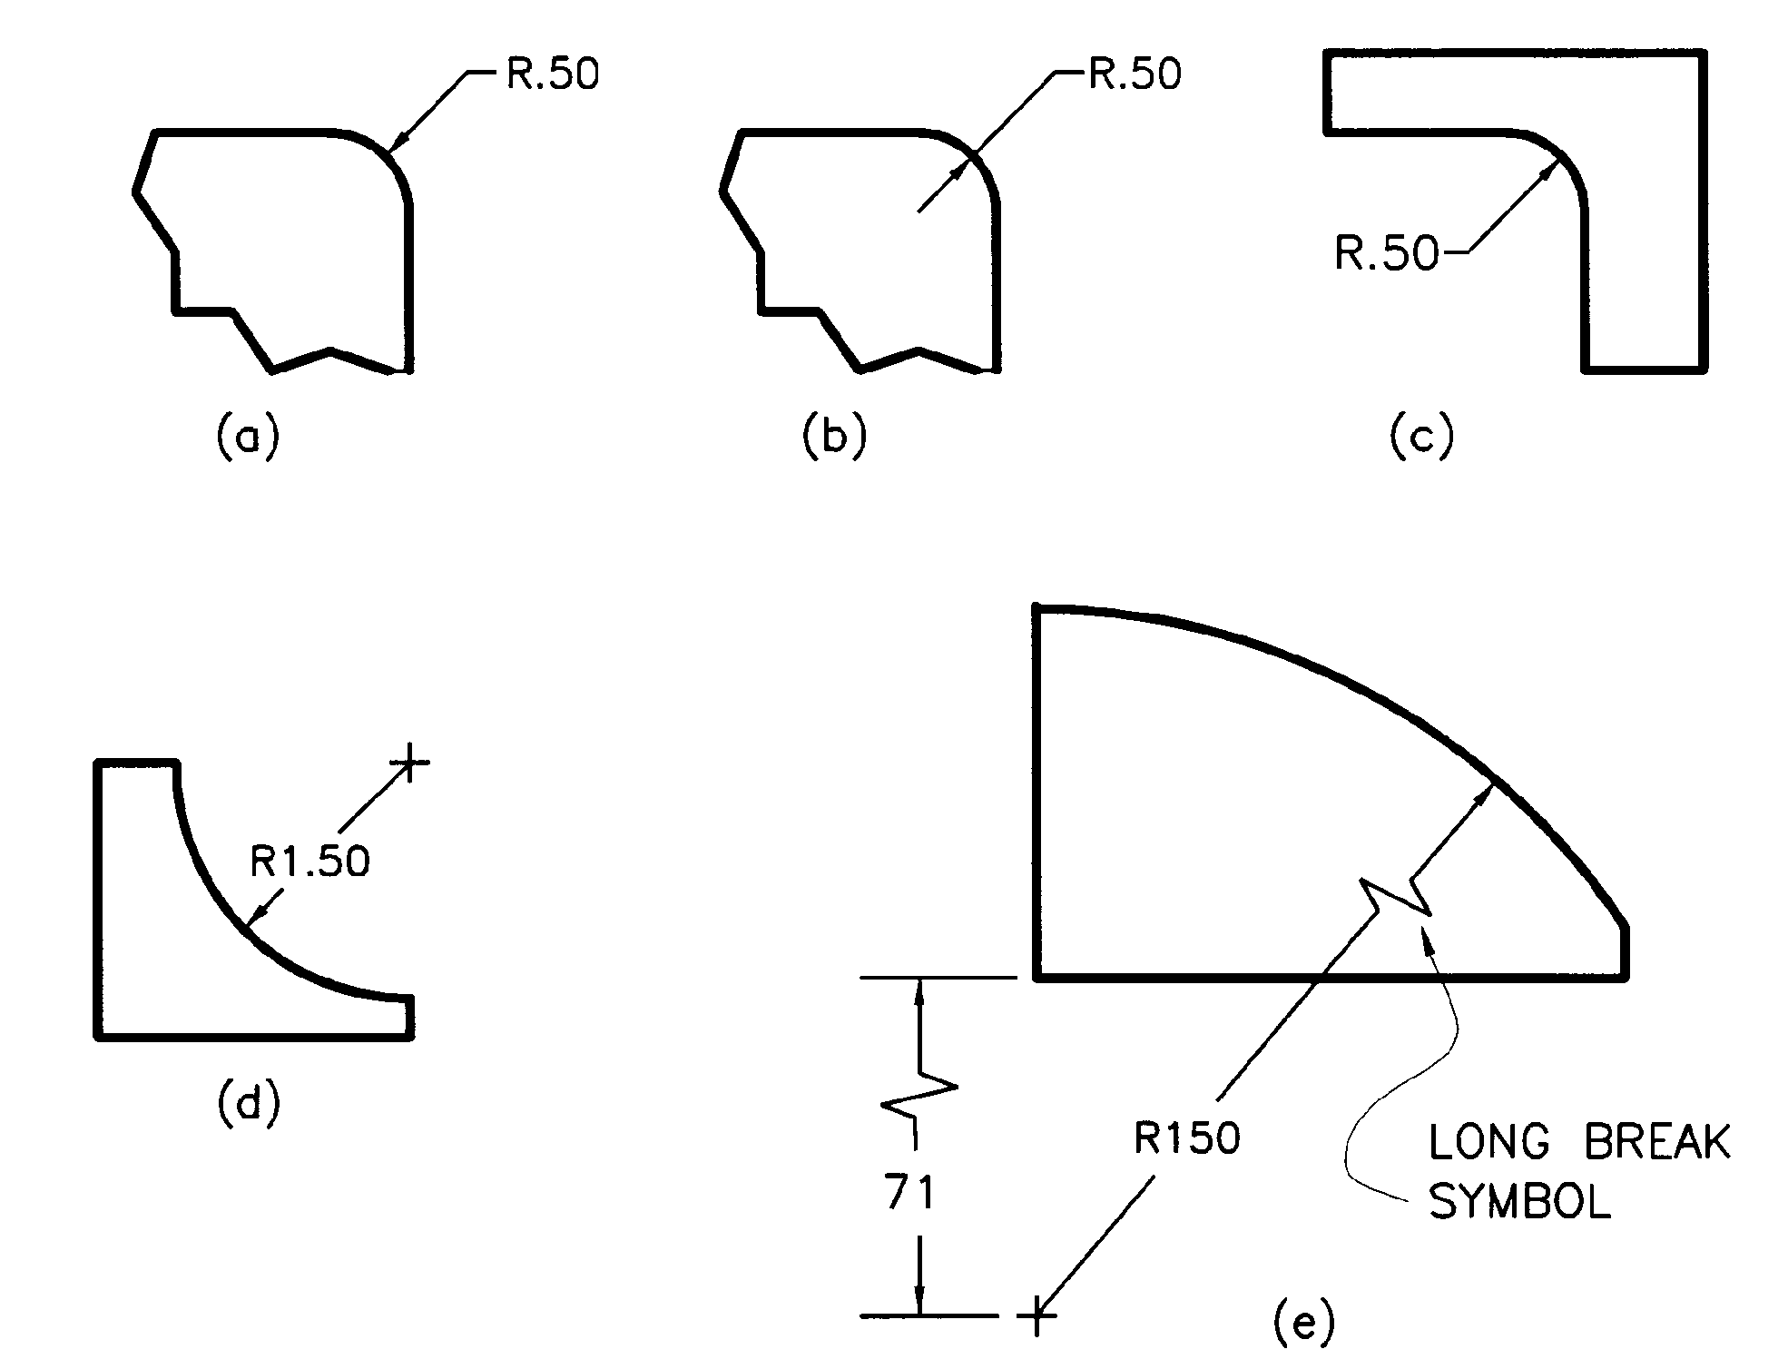
Dimensioning Guidelines – Arcs
Leader, symbol, dimension
dimension and arrow between center and arc
arrow between, dimension and leader outside
or
dimension and leader outside
Notes:
Recall that fillets and rounds may be dimensioned with notes (see the “Repetitive Symbols & Notes” slide)

Slide 32
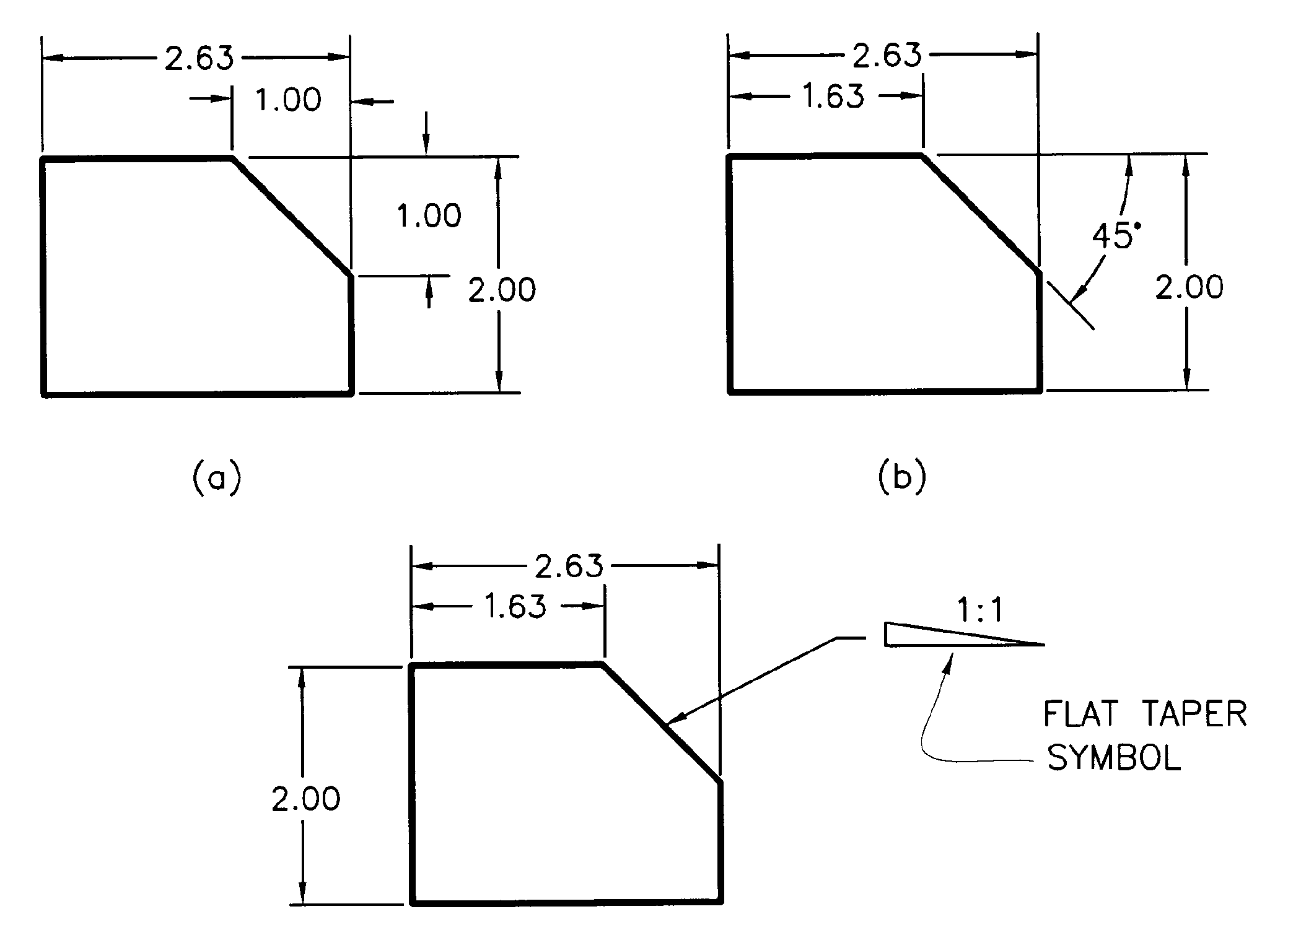
Dimensioning Guidelines – Angles

Slide 33
Dimensioning Guidelines – Chamfers
A chamfer is a small angled surface formed between two other surfaces
Removes sharp corner – avoids chipping, safer
Makes assembly (insertion) easier
Chamfers may be dimensioned with two linear dimensions, a linear dimension and an angle, or a note

Slide 34
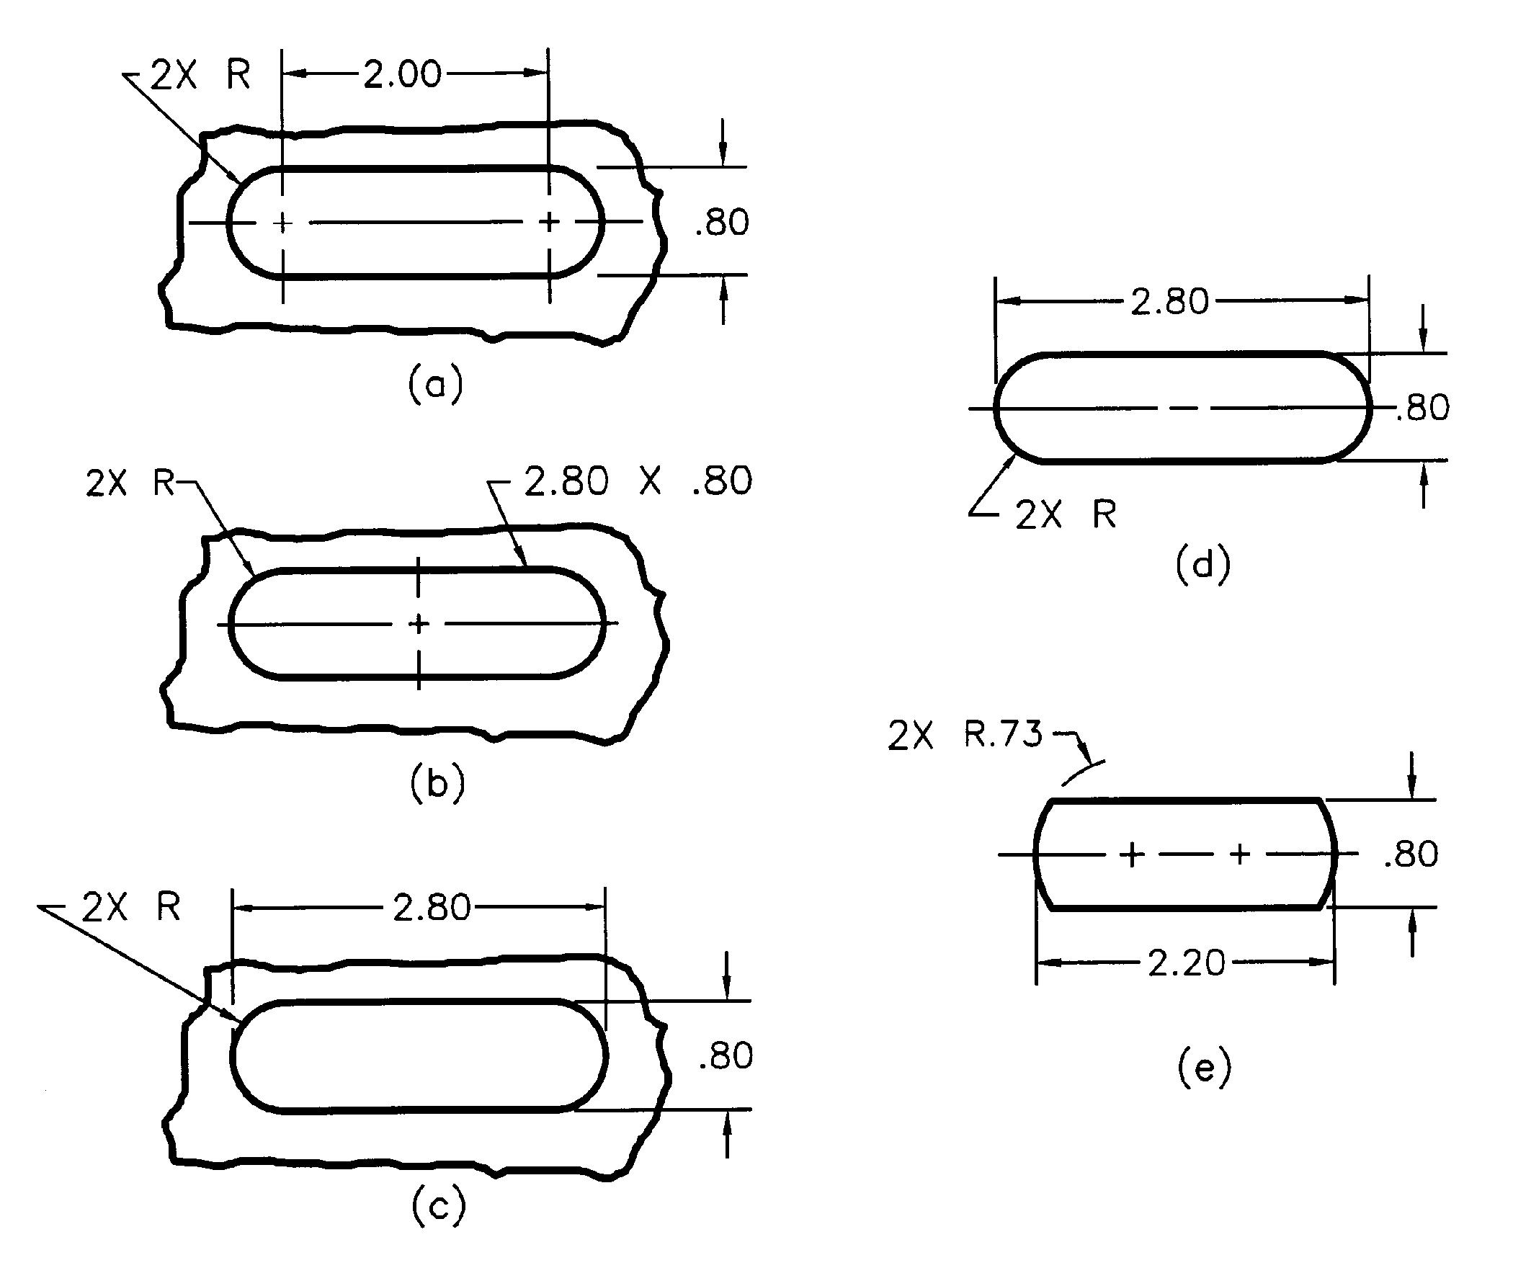
Dimensioning Guidelines – Slot Shapes
most common
slots
objects
Note the variations on centerlines
Notes:
Figure (a) shows the most common way of dimensioning a slot.

Slide 35
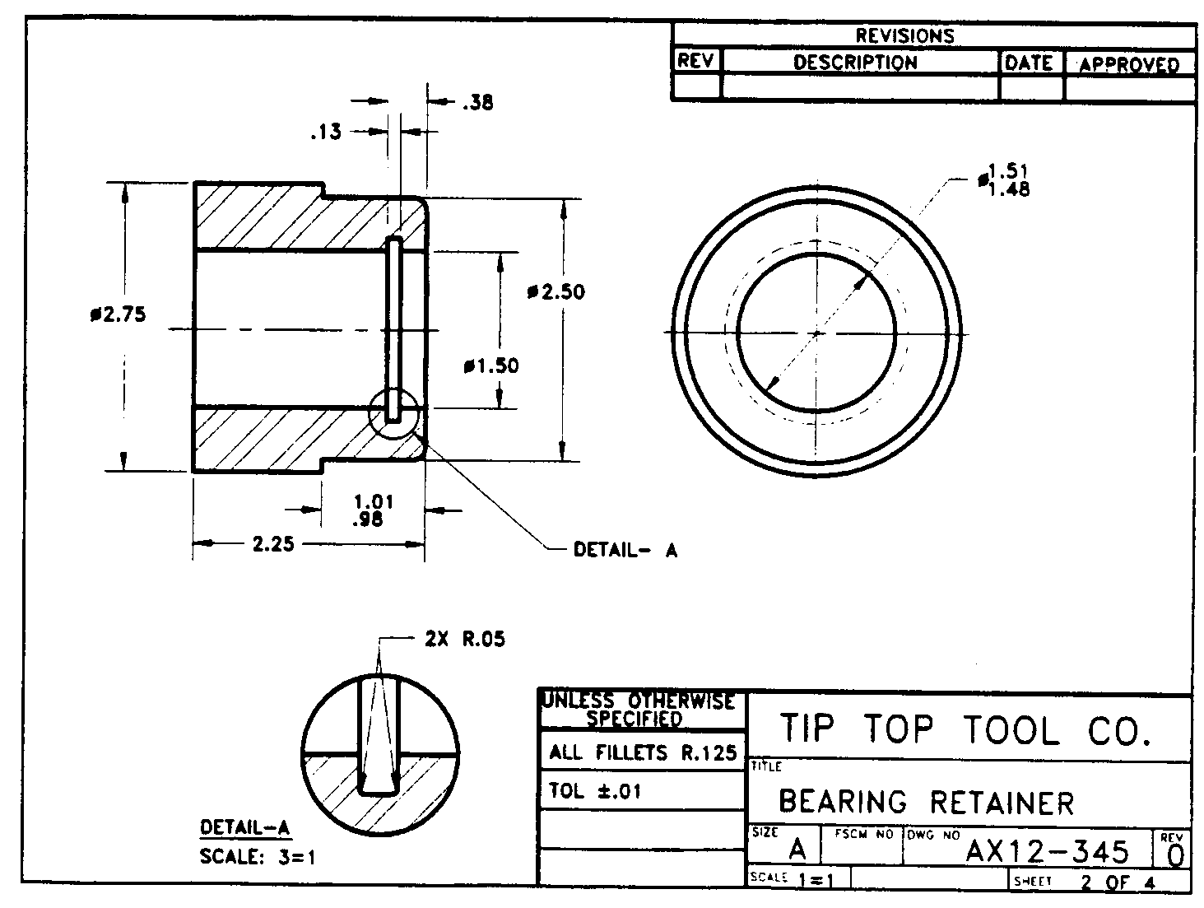
Detail Views
Encircle the area of interest
Note and leader to identify
Enlarge, label, and scale
Notes:
Used to achieve a “close-up” of a feature that is small with respect to the rest of the drawing.
The encircled area in the “parent” view should be duplicated and enlarged in the detail view.

Slide 36
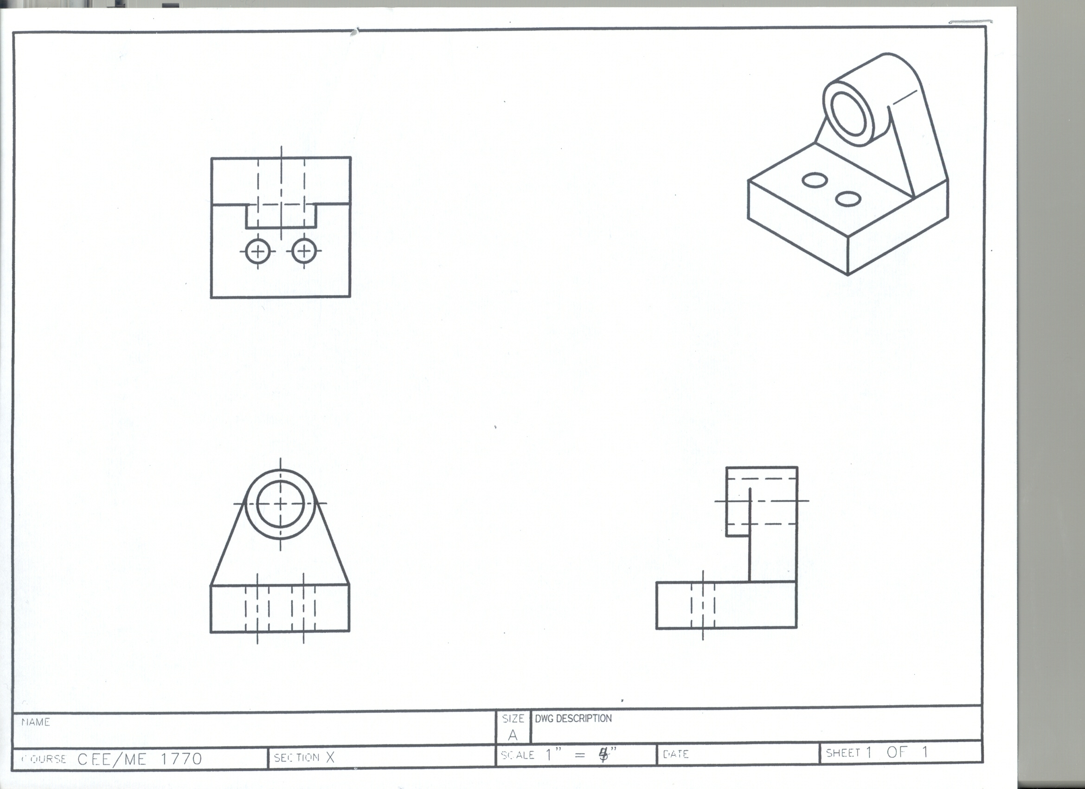
Dimensioning exercises

Slide 37
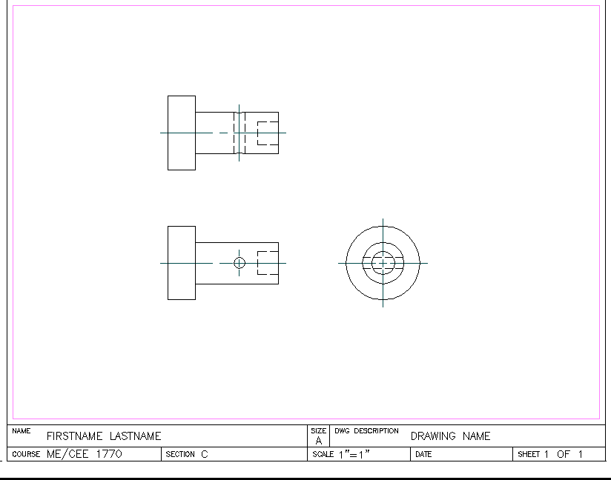
Dimensioning exercises

Slide 38
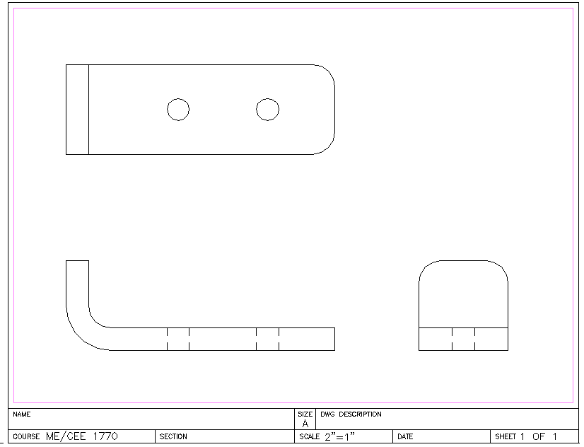
Dimensioning exercises

