Slide 1
Tolerances
Limit Dimensions
Plus and Minus
General Notes
GD&T
Examples

Slide 2
Assignment
Read pages 69-117 in the textbook.

Slide 3
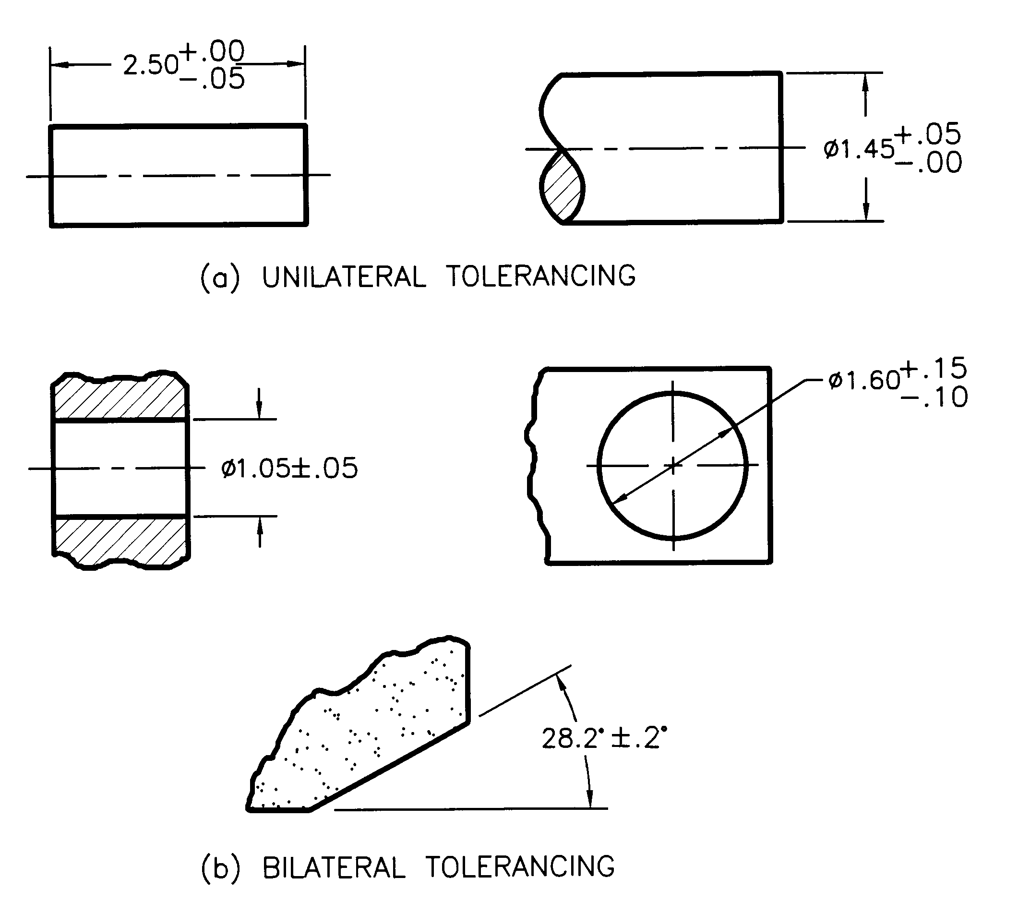
Plus/Minus Tolerances

Slide 4
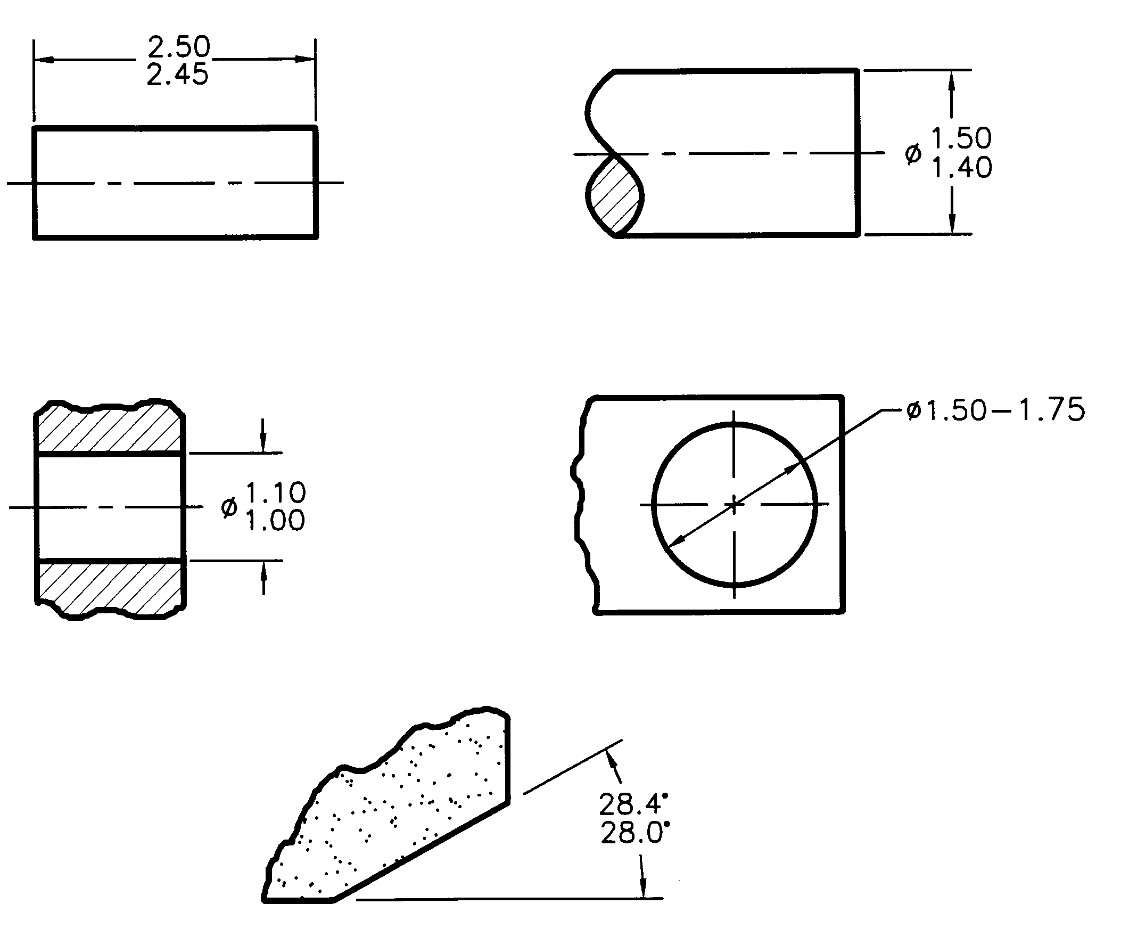
Limit Tolerances
MAX
MIN
MIN - MAX

Slide 5
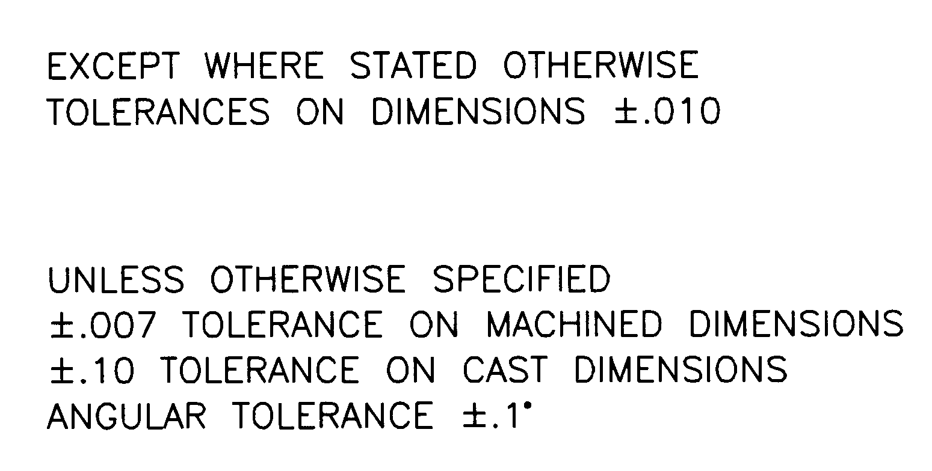
General Tolerance Notes
These notes are used to reduce the number of dimensions required on a drawing to have tolerances added and to promote drawing clarity.

Slide 6
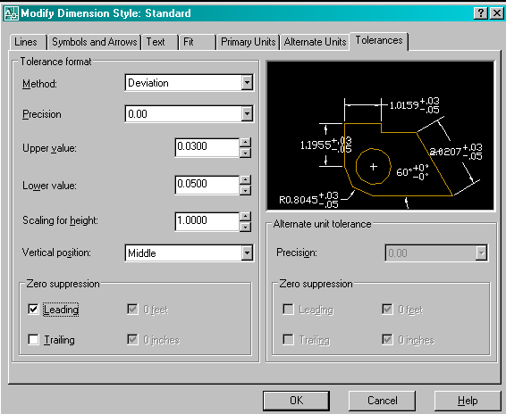
Adding Tolerances in AutoCAD

Slide 7
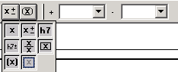
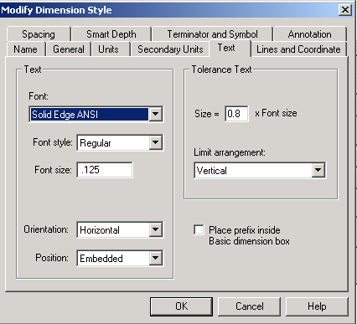
Adding Tolerances in Solid Edge
On Smart Dimension ribbon bar
Format > Style …

Slide 8
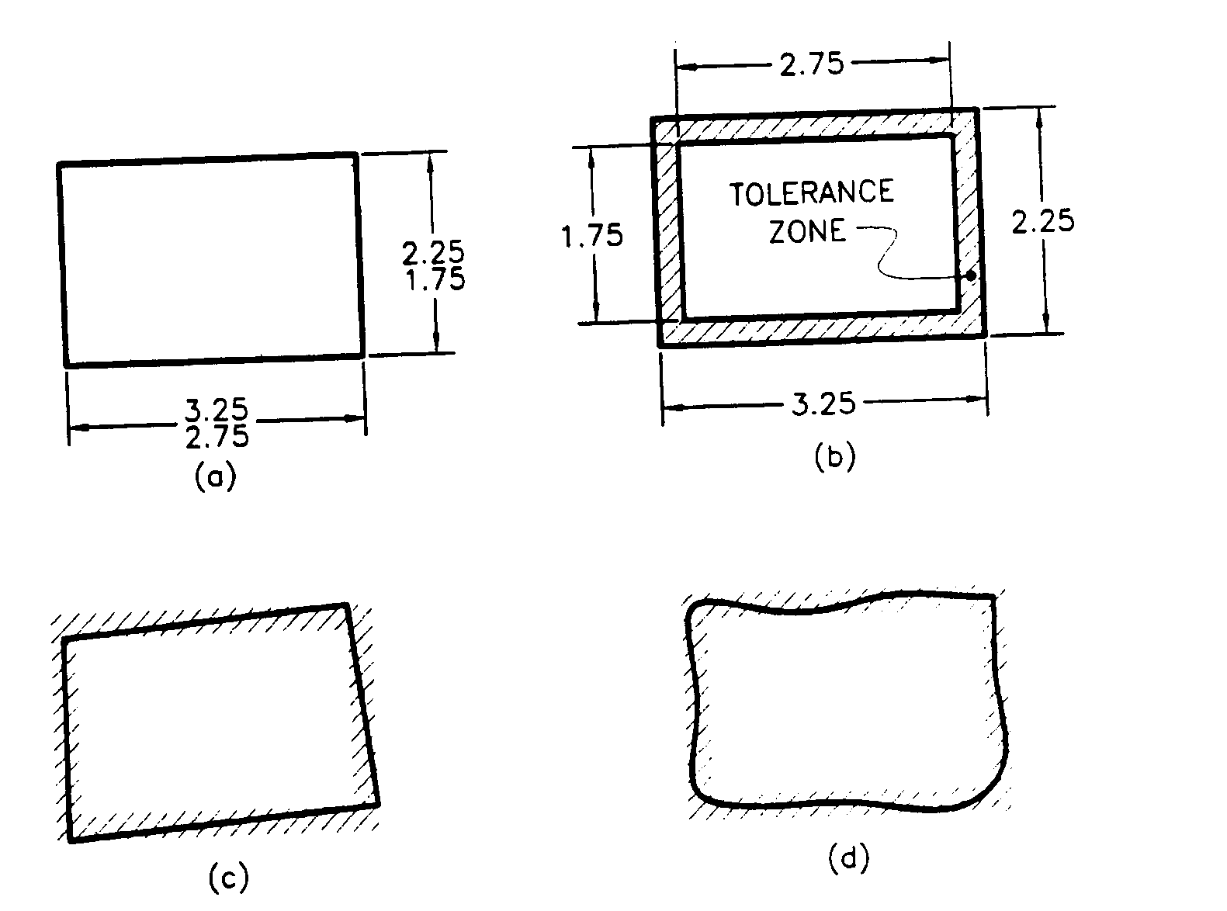
Geometric Dimensioning and Tolerancing (GD&T)

Slide 9
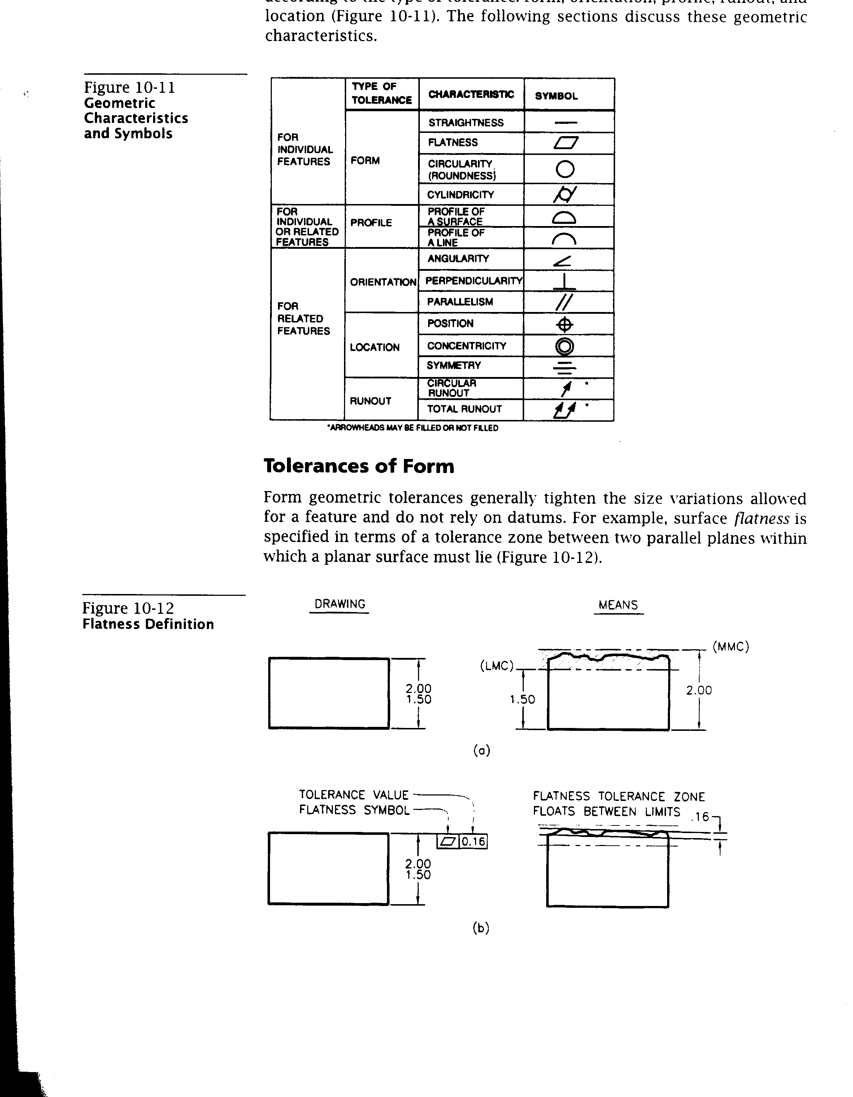
GD&T – Tolerance Types

Slide 10
GD&T – Flatness

Slide 11
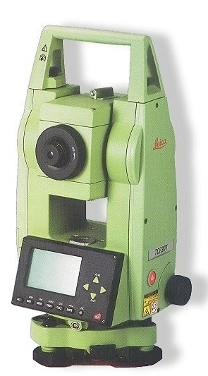
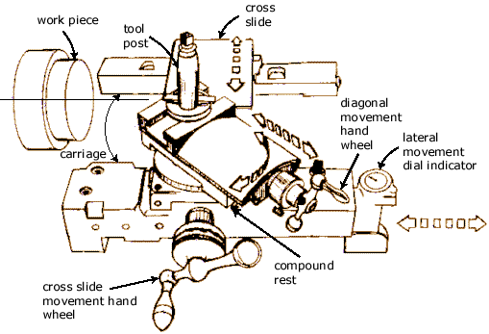
Examples
Manufacturing
Construction
Urethane
Theodolite
Lathe carriage

