Slide 1
Chapter 5
Creativity and the Design Process

Slide 2
Objectives
Describe the steps in the design process
Identify engineering tasks at the various stages of the design process
Explain the role of creativity in the engineering design process
Use several techniques that aid in the development of creative thinking

Slide 3
Introduction
Engineers: design and solve technical problems
Design procedure same regardless of industry
Need to understand design process thoroughly

Slide 4
What Is Design?
A goal-oriented, problem-solving activity
  Typically takes many iterations
Must keep certain factors in mind
  Usually related to function and cost
  Sustainable design: environmental impact
Prototype vs. computer software tools
Almost all designs require drawings, sketches, models, and analysis

Slide 5
Computers in Design
Eliminates need for numerous prototypes
Numerical methods
  Finite element analysis, modal analysis, thermal analysis
Computer-aided design (CAD)
  Construction of graphical 3-D model on computer
  Computer-aided manufacturing (CAM)

Slide 6
Classification of Engineering Designers
Chief designer
Industrial designer
Architect
CAD designer
Design analyst
Model builder
Detail designer

Slide 7
Creativity in Design
Important feature of design process
  Vs. rules or constraints
Leonardo da Vinci
Creativity is heart of innovation
Brain works most creatively when hands are engaged in mindless tasks

Slide 8
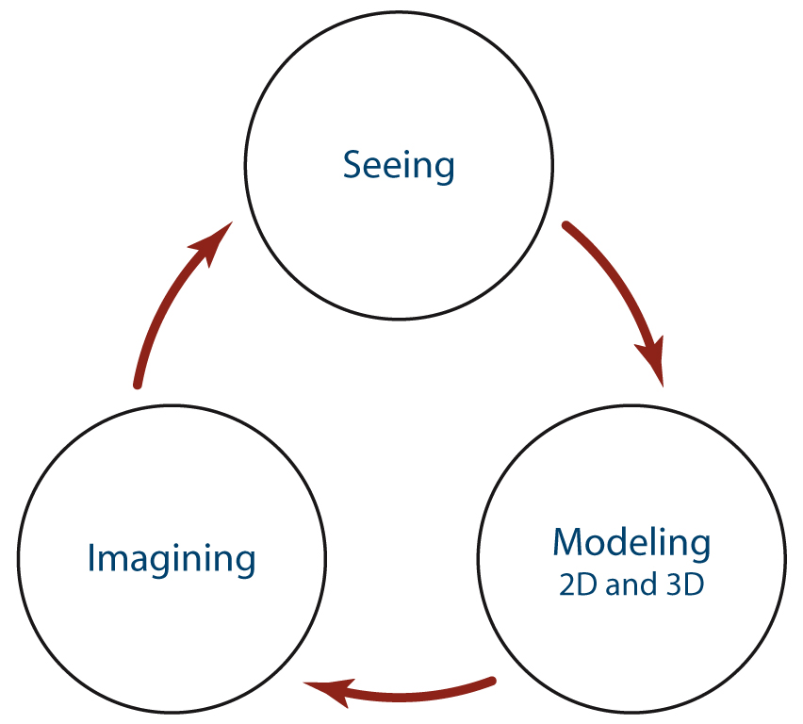
Visual Thinking
FIGURE 5.01. Visual thinking
model.

Slide 9
Brainstorming
Most common form of group ideation and concept generation
Step 1: Assemble project team
Step 2: Define the idea of design project
Step 3: Discuss brainstorming rules
Step 4: Ask everyone to offer an idea
Step 5: Narrow the list of ideas

Slide 10
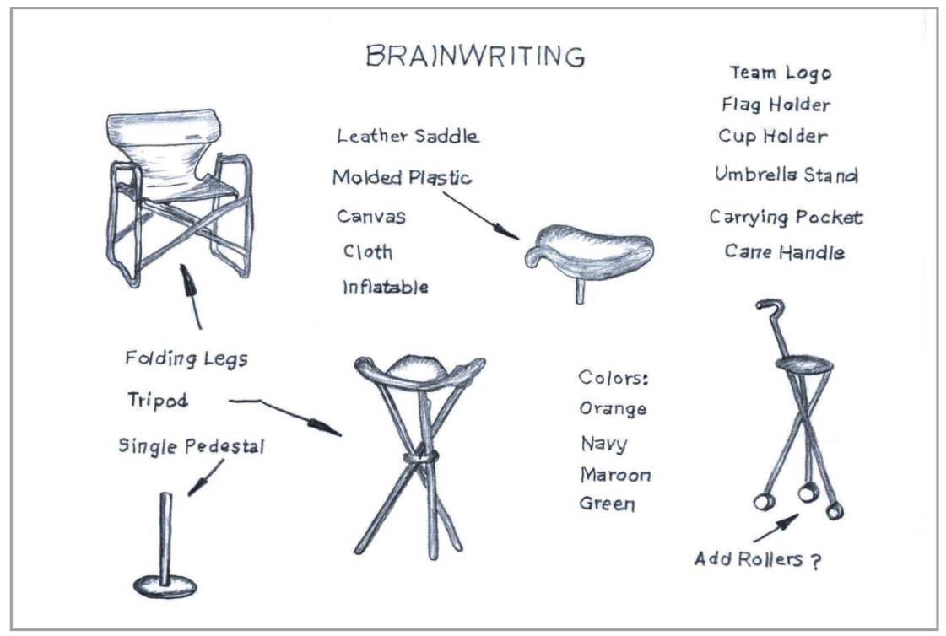
Brainwriting (6-3-5 Method)
Six people, three ideas each, five times around the table
FIGURE 5.02. Brainwriting.

Slide 11
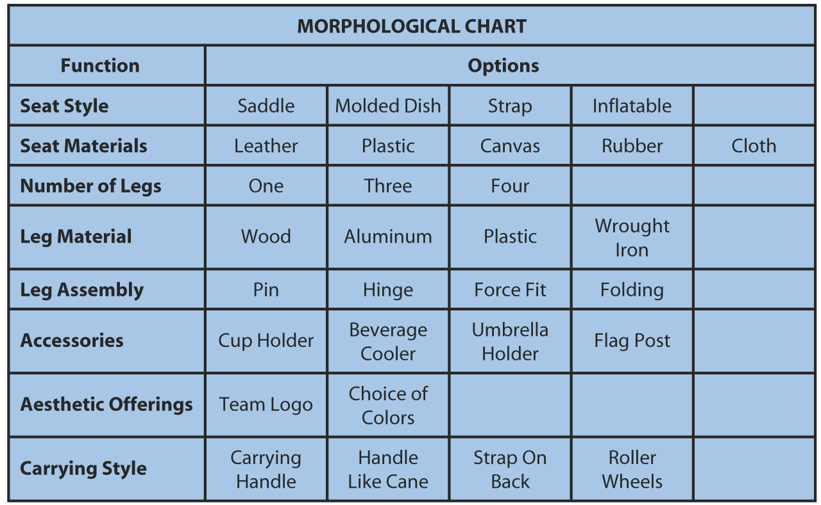
Morphological Charts
FIGURE 5.03. A morphological chart.

Slide 12
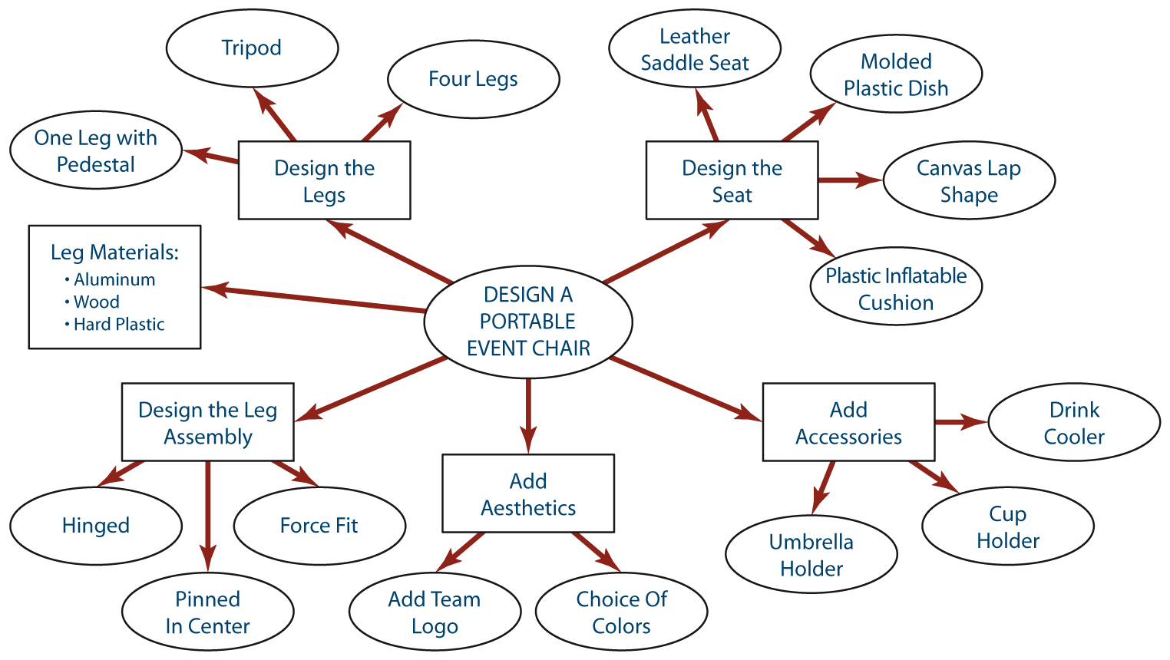
Concept Mapping
FIGURE 5.04. A concept map.

Slide 13
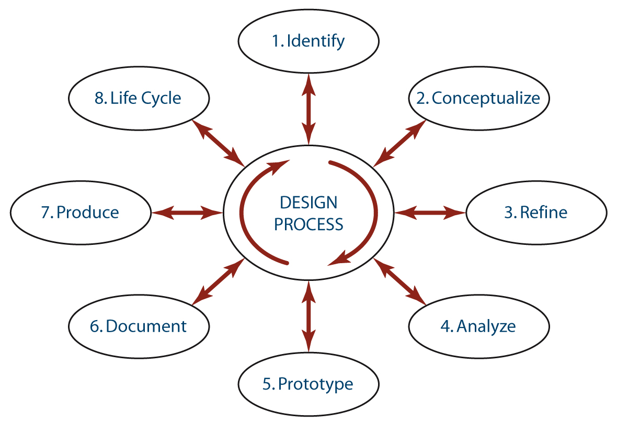
The Engineering Design Process
FIGURE 5.05. An engineering
design process.

Slide 14
Stage 1: Problem Identification
Must address questions and answers from:
  Customer’s/client’s perspective
  Engineer’s perspective
Life cycle: how long product can be used before ineffective
Green engineering: environmental concerns

Slide 15
Stage 2: Concept Generation
Most creative phase
Starts with brainstorming or brainwriting
Criticism limited
Sketching is integral way to develop ideas
By the end, a few main ideas should have been selected

Slide 16
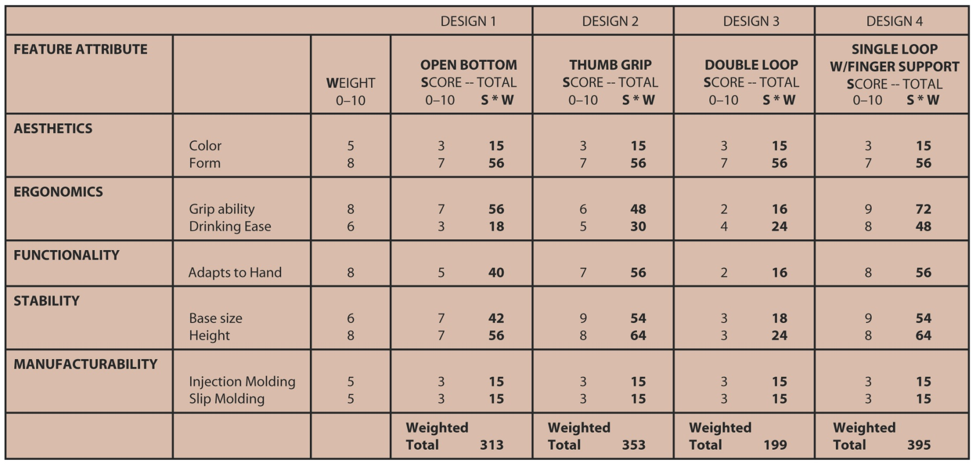
Stage 3: Concept Selection and Refinement
FIGURE 5.07. A weighted decision table for concept selection.

Slide 17
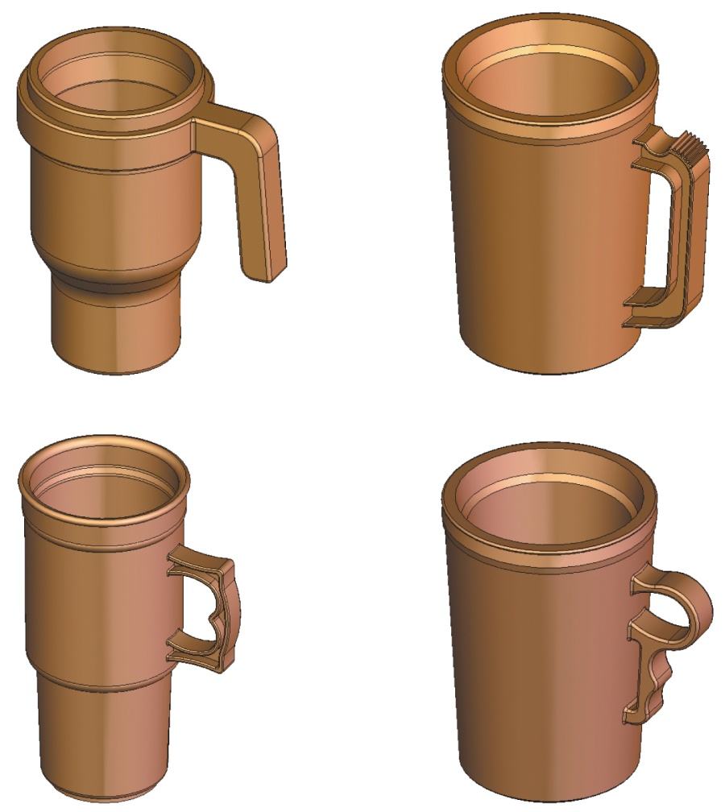
Stage 3: Concept Selection and Refinement (cont’d.)
FIGURE 5.08. Computer models for concept selection.

Slide 18
Stage 4: Design Evaluation and Analysis
Concept further analyzed by numerical methods
Building and testing done on computer saves time and money
Mass properties analysis
Analysis might also include FEA of stress contours, heat transfer, aerodynamic flow

Slide 19
Stage 5: Physical Prototyping
Physical models
  Scale model
  True-size model
  Mock-up concept model
CAM systems
  CNC machines
Rapid prototyping methods
  SLA, SLS, LOM, FDM, SGC, inkjet printing

Slide 20
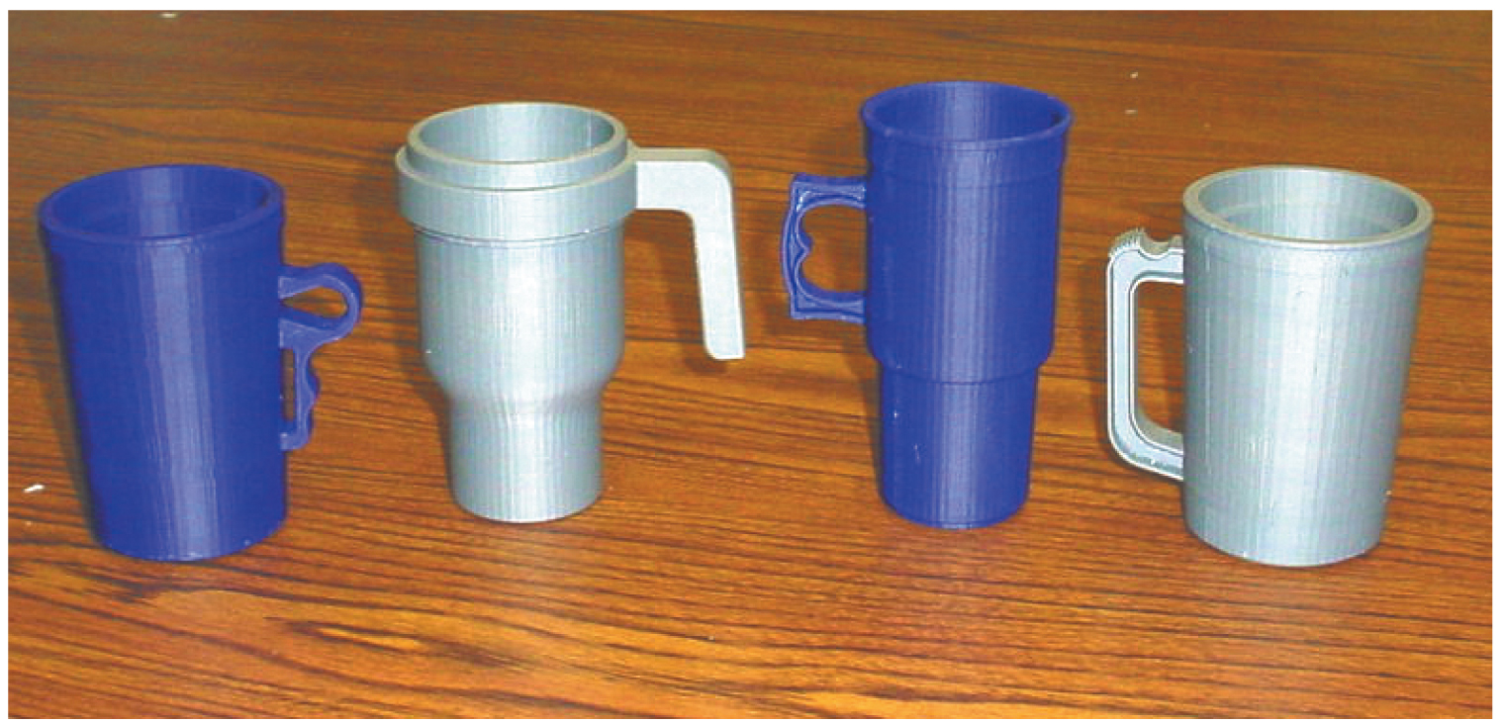
Stage 5: Physical Prototyping (cont’d.)
FIGURE 5.12. Models created with a 3-D printer.

Slide 21
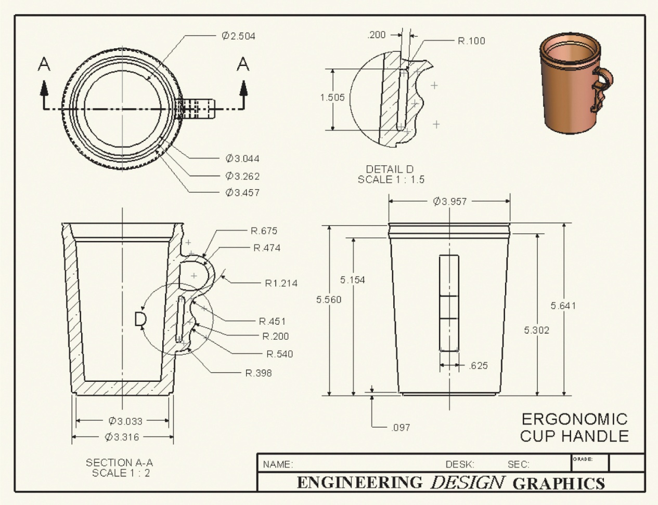
Stage 6: Design Documentation
FIGURE 5.13. A detailed design drawing.

Slide 22
Stage 7: Production
Many different methods for manufacturing
  Machining, casting, rolling, and sheet metal cutting processes
Civil engineering: design modifications are common
  As-built drawings

Slide 23
The Concurrent Engineering Design Process
Traditional engineering
  Part being designed progresses through each stage, moving from one team to the next
Concurrent engineering
  Designers, analysts, and manufacturing engineers work together from the initial stages
  Saves millions of dollars
  Possible because of computer networks

Slide 24
Patents
Protect intellectual property of a new design
In U.S., inventor has sole claim for twenty years
Patent application includes:
  Written documentation: specification plus oath
  Patent drawing
  Filing, search, and examination fees

Slide 25
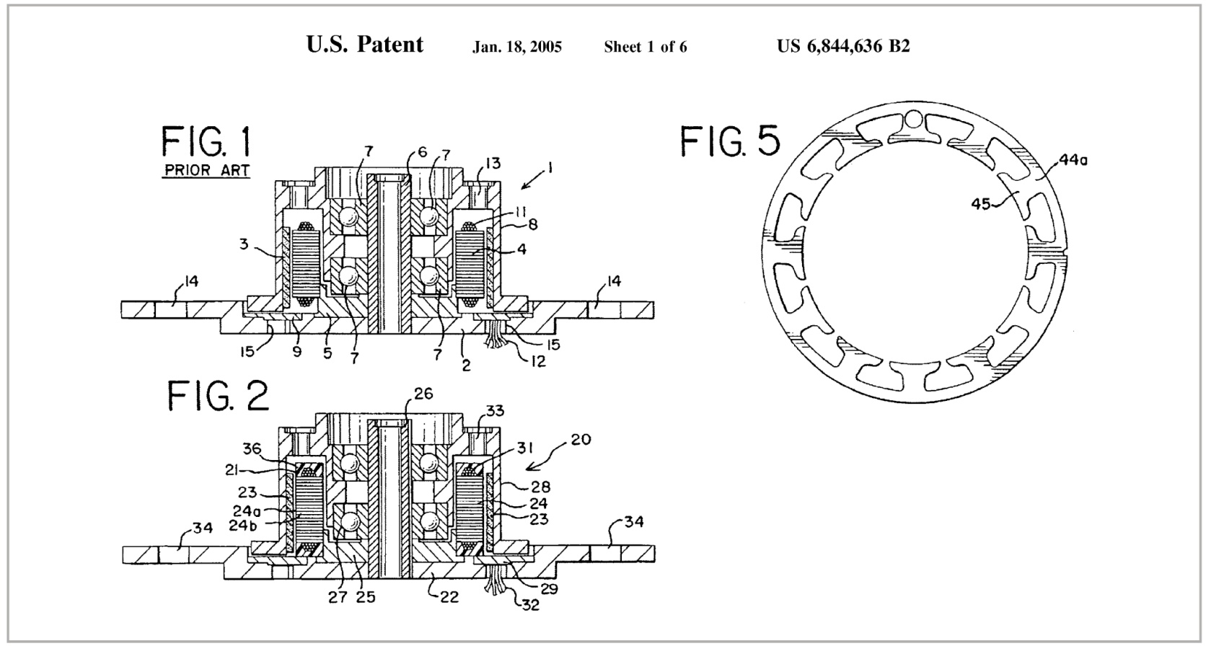
Patents (cont’d.)
FIGURE 5.14. A patent drawing.

Slide 26
Summary
Learned that design is an iterative process with several stages
Learned that engineers must weigh competing factors such as cost, function, and environmental impact
Learned about ways computers are used throughout the design process

Slide 27
Summary (cont’d.)
Learned about creativity in engineering design and about techniques that foster creative thinking
Learned about concurrent engineering, which is enabled by computer technologies and can be used to reduce product costs and improve product quality

