Slide 1
VOLUME
Terabytes
Records
Transactions
Tables, files
BIG DATA
Real-time
Batch
Streams
Near-time
Structured
Unstructured
Semi-
structured
VELOCITY
VARIETY

Slide 2

Dataframe
ML pipelines
BigDL
MLlib
GraphX
SQL
SparkR
Streaming
core

Slide 3
Creation of RDD
Transformation
lineage
RDD
Action
Result

Slide 4
WORKER 1
Spark Task
Spark Task
Spark Task
DRIVER NODE
WORKER 2
Spark Task
Spark Job
Spark Task
Spark Task
….
WORKER n
Spark Task
Spark Task
Spark Task

Slide 5
WORKER NODE 1
DRIVER NODE
Spark
executor
(JVM)
Spark
tasks
Intel MKL
Spark
program
BigDL
library
Spark
jobs
calls
spawns
WORKER NODE 2
…..
Spark
executor
(JVM)
Spark
tasks
Intel MKL
WORKER NODE n
Spark
executor
(JVM)
WORKER NODE 3
Spark
tasks
Intel MKL
Spark
executor
(JVM)
launches
leverages
Spark
tasks
Intel MKL

Slide 6
Workers
Training RDD
3
samples
Partition 1
1
2
3
samples
1
Partition 2
Driver
2
samples
1
Partition 3
2
3
. . . .
samples
1
Partition n
2
3

Slide 7
…..
WORKER 1
WORKER 2
WORKER 3
WORKER n
Replica
Replica
Replica
Sample
RDD
Replica
TASK 1
TASK 2
TASK 3
TASK n
Partition 1
Partition 2
Partition 3
Model
RDD
Partition n

Slide 8
…..
WORKER 1
WORKER 2
WORKER 3
WORKER n
Partition 1
Partition 2
Partition 3
Sample
RDD
Partition n
TASK 1
TASK 2
TASK 3
TASK n
Replica
Replica
Replica
Model
RDD
Replica

Slide 9
Training RDD
. . . . .
Partition 1
Partition 2
Partition n
samples
1
samples
1
samples
1
worker
worker
worker
2
2
2
gradient
4
gradient
4
gradient
4
parameter
parameter
parameter
3
3
3
5
5
5
PARAMETER SERVER

Slide 10

WORKER 1
WORKER 2
WORKER 3
…..
WORKER n
TASK 1
TASK 2
TASK 3
TASK n
local gradient
local gradient
local gradient
local gradient
1
2
n
1
2
n
1
2
n
1
2
n
…..
gradient
1
1
gradient
2
2
gradient
3
3
gradient
n
n
update
update
update
update
weight
1
1
weight
2
2
weight
3
3
weight
n
n
TASK 1
TASK 2
TASK 3
TASK n
PARAMETER SYNCHRONIZATION JOB

Slide 11
Caffe
model file
load
BigDL
Torch
model file
save
retrieve
Storage

Slide 12
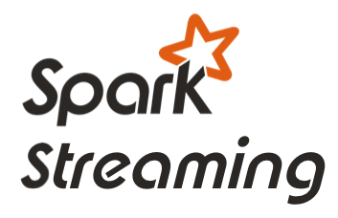


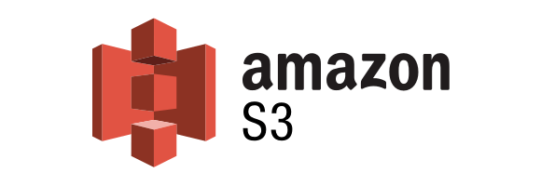



Data sources
data
RDD
train
predict
BigDL
model
Evaluator
StreamWriter
Event system
Storage

Slide 13









happy
Fine-tune
afraid
face
BigDL model
sad
load
Caffe
model file

Slide 14
Spark_Conf.JavaSparkContext
GateWayWrapper()
*bigdl_type
port=25333
CallBigDLFunc
Create_Spark_Conf()
get_bigdl_conf()
from_ndarray()
sparse()
to_ndarray()
_init_(bigdl_type, value, port_no)
Spark_Conf.JavaSparkContext
GateWayWrapper
bigdl.util.common
Collections
java_Gateway
java_collections
java_Gateway
java_Client
jvm_class_constructor()
py4j
jvm_class_constructor
GateWay
_class_creator
add_creator_class
_creator_class
_instance
get_creator_class()
set_creator_class()
_init_(bigdl_type, gateway)
init_engine()
init_executor_gateway()
get_spark_sql_context()
RDD
Spark Context
SQL
Dataframe SQLContext
MLib
CallJavaFunc
SC: JavaSparkContext
Spark_Conf
bigdl.util.engine
JavaCreator
SQLContext.SparkContext
pyspark

