Slide 1
OPTIMAL CLASSIFICATION OF
BLE RSSI DATASET
VISHAKH.S
(Under the guidance of
DR. VENKATA RAMANA BADARLA)

Slide 2
CONTENTS
1
INTRODUCTION
METRICS
INTRODUCTION
APPROACH
RESULTS
2
METRICS
APPROACH
3
4
RESULTS

Slide 3
MOTIVATION
Reliable estimation of occupancy in an area – beneficial !
  Optimized energy consumption in smart buildings
  Customized experiences
  Targeted marketing
  Emergency management
A promising technology – Bluetooth Low Energy !
METRICS
INTRODUCTION
APPROACH
RESULTS

Slide 4


INTRODUCTION
The 3 major components of a system
METRICS
INTRODUCTION
APPROACH
RESULTS
BLE Beacons
Smartphone
Server

Slide 5
INTRODUCTION
The 3 major components of a system
(Emergency system)
RSSI Information
Broadcast Packet
METRICS
INTRODUCTION
APPROACH
RESULTS
The mobile phone does not process the received beacon packets to calculate the location information. ==> Better response to crisis

Slide 6
INTRODUCTION
1
Beacons – Portable, easily available, easy to deploy
PROS :
2
Low-powered, wireless
METRICS
INTRODUCTION
APPROACH
RESULTS
3
1 device – can receive signals from multiple beacons

Slide 7
CHALLENGES
Obstructions in BLE signal path
Ideal beacon density ?
Trade-off between frequency and energy
METRICS
INTRODUCTION
APPROACH
RESULTS

Slide 8
Combining Bluetooth low energy
and Machine Learning
- A promising basis for occupancy detection
METRICS
INTRODUCTION
APPROACH
RESULTS

Slide 9
2 METRICS
ACCURACY
CONFUSION MATRIX
METRICS
APPROACH
INTRODUCTION
RESULTS

Slide 10
ACCURACY
Number of correct predictions
Accuracy =
Total number of predictions
METRICS
APPROACH
INTRODUCTION
RESULTS
A major disadvantage of accuracy !
- Relationship between classes NOT indicated
75%

Slide 11
CONFUSION MATRIX
An NxN matrix (N = # classes)
A1
A2
A3
A4
A5
Row : instances in actual class
Column : instances in predicted class
Diagonal elements : instances for which
true label = predicted label
For 3 out of the 20 samples, the predicted class was A2 when the actual class was A4.
A1
METRICS
APPROACH
INTRODUCTION
RESULTS
A2
A3
A4
0.15
A5

Slide 12
Confusion matrix – a better metric !
Relationship between the classes
Better visualization of misclassification
METRICS
APPROACH
INTRODUCTION
RESULTS

Slide 13
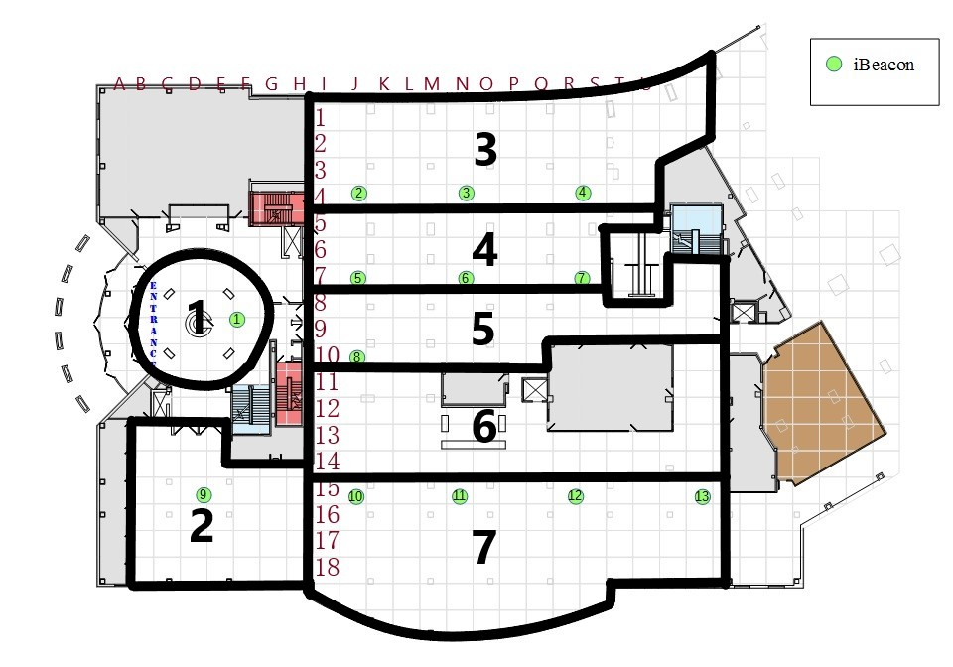
DATASET
APPROACH
METRICS
RESULTS
INTRODUCTION
M. Mohammadi et al. “Semi-supervised Deep Reinforcement Learning in Support of IoT and Smart City Services”. In: IEEE Internet of Things Journal (2017), pp. 1–12. ISSN: 2327-4662. DOI: 10.1109/JIOT.2017.2712560

Slide 14
5 CLASSIFIERS
Naive Bayes
Support Vector Machine
K-Nearest Neighbors
APPROACH
METRICS
RESULTS
INTRODUCTION
Logistic regression
Decision Tree Classifier

Slide 15
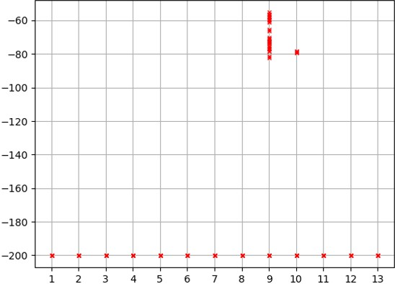
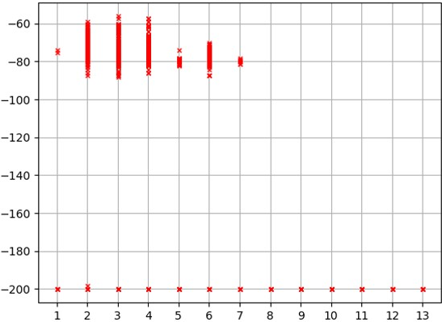
BASIS OF CLASSIFICATION
Zone 2
Zone 3
APPROACH
METRICS
RESULTS
INTRODUCTION

Slide 16

IMPLEMENTATION
Read input data
(labelled)
Partition data into training and testing sets
Train a classifier
using the data samples in the training set
APPROACH
METRICS
RESULTS
INTRODUCTION
Use metrics to evaluate the performance of
the classifier
Test the classifier using the data samples in the
testing set

Slide 17
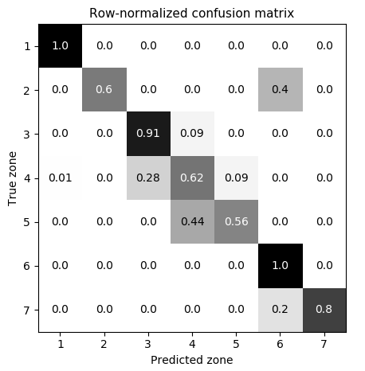
A DILEMMA !
Which class got dropped ?
APPROACH
METRICS
RESULTS
INTRODUCTION

Slide 18
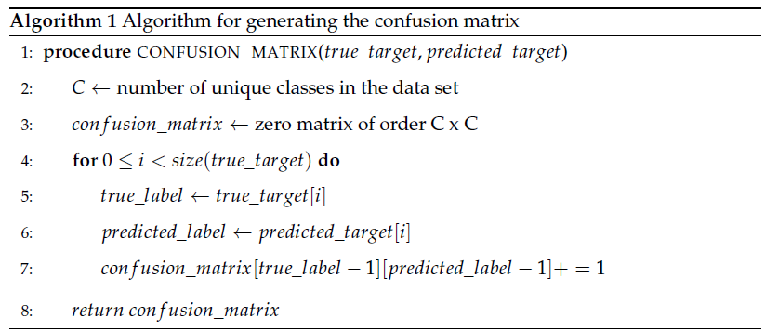
CONFUSION MATRIX
APPROACH
METRICS
RESULTS
INTRODUCTION

Slide 19
CLASS IMBALANCE
Zone | Number of samples | Percentage of the samples (in %) (Total : 1420)
1 | 5 | 0.003521
2 | 32 | 0.022535
3 | 731 | 0.514789
4 | 475 | 0.334507
5 | 83 | 0.058451
6 | 18 | 0.012676
7 | 76 | 0.053521
APPROACH
METRICS
RESULTS
INTRODUCTION

Slide 20
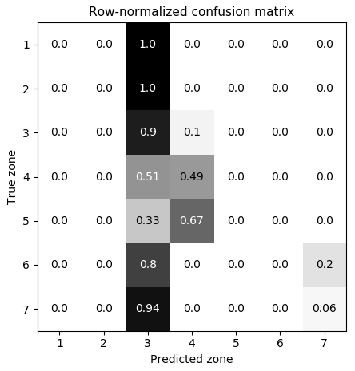
CLASS IMBALANCE
Classifier biased towards majority class !
APPROACH
METRICS
RESULTS
INTRODUCTION

Slide 21
CLASS IMBALANCE
2 common approaches :
Over - sampling - replicating a few instances of the minority classes.
Under - sampling - removing a few instances of the majority classes.
APPROACH
METRICS
RESULTS
INTRODUCTION
May lead to loss of critical information

Slide 22
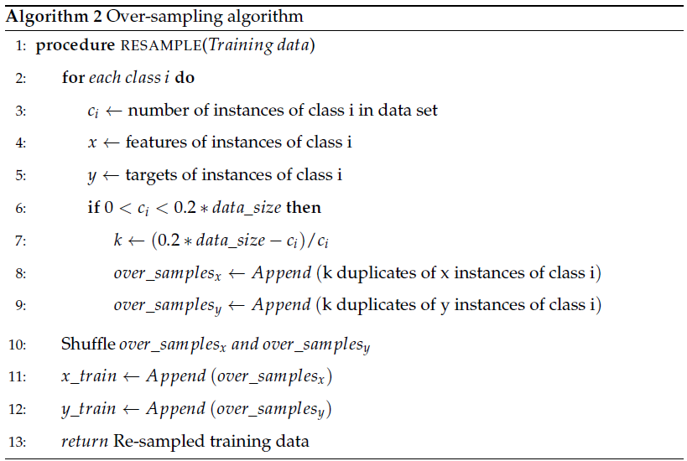
APPROACH
METRICS
RESULTS
INTRODUCTION

Slide 23
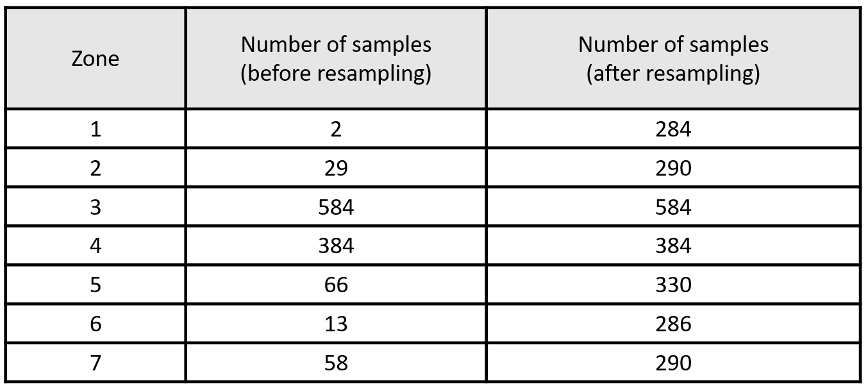
OUTCOME
APPROACH
METRICS
RESULTS
INTRODUCTION

Slide 24
Comes with a cost
Increases data size and hence the time required
APPROACH
METRICS
RESULTS
INTRODUCTION

Slide 25
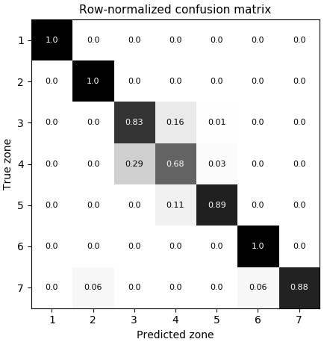
K-NEAREST NEIGHBORS
69%
k = 3
APPROACH
METRICS
RESULTS
INTRODUCTION
80%
k = 1
Optimum

Slide 26
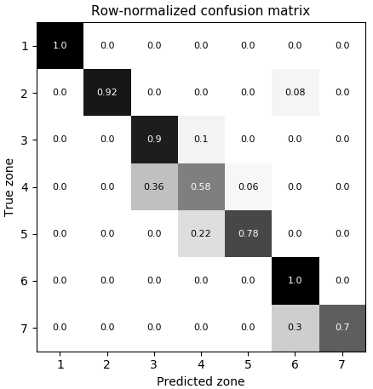
SUPPORT VECTOR MACHINE
72%
c = 1
APPROACH
METRICS
RESULTS
INTRODUCTION
77%
c = 19
Optimum

Slide 27
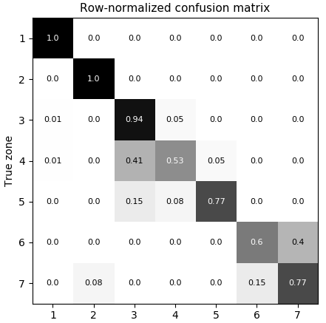
LOGISTIC REGRESSION
78%
APPROACH
METRICS
RESULTS
INTRODUCTION

Slide 28

NAÏVE BAYES CLASSIFIER
74%
APPROACH
METRICS
RESULTS
INTRODUCTION

Slide 29
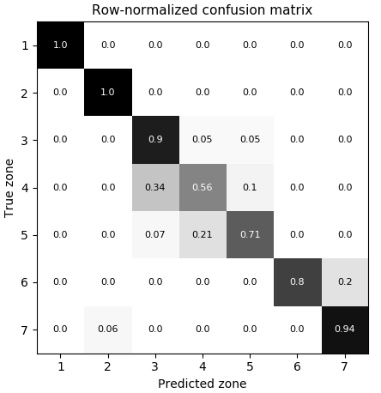
DECISION TREE CLASSIFIER
78%
APPROACH
METRICS
RESULTS
INTRODUCTION
75%

Slide 30
CONCLUSIONS
KNN - the best performance among all classifiers for the data set.
SVM - good performance in general
but, performance is inconsistent and dependent heavily on the partitions of the data set.
LR - exhibits the worst performance among all classifiers for the “imbalanced” data set.
APPROACH
METRICS
RESULTS
INTRODUCTION

Slide 31
SCOPE
Combining results with other wireless means for improved performance.
Analyze various beacon configurations and densities for better results.
APPROACH
METRICS
RESULTS
INTRODUCTION

Slide 32

A word of gratitude to my BTP mentor Dr. Venkata Ramana Badarla, for his guidance and for keeping me motivated, while letting me work at my own pace.

Slide 33
THANK YOU !

