Slide 1

PRESENTATION on
Amrutvahini College of Engineering, Sangamner
Department of Computer Engineering
RESULT MANAGEMENT SYSTEM
Presented by
NAME
Laulkar Om Shreekant
Morankar Arnav Jitendra
Narawade Bhushan Bhausaheb
Ukade Vishal Hiralal
→ Under The Guidance of
SumAgo infotech pvt . LTD.

Slide 2
Introduction
Result Management System offers a optimistic approach to managing and analyzing performance results. Whether in academia or organizations, discover how this system transforms data into evaluated form and informed decision-making.
Result Management System ensures precision in grading, timely feedback, and informed educational decisions. It facilitates meticulous student performance evaluation, goal tracking, and strategic decision-making.

Slide 3
Purpose
The result management system (RMS) serves as a pivotal tool designed to fulfill several crucial objectives in the realms of education. At its core, the purpose of RMS is to optimize the management, analysis, and communication of performance results.
RMS aims to enhance efficiency associated with result computation, grading, and assessment. Its primary goal is to ensure accuracy, minimizing errors in the calculation and recording of results, thus providing a reliable foundation for decision-making.

Slide 4
OBJECTIVEs
It aims to significantly improve efficiency in the management and processing of performance results.
RMS reduces the burden of manual efforts on educators and administrators.
Identify areas of strength and weakness in individual students to learning support.
Optimize resource allocation based on performance trends and educational priorities.

Slide 5

SOFTWARE AND HARDWARE REQUIREMENTS
HARDWARE REQUIREMENTS:
Processor : intel 3
Motherboard : intel 915gvsr chipset board
Ram : 4 gb
SOFTWARE REQUIREMENTS:
Front end : html, css, REACT JS, BOOTSTRAP
Back end : EXPRESS JS, MONGODB
Control end : java script

Slide 6
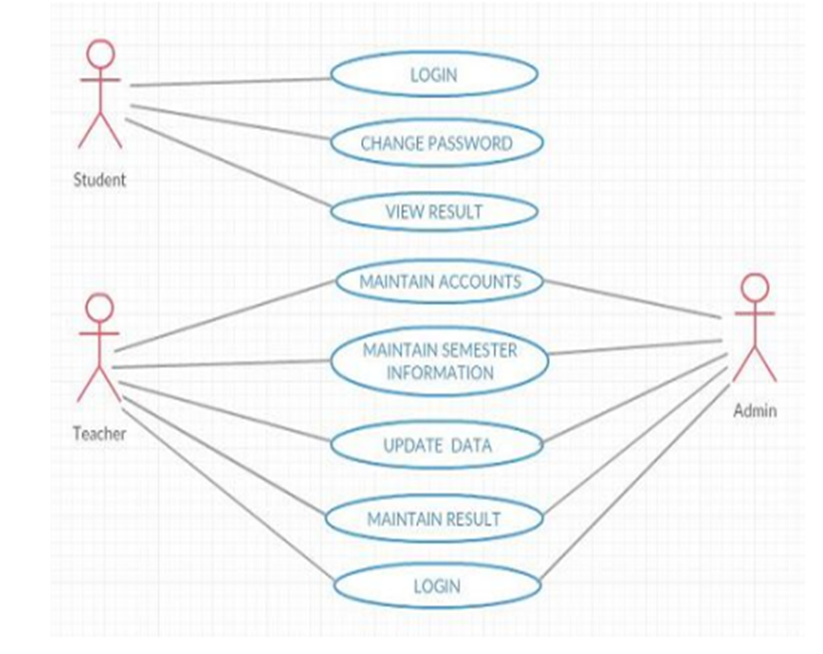
Design of model
.

Slide 7

USECASE DIAGRAMS
1 .USER/ PUBLIC:
See marks
Ranklist
user
Recommendations
Contact us

Slide 8

2 . ADMIN
Manual result analysis
Upload result file
Admin
Student report
Add student

Slide 9
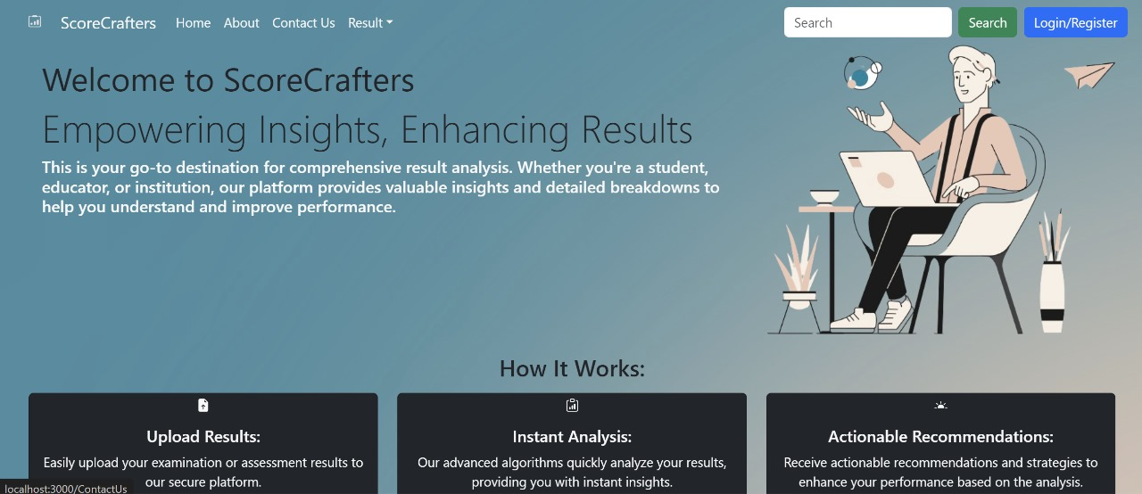
Web App Overview

Slide 10
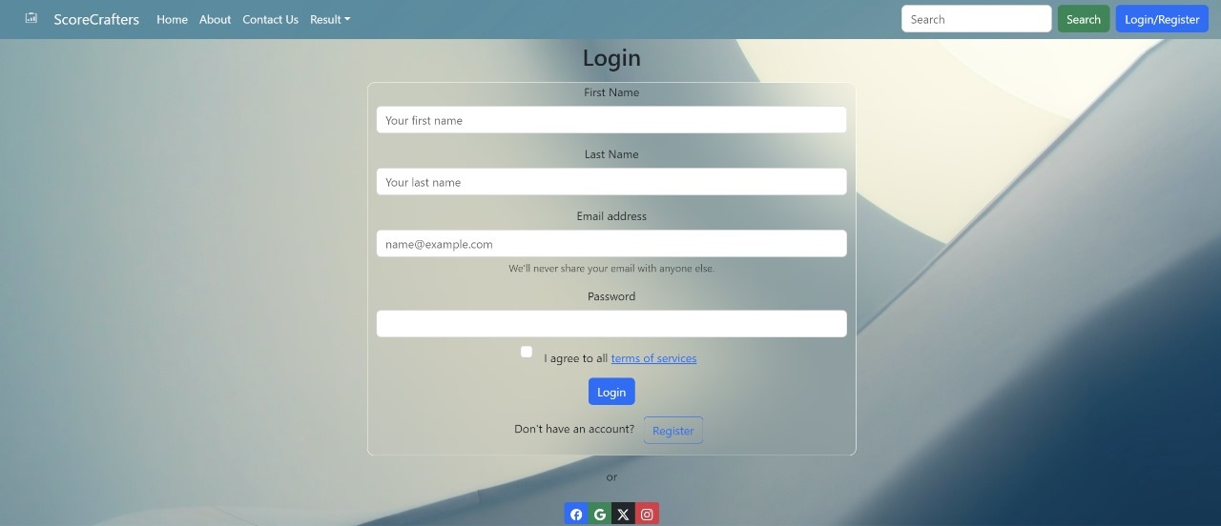

Slide 11
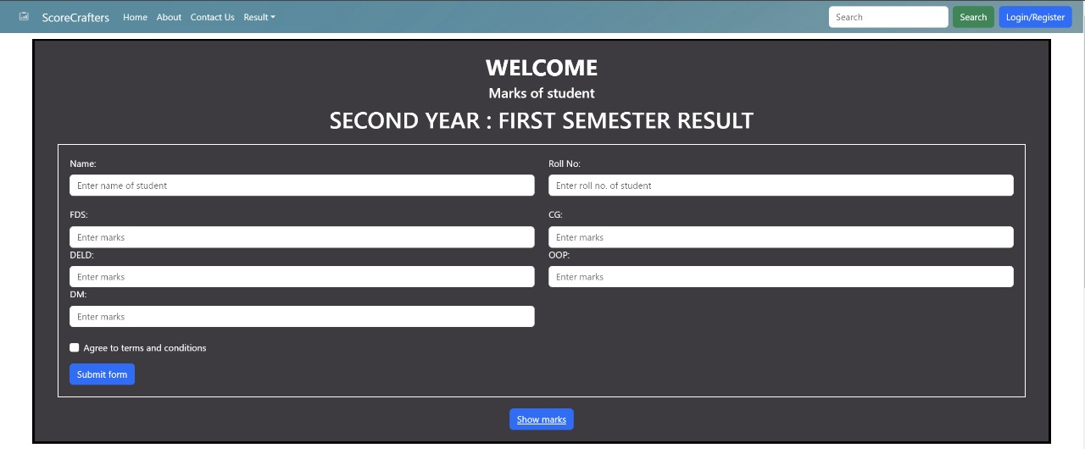

Slide 12
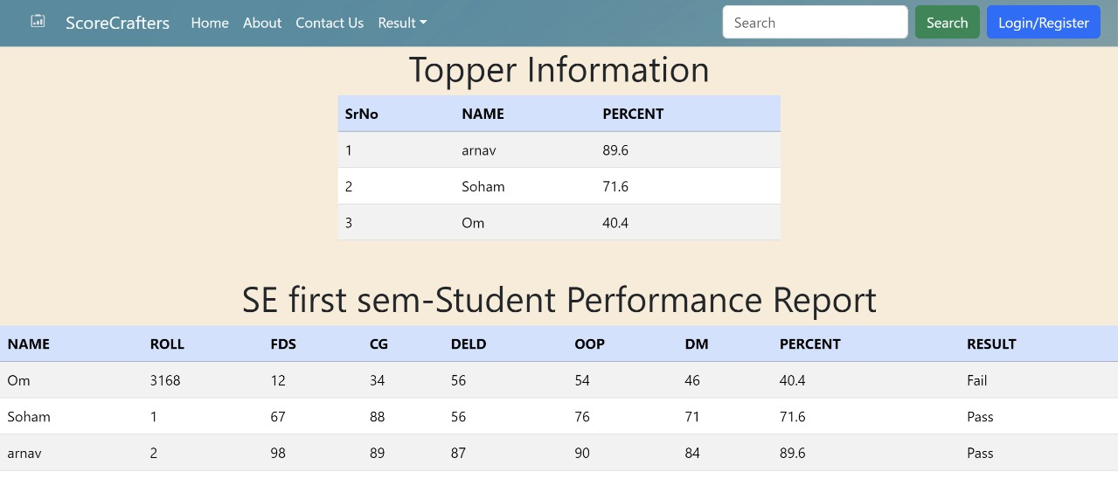

Slide 13
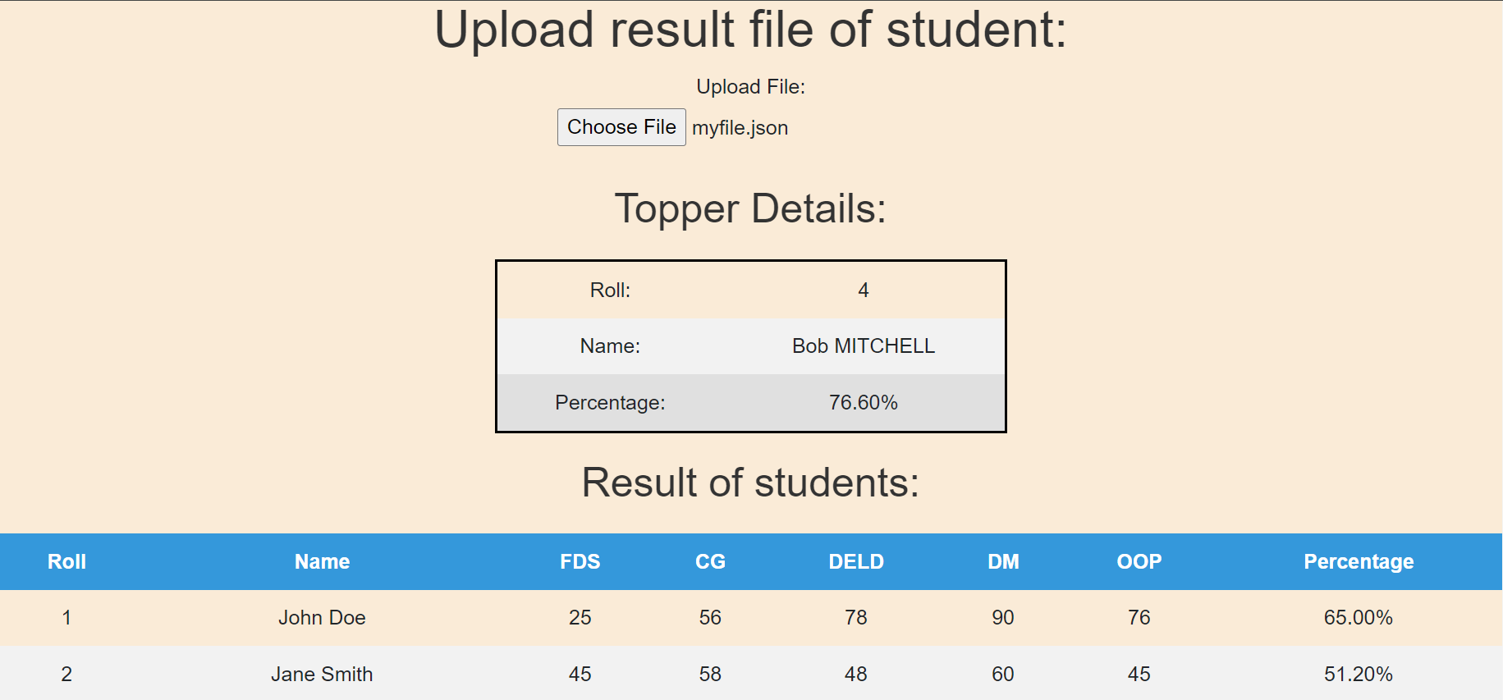

Slide 14
Future scope
RMS developments may focus on creating more user-friendly interfaces, making it accessible to a wider audience, including educators, administrators, and students.
RMS can leverage AI and ML algorithms to provide predictive analytics, personalized insights, and automated decision support, enhancing the system's intelligence and utility.
Future developments may introduce more sophisticated reporting tools and data visualization techniques

Slide 15
Advantages
● User-friendly interface.
● Fast access to database.
● More storage capacity.
● Look and feel environment.
● RMS automates result computation and grading, reducing efforts and saving time for educators .
● RMS minimizes the likelihood of errors in result recording and computation, ensuring accurate and reliable data.

Slide 16
Conclusion:
Result management system (RMS) stands as a pivotal solution to redefine how we manage, analyze and communicate performance results in education.
Through its core objectives of enhancing efficiency and promoting transparency, RMS streamlines saving valuable time and resources for educators, administrators.
RMS remains a catalyst for continuous improvement, informed decision-making, and a culture of excellence in result management.

Slide 17
THANK YOU

