Slide 1
Adversarial Robustness Analyzer
February 7, 2026
Adversarial Robustness Analyzer
f Engineering)

Slide 2
Introduction
This project applies classical machine learning techniques using standard Python libraries. Models such as logistic regression, SVMs, tree-based methods, boosting, and k-NN were selected for interpretability, computational efficiency, and reproducibility. Evaluation was performed using standard metrics and
cross-validation.
The code utilizes Streamlit for the web interface, PyTorch and Torchvision for AI models, Adversarial Robustness Toolbox (ART) for attack generation, Grad-CAM for heatmap visualization, Scikit-Image for metrics, Hugging Face Datasets for streaming data, and utility libraries including NumPy, Pandas, Plotly, Pillow, and Requests.
Classical machine learning was chosen deliberately to enable faster iteration, easier reproducibility, and clearer interpretability of results. Models were evaluated using accuracy, precision/recall, F1-score, ROC AUC, and cross-validation.
Adversarial Robustness Analyzer
f Engineering)

Slide 3
Problem Statement
Real-world vision systems face: Sensor noise
Motion blur Occlusion Lighting variations
Adversarial manipulation
Even imperceptible perturbations can cause misclassification, leading to potential security failures in sensitive applications.
Adversarial Robustness Analyzer
f Engineering)

Slide 4
Objective
Primary Objective
Evaluate robustness of image-classification models against adversarial attacks and identify security risks before deployment.
Test pretrained models under perturbations Measure prediction stability
Visualize decision shifts
Generate scientific vulnerability reports
Adversarial Robustness Analyzer
f Engineering)

Slide 5
System Overview
The system consists of three major modules:
Live Sentinel Module – Real-time robustness monitoring Single Image Scientific Analysis – Deep forensic evaluation Batch Dataset Audit (RAID) – Large-scale benchmarking
1
2
3
Adversarial Robustness Analyzer
f Engineering)

Slide 6
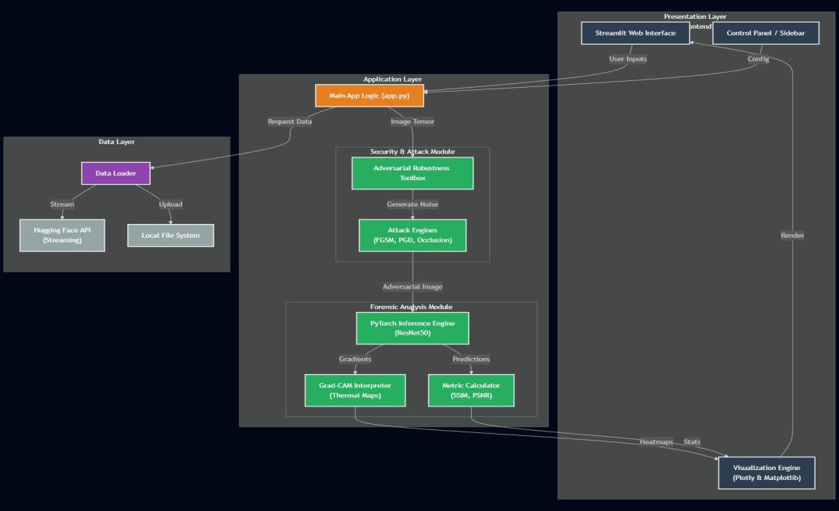
System Architecture
architecture_placeholder.png
Adversarial Robustness Analyzer
f Engineering)

Slide 7
Input & Model Layer
Inputs
Live webcam feed Uploaded images HuggingFace datasets
Models Used
MobileNetV2 — lightweight inference ResNet50 — high-accuracy auditing
Adversarial Robustness Analyzer
f Engineering)

Slide 8
Adversarial Attack Layer
Implemented attacks include: FGSM
PGD
Noise Injection Patch Attacks
Oscillatory Perturbations Occlusion Masking
Adversarial Robustness Analyzer
f Engineering)

Slide 9
Defense & Metrics
Defense Mechanisms Gaussian filtering Live defense toggles
Robustness Metrics Confidence Drop SSIM
PSNR
Adversarial Robustness Analyzer
f Engineering)

Slide 10
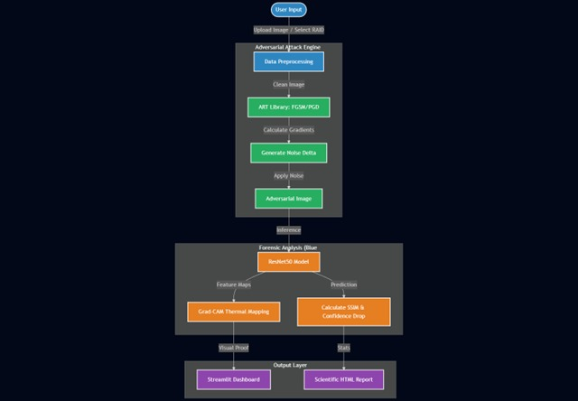
System Flow
flowchart_placeholder.png
Adversarial Robustness Analyzer
f Engineering)

Slide 11
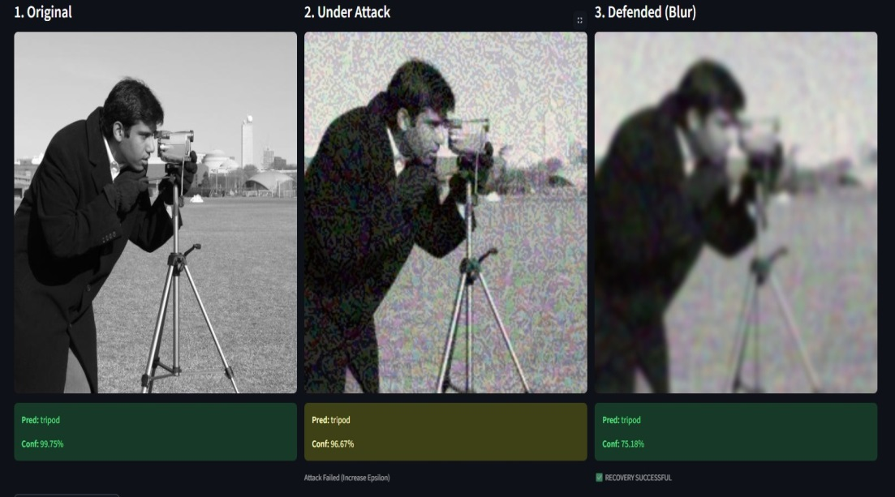
Visualization & Analysis
original_vs_adv.png
gradcam_placeholder.png
Original vs Adversarial Images
Grad-CAM Heatmaps
Adversarial Robustness Analyzer
f Engineering)

Slide 12
Results & Observations
Significant confidence drop under attacks Minimal perturbations cause misclassification Attention shift observed in Grad-CAM Dataset-level vulnerabilities identified
Adversarial Robustness Analyzer
f Engineering)

Slide 13
Real-World Applications
Surveillance robustness auditing Biometric authentication testing Autonomous vehicle perception AI compliance certification Security vulnerability assessment
Adversarial Robustness Analyzer
f Engineering)

Slide 14
Key Innovations
Real-time adversarial monitoring Oscillatory perturbation simulation Grad-CAM-based visualization Dataset-scale auditing
Automated reporting
Adversarial Robustness Analyzer
f Engineering)

Slide 15
Why Our Solution Stands Out
Real-time monitoring vs offline evaluation in standard tools Multi-attack coverage including novel oscillatory perturbations Dataset-scale auditing with automated reporting
Grad-CAM visualization for interpretable forensic analysis Lightweight inference for quick testing with MobileNetV2
Adversarial Robustness Analyzer
f Engineering)

Slide 16
Team Contributions
N.Vishal– Adversarial Attack Layer,Visualization, Grad-CAM, and Analysis,System Integration, Model Implementation
M.Charan – Reporting and Documentation, Streaming Data and Interface, Evaluation Metrics
Adversarial Robustness Analyzer
f Engineering)

Slide 17
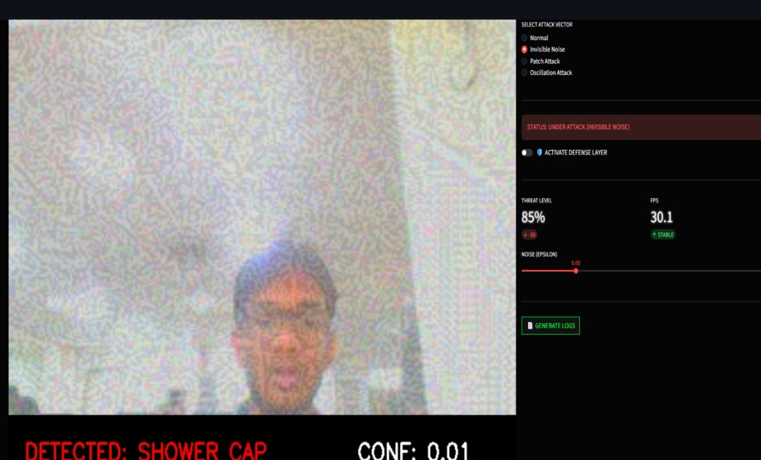
Live Demo
streamlit_de mo_placeholder.png
Adversarial Robustness Analyzer
f Engineering)

Slide 18
Limitations & Future Work
Limitations
Limited to 2D vision models No physical-world attacks Depends on ImageNet labels
Future Scope
Physical adversarial patches Face recognition robustness Vision transformers
Adversarial Robustness Analyzer
f Engineering)

Slide 19
Ethical Considerations
This project is intended strictly for: Defensive AI research
Security auditing Responsible disclosure
Unauthorized exploitation of AI systems is discouraged.
Adversarial Robustness Analyzer
f Engineering)

Slide 20
Conclusion
The Adversarial Robustness Analyzer demonstrates that even high-accuracy vision models are vulnerable to adversarial and environmental disturbances.
The system provides a practical framework for evaluating robustness in real-world AI deployments and guiding secure AI development.
Adversarial Robustness Analyzer
f Engineering)

Slide 21
Thank You
Adversarial Robustness Analyzer
f Engineering)

