Slide 1
Use a Real Editor!
Using Emacs

Slide 2

Session Goals
To understand why we use Emacs
To understand how you can use Emacs to enhance your productivity in editing
To learn the basic Emacs commands
To learn how to work with multiple buffers
To learn how Emacs can be used as a work environment

Slide 3
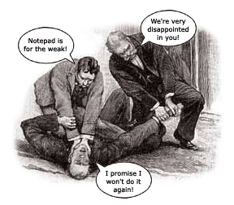
NO MORE NOTEPAD!
Notepad does not give you the power of a full-fledged programming editor
Notepad lacks the tools need to write effective code (proper indention, macros, etc.)
Notepad requires that you do everything locally and then FTP

Slide 4
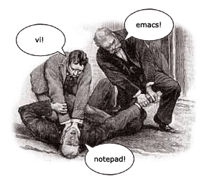

Other Editors
Other Unix Editors
  Pico (primitive; not good for programming)
  Vi (quite powerful; difficult to learn)
Other Windows Editors
  Jext
  Emacs for Windows

Slide 5

Why Learn Emacs?
Emacs is good for programming
Emacs is pervasive
Emacs is free
Emacs is powerful
Emacs can increase productivity

Slide 6

The Good, The Bad & The Ugly
Can be challenging to learn
Requires memorization
Learning curve pays for itself in the end!

Slide 7
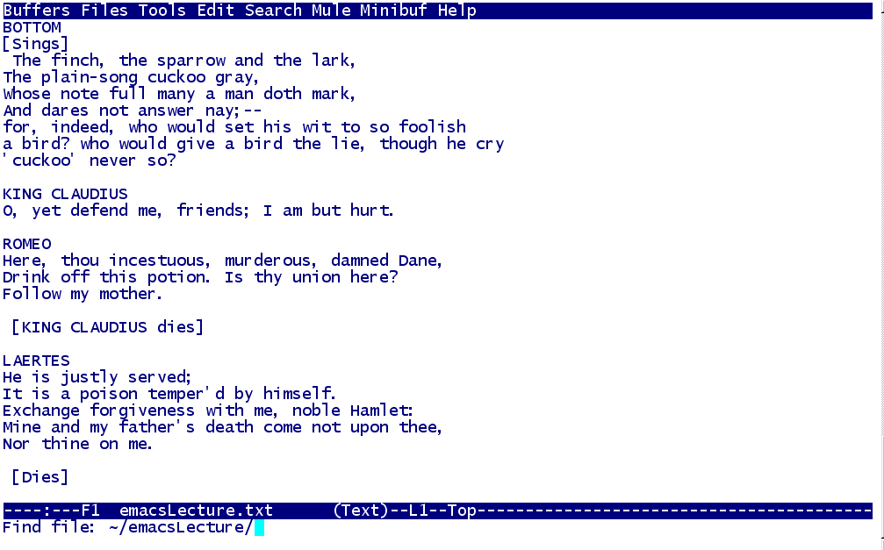
The Emacs Screen
Buffer
Mode Line
Minibuffer

Slide 8
Using Control Key Keystrokes
Used as a part of a combination
Hold DOWN the control key when using a Control-key combination
Usually abbreviated: “C-x C-s”

Slide 9



The Meta Key
Key on the “virtual” keyboard
Mapped differently from computer to computer
Windows:
Macintosh:
Unix:

Slide 10
The Meta Key
Used as part of a combination
PRESS AND RELEASE the meta key before pressing the second key of the combination
Usually abbreviated: “M-x %”

