Slide 1
DSM 6.0.3 Project Update Saurabh Dixit 04/25/2018

Slide 2
Current DSM Status - Yellow
6.0.2 – VISA IBM Spectrum Validation with python KMIP client
6.0.2 – April Patch – Released to support
6.0.2 – Gov Cloud Image - Released to Support
6.0.3 build –
BYOK UI Feature – Done
Network HSM – Done
RESTful AP I- In IVVQ
RESTful API documentation – In IVVQ
LDT/Docker automatic agent registration – In IVVQ
Intermediate CA feature – In IVVQ
Regression Test – In IVVQ (Test first Pass August 30, 2018)
Build 8058 – Rejected because of blocker SRV-22681
6.2 Build –
PostgreSQL sanity test – In Progress
Note:- RED color text means feature still in development, partial delivery to IVVQ

Slide 3
Test Case Metrics

Slide 4
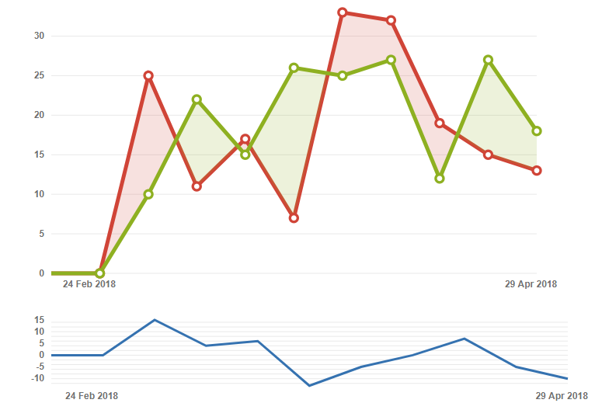
DSM Created Vs Resolved JIRA Incidents

Slide 5
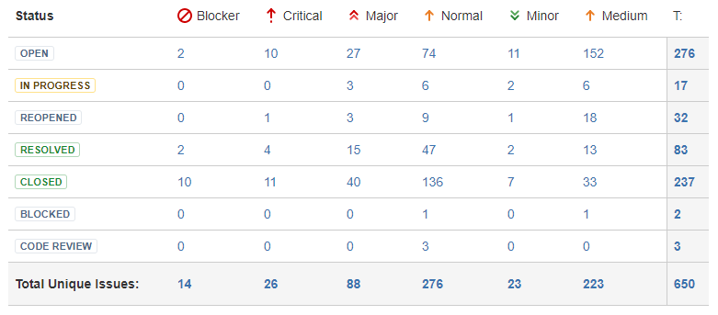
Total Jira Incidents Statistics for current release

Slide 6
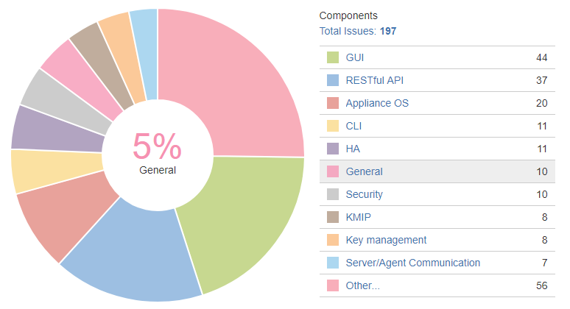
Release Criteria Open Jira Incidents

Slide 7
List of DSM New Feature – 5/22/18
New Feature | Dev Status | QA Status
Fix all medium or above SRV- bugs for Covertly Nessus and BurpSuite in train #3 | Open
Incremental list of DSM REST APIs | In Progress | In Progress
Document the DSM KMIP integration for VMware | Done | Done
Thales branding - GUI | In Progress | In Progress
Thales branding - CLI | Done | Done
Thales branding - Documentation | Open
BYOK REST APIs, UI for Symmetric Key import/Export in DSM | Done | Done
Support AD/LDAP integration with RESTful APIs | Done | Done
LDT/Docker - Automatic agent registration | Done | Done
Support network HSMs [Thales nShield] | Done | Done
Intermediate CA Support | In Progress | In Progress
IBM Spectrum Scale Advanced Edition: Integration with DSM | Done | Done
Enforced Shared Secret | In Progress | In Progress

Slide 8
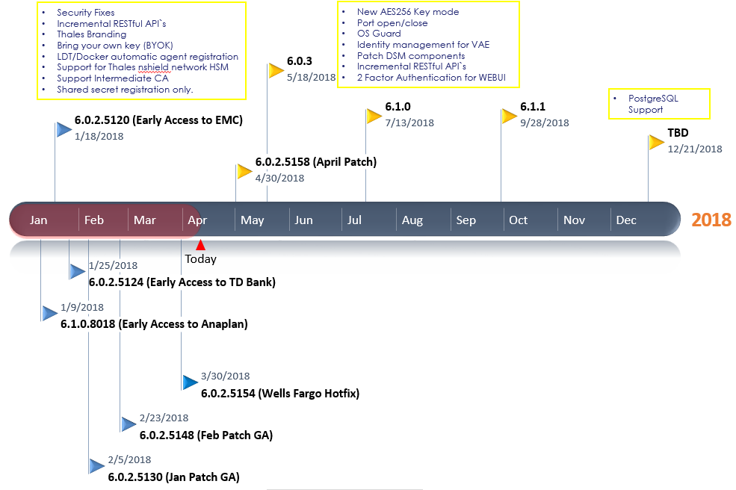
DSM ROADMAP

Slide 9
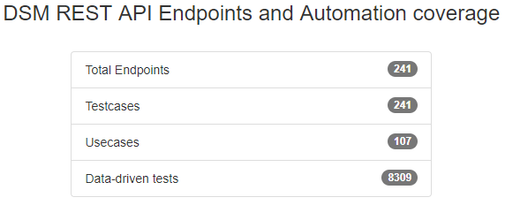
QA Metrics
DSM 6.1 | Number of Test cases | Test case Automated | Test case Executed | Test case Success
New Feature | 176 | 6 | 164 | 132
Regression | 669 | 185 | 456 | 423
New Feature %
Regression %

