Slide 1





ASRM Ops Review 2018
Anirudh Mavinkurve
April 27 2018

Slide 2
Agenda
ASRM Team
Updates for 2018
VTE QA update
VAE QA and Automation update
DSM, CTM, VTS automation update
Agent automation update
ASRM Infrastructure team update
Issues and concerns
Q & A

Slide 3

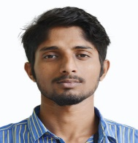




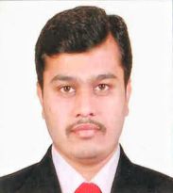
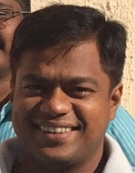
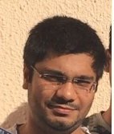
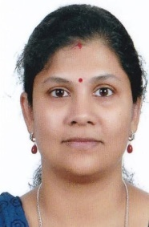
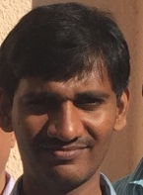
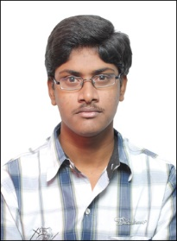

ASRM Team
Ankur (Infra)
Ravi (DSM)
Manas (Infra)
Manikanta (VTE)
Mohit (DSM)
Pravin (VTE)
Anirudh
Sachin (Infra)
Rahul (VTE)
Sangeetha (VTE)
Kapil (DSM)
Prafful (VTE)
Shrikant (VTE)

Slide 4
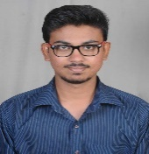
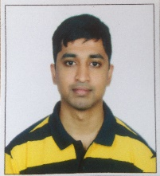
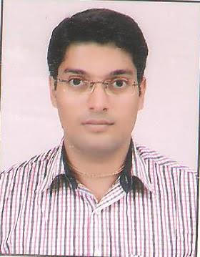

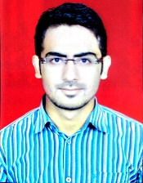
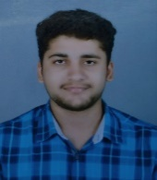


ASRM Team recent hires
Ayush (CTM)
Anubhav (VTE)
Himanshu (DSM)
Tushar (Agent)
Vishal Chillal (DSM)
Ashutosh (DevOps)
Anirudh
Dipankar (DSM)
Vishal Jethani (Infra)
Anilkumar (Infra)

Slide 5
ASRM Org Chart
Anirudh
Anilkumar Phurailatpam (Infra)
Sachin Karambalkar(Infra)
Manikanta T (VTE Linux)
Ankur Parasor(Infra)
Prafful Srivastava (VTE Linux)
Tushar Shukla (VTE Linux)
Anubhav Sengar(VTE Linux)
Pravin Bhumkar (VTE Linux)
Rahul Karale (VTE Windows)
Sangeetha Biswas (VTE Windows)
Kapil Negi (DSM)
Ravi Singh (DSM)
Mohit Chandak (DSM, VTS)
Himanshu Bhagwani (DSM)
Ashutosh Madane (DevOps)
Vishal Jethani (Infra)
Shrikant Ubale (VTE Linux)
Vishal Chillal (DSM)
Dipankar Chavare (DSM)
Ayush Shrivastava (Cyphertrust Monitor)
Rahul Pawar (VTS)
Ashwani (Prospective hire)
TBH (VTE Windows)
TBH (DSM DevOps) ??

Slide 6
Updates – 2018 VTE Linux QA Update
VTE Linux QA update from Bhupathi
Work done
End to end testing of VTE product for the 6.0.3 release train
Adding test cases, test plan and coverage for all supported Linux platforms for the following features.
VTE for Azure File Storage - PMSJ-976
VTE for Azure VMs - PMSJ-977
Closely working with Blindspot scrum team and ASRM team for new test automation, additional test coverage, monitoring test results and reporting bugs
Regression test of 6.0.3 test and retesting of bug fixes
Currently working on …
Retroactive host settings updates (All Linux platform) which includes the local host settings, host group host settings and docker host settings
Restructure/refactor of file system agent script, covering regression test on all Linux platform
Working closely with Blindspot scrum team for early testing of feature, adding request for ASRM automation and monitoring the test runs

Slide 7
Updates – 2018 VAE Automation/QA Update
VAE Automation and QA update from Dipak
Work Done
Worked on C# sample and Java sample test case automation.
25/58 test cases has been automated for C# and 23/70 test cases for Java samples
Qualified and released VPTD (Vormetric Protection for Teradata ) v.5.2.5 patch in mid Dec 2017 This had two new UDFs and extended support for latest Teradata 16.00 and 16.10
Qualified and released BDT (Batch Data Transformation ) v2.0 at end of Jan 2018
Qualified and released VKM ( Vormetric Key Management ) v5.2.5 patch in early March 2018
Currently working on …
VPTD 6.0 release is scheduled on 10th May 2018

Slide 8
Updates – 2018 DSM VTS and CTM Automation
DSM VTS and CTM Automation update from Mohit
Work Done
Consistently >10 testcases automated per month, by every engineer
Testcases automated: DSM - 156, VTS- 59, CTM - 70
Bugs filed: DSM - 82, VTS - 33, CTM - 16
DSM Incremental REST API (6.1) - 100% Testcases and data driven cases automation coverage
VTS - 100% Testcases and data driven cases automation coverage
Appliance deployment pipelines up and running smoothly for VTS, DSM CICD
Current + Future Roadmap
Covering more use cases for DSM and VTS
Providing more sophisticated test-results reports
Building go-no go and build comparison reporting tools
CTM Automation to simulate 500 devices for Payshield, Nshield
VCEG and CCKM automation.

Slide 9
Updates – 2018 DSM Automation (contd..)
DSM Automation update from Kapil (Selenium and DSM regression testing)
Work Done
Test cases automated since Jan 2018: 109
Bugs filed : 38
Regression runs: 27
Design and implementation of Page Object Model for GUI automation
Completed “Bring Your Own Key” (BYOK) Automation
KMIP automation
Automated Cryptsoft's KMIP client
UI automation
Automated customer escalations
Automated few test-cases for AES CBC-CS1 key feature
Automated test-cases for the versioned key feature
Automated DSM deployment on AWS cloud
Key versioning of LDT
Scheduling and Monitoring runs for DSM automation suites
Current + Future Roadmap
Rectify GUI automation scripts
Working on DSM agent inter-op for Linux
Maintaining and extending testbeds – 120+ VMs spanning 3 ESXi hypervisors
Implementation of page object model
Azure GCP Hyper-V and KVM DSM deployment
Azure Stack

Slide 10
Updates – 2018 – VTE Linux Automation
Linux/UNIX Agent Automation Update from Manikanta
Work Done
Total number of test-cases automated by VTE agent team: 110
Virtual machine provision on cloud library.
Legacy host settings test automation(authenticator_euid)
6.0.3 VTE host settings test cases including path_no_trust
VTE development escalation test automation
Harness changes to support cloud and test case changes for cloud(BAIT,LTP,MOAS)
Azure CIFS support on VAQA
Vulnerability - Binary hardening test cases
New AES CBC CS1 encryption mode tests
VTE fsfreeze feature automation
VTE restricted mode installation test cases
User authentication across secfs restart tests
Dynamic host settings
Current + Future Roadmap
Stabilising ASRM runs
PCF use cases (Postgres and MySQL backup restore during LDT )
Continue to work on AES CBC CS1 encryption mode tests
Adding Automated tests that are not being executed into the Agent regression runs cycle
Completing Entire host settings automation including dynamic host settings
Working on docker host settings automation

Slide 11
Updates – 2018 VTE Linux Automation (LDT and Docker)
Linux/UNIX Agent Automation Update from Pravin and Shrikant
LDT
Work Done
Worked on LDT pre-commit
Added ENOSPC and FSFreeze tests with LDT ahead of the development
Designed and automated test cases for CBC-CS1 feature
LDT post-commit and 72 hour workload testing
Current + Future Roadmap
Stabilizing runs for LDT so that every build has the same coverage
Automating tests that are prioritized by the Transformers scrum team
Adding test coverage to platforms that are not yet covered
Adding more tests for CICD pre-commit
Docker
Work Done
Automation for Docker testcases
Automation for OpenShift Container Platform testcases
Current + Future Roadmap
Will work on automation for Docker resource manager (OCP, Kubernetes, Apache Mesos)

Slide 12
Updates – 2018 – VTE Windows Automation
Windows Agent Automation Update from Rahul and Sangeetha
Work Done
Microsoft SQL Server Always On - LDT test cases automation
Upgrade On Reboot feature - Test cases automation
Netbackup: Backup-restore on network shared GP, backup-restore on whole drive
Ultrabac: LDT Windows I/O operations
soft link, hard link, truncate, extend, sendto recyclebin-restore, edit while LDT in progress
Microsoft SQL Server File Table - Test cases automation
Working on MySQL test cases automation
SQL Always Encrypted database - backup and restore
SQL Always On - LDT, non LDT tests
SQL File Table - offline data transform test-cases
Verify Preserve modify time stamp with reboot while rekey in progress
Manual test-cases execution during 6.0.3 release
Monitor test runs for BAIT, functional tests
Current + Future Roadmap
Working on DB2 test-cases automation
Working on MySQL test cases automation
Automate new LDT test cases as part of LDT get well plan
CBC-CS1 test cases automation

Slide 13
Updates – 2018 – ASRM Infrastructure
ASRM Infrastructure team update by Anil
Work Done
CVE Linux Taxonomy run automation
VTE CI Pre commit and Post commit ( Windows and Linux )
Cross Platform CI projects (Windows/Linux combined build+test)
DSM Pre commit ( Beta release )
VTS Pre commit and Post commit CICD
VAE Pre commit and Post commit ( C and Java samples ) CICD
Monitor page Dashboard
Cloud and CVE Dashboard pages
Cloud support VAQA ( AWS, AZURE )
Machine deployment for general purpose use (non CICD)
Currently working on …
LDT post commit CICD (Ashutosh)
Docker Pre commit automation support (Ashutosh)
VAE CICD C# Samples Windows (Anil)
CVE enhancements and various distros support (Ashutosh)
Harness enhancements - requirement and specification (Infra team)

Slide 14
ASRM Infrastructure Team Futures
ASRM Infrastructure team Futures
Short term
Snapshot revert - the SUTs after every test runs
Stabilize and Enhance existing CICD runs.
Show accurate and real-time test results in the Dashboard UI
Work on Dashboard database optimization and optimize schema for faster query results
Some more bug fixes and improvements in the Dashboard UI
Complete requirement gathering – Harness redesign
Hypervisor Management scripts to manage start/stop ESXI, KVM boxes and its associated VMs
Medium term
Machine Deployment tools to support REST api, so as to easily manage the various different ecosystems and hypervisors.
Harness Redesign - Design and Implementation
Long term
Extract more data (analytics) from logs stored as file system or HDFS file system.
More analytics UI widget in Dashboard
Go-No-Go UI Dashboard

Slide 15
San Jose Team Concerns
San Jose VTE team concerns
Concerns raised by San Jose VTE team
Inconsistent coverage of ASRM dashboard in general across all areas
Frequent errors seen on ASRM dashboard for obvious setup/script issues
No proactive communication update on the coverage plan for builds across 6.0.x and 6.1.x
Infrequent updates on JIRA tickets for TSTH (In Progress) tickets
Communication Communication Communication
Some mitigations planned for these concerns
Inconsistent coverage of ASRM dashboard in general across all areas
With the VTE dev team planning to move to the Nightly CICD run paradigm for build promotion ASRM infrastructure team and the VTE automation team will collaborate to create a scalable and repeatable clean test environment using either snapshots (ESXi) or backing store image (KVM) to deploy VMs at start of every run
Frequent errors seen on ASRM dashboard for obvious setup/script issues
Issue with cleanup will be taken care of by using some kind of machine deployment tool so every run has independent VM. In the meanwhile will use snapshots to tide over machine cleanup issues
No proactive communication update on the coverage plan for builds across 6.0.x and 6.1.x
Proposal for Ben to have a weekly team meeting for VTE Linux automation team so communication gaps are avoided
Infrequent updates on JIRA tickets for TSTH (In Progress) tickets
Mandated ASRM VTE team to update the in progress tickets at end of each day
This is part of the process change and please email me if the mandate is not being followed
Communication Communication Communication
Proposal for Ben to have a weekly team meeting for VTE Linux automation team

Slide 16
ASRM Team Concerns
ASRM team concerns
DSM/VTS/CTM
Running out of test link testcases, backlog needs to be created
San Jose QA engineers not contributing enough to writing use cases
Lack of collaboration with development team (VTS and DSM)
Fixed in build not mentioned for any bugs (VTS)
Same Bugs keep reoccurring again and again after every private branch merge (VTS and DSM)
Documentation (VTS and DSM)
Test link test-cases are either not updated or not following the business flow
Test steps in the test link are not explained properly
GUI development is not following a good practice of using fixed id's of web elements and keeping them same across all the builds, it can make GUI automation much efficient
VTE
Don’t get enough tasks/tickets in backlog before starting of any sprint. Several times we have picked tickets in running sprint (Docker/VTE ?)
In many cases, there are no steps mentioned for testcase in test link OR not clearly written steps without expected behaviour. We need to figure out step by reading testcase title (Docker)
Infrastructure
Colo VPN should have a backup. Have already lost few hours of productivity this month due to network outage

Slide 17
Q & A

