Slide 1
Sales Data Analysis Report
Prepared by Vishal Desai

Slide 2
Dataset Overview
The dataset contains sales transaction records with key details such as product names, quantity ordered, sales amount, city of purchase, hour of the day, and month. It provides a comprehensive view of customer buying behavior across different locations and times, enabling detailed analysis of sales trends, product performance, and customer activity patterns.

Slide 3

Total Sales Revenue
Query:
select round(sum(sales),2) as [total sales]
from [Sales Data];
Result:

Slide 4
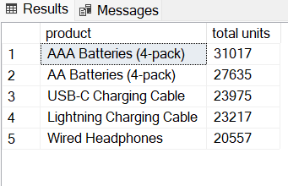
. Top 5 Best-Selling Products by Units Sold
Query:
SELECT TOP 5 product, SUM(Quantity_Ordered) AS [total units]
FROM [Sales Data]
GROUP BY product
ORDER BY [total units] DESC;
Result:

Slide 5
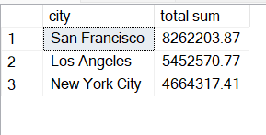
Top 3 Cities by Sales Revenue
Query
select top 3 city,round(sum(sales),2) as [total sum]
from [Sales Data]
group by city
order by [total sum] desc;
Result:

Slide 6
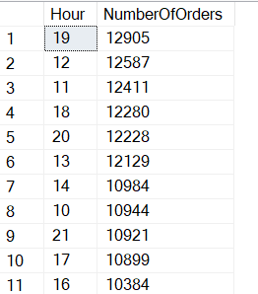
Peak Shopping Hours
Query :
SELECT Hour, COUNT(*) AS NumberOfOrders
FROM [Sales Data]
GROUP BY Hour
ORDER BY NumberOfOrders DESC;
Result:

Slide 7

Month with Highest Sales
Query:
select top 1 Month,sum(sales)as [total sale]
from [Sales Data]
group by Month
order by [total sale] desc;
Result:

Slide 8
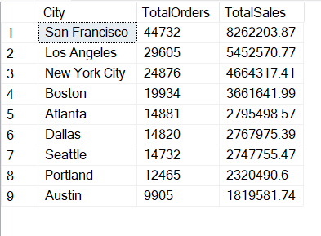
City-wise Total Orders and Sales
Query :
SELECT City, COUNT(*) AS TotalOrders ,
ROUND(SUM(Sales), 2) AS TotalSales
FROM [Sales Data]
GROUP BY City
ORDER BY TotalSales DESC;
Result:

Slide 9
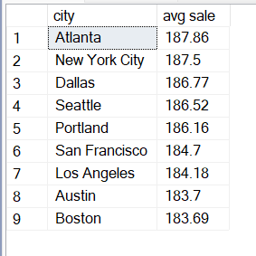
Average Sales per City
Query :
select city ,round(avg(sales),2) as [avg sale]
from [Sales Data]
group by city
ORDER BY [avg sale] DESC;
Result:

Slide 10
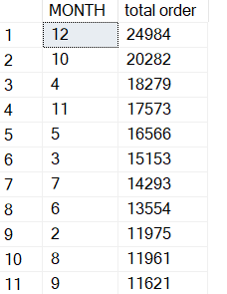
Total Orders per Month
Query :
SELECT MONTH, COUNT(Quantity_Ordered) AS [total order]
FROM [Sales Data]
GROUP BY Month
ORDER BY [total order] DESC;
Result:

Slide 11
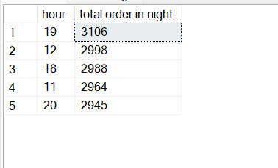
Top 5 Hours by Orders in San Francisco
Query :
select top 5 hour ,
count(Quantity_Ordered) as [total order in night]
from [Sales Data]
where city='San Francisco'
group by hour
order by [total order in night] desc;
Result:

