Slide 1
CREDIT CARD INTENT ANALYSIS
Using SAS and Power BI
BSC. Data Analytics
NAME : VISHAL A
REG NO:2213141104047
ROLL NO : 61551

Slide 2
INTRODUCTION
This project analyzes credit card application intent using data analytics tools - SAS for statistical analysis and Power BI for visualization. It examines key factors such as income, employment, and credit history to determine approval likelihood.

Slide 3
Abstract
The objective of this study is to identify the factors influencing an individual’s decision to apply for a credit card. Using SAS for statistical insights and Power BI for visualization, the project uncovers trends in demographics, income levels, and credit histories affecting application approval rates.

Slide 4
Problem Statement
Many financial institutions face challenges in identifying customers who are likely to apply for a credit card. Understanding key factors such as income, employment, and credit history can improve approval strategies and reduce default risks.

Slide 5
Objectives
Analyze factors affecting credit card intent
Identify customer segments with high approval chances
Improve risk assessment using statistical techniques
Visualize trends in credit applications

Slide 6
Tools Used
- SAS: For statistical data processing and analysis
- Power BI: For visualization and dashboard creation
- SAS SQL: For querying and filtering data
- Excel: For initial data handling and transformation

Slide 7
Dataset Overview
The dataset consists of 1,000 records with 13 attributes related to credit applications:
Age
Income
Home Ownership
Employment CARD Length
Loan Intent
Loan Amount
Interest Rate
Credit History

Slide 8
Data Preprocessing
Handled missing values
Removed duplicate records
Standardized categorical values
Scaled numerical data for analysis

Slide 9
Exploratory Data Analysis (EDA)
Identified patterns in credit application trends
Analyzed demographic influences on approvals
Examined income distribution and its effect on loan approvals

Slide 10
Statistical Analysis (SAS)
Used PROC MEANS for summary statistics
Applied PROC UNIVARIATE for data distribution insights
Performed PROC FREQ for categorical variable analysis
Used PROC SQL for filtering and grouping

Slide 11
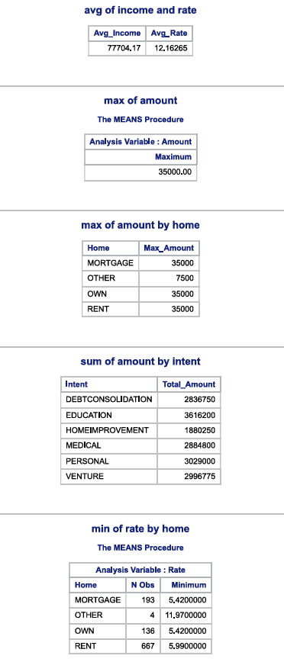
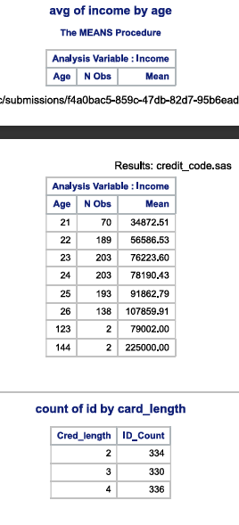
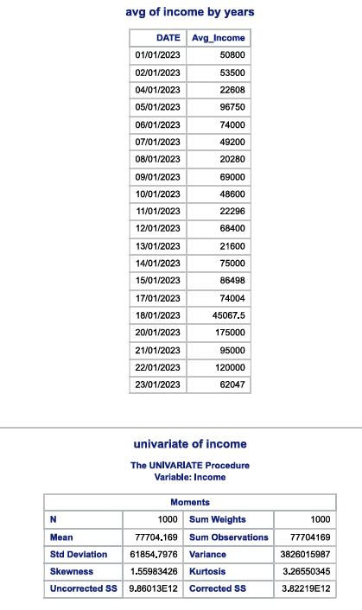
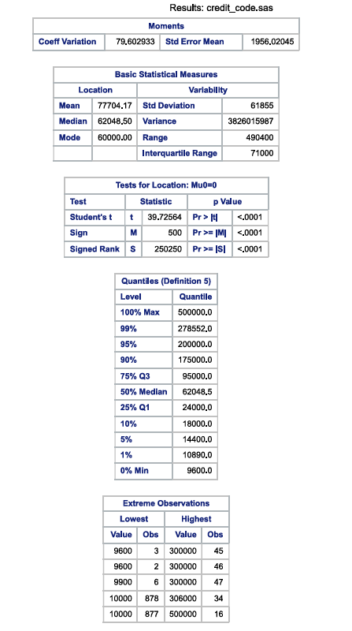
ANALYZED REPORTS

Slide 12
Visualization with Power BI
Created interactive dashboards
Used bar charts for intent distribution
Pie charts for approval rates
Line charts for income vs. approval trends
AND SO ON.

Slide 13
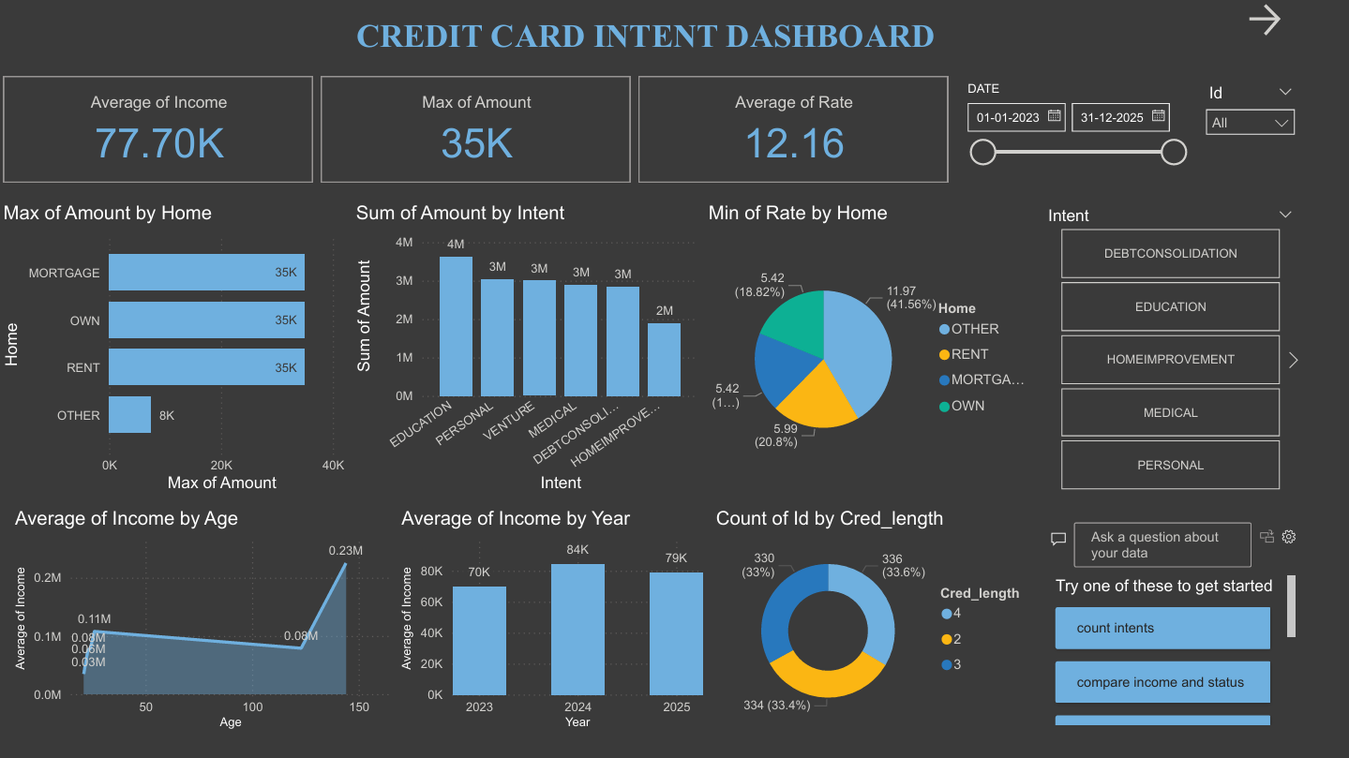
Power bi dashboard

Slide 14
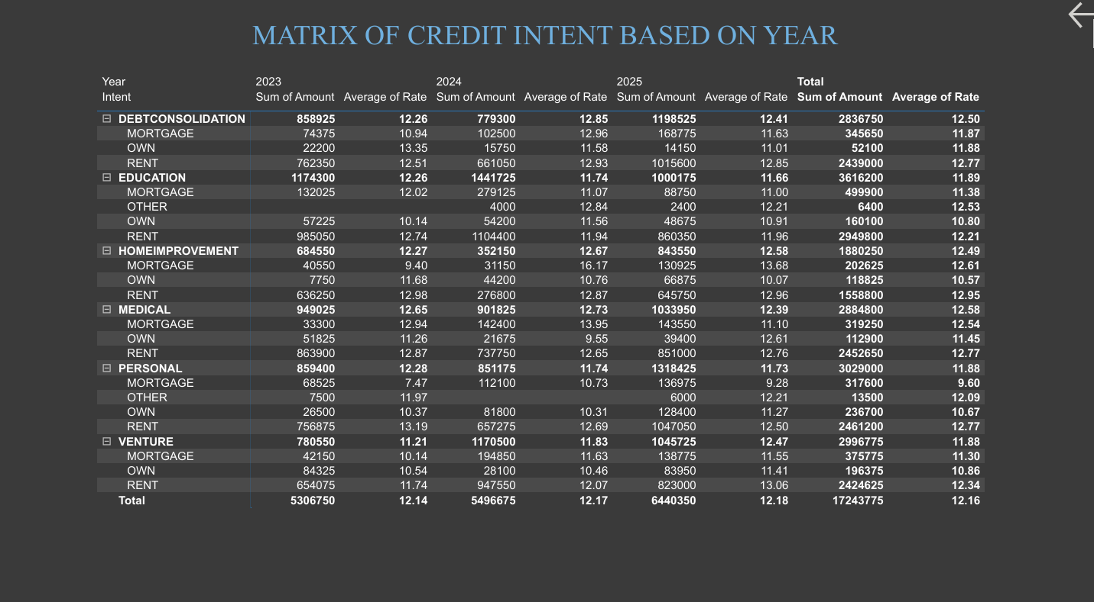
POWER BI MATRIX

Slide 15
Advantages
Provides data-driven insights for financial institutions
Identifies key factors influencing credit card approvals
Enhances risk assessment and reduces default rates

Slide 16
Challenges & Limitations
Relies on historical data, which may not reflect future trends
Potential biases in dataset affecting analysis accuracy
Limited by available features in the dataset
Requires domain expertise for accurate interpretation

Slide 17
Accessibility
SAS is widely used in financial and banking sectors for risk analysis
Power BI dashboards provide interactive visualizations for easy interpretation
Can be integrated into business intelligence systems for decision-making
Scalable for use with larger datasets and additional features

Slide 18
References
1. SAS Documentation - SAS Institute Inc.
2. Power BI Documentation - Microsoft Corporation
3. Kaggle - Credit Card Applicant Dataset
4. Exploratory Data Analysis - J. W. Tukey
5. Consumer Credit Models - L. C. Thomas

Slide 19



