Slide 1
Url-Shortner
By: Vishal Mourya (IT-B-01)
Sanjay Shukla(IT-B-30)
Adarsh Singh (IT-B-32)

Slide 2
Problem Definition
A URL shortener is a simple web tool that takes a long URL and simplifies them to smaller, manageable links, allowing easier online traffic management.
The most commonly used URL shorteners are:
Tinyurl.com
Bitly.com

Slide 3
System used
MongoDB NodeJS Express Bootstrap
JavaScript

Slide 4
Features
Reduces lengthy URLs into smaller manageable links.
Keeps count of the number of visitors on the shortened link.
Replaces a long URL into short 5 character URL.

Slide 5
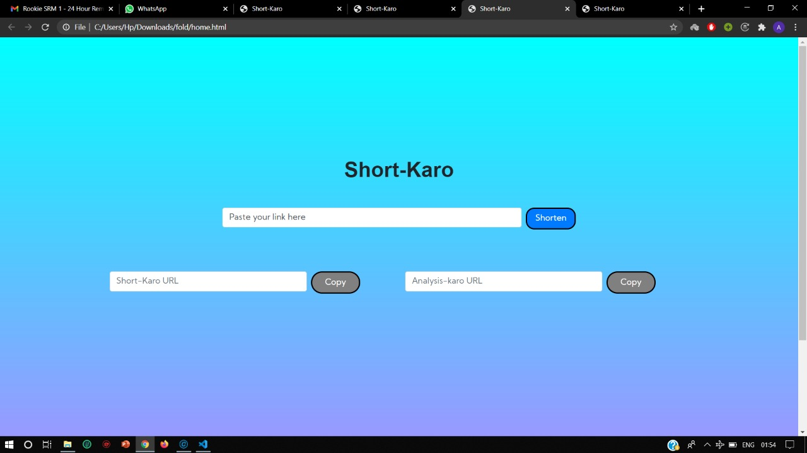

Slide 6
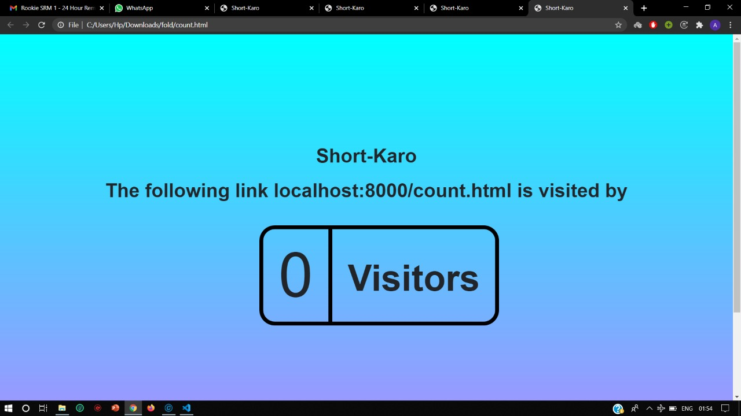

Slide 7
Thank you

