Slide 1
What is OOPs?

Slide 2
What is OOPs?
OOPs is known as “Object Oriented Programming”.
OOP is a Programming a feature based on the concept of “Objects”.
Classes and Objects are the fundamental components of OOP's.

Slide 3
Why OOPs?
Code Reusability
Code - Maintenance
Security
Design Benefits
Easy Troubleshooting

Slide 4
What is Class in Java
What is Objects in Java
A class is a blueprint or prototype that defines the variables and the methods (functions) common to all objects of a certain kind.
A Java object is a member (also called an instance) of a Java class. An object is a specimen of a class.
Each object has an Identity, a Behavior and a State.
The State of an object is stored in fields (variables)
class Class_name{
field or variable ;
method like main() and others ;
constructor
block
sub class and interface
}
Creating object:
Approach 1:
Student s1;
s1=new Student();
Approach 2:
Student s1=new Student();

Slide 5
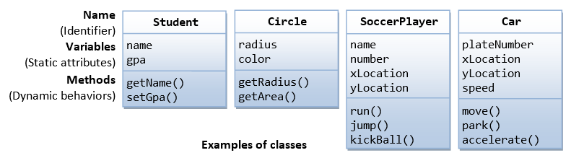
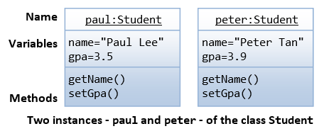
Example Of Class

Slide 6
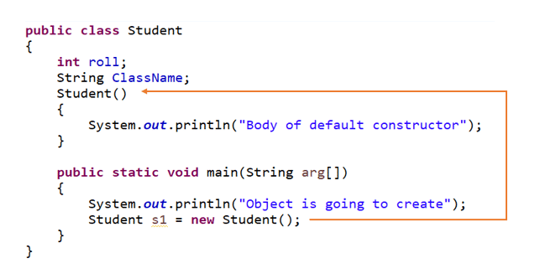
Class syntax

Slide 7
Constructors
A constructor is a special method that has the same method name as the class name. That is, the constructor of the class Circle is called Circle().
A constructor method is different from an ordinary method in the following aspects:
The name of the constructor method must be the same as the classname. By classname's convention, it begins with an uppercase (instead of lowercase for ordinary methods).
Constructor has no return type in its method heading. It implicitly returns void. No return statement is allowed inside the constructor's body.
Constructor can only be invoked via the "new" operator. It can only be used once to initialize the instance constructed. Once an instance is constructed, you cannot call the constructor anymore.
Constructors are not inherited. Every class shall define its own constructors.
Notes:
Creating an object is also referred to as instantiating an object.
When we declare s1, it points to null.
When we instantiate as given in second line s1 is a reference to Student1.
The method Student1() is the default constructor of the class.

Slide 8
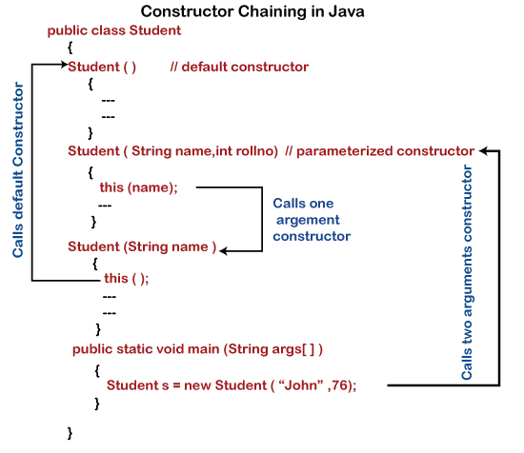
Types of Constructors and Syntax
There are two types of Constructors.
Default Constructor.
Parameterized Constructor.
A constructor with no parameter is called the default constructor. It initializes the member variables to their default values.

Slide 9
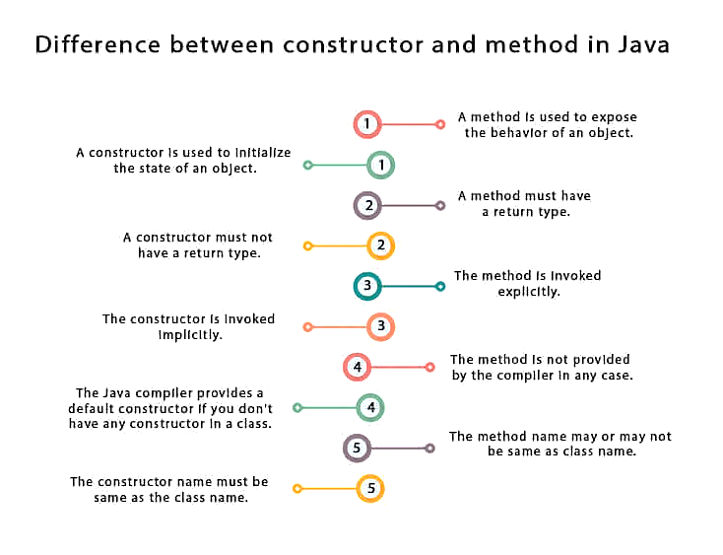

Slide 10
Access modifiers
As the word “Access” says to provide privileges for something.
In Java, we have various ways to provide access to attributes, classes, methods, constructors.
Types of Access Modifiers
Default: Access only within the Class and same package.
Public: Access everywhere.
Private: Access only within the Class.
Protected : Access only within the Class and Subclass inside the same package.

Slide 11
Syntax of Access modifiers.
/**
* The Circle class models a circle with a radius and color.
*/
public class Circle {
// Private instance variables
private double radius;
private String color;
// Default Constructors (overloaded)
/** Constructs a Circle instance with default radius and color */
public Circle() { // 1st Constructor (default constructor)
radius = 1.0;
color = "red";
}
/** Returns the area of this circle */
public double getArea() {
return radius * radius * Math.PI;
}
}

Slide 12
Accessibility of Access modifiers
S. No | Access Modifier | Same class | Same package subclass | Same package non-subclass | Different package subclass | Different package non-subclass
1 | Default | Y | Y | Y | N | N
2 | Public | Y | Y | Y | Y | Y
3 | Private | Y | N | N | N | N
4 | Protected | Y | Y | Y | Y | N

Slide 13
Accessing Class Members
class Home {
void designBedroom(){
//code...
}
void designKitchen(){
//code...
}
}
class BuildHome {
public static void main(String[] args){
// create object here
Home home= new Home();
// Access class members here or Execute plan here
home.designBedroom();
home.designKitchen();
}
}
Accessing Class Members:
Object and dot operator
Objectname.variableName=value;
Objectname.methodName(parameterList);
Notes:
Creating an object is also referred to as instantiating an object.
When we declare s1, it points to null.
When we instantiate as given in second line s1 is a reference to Student1.
The method Student1() is the default constructor of the class.

Slide 14
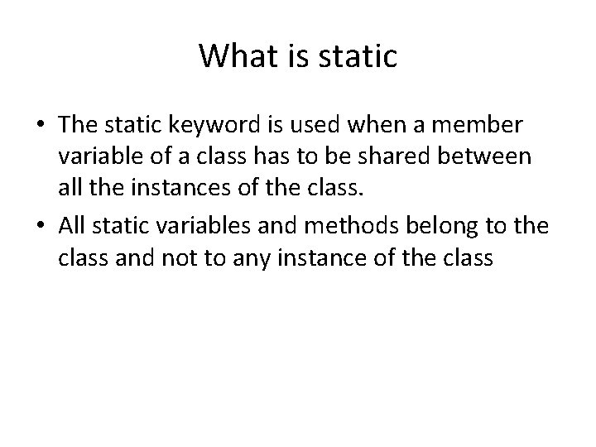
Static Keyword
class Cube {
static int height = 20;
static int width = 15;
public static void calculateVolume(float depth){
float vol = height * width * depth;
System.out.println("Volume of cube is " +vol);
}
public static void main(String[] args) {
Cube.calculateVolume(2);
}
}

Slide 15
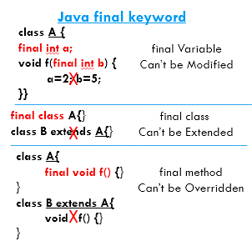
Final Keyword

Slide 16
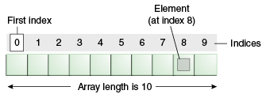
Arrays
Java array is an object that contains elements of similar data type.
It is a data structure where we store similar elements.
Array in java is index based, first element of the array is stored at 0 index.

Slide 17
Advantage of Java Array
Code Optimization: It makes the code optimized, we can retrieve or sort the data easily.
Random access: We can get any data located at any index position.
Disadvantage of Java Array
Size Limit: We can store only fixed size of elements in the array. It doesn't grow its size at runtime. To solve this problem, collection framework is used in java.

Slide 18
Types of Array in java
There are two types of array.
Single Dimensional Array
Multidimensional Array

Slide 19
Single Dimensional Array in java
You can create an array by using the new operator with the following syntax:
datatype[ ] arrayRefVar;
arrayRefVar=new datatype[size];
This is same as
datatype[ ] arrayRefVar=new datatype[size];
int[] numbers = {2, -9, 0, 5, 12, -25, 22, 9, 8, 12};

Slide 20
Multidimensional array(2 D) in java
Multidimensional Arrays can be defined in simple words as array of arrays. Data in multidimensional arrays are stored in tabular form.
2 Dimensional array:
data_type[][] array_name = new data_type[x][y];
For Example: int[][] twoDim = new int[10][20];
Three dimensional array:
data_type[][][] array_name = new data_type[x][y][z];
For Example: int[][][] threeDim = new int[10][20][30];

Slide 21
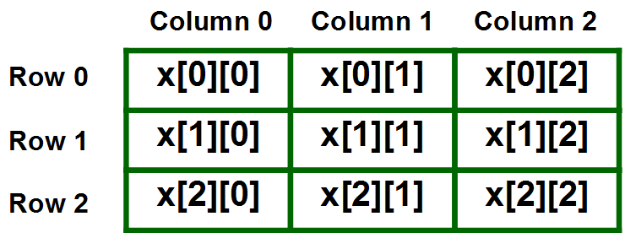
int X[ ][ ] = new int[3][3]; X[0][0] = 50;
Representation of 2D array in Tabular Format

Slide 22
Thank You
Proprietary content. ©Great Learning. All Rights Reserved. Unauthorized use or distribution prohibited

