Slide 1


Slide 2



BigQuery is a serverless, cloud-based data warehouse from Google.
It helps you analyze massive datasets quickly using SQL.

Slide 3
STORAGE
INGESTION
QUERYIN
Data in BigQuery is stored in structured tables.
BigQuery automatically manages storage and scaling for you.
Once your data is in BigQuery, you’re ready to start querying it.
There are various ways to do this:
Upload from Cloud Storage
Stream from Cloud Dataflow
Components Of BigQuery

Slide 4
STORAGE
INGESTION
QUERYING
Data in BigQuery is stored in structured tables.
BigQuery automatically manages storage and scaling for you.
There are various ways to do this:
Upload from Cloud Storage
Stream from Cloud Dataflow
Once your data is in BigQuery, you’re ready to start querying it.

Slide 5
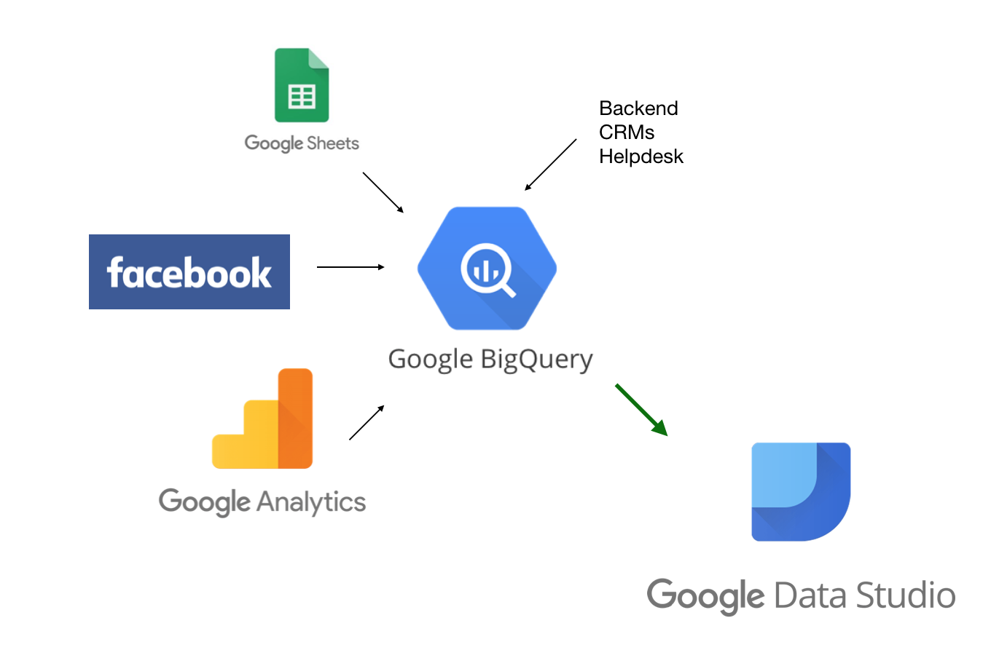

Slide 6
Fast and Scalable
Cost-Efficient
Features
Data Visualization
SQL-Based Queries

Slide 7
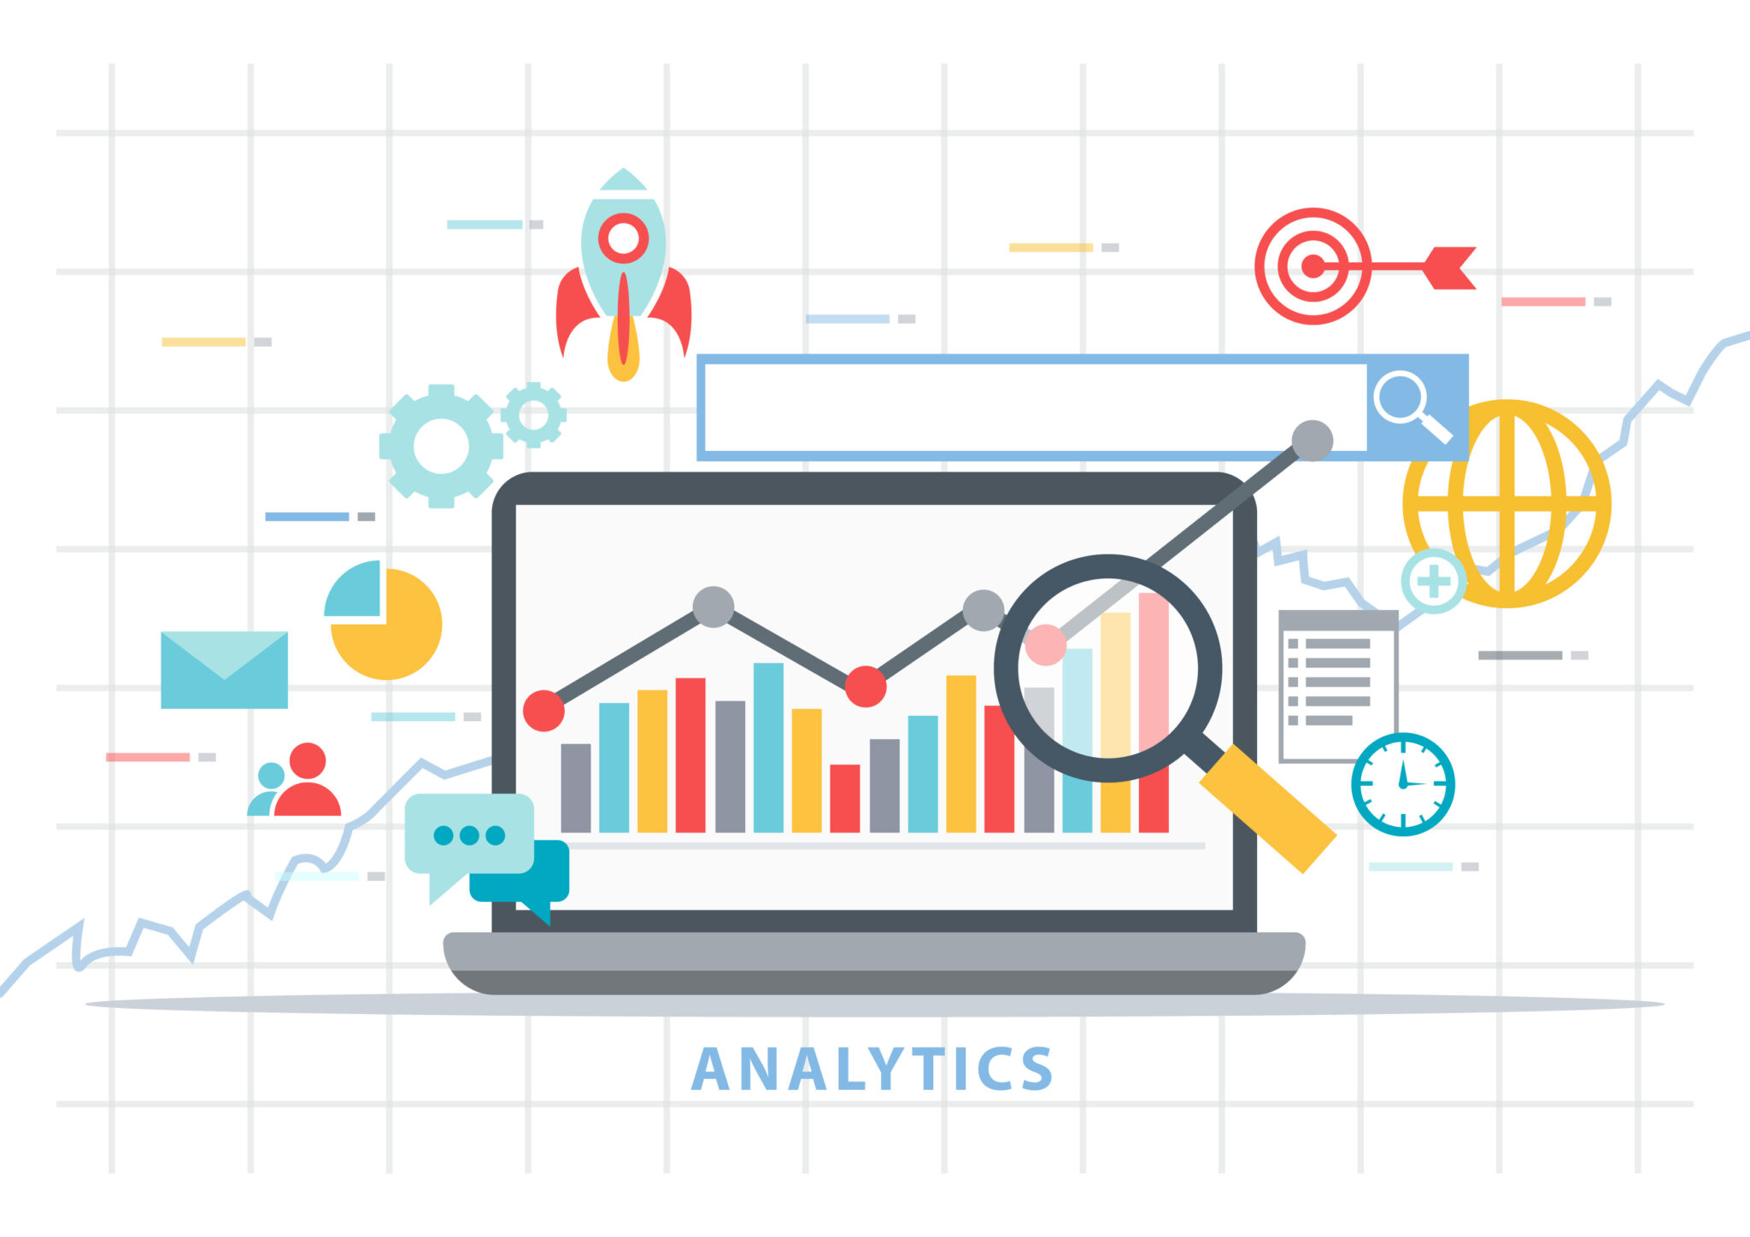


Use Case of BigQuery
Marketing
Analytics
Optimize campaigns with deep customer insights.
IoT Analytics
Process and analyze vast streams of sensor data.
Financial Reporting
Generate complex financial reports quickly and accurately.

